Slide 1

State of Wisconsin
Adding a Link for Survey Notifications

Slide 2
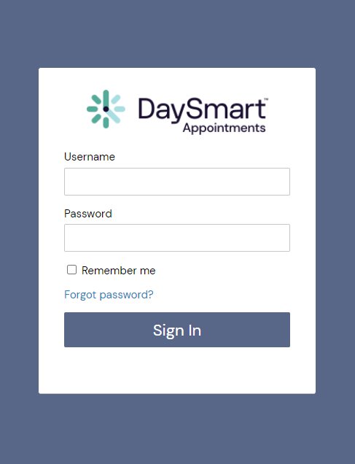

How to login to
DaySmart Appointments
Go to www.DaySmartAppointments.com
Click on Login at the top of the page
Enter your login and password. Passwords are case sensitive.
If you forget your password, use the “Forgot password” link in the login box and you will receive an email with password reset instructions
LOGIN

Slide 3
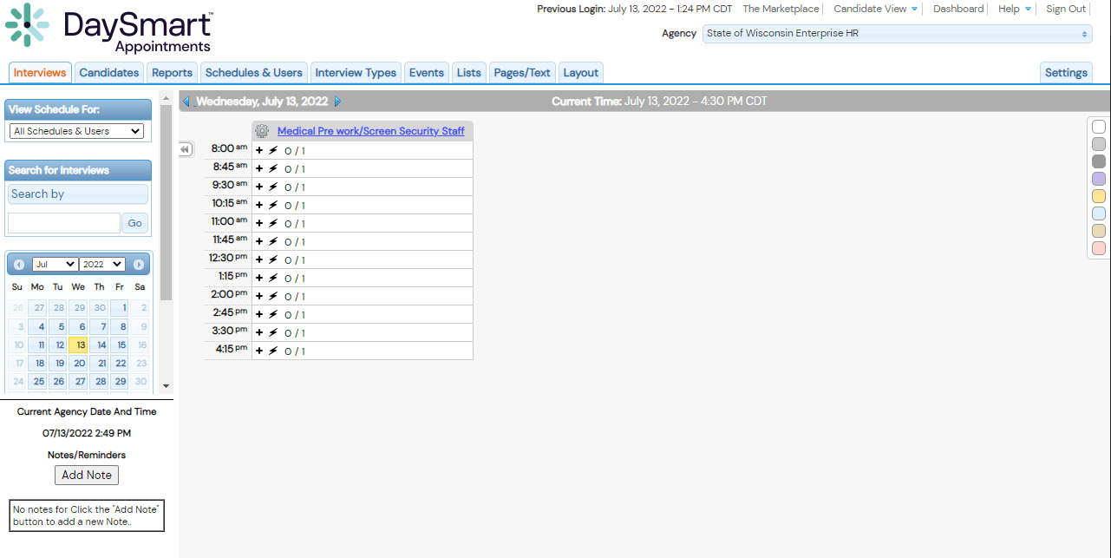
Adding Survey Link to Email Notifications
1. Select “Select Settings” Tab
DaySmart Appointments

Slide 4
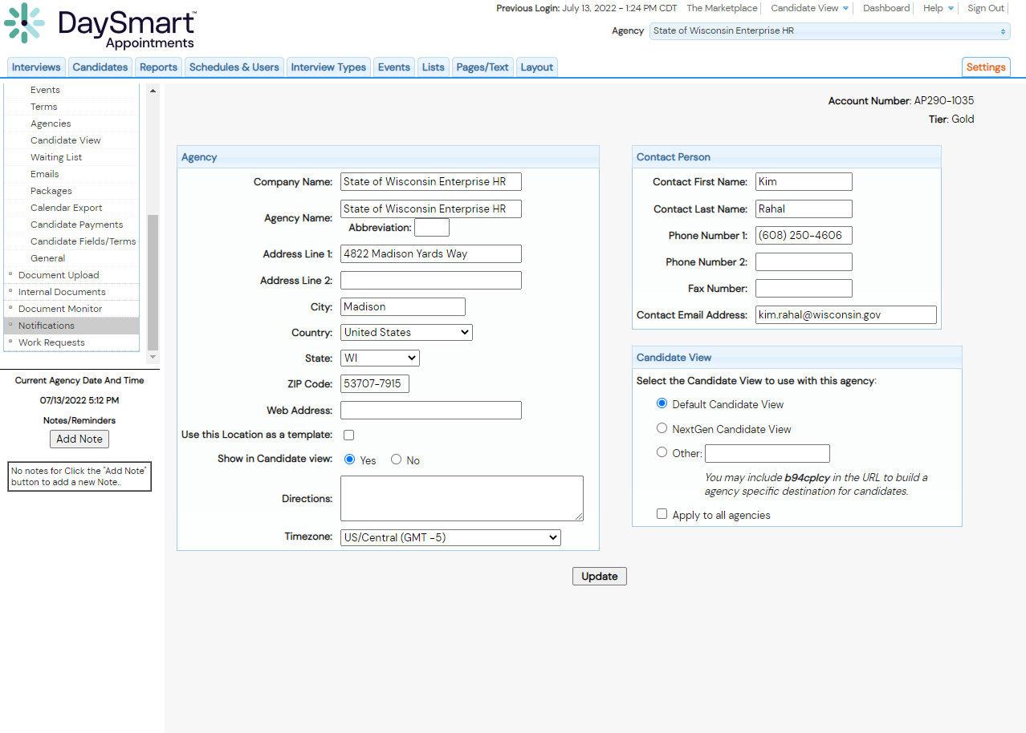
Adding Survey Link to Email Notifications
4. Select “Notifications” Setting
DaySmart Appointments

Slide 5
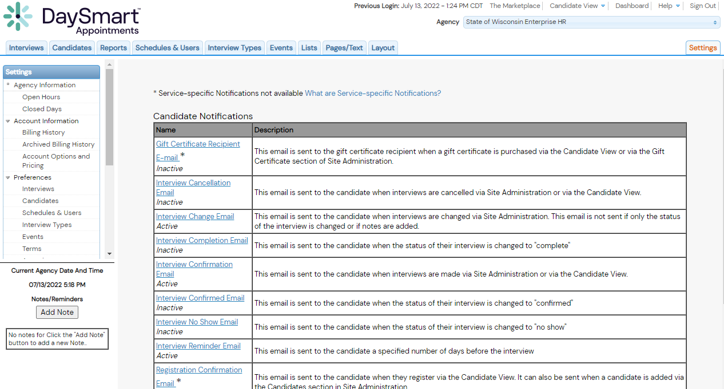
Adding Survey Link to Email Notifications
5. Select An Email Template To Edit
DaySmart Appointments

Slide 6
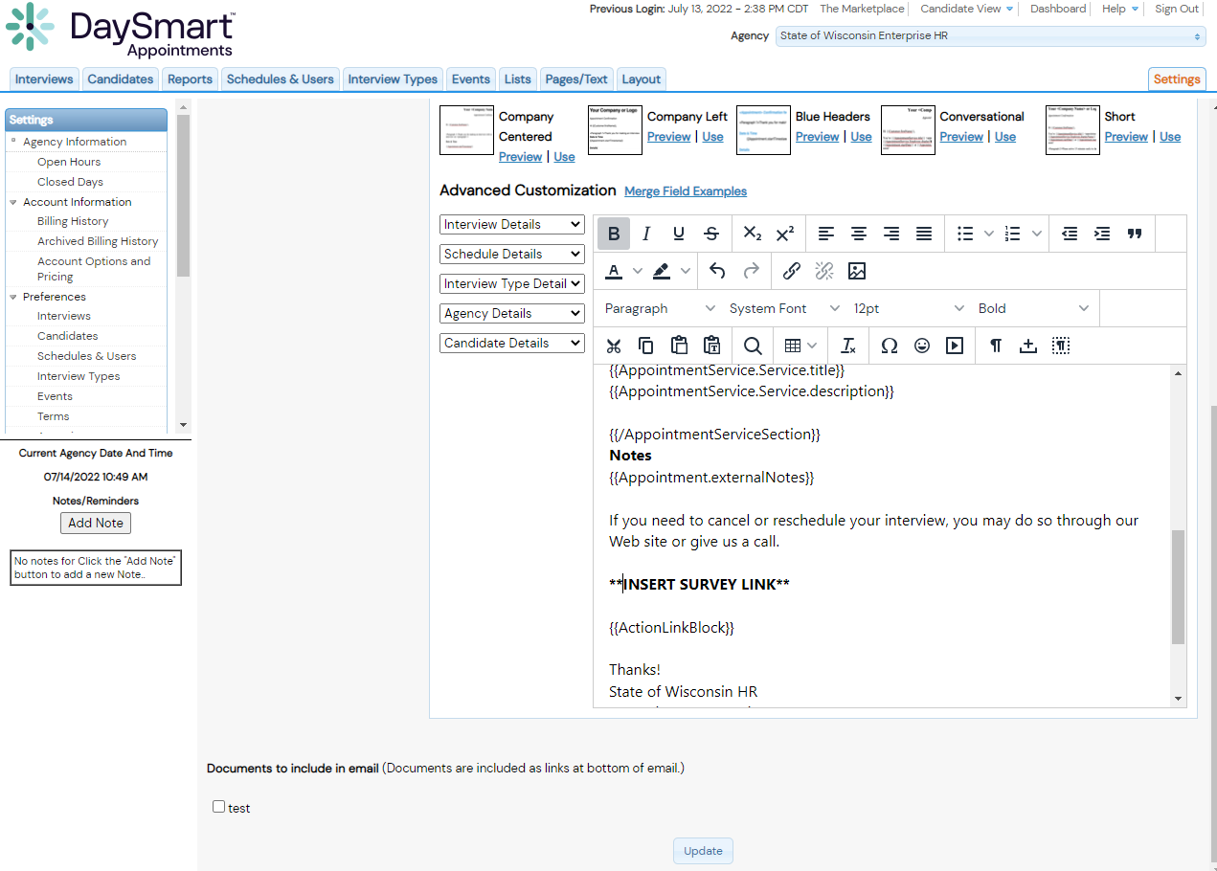
Adding Survey Link to Email Notifications
4. Paste Survey Link Into Text Box
1.
DaySmart Appointments
2. Click “Update” to Save Changes

Slide 7
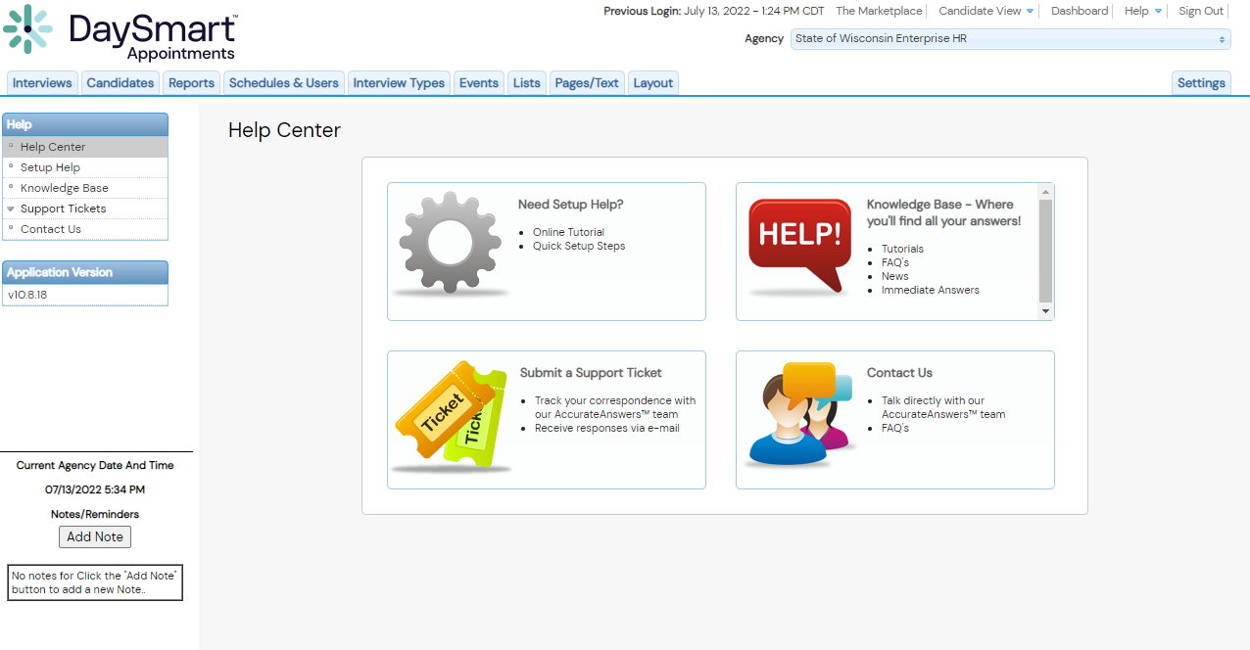
Help Resources
DaySmart Appointments

Slide 8

Thankyou

