Slide 1
State of Wisconsin
Document Upload Guide

Slide 2
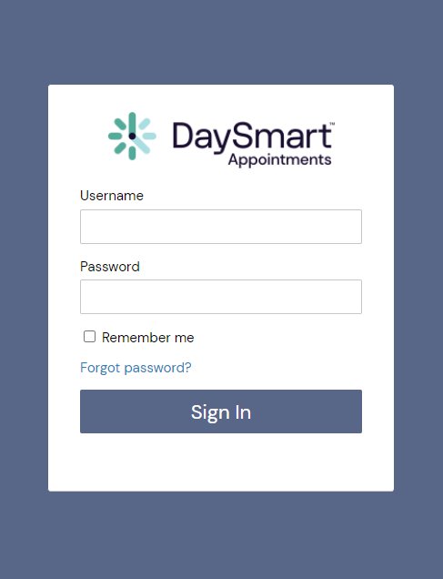
How to login to
DaySmart Appointments
Go to www.DaySmartAppointments.com
Click on Login at the top of the page
Enter your login and password. Passwords are case sensitive.
If you forget your password, use the “Forgot password” link in the login box and you will receive an email with password reset instructions
LOGIN

Slide 3
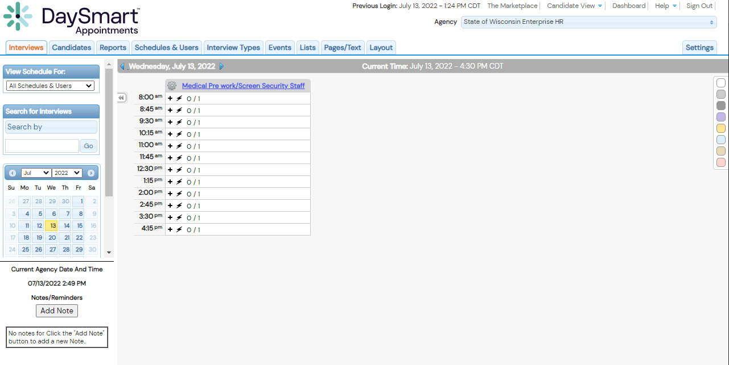
Adding Documents to Email Notification
1. Select “Select Settings” Tab
DaySmart Appointments

Slide 4
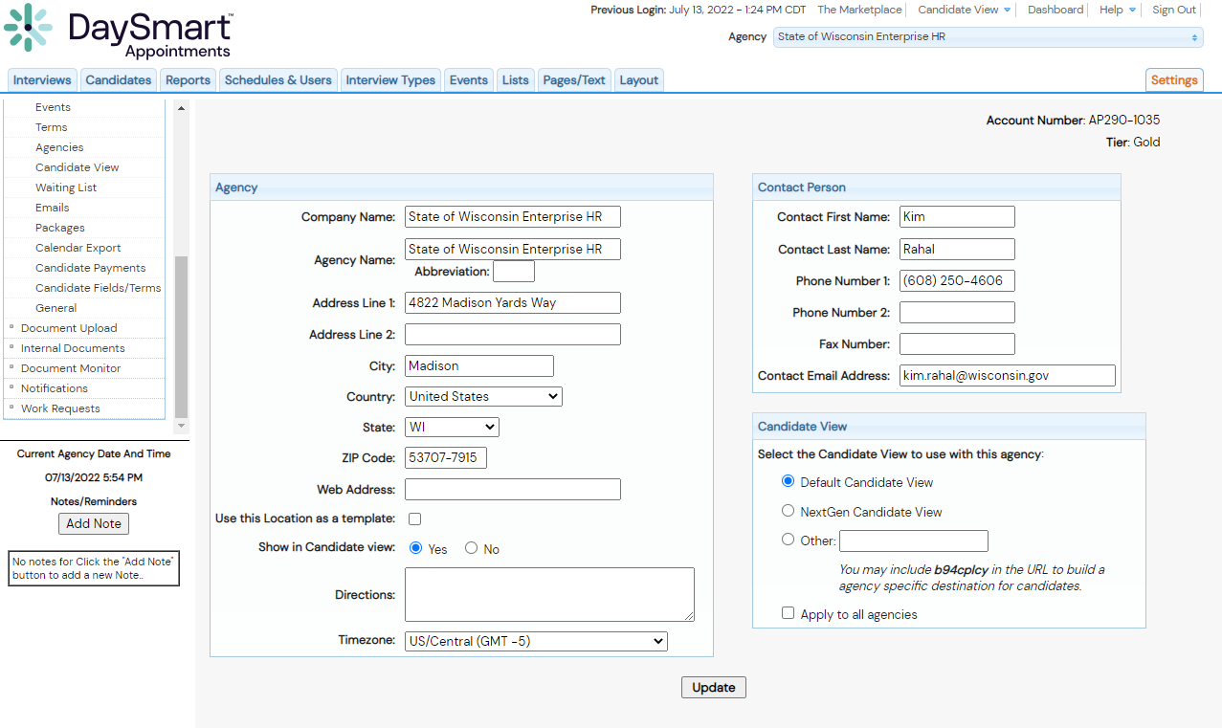
Adding Documents to Email Notification
2. Select “Internal Documents” Setting
DaySmart Appointments

Slide 5
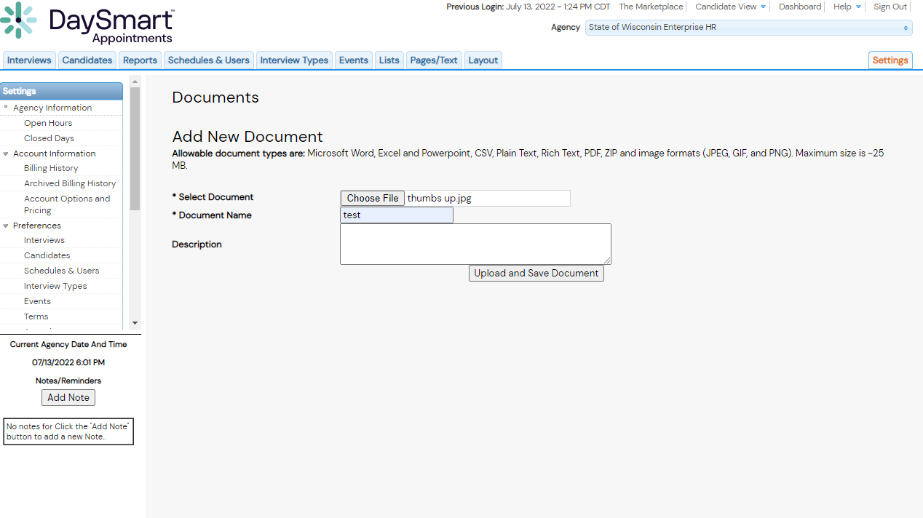
Adding Documents to Email Notification
3. Select a Document to Upload and Give it a Name
Select “Upload and Save Document”
DaySmart Appointments

Slide 6
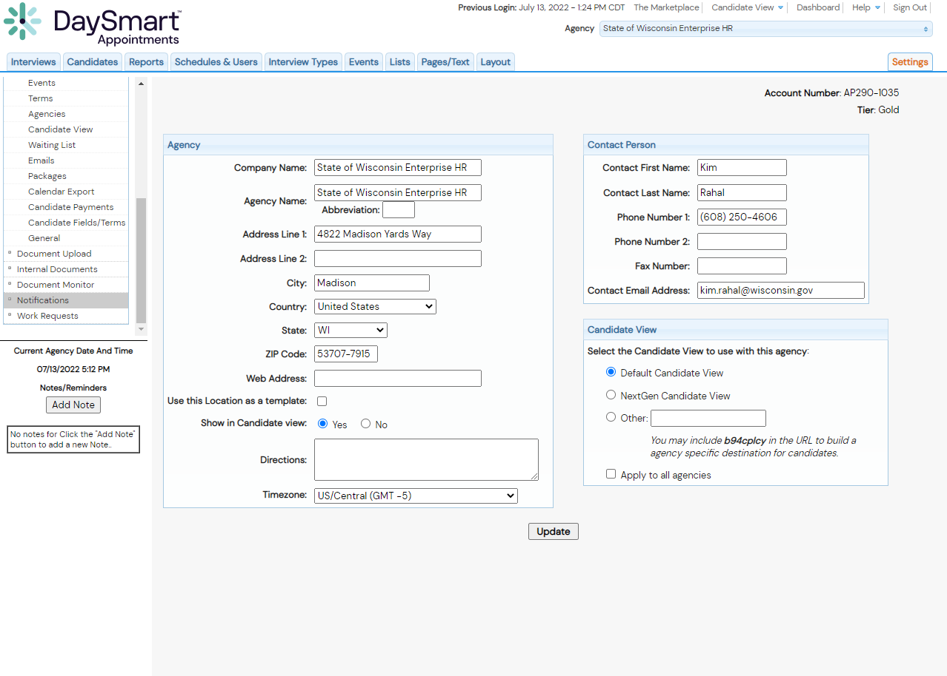
Adding Documents to Email Notification
4. Select “Notifications” Setting
DaySmart Appointments

Slide 7
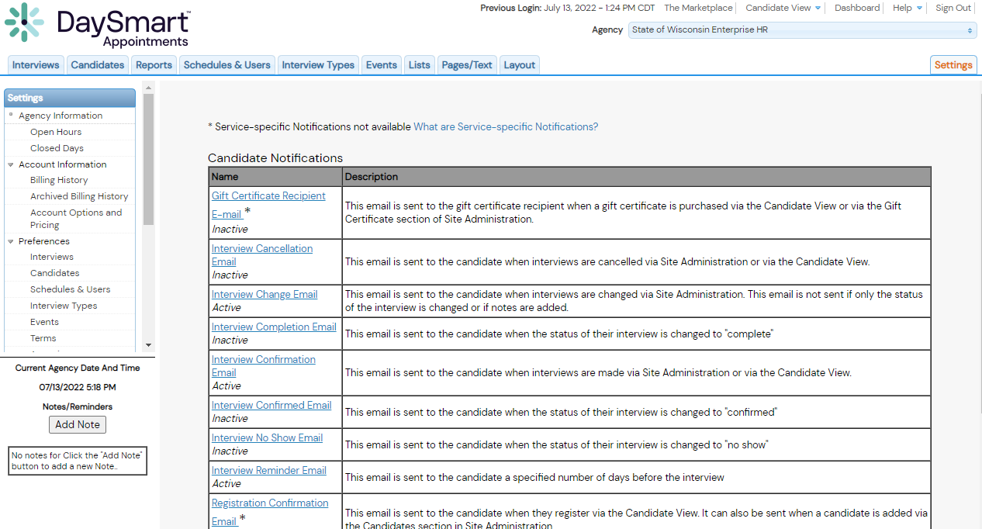
Adding Documents to Email Notification
5. Select An Email Template To Edit
DaySmart Appointments

Slide 8
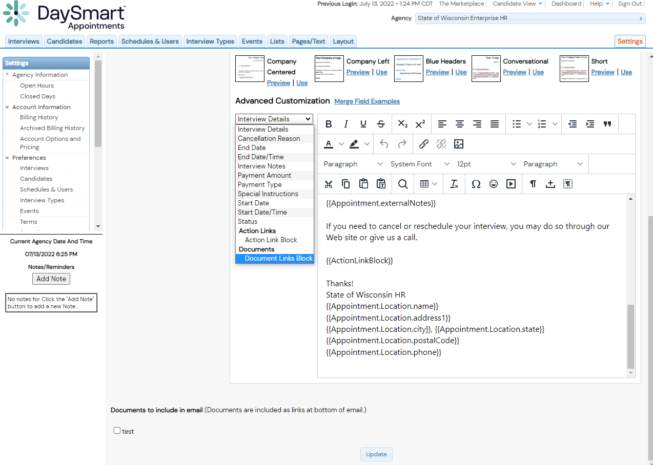
Adding Documents to Email Notification
5. Select “Interview Details” Drop Down
1.
2.
Select “Document Link Block”
3.
DaySmart Appointments
Select Which Documents You Want Included in This Template
4.
Select Update to Save Changes

Slide 9
How to Add a Document
When Creating an Appointment
DaySmart Appointments
LEARN NOW

Slide 10
Adding Documents When Creating an Appointment
1. Select A Time Slot to Create an Appointment
DaySmart Appointments

Slide 11
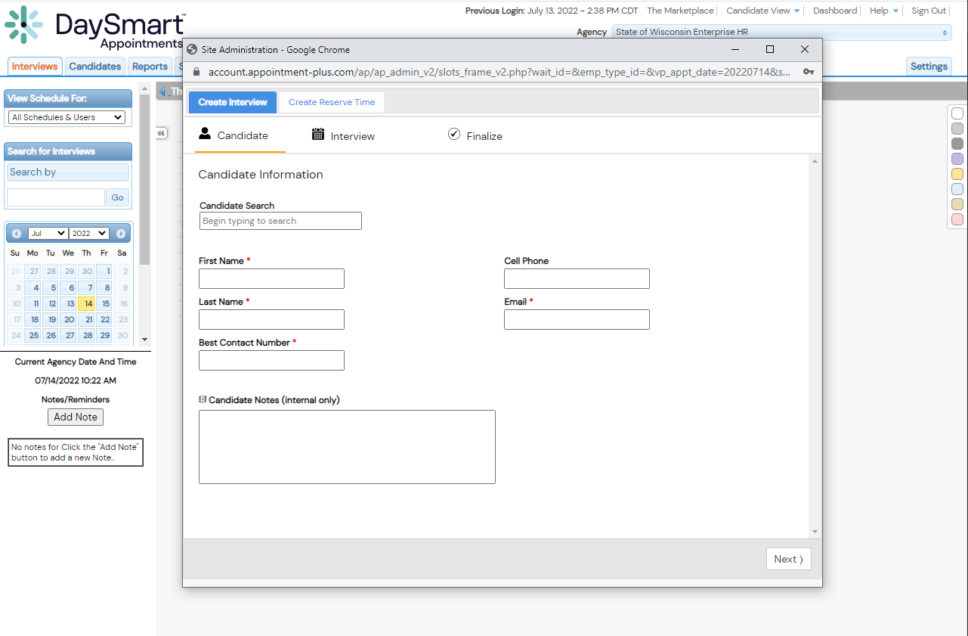
Adding Documents When Creating an Appointment
2. Fill Out Candidate information (Or use search for existing candidate) Then Select “Next”
DaySmart Appointments

Slide 12
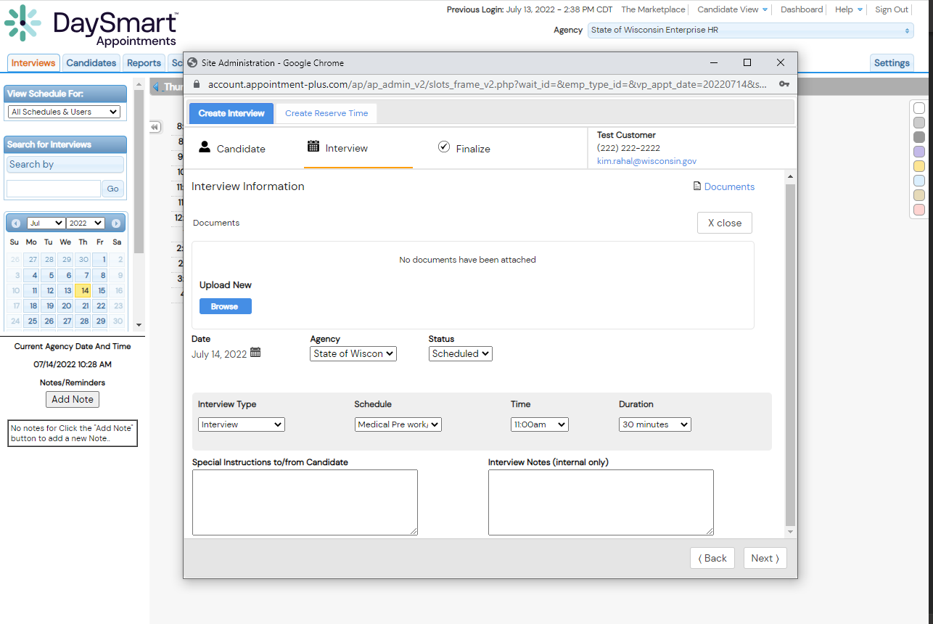
Adding Documents When Creating an Appointment
Select
Documents
2. Select Browse and Choose a Document
3. Choose an Interview Type
4. Click “Next”
DaySmart Appointments

Slide 13
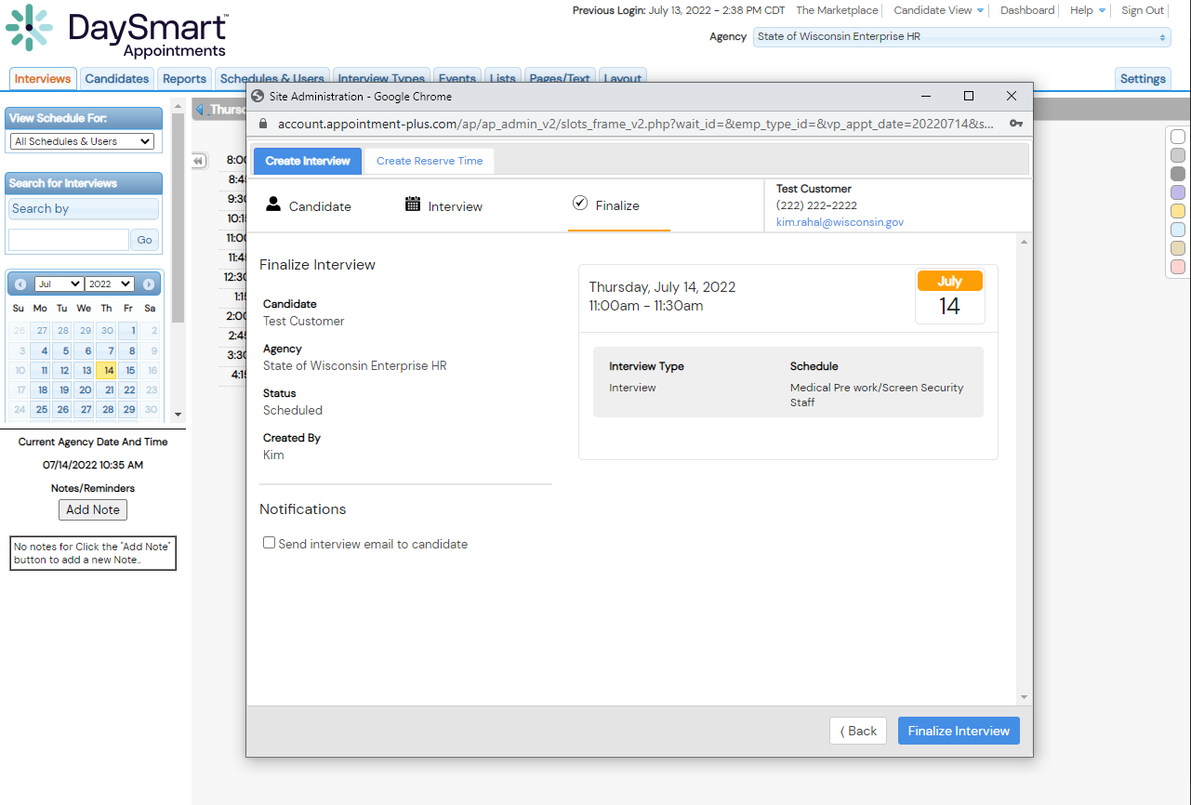
Adding Documents When Creating an Appointment
4. Click “Finalize Interview” to Complete the Booking
DaySmart Appointments

Slide 14
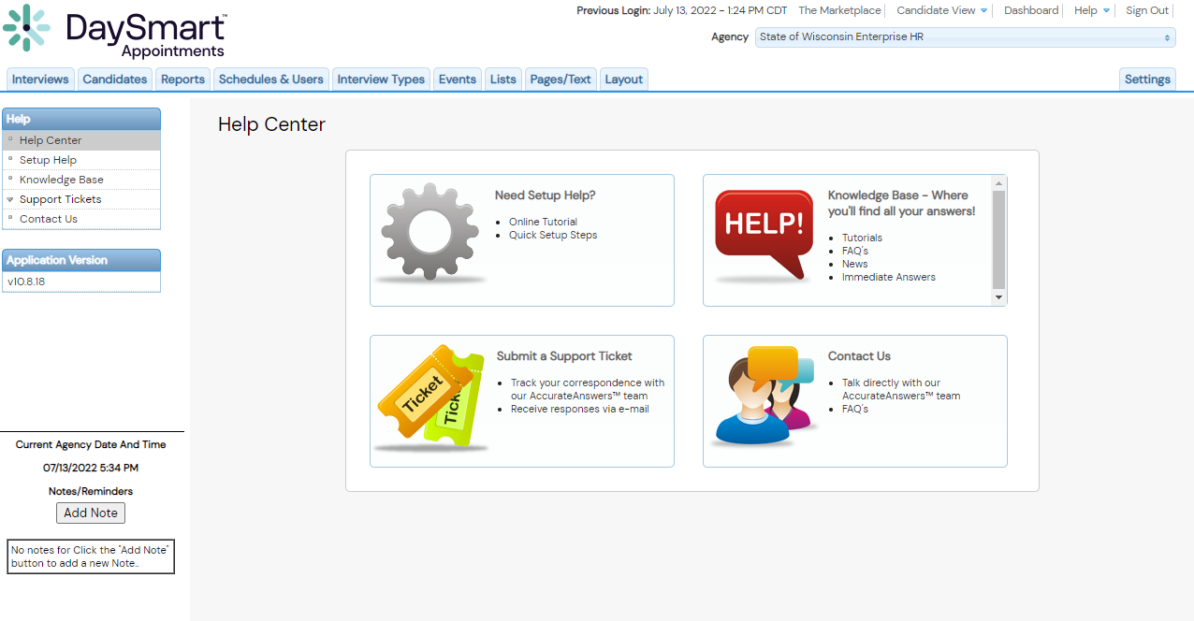
Help Resources
DaySmart Appointments

Slide 15
Thankyou

