Slide 1
State of Wisconsin
Adding Google Maps Link to Candidate View & Email Notification Guide

Slide 2
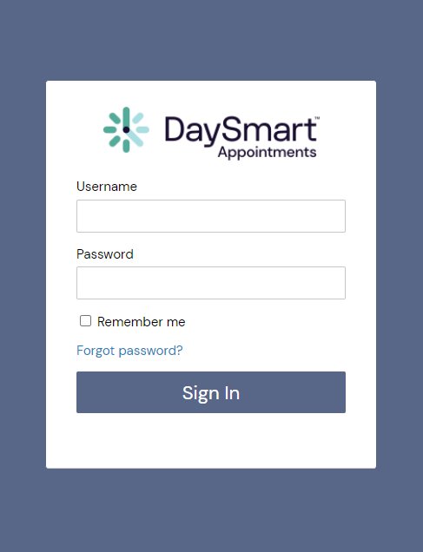
How to login to
DaySmart Appointments
Go to www.DaySmartAppointments.com
Click on Login at the top of the page
Enter your login and password. Passwords are case sensitive.
If you forget your password, use the “Forgot password” link in the login box and you will receive an email with password reset instructions
LOGIN

Slide 3
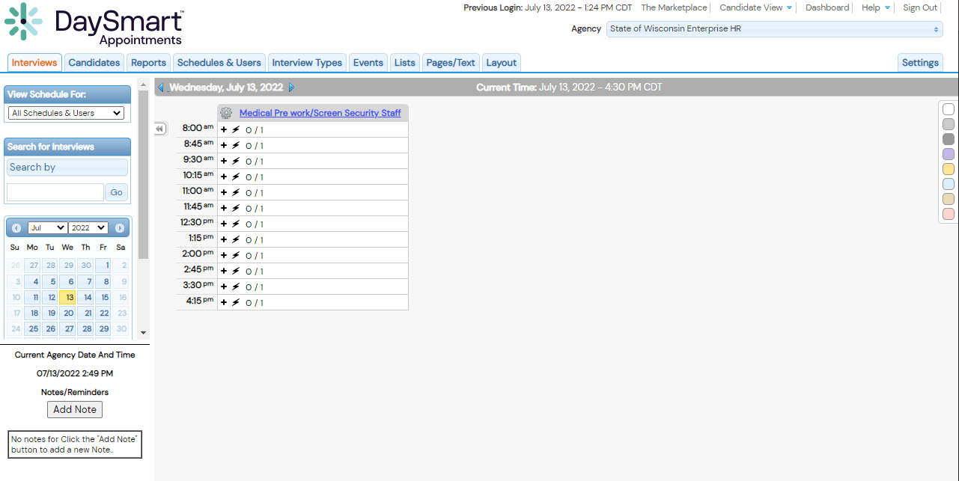
Adding Google Maps Link to Candidate View
1. Select “Pages/Text” Tab
DaySmart Appointments

Slide 4
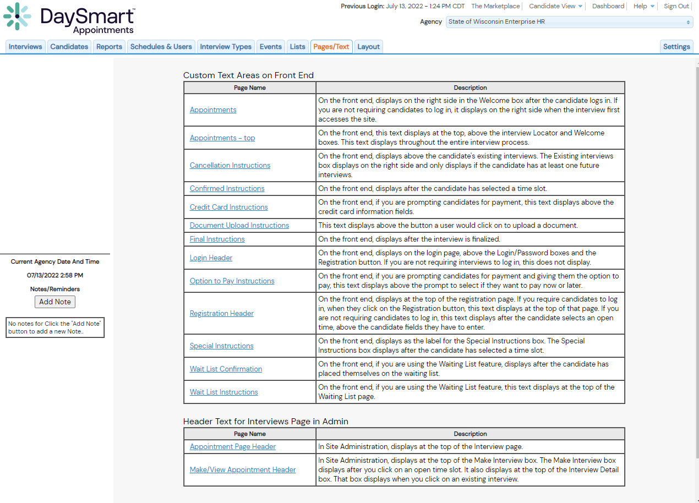
Adding Google Maps Link to Candidate View
2. Select “Appointments” Page
DaySmart Appointments

Slide 5
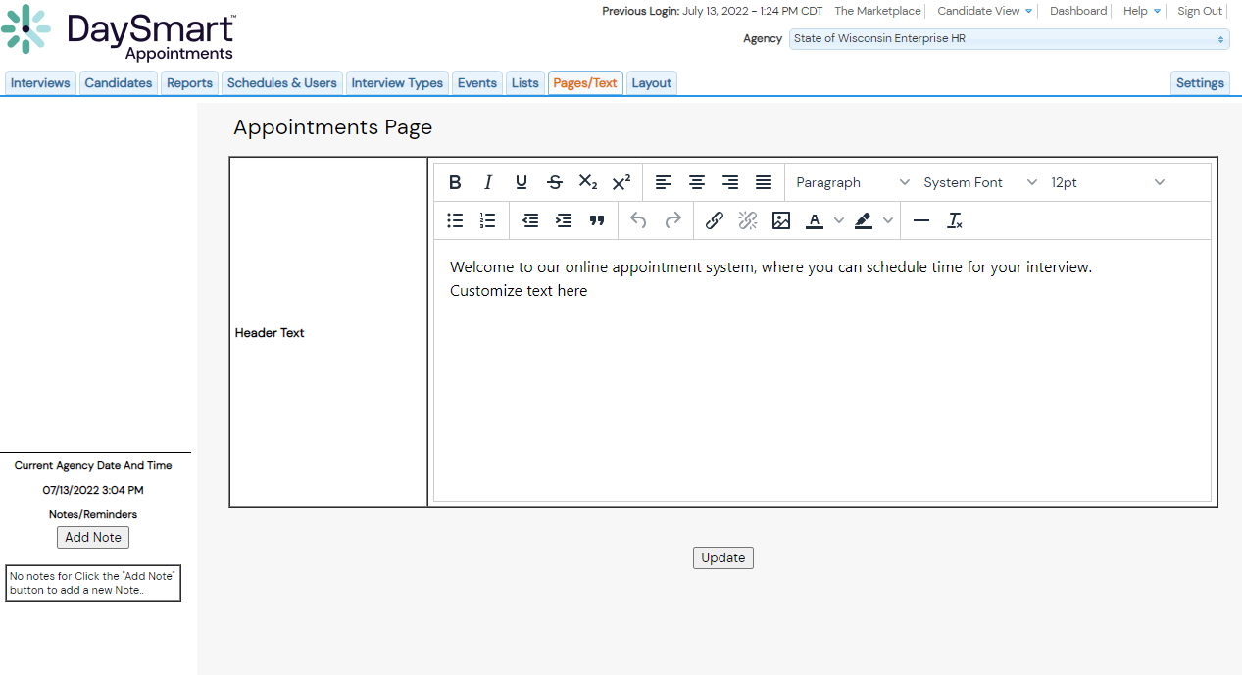
Adding Google Maps Link to Candidate View
3. Insert Google Maps Link To Header Text
Select “Update” To Save Changes
DaySmart Appointments

Slide 6
Adding Google Maps Link to
Email Notifications
DaySmart Appointments

Slide 7
Adding Google Maps Link to Email Notifications
1. Select “Settings” Tab
DaySmart Appointments

Slide 8
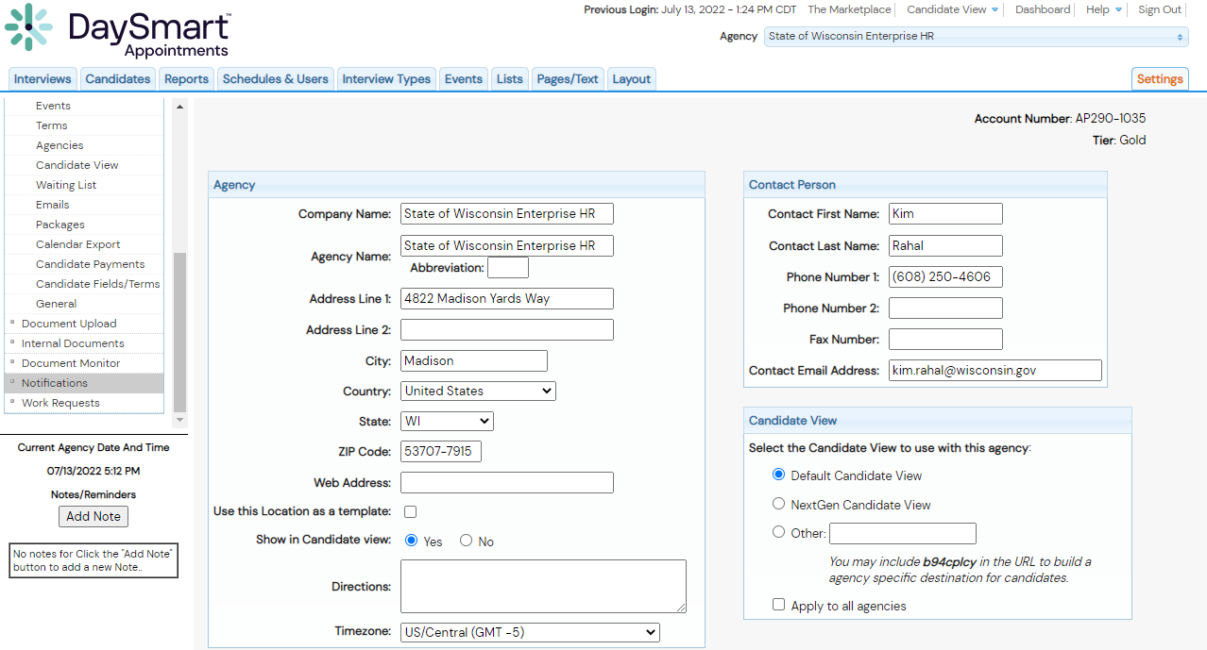
Adding Google Maps Link to Email Notifications
2. Select “Notifications” Setting
DaySmart Appointments

Slide 9
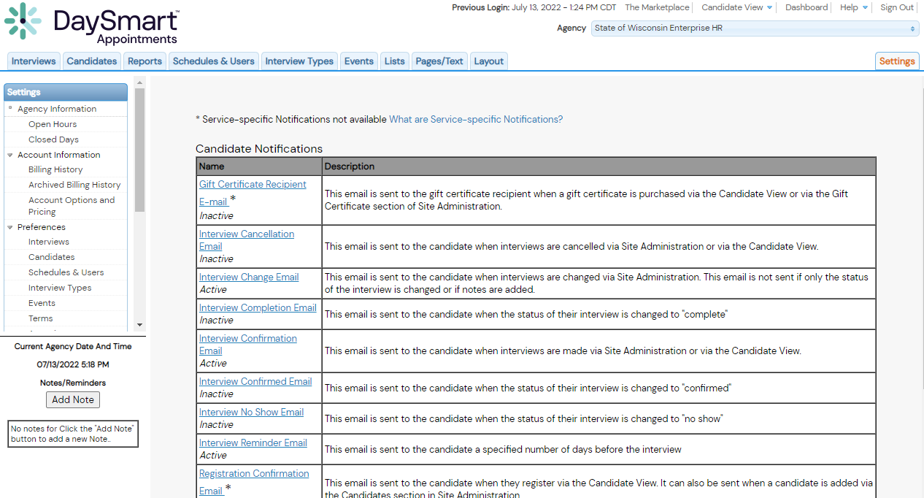
Adding Google Maps Link to Email Notifications
3. Select An Email Template To Edit
DaySmart Appointments

Slide 10
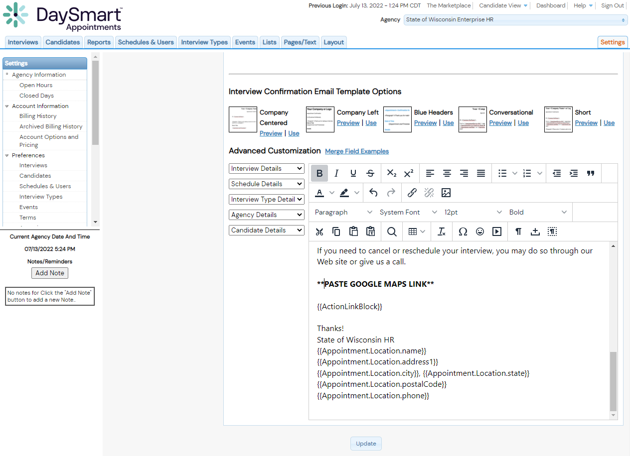
Adding Google Maps Link to Email Notifications
4. Paste Google Maps Link Into Text Box
DaySmart Appointments

Slide 11
Adding Google Maps Link to Email Notifications
5. Select Update To Save Changes
DaySmart Appointments

Slide 12
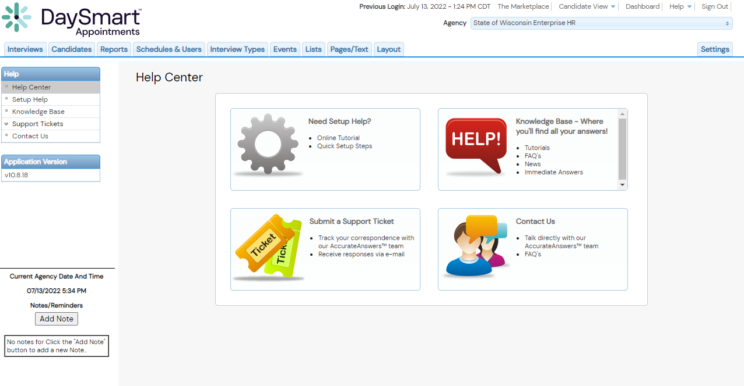
Help Resources
DaySmart Appointments

Slide 13
Thankyou

