Slide 1

State of Wisconsin
Location Admin Training Guide

Slide 2
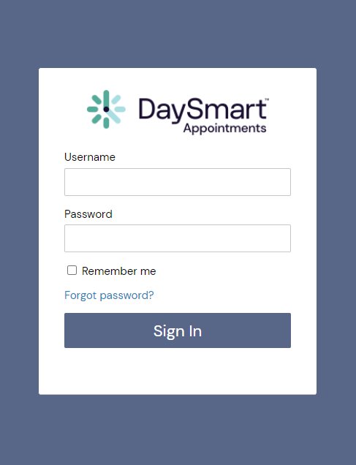

How to login to
DaySmart Appointments
Go to www.DaySmartAppointments.com
Click on Login at the top of the page
Enter your login and password. Passwords are case sensitive.
If you forget your password, use the “Forgot password” link in the login box and you will receive an email with password reset instructions
LOGIN

Slide 3
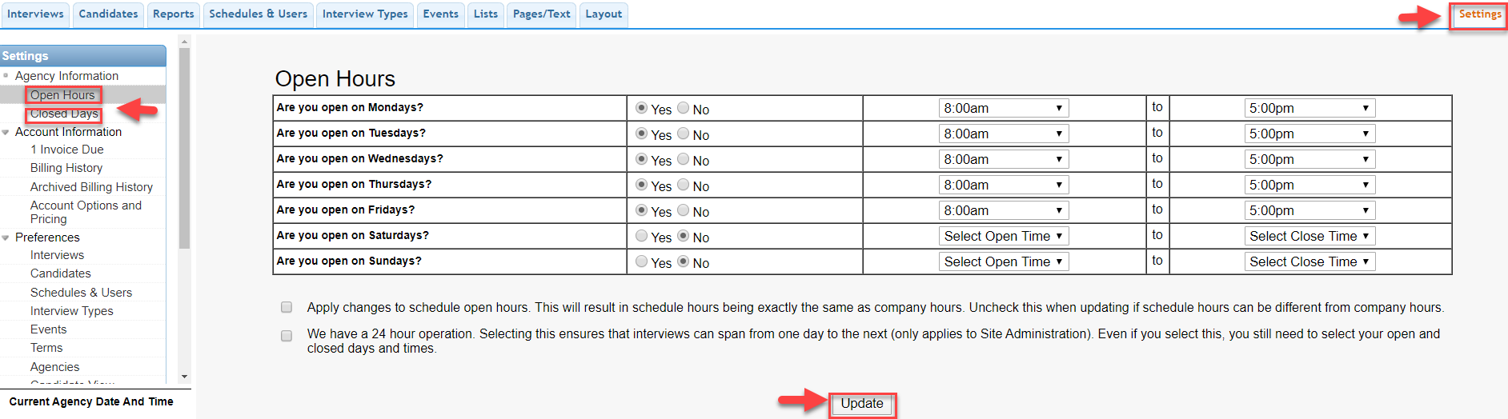
How to Set Your Agency Open Hours & Closed Days
1. Click on Settings.
2. Click on Open Hours, set your Open & Close times, then update.
3. Click on Closed Days, check any days that the Agency is closed, then update.

Slide 4
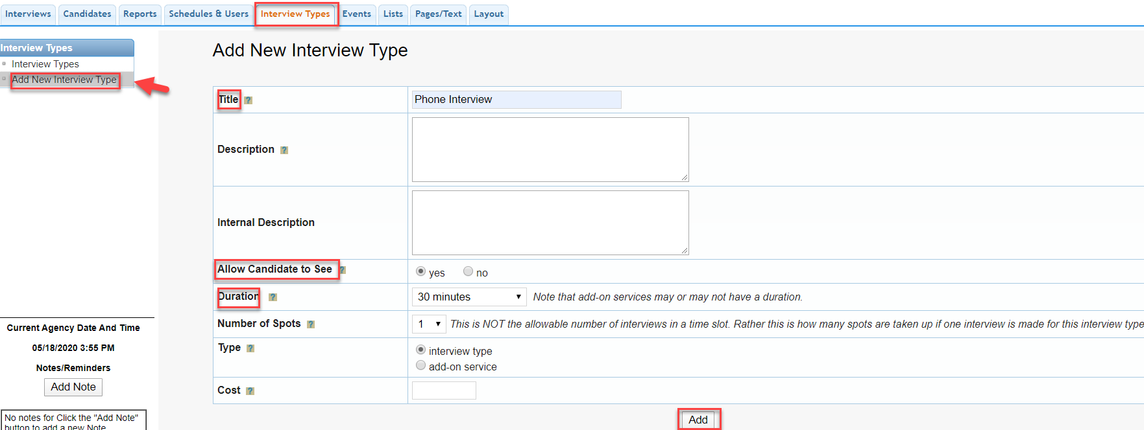
How to Add an Interview Type
1. Click on the Interview Types tab.
2. Click on Add New Interview Type on the Left.
3. Enter the Title, Allow Candidate to See: Yes, and Duration. Click Add.

Slide 5
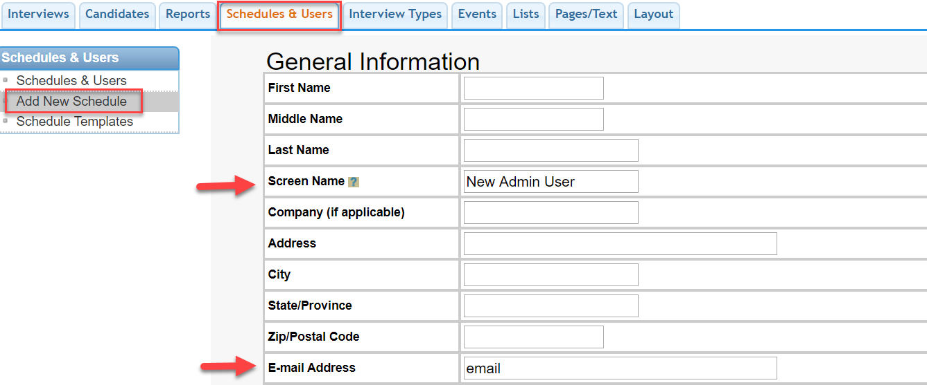
How to Add an Admin User
1. Click on the Schedules & Users tab.
2. Click on Add New Schedule on the Left.
3. Enter the User Name (Under Screen Name) and the User’s email associated with this profile.

Slide 6
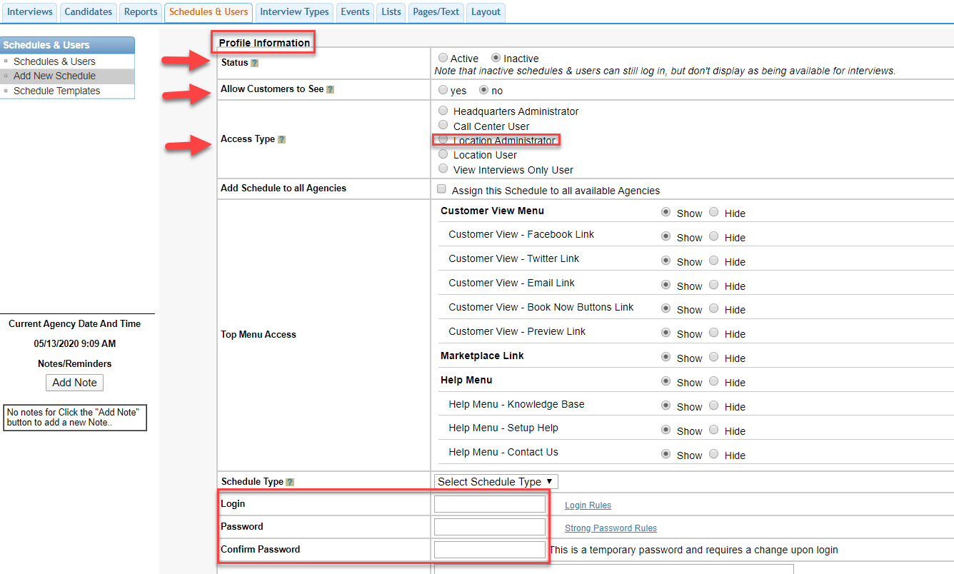
How to Add an Admin User Continued
1. Set the Status To Inactive and Allow Customers to See No.
2. Select Location Administrator as the Access Type.
3. Enter the Login (Email) and Temporary Password for this User. Click Add.

Slide 7
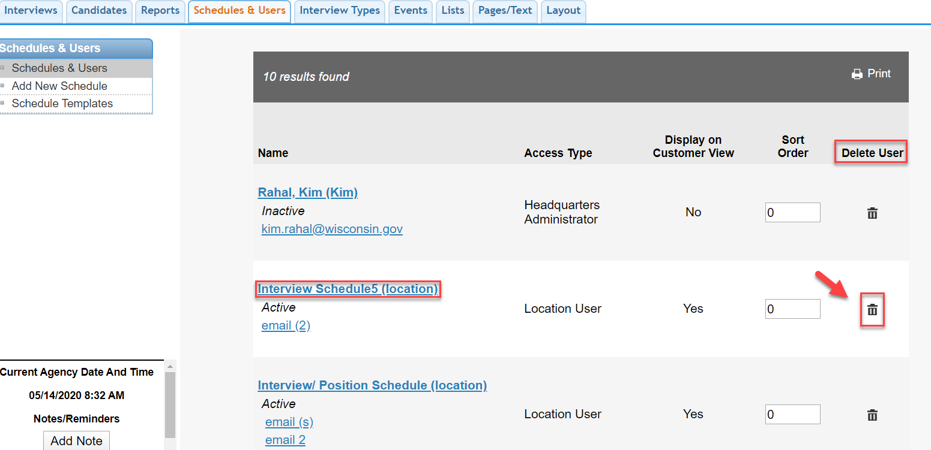
How to Delete a Schedule or User
1. Click Schedules and Users.
2. Click the Delete Icon to the right of the Schedule/User.

Slide 8
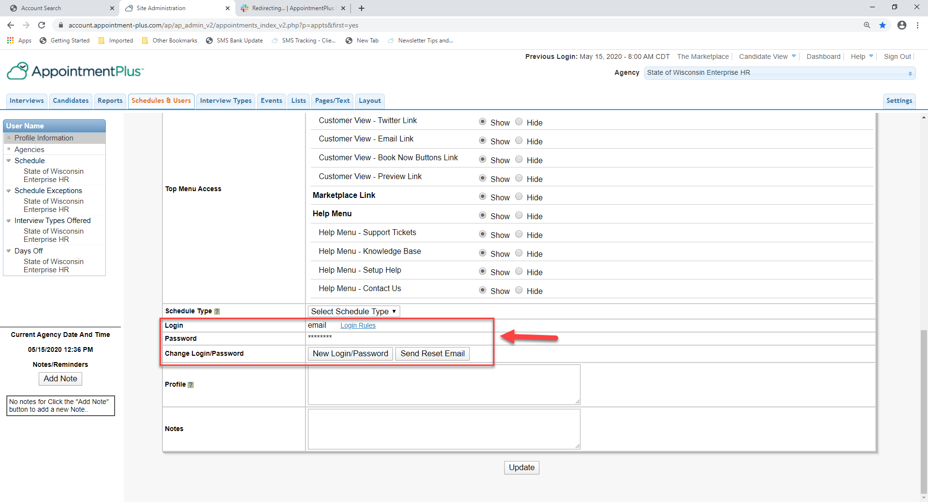
How to Reset a User Login or Password
1. Click Schedules and Users, then click the User Name.
2. Scroll down to the Login and Password fields.
3. Click New Login/Password button to reset both or click Send Reset Email to send an email to the user to create a new password only.

Slide 9
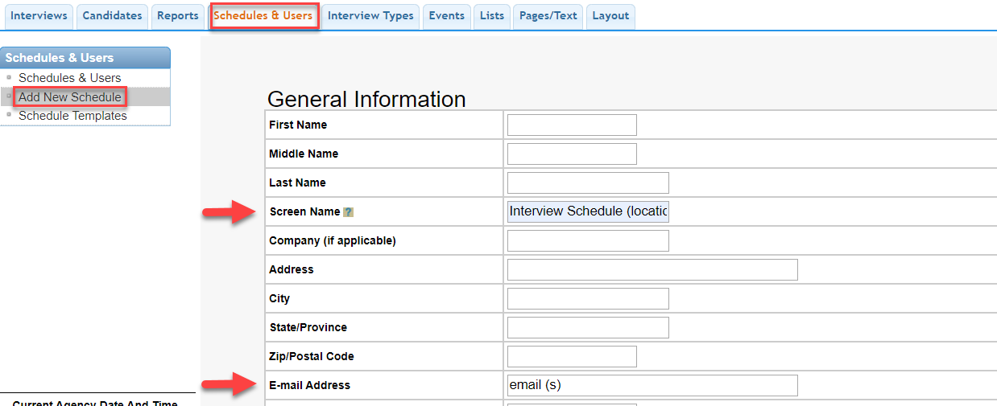
How to Add an Interview Schedule
1. Click on the Schedules & Users tab.
2. Click on Add New Schedule on the Left.
3. Enter the Schedule Name (Under Screen Name) and add any emails associated with this schedule.

Slide 10
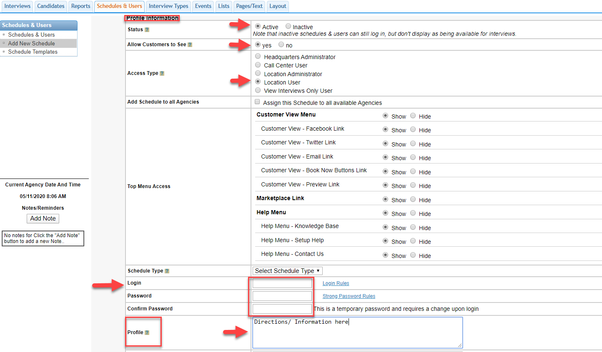
How to Add an Interview Schedule Continued
1. Set the Status To Active and Allow Customers to See Yes.
2. Select Location User as the Access Type.
3. Enter the Login and Temporary Password associated with this schedule.
4. Enter additional details in the Profile box (included in emails). Click Add.

Slide 11
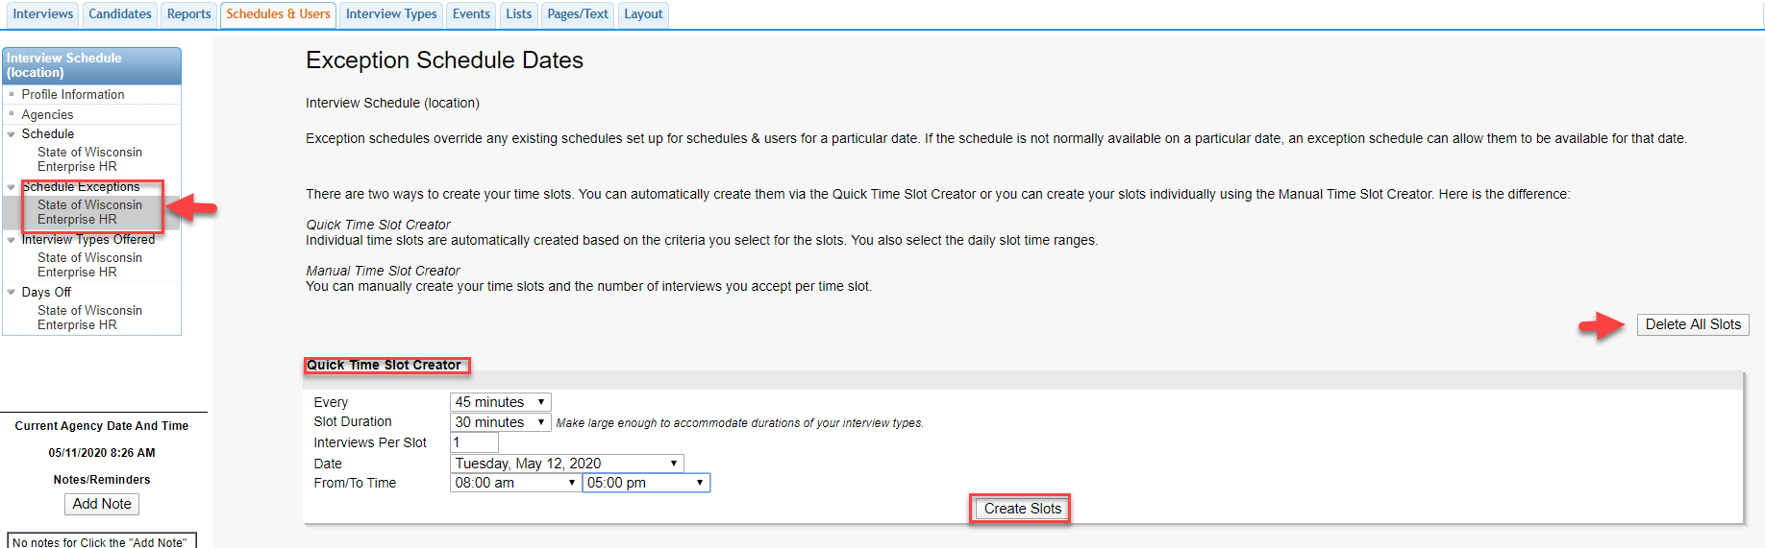
How to Create A Schedule Exception
Click Schedule Exceptions on the upper left.
Select the Increment to Start, Duration of Interview, Appointments Per Slot (1), Date, Start & End Time, and Click Create Slots. This will create your Interview Schedule for a specific date. (delete all slots allows you to start over)

Slide 12
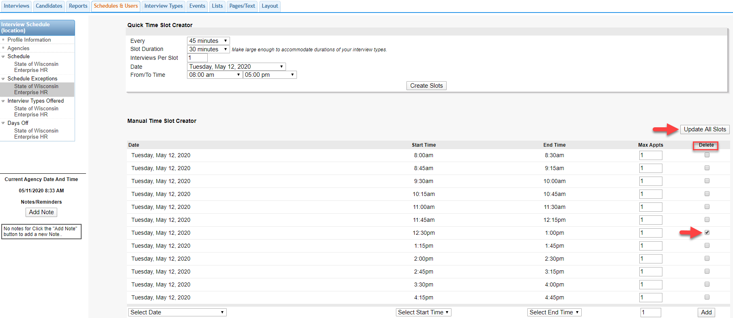
How to Create A Schedule Exception Continued
To create breaks, select a time slot on the right under the Delete column, then click Update All Slots and that will remove those time slots.

Slide 13
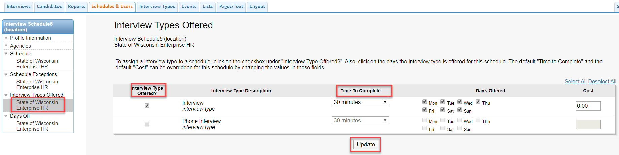
How to Assign an Interview Type to a Schedule
Click Interview Types Offered on the left.
Select which ones should be assigned to this schedule and the time to complete. Click Update.

Slide 14
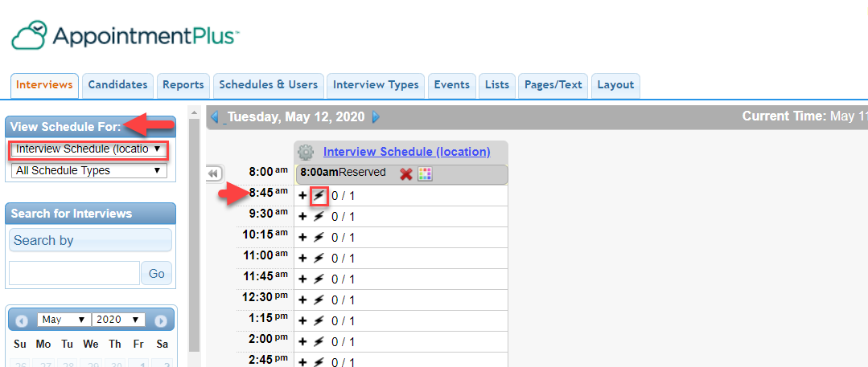
How to Reserve/ Block Out Time
Select the Interview Schedule on the left.
Click the Lightening Bolt at a time slot and this will reserve/ block out that time slot.

Slide 15
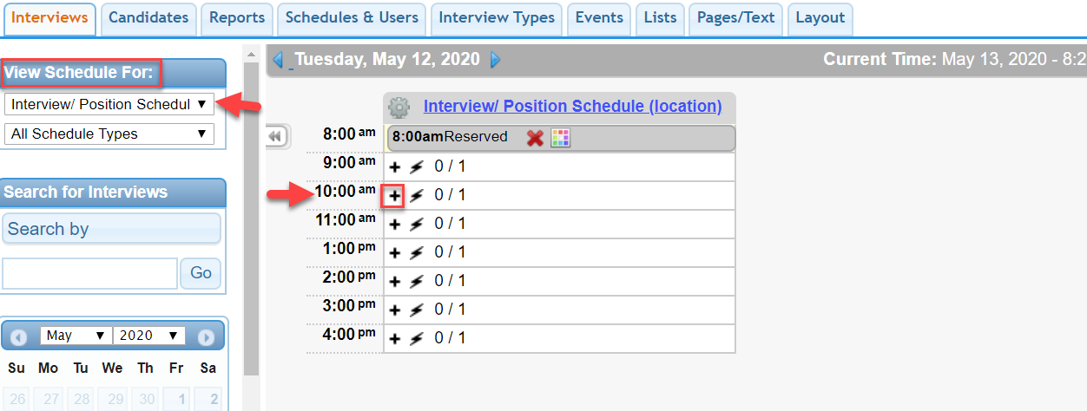
How to Book an Interview On Your Calendar
Click the Interviews Tab at the Top Left.
Select your Interview Schedule.
Select the Date and Time and click the “+” sign.

Slide 16
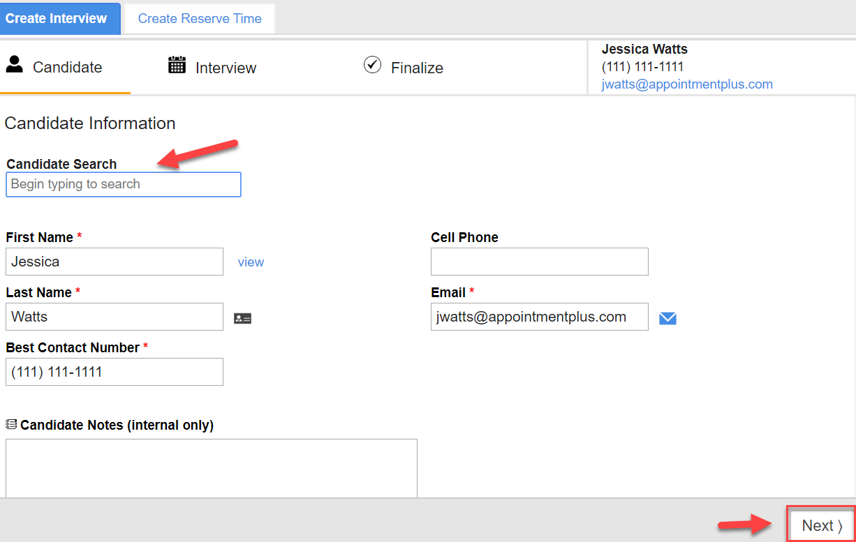
How to Book an Interview On Your Calendar
You can search for returning candidates or add a new candidate, then click Next.

Slide 17
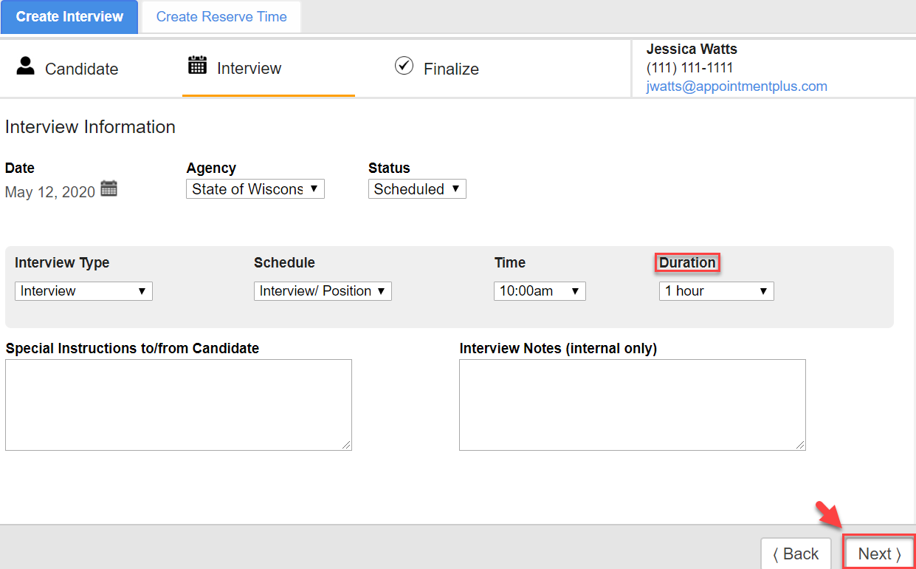
How to Book an Interview On Your Calendar
Verify the Interview Duration, click next.

Slide 18
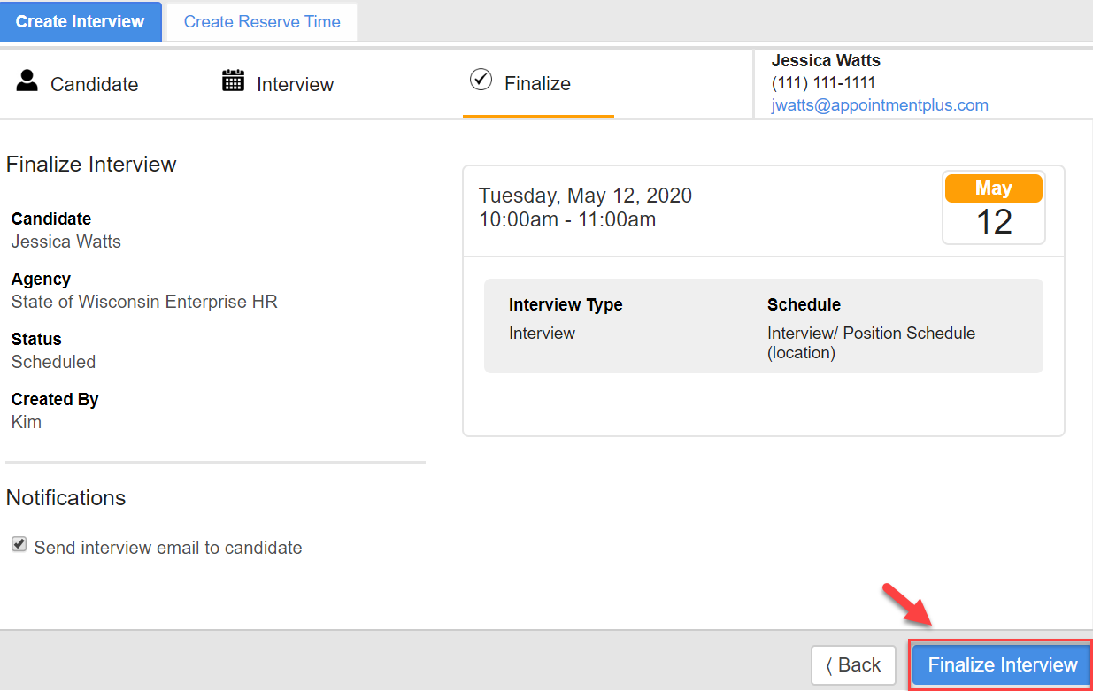
How to Book an Interview On Your Calendar
Verify the Information and click Finalize Appointment.

Slide 19
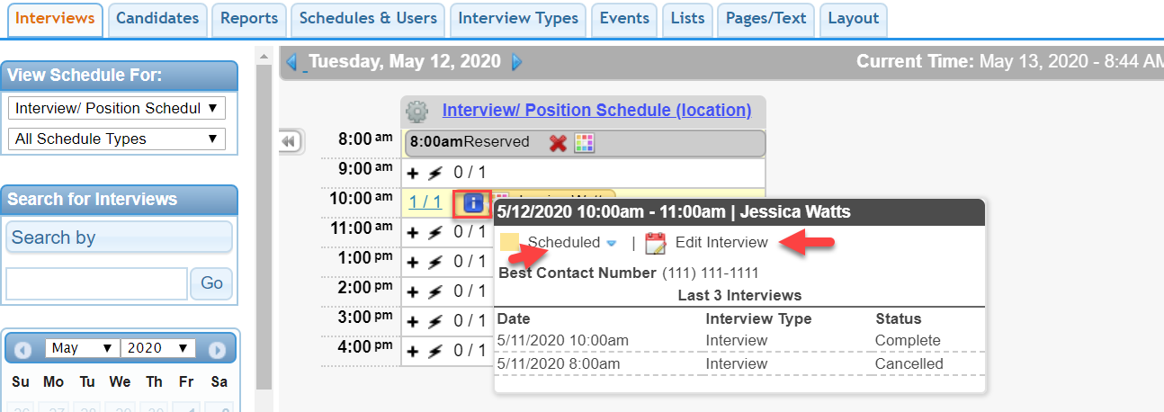
How to Cancel or Edit an Interview
Hovering over the Blue Icon is quick interview information.
Click Edit Interview, then Cancel or Edit the Interview.

Slide 20
How to Create a Link to an Interview Schedule
State of Wisconsin Enterprise HR
https://booknow.appointment-plus.com/b94cplcy/?&e_id=####
Region 1-DOA
https://book.appointment-plus.com/b951dtz0/?&e_id=####
Region 1-DPM
https://booknow.appointment-plus.com/b951xp42/?&e_id=####
Region 2-DOC
https://booknow.appointment-plus.com/b95287ky/?&e_id=####
Region 3-DATCP
https://booknow.appointment-plus.com/b952d39c/?&e_id=####
Region-3 DCF
https://booknow.appointment-plus.com/b952hsse/?&e_id=####
Region 3-DNR
https://booknow.appointment-plus.com/b952mvhg/?&e_id=####
Region 3-DWD
https://booknow.appointment-plus.com/b952rk6x/?&e_id=####
1. These are the starting Agency links.

Slide 21
How to Create a Link to an Interview Schedule
Region 4-DHS
https://booknow.appointment-plus.com/b953h2mq/?&e_id=####
Region 4-DVA
https://booknow.appointment-plus.com/b953lsbs/?&e_id=####
Region 4-DOR
https://booknow.appointment-plus.com/b953qv10/?&e_id=####
DMA
https://booknow.appointment-plus.com/b9541jk2/?&e_id=####
DOJ
https://booknow.appointment-plus.com/b9546z94/?&e_id=####
OSPD
https://booknow.appointment-plus.com/b95cxsyx/?&e_id=####
WHS
https://booknow.appointment-plus.com/b95cnntk/?&e_id=####
WTS
https://booknow.appointment-plus.com/b95csjxm/?&e_id=####
1. These are the starting Agency links.

Slide 22
Instructions for Creating Schedule Links
https://apptplus.zendesk.com/hc/en-us/articles/215148823-Custom-Customer-View-Links

Slide 23
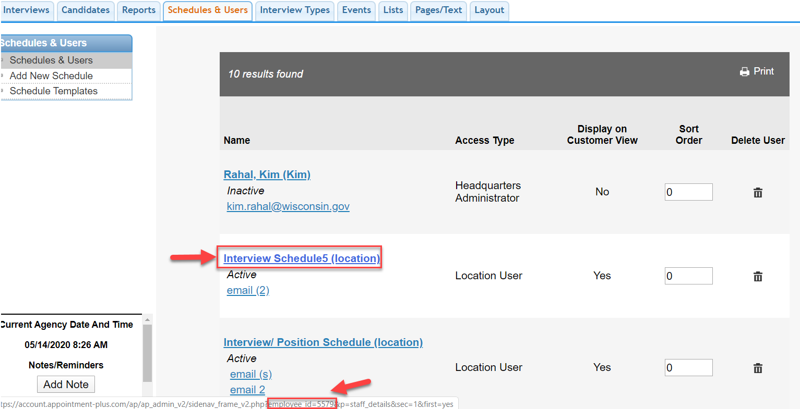
How to Get the 4-Digit Schedule Code
1. Hover Over the Schedule Name.
2. The Schedule Code is at the bottom of the screen: employee_id=####.

Slide 24
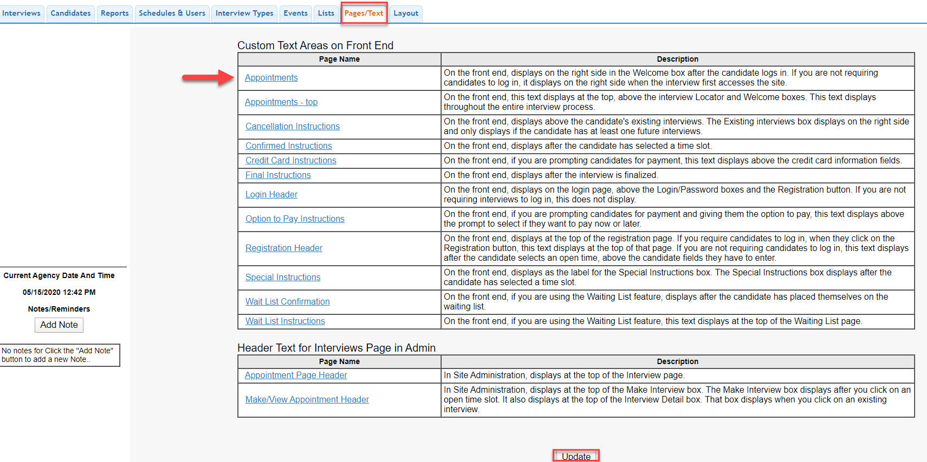
Update Text on Candidate Booking Page
Click Pages/Text Tab.
2. Click Appointments link, update your instructions here for that location, then click Update.

Slide 25
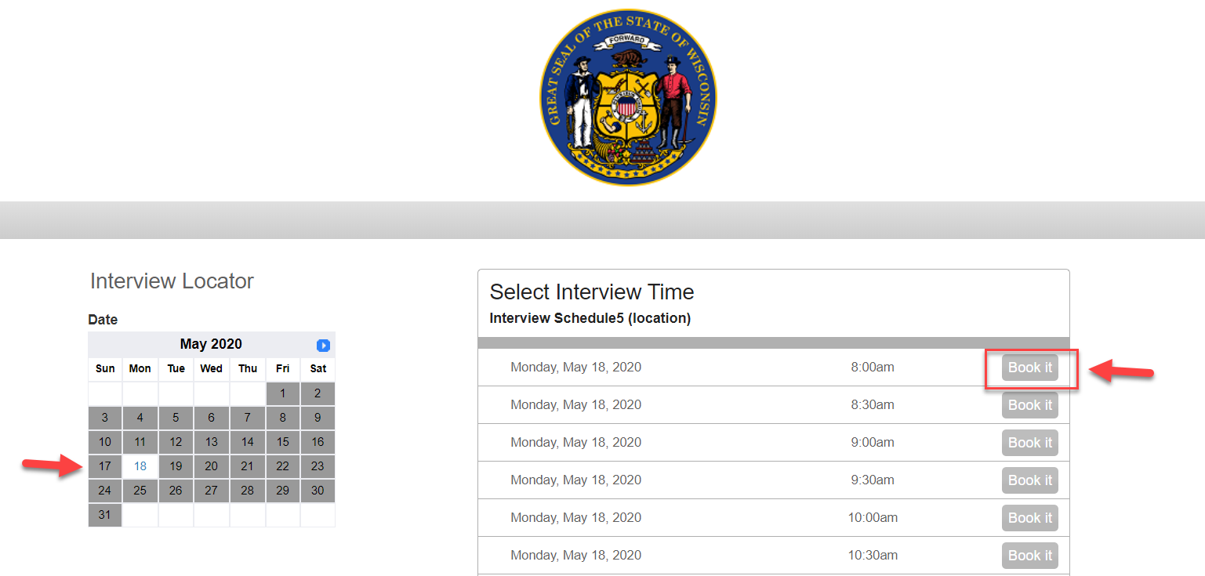
Candidate Booking Page
Candidate will click on the link, select the date, time, and enter their contact details, then finalize.
2. A Confirmation email will be sent.

Slide 26
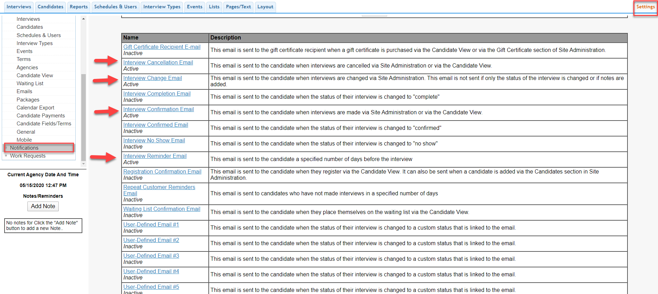
Candidate Email Templates
1. Click Settings on the upper right, then click Notifications on the lower left.
2. The top link are the templates for the Candidates. The bottom half can go out to the interview schedule.
3. Click each link to update the email templates you would like to use.

Slide 27
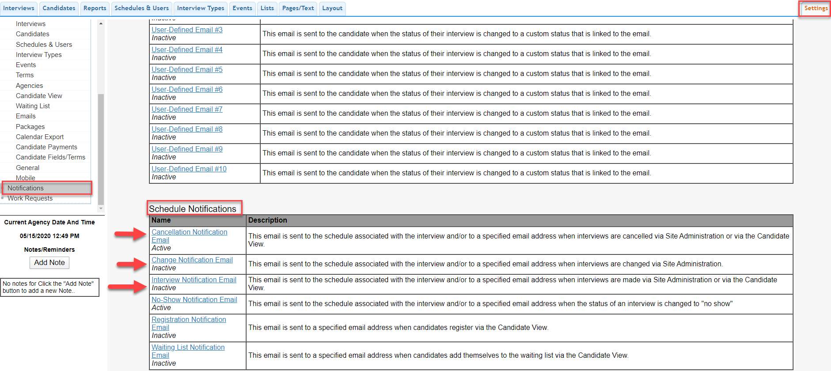
Schedule Email Templates
1. Click Settings on the upper right, then click Notifications on the lower left.
2. The top link are the templates for the Candidates. The bottom half can go out to the interview schedule.
3. Click each link to update the email templates you would like to use.

Slide 28
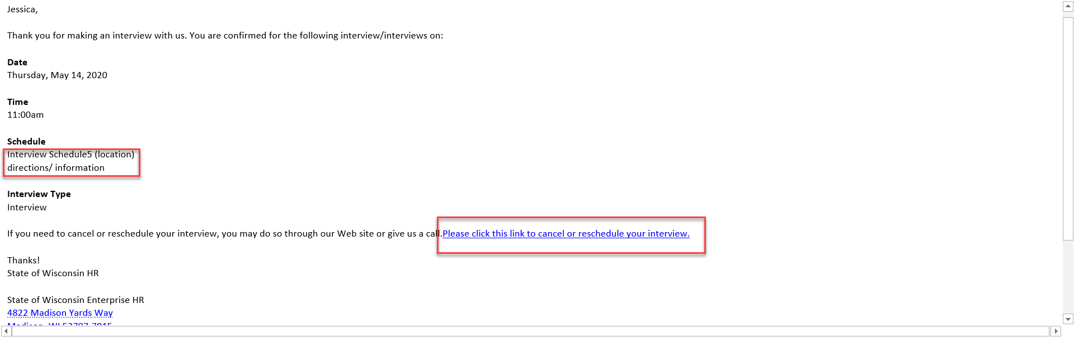
Emails to Candidate and Link to Cancel or Reschedule
1. Sample Confirmation Email.
2. Candidate can click the link to cancel or reschedule their interview.

Slide 29
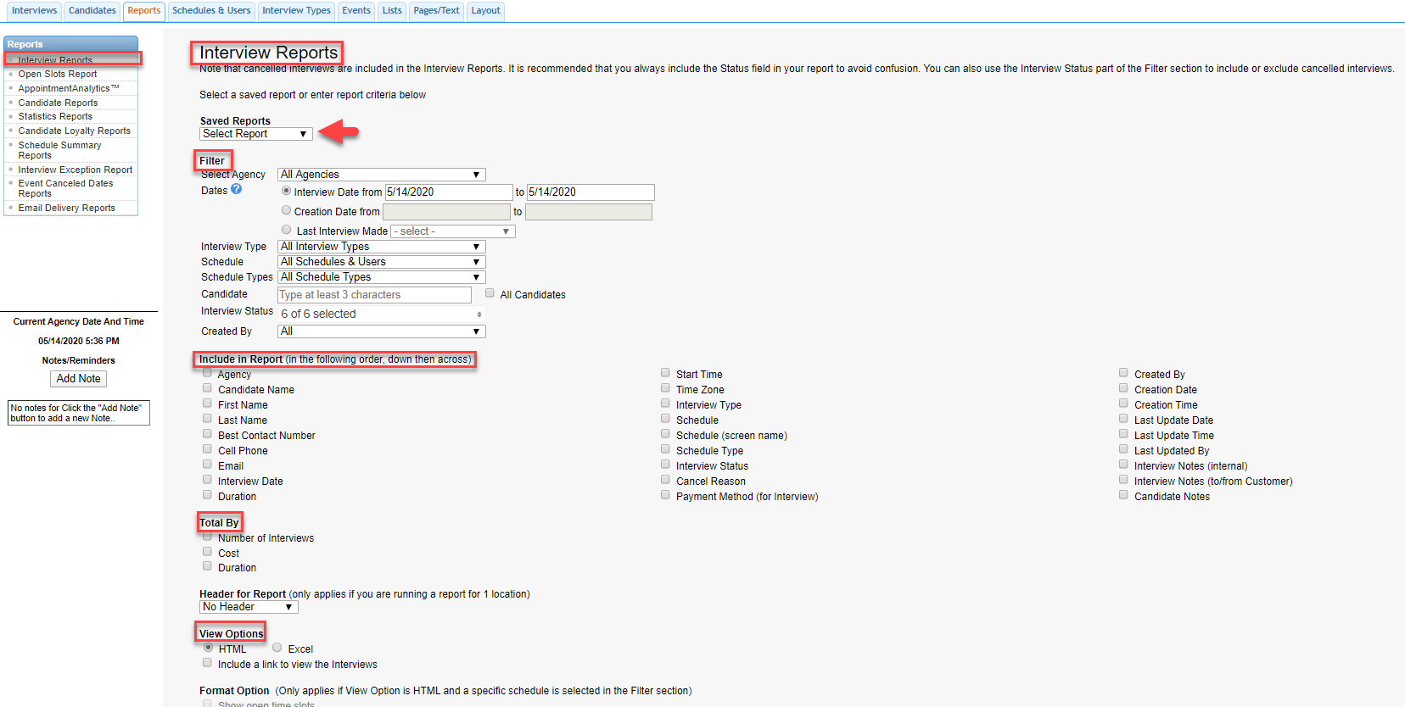
Reports
1. Click the Reports tab at the top.
2. For Interview Reports, select your Agency (or all for HQ Admins), filters for your report and run report.
3. You can name a report and click Save and Run Report to create a report template.

Slide 30
Reports Overview
https://apptplus.zendesk.com/hc/en-us/articles/215144203-Reports-Overview

Slide 31
Preferences Overview
In AppointmentPlus we have hundreds of Preferences. Please contact us directly if you have any specific questions.
Please note that Preferences are currently being shared across all Agencies.

Slide 32
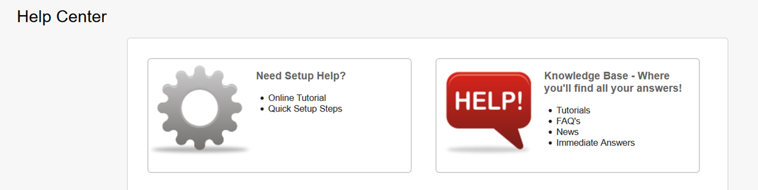

Help Resources
You can hover over the Help option in the top right corner
Here you can view our knowledge base.
For Additional Help Articles, FAQ’s and Tutorial Videos

Slide 33
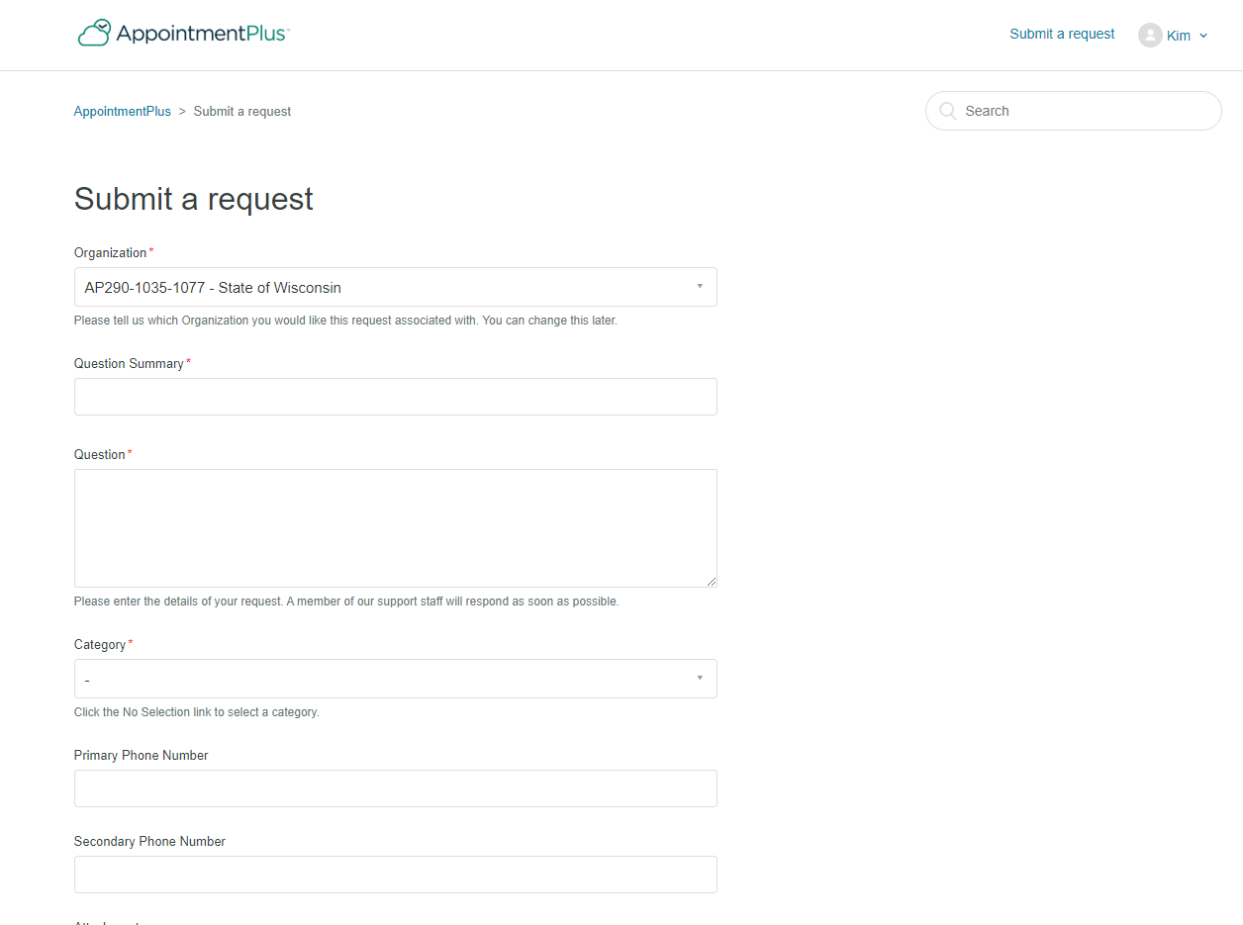
Submit a Ticket
You can hover over the Help option in the top right corner. Then click Support Tickets
Click Submit a Request, fill out the form, and submit at the bottom.

Slide 34

Thankyou

