Slide 1

State of Wisconsin
Document Upload Guide

Slide 2
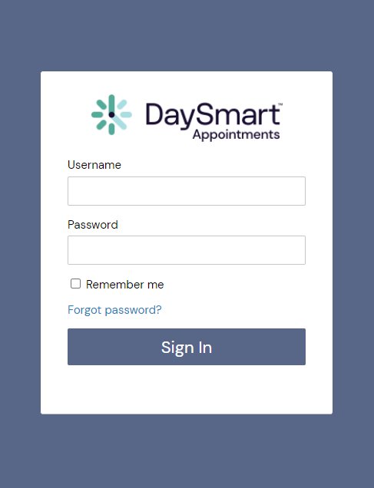

How to login to
DaySmart Appointments
Go to www.DaySmartAppointments.com
Click on Login at the top of the page
Enter your login and password. Passwords are case sensitive.
If you forget your password, use the “Forgot password” link in the login box and you will receive an email with password reset instructions
LOGIN

Slide 3
How to Create a Link to an Interview Schedule
State of Wisconsin Enterprise HR
https://booknow.appointment-plus.com/b94cplcy/?&e_id=####
Region 1-DOA
https://book.appointment-plus.com/b951dtz0/?&e_id=####
Region 1-DPM
https://booknow.appointment-plus.com/b951xp42/?&e_id=####
Region 2-DOC
https://booknow.appointment-plus.com/b95287ky/?&e_id=####
Region 3-DATCP
https://booknow.appointment-plus.com/b952d39c/?&e_id=####
Region-3 DCF
https://booknow.appointment-plus.com/b952hsse/?&e_id=####
Region 3-DNR
https://booknow.appointment-plus.com/b952mvhg/?&e_id=####
Region 3-DWD
https://booknow.appointment-plus.com/b952rk6x/?&e_id=####
1. These are the starting Agency links.

Slide 4
How to Create a Link to an Interview Schedule
Region 4-DHS
https://booknow.appointment-plus.com/b953h2mq/?&e_id=####
Region 4-DVA
https://booknow.appointment-plus.com/b953lsbs/?&e_id=####
Region 4-DOR
https://booknow.appointment-plus.com/b953qv10/?&e_id=####
DMA
https://booknow.appointment-plus.com/b9541jk2/?&e_id=####
DOJ
https://booknow.appointment-plus.com/b9546z94/?&e_id=####
OSPD
https://booknow.appointment-plus.com/b95cxsyx/?&e_id=####
WHS
https://booknow.appointment-plus.com/b95cnntk/?&e_id=####
WTS
https://booknow.appointment-plus.com/b95csjxm/?&e_id=####
1. These are the starting Agency links.

Slide 5
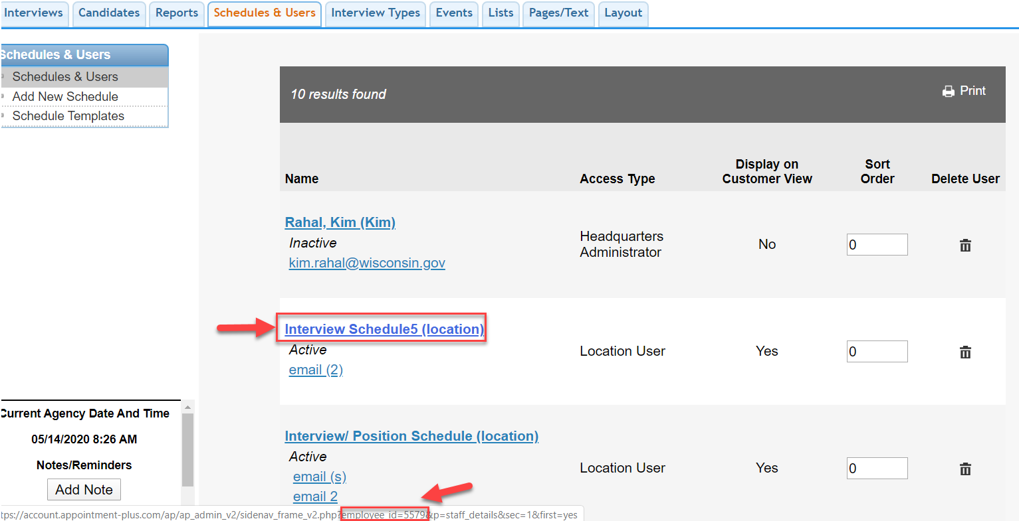
How to Get the 4-Digit Schedule ID Number
1. Hover Over the Schedule Name.
2. The Schedule ID Number is at the bottom of the screen: employee_id=####.

Slide 6
How to Get the 4-Digit Schedule ID Number
Replace the #### with the employee_id code.
For ex: https://booknow.appointment-plus.com/b94cplcy/?&e_id=5579

Slide 7
Instructions for Creating Schedule Links
https://apptplus.zendesk.com/hc/en-us/articles/215148823-Custom-Customer-View-Links

Slide 8

Thankyou

