Slide 1

State of Wisconsin
Document Upload Guide

Slide 2
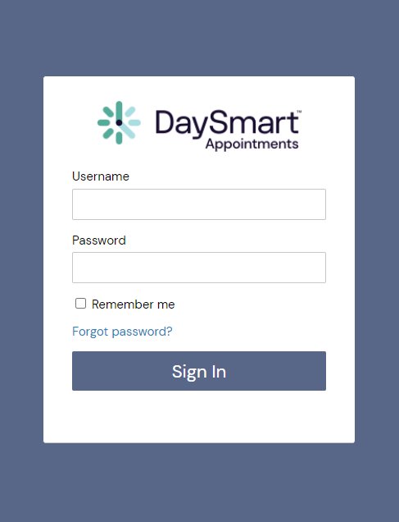

How to login to
DaySmart Appointments
Go to www.DaySmartAppointments.com
Click on Login at the top of the page
Enter your login and password. Passwords are case sensitive.
If you forget your password, use the “Forgot password” link in the login box and you will receive an email with password reset instructions
LOGIN

Slide 3
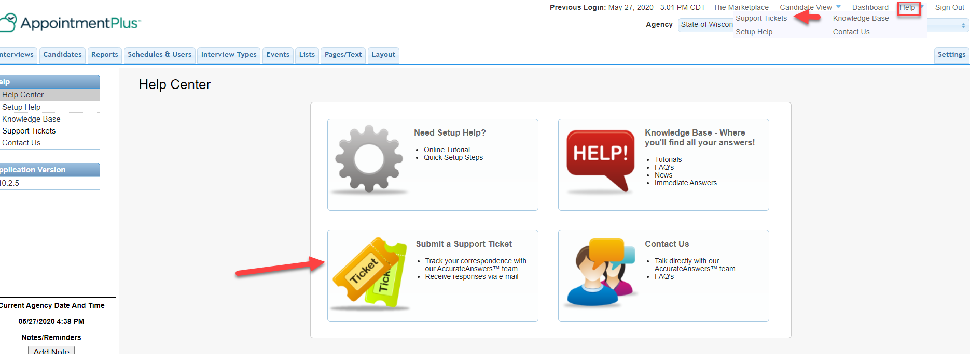
Help Resources
Hover over Help at the top right.
Click Support Tickets OR Submit a Support Ticket

Slide 4
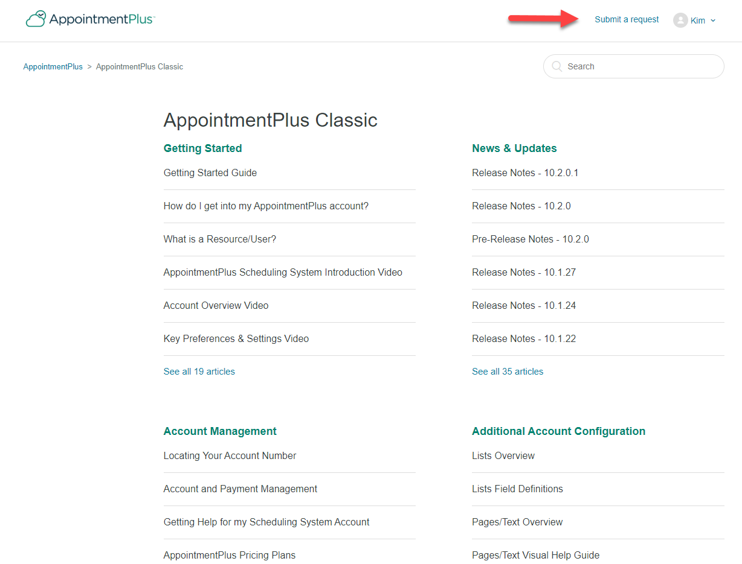
Submit a Ticket
Click Submit a Request.

Slide 5
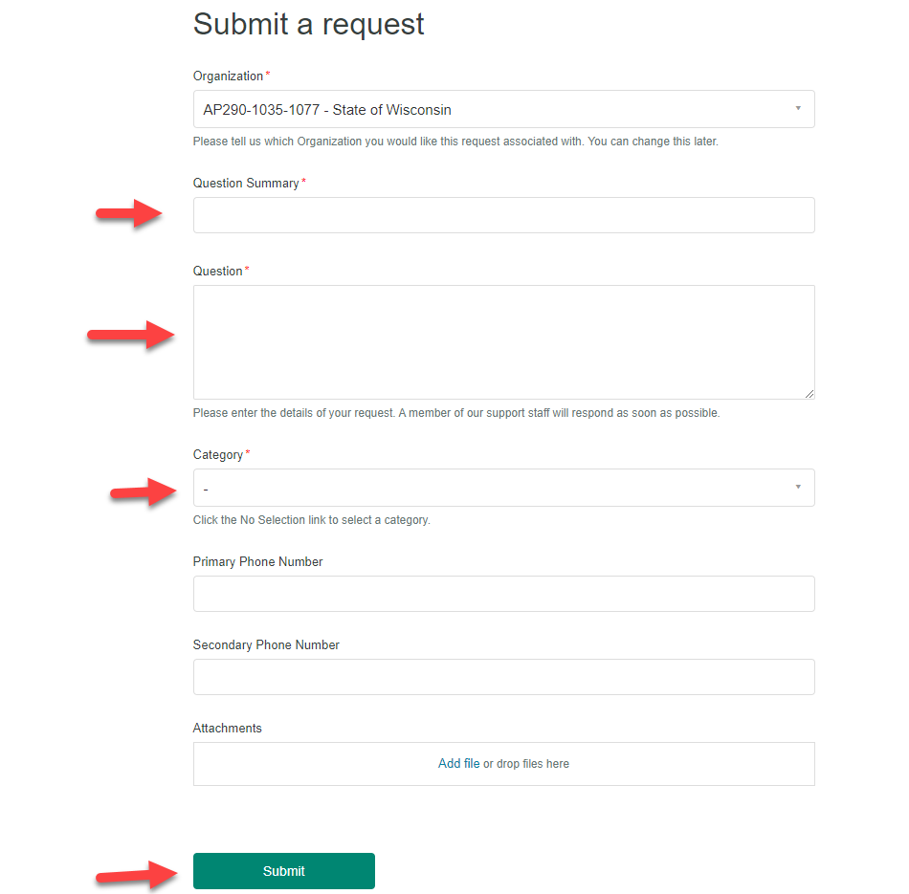
Submit a Ticket Continued
Fill out the form and click submit at the bottom.

Slide 6

Thankyou

