Slide 1
Income Continuation Insurance 2024 Redesign
December 7, 2023

Slide 2
What changes are being made to ICI
Effective 2/1/2024 the ICI Program will consolidate its standard and supplemental coverage levels into a single level of coverage for WRS earnings up to $120,000.
There will be only one level of coverage- no supplemental coverage
ETF will no longer use the terms “standard” and “supplemental” to describe coverage
Employers will now pay contributions for insured employees’ annual earnings up to the $120,000 limit

Slide 3
New Hire Job data changes
New hires dated 01/02/2024 or later with ICI coverage effective 2/1/24 or later will have the updated values for Elig Field 2
Agencies will see Categories 1-6 only as options
The supplemental values will no longer be an option on the dropdown for Elig Field 2

Slide 4
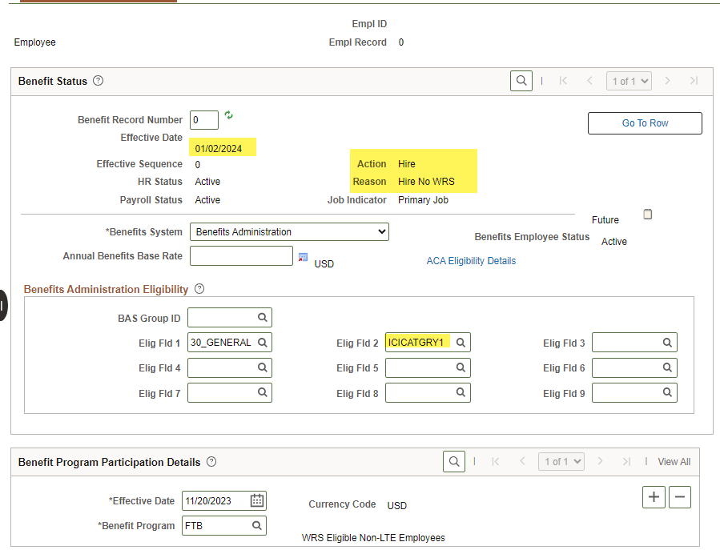
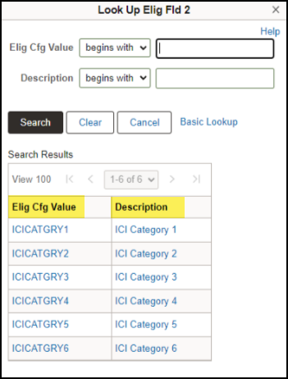

Slide 5
Next Steps
Central Benefits
Update New Employee Orientation material
Update DPM website
Update ICI resources
Agency
Update any forms used between Payroll & Benefit Specialists and HR staff regarding new hires and Elig Field values
Update any material you have referencing ICI Supplemental coverage
Will post ICI Premiums once they’ve been finialized

Slide 6
Resources
ETF Employer News (December 4, 2023)- State Income Continuation Insurance Annual Review and Premium Adjustments
Income Continuation Insurance Brochure
Income Continuation Insurance Administration Manual
ICI ABBR rules
12/07 ICI Presentation slides

