Slide 1
New Employee benefit orientation
2026
Updated 01/2024

Slide 2

Payroll information

Slide 3
Paychecks
How Often | When | Where
You are paid biweekly (every two weeks). See the Payroll Calendar for details. There are 26 pay periods per year. They are labeled A, B, or C. No insurance, Pre-Tax Savings Accounts or Health Savings Account deductions are taken on the C payrolls. | Paychecks are directly deposited on Thursdays (if there is a legal holiday on Thursday, check deposited on Wednesday) | You must complete your Direct Deposit Information within the first two weeks of your hire date via employee self-service. If direct deposit not entered timely, may initially receive a paper check.
See the Payroll Employee Self Service webpage for helpful job aids

Slide 4
Payroll information
Should submit State and Federal tax withholding forms within 10 days of hire. If no election made, withholding defaults to Single with 0 exemptions.
  All tax withholding elections should be done through employee self-service
Focus Card – prepaid Visa card that can be used in lieu of direct deposit to a bank account
  Focus Card Overview
  Focus Card Enrollment Form
  Focus Card Mobile App (available in Apple and Android formats) – view website for details

Slide 5
Benefit Deductions
Benefit deductions are taken from the first 2 paychecks payable each month (A and B payrolls)
  Monthly premiums are split evenly over the 2 checks
In the 2 months per year in which 3 checks are payable, benefit deductions are only taken for the following plans on 3rd check payable in the month (C payroll):
  Wisconsin Retirement System
  Wisconsin Deferred Compensation
  On-Site Parking Deductions
At hire, multiple benefit deductions might be necessary depending on the timing of your enrollments.

Slide 6
Paid leave benefits
Vacation
Sick leave
Personal holiday
Legal holiday

Slide 7

Paid leave benefits
A variety of paid leave benefits are available
  Vacation
  Sick Leave
  Personal Holiday
  Legal Holiday
Paid leave is prorated based on your appointment percentage/hours in pay status

Slide 8
Paid leave - vacation
Earned from the first day of employment but cannot be used during the first 6 months of an original appointment in state service
Number of vacation hours based on FLSA status (exempt or non-exempt), years of service and appointment percentage
What is FLSA status? An employee is either exempt or non-exempt under the Fair Labor Standards Act. Non-exempt employees are eligible for overtime pay and exempt employee are not. Your FLSA status is listed in your appointment letter.
At hire, total vacation hours granted are prorated based on hire date
New allotment of vacation hours then granted at the start of each calendar year
You will be able to carry over a maximum of 40 hours of unused vacation per year
Must be used by June 30th of the following calendar year
If hire date later in the year, may be able to carryover unused vacation past June 30th for the 1st year
Notes:
Talking point – point out any differences your agency may have relative to vacation carryover (if applicable)

Slide 9
Paid leave - vacation
Years of Service | Annual Vacation Hours FLSA Non-Exempt | Annual Vacation Hours FLSA Exempt
During First 5 Years | 104 | 120
5+ to 10 years | 144 | 160
10+ to 15 years | 160 | 176
15+ to 20 years | 184 | 200
20+ to 25 years | 200 | 216
25 and Over | 216 | 216
Assumes 100% appointment percentage – prorated if part-time
Prorated during 1st year of employment based on hire date

Slide 10
Paid leave - vacation
If you use more vacation than you’ve earned, you will be required to pay it back (will be automatically deducted from check)
Vacation is granted at the start of the year on the assumption that you will work your full appointment percentage for the entire calendar year
If you term employment mid-year or are unpaid for some or all your appointment percentage, your vacation hours are reduced
Once eligible, you can put 40 up to 120 hours of your unused vacation hours into a Sabbatical Account
Once in Sabbatical, hours do not expire and can be used like other paid leave hours
Employees will be notified in November of the year when eligible
Once you earn 200 hours of vacation per year, you are also eligible to receive up to 40 hours of unused vacation as a cash payment
This Photo by Unknown Author is licensed under CC BY-NC-ND

Slide 11
Paid leave – sabbatical and vacation cash-out eligibility
Years of Service | FLSA Non-Exempt # Hours that Can Be Put in Sabbatical | FLSA Non-Exempt # Hours that Can Be Cashed Out | FLSA Exempt # Hours that Can Be Put in Sabbatical | FLSA Exempt # Hours that Can Be Cashed Out
During First 5 Years | 0* | 0 | 0* | 0
5+ to 10 years | 0* | 0 | 40 | 0
10+ to 15 years | 40 | 0 | 40 | 0
15+ to 20 years | 40 | 0 | 80 | 40
20+ to 25 years | 80 | 40 | 120 | 40
25 and Over | 120 | 40 | 120 | 40
*Note: If you earn < 160 hours of vacation per year AND you have at least 520 of accumulated sick leave, you are eligible to put up to 40 hours of unused vacation into Sabbatical

Slide 12

Paid leave – sick leave
Earn 5 hours of sick leave per pay period
  Can never earn more than 5 hours per pay period (130 hours/year)
  Prorated if part-time or on partial or full leave without pay
Unused sick leave accumulates from year to year – no limit on accumulation
There is no cash value (is not paid out at termination)
Other Benefits of Sick Leave
  Unused sick leave may be converted to credits to pay for state health insurance upon retirement (if eligible)
  Sick leave balance can help reduce your premiums for Income Continuation Insurance (a benefit mentioned later in the presentation)
  Sick leave balance can allow you to put unused vacation in sabbatical earlier

Slide 13
Paid leave – personal holiday
Employees granted 4.5 days (36 hours) of Personal Holiday at hire and at start of every calendar year (pro-rated if part-time)
Personal Holiday can be used starting on the first day of employment
Must be used by end of calendar year or it is lost (limited exceptions if late year hire)
If you resign within the first 6 months of employment, must pay back all personal holiday used
If you are terminated by the employer within the first 6 months of employment, must pay back a prorated amount based on your hire date

Slide 14

Paid leave – legal holidays
The state provides 9 paid Legal Holidays (LH) every calendar year
New Year’s Day (January 1) | Thanksgiving Day (Fourth Thursday in November)
Martin Luther King Jr.’s Birthday (Third Monday in January) | Christmas Eve Day (December 24)
Memorial Day (Last Monday in May) | Christmas Day (December 25)
Independence Day (July 4) | New Year’s Eve Day (December 31)
Labor Day (First Monday in September)

Slide 15
Paid leave – legal holidays
If LH falls on a Sunday, state office buildings are closed on the following Monday
If LH falls on a Saturday or if scheduled to work on a LH, you are granted floating legal holiday hours that can be used at any time
Floating LH hours must be used by the end of the calendar year, or they are lost
Eligibility for paid legal holiday
Must be an employee on the holiday; and
Must be in pay status on the last scheduled workday immediately preceding the holiday or immediately following the holiday

Slide 16
Other Leave benefits
Other leave benefits may include:
  Jury Duty
  Workers Compensation
  Military Leave
  Organ/Tissue Donor
  Catastrophic Leave
  Exam and Interview Time
  Poll Worker
  Voting
  Family and Medical Leave Act (FMLA)
  Leave of absence without pay (LWOP)
For more details, see your payroll and benefits department

Slide 17

Employee benefit information

Slide 18
Enrollment period and effective dates
Employees have 30 days from the date of hire to enroll in or waive all benefit plans via eBenefits
Coverage Effective Dates
1st of Month on or Following Hire Date | 1st of Month on or Following 30-Day Enrollment Period | 1st of Month on or Following 2 Months
State Group Health Insurance (if employee has prior state service or enrolls in coverage before eligible for employer contribution towards premium) Health Savings Account – effective when state health insurance begins (if enrolling High-Deductible Health Plan) Income Continuation Insurance (ICI) Delta Dental PPO Plans (Preventive and Supplemental Dental) MetLife Vision Plan Securian Accident Plan Pre-Tax Savings Accounts (Healthcare FSA, Dep Day Care FSA, Parking/Transit) Health Insurance Opt-Out Stipend if employee has at least 2 months of eligible state service at hire | State Group Life Insurance | State Group Health Insurance (if employee has no prior service and waits for employer contribution towards premium) Health Savings Account – effective when health insurance begins (if enrolling High-Deductible Health Plan) Health Insurance Opt-Out Stipend if employee has no eligible prior state service

Slide 19
Enrollment period and effective dates for WRS-covered LTEs
Employees have 30 days from the date of eligibility to enroll in or waive all benefit plans via eBenefits
Coverage Effective Dates
1st of Month on or Following Hire Date | 1st of Month on or Following 30-Day Enrollment Period | 1st of Month on or Following 6 Months
State Group Health Insurance (if employee has prior state service or enrolls in coverage before eligible for employer contribution towards premium) Health Savings Account – effective when health insurance begins (if enrolling High-Deductible Health Plan) Income Continuation Insurance (ICI) Delta Dental PPO Plans (Preventive and Supplemental Dental) MetLife Vision Plan Securian Accident Plan Pre-Tax Parking and Transit Accounts Health Insurance Opt-Out Stipend if employee has at least 6 months of eligible state service at hire | State Group Life Insurance | State Group Health Insurance (if employee has no prior service and waits for employer contribution towards premium) Health Savings Account – effective when health insurance begins (if enrolling High-Deductible Health Plan) Health Insurance Opt-Out Stipend if employee has no eligible prior state service

Slide 20
Ongoing Benefit Enrollment Opportunities
There are limited opportunities to enroll in benefits outside of the 30-day new hire enrollment period
Able to make changes to some (not all) benefits if you have a qualifying life event (ex. marriage, birth…)
Must make updates to benefits typically within 30 days of life event
See the Life Changes and My Benefits page for more information
Paper applications are required for life event changes
Annual open enrollment period in October of each year allows for changes to most benefits
State Group Life Insurance and Income Continuation Insurance are NOT part of Open Enrollment

Slide 21
Wisconsin Retirement System (WRS)

Slide 22

Wisconsin Retirement System (WRS)
Overview
Administered by the Department of Employee Trust Funds (ETF)
Provides retirement (pension) benefits to state and local employees [IRS 401(a) Plan]
Participation is mandatory for eligible employees (enrollment is automatic)
Employees and employers are required to make pre-tax contributions to their WRS account.
  WRS contributions are automatically deducted from paycheck for all covered earnings
The required employee and employer contribution rates are updated annually.
  2026 employee contribution rate = 7.20% (for most)

Slide 23
Wisconsin Retirement System (WRS)
Overview
Vesting requirement: If you begin WRS employment on or after 7/1/2011, you must have 5 years of WRS creditable service before you are vested in the WRS.
  What is vesting? Once vested, at retirement, you are eligible to receive a benefit based on the full value of your WRS account (employee + employer contributions + interest).
    If you term employment (vested or not) and you remove your funds from the WRS, it will only include employee contributions + interest
  Once vested, minimum retirement age is 55 for most employees (50 if covered by protective retirement category)
Can NOT rollover funds from other retirement account into the WRS
In addition to retirement benefits, the Wisconsin Retirement System also provides:
  Separation Benefits
  Disability Benefits
  Death Benefits
  See the Overview of the WRS video for more information

Slide 24
Wisconsin Retirement System (WRS)
Core vs. Variable Fund
Two funds available under the WRS:
  Core Fund: 50% stocks, 50% fixed income and other assets - returns are averaged over a 5-year period so there is less variability
  Variable Fund: 100% stocks (Optional) – returns are realized annually so there is more variability
All contributions invested in the Core Fund unless you elect to participate in the Variable Fund
To participate in the Variable Fund, complete an Election to Participate in Variable Fund form and submit to ETF
  Will invest 50% of your WRS contributions to the Variable and 50% to the Core Fund.
  If you want to immediately invest in the Variable Fund, must submit form to ETF within 30 days of hire. Elections received after this date will be effective on the 1st of the following year
Resources
  Variable Fund Brochure
  Core and Variable Fund Comparison
Notes:
Talking point: let them know that they can cancel Variable, but if they do, they can’t get back in

Slide 25
Wisconsin Retirement System (WRS)
Employees can make voluntary, post-tax additional contributions to their WRS account
Post-tax contributions only
Can set up via payroll deduction or submit directly to ETF via personal payment
No matching employer contribution
No access to funds until termination of employment and you receive a WRS benefit
WRS investments are managed by the State of Wisconsin Investment Board (SWIB)
Historical returns are posted on ETF’s website
Will receive an Annual Statement of Benefits in April of each year (paper statement and online access available)
Interest applied annually
Notes:
Talking point for late year hires: will not receive a statement in April if not paid in the prior year

Slide 26
State Group Health insurance
Health plan design
Prescription coverage
Uniform dental
Health insurance opt out stipend
Wellness benefits and incentive

Slide 27

State Group Health Insurance
Overview
Health Insurance Coverage
  Comprehensive medical and prescription coverage
  Preventive dental coverage available for minimal additional cost (Uniform Dental)
Uniform Benefits
  All plans offer the same benefits, but the health plan determines the provider network, and the plan design determines cost-sharing
Effective Date
  No prior service under the Wisconsin Retirement System (WRS)
    Eligible for the employer contribution towards premium on the 1st of the month on or following the completion of 2 months of WRS state service
    Can have coverage on the 1st of the month on or following hire date but will pay full premium for first 2 months of coverage
  At least 2 months of WRS state service
    Coverage effective on the 1st of the month on or following hire date
Annual opportunity in October to enroll/make changes to coverage during It’s Your Choice Open Enrollment period
Administered by the Department of Employee Trust Funds

Slide 28
State group health insurance
ETF Documentation requirements
New hires or employee’s who make changes to enroll in/change to family coverage (regardless of marital status) effective 1/1/2025 and later:
  Marriage certificates required to verify the date of marriage
  Birth certificates required for all dependents to verify the date of birth
Life events that occur 1/1/2025 or after:
  Birth – birth certificate required for the new dependent
    If the employee already has family coverage and is adding a new dependent, birth certificates and marriage certificates are not needed for dependents already covered.
  Marriage – marriage certificate required for the spouse

Slide 29
State group health insurance
ETF Documentation requirements
If an employee is married and they’re enrolling in health insurance, they must provide the SSN for their spouse and any dependent age 1 or older. If the spouse and/or dependent child(ren) do not have an SSN, the employer is required to complete the new ETF Form ET-1907 No tax-payer identification number.
Employees must submit birth and marriage certificates to their Payroll & Benefits Specialist for review.

Slide 30
Deciding when to begin coverage
Items to consider if NOT immediately eligible for employer contribution towards health insurance
  Can I afford state health insurance with no employer contribution?
    Single coverage monthly premium range for most plans = $800 - $2,000
    Family coverage monthly premiums range for most plans = $2,000 - $4,600
  What is cost of COBRA coverage from former employer and enrollment deadline?
  Do you have coverage through a significant other or parent?
  What is the cost of coverage through the Health Insurance Marketplace?
  What are expected medical expenses until eligible for employer contribution?

Slide 31
Understanding out-of-pocket costs
Annual Deductible: the amount you will pay out-of-pocket for covered services on an annual basis before the health plan begins to pay
Co-payment (Copay): a fixed amount you will pay for a covered service
Co-insurance: your share of the costs of a covered health care service, calculated as a percentage (ex. you pay 10% of cost and insurance plan pays 90%)
Out-of-Pocket Limit (OOPL): the most you could pay for covered services during a calendar year. After this limit is met, the plan will typically pay 100% of the allowed amount.

Slide 32
Understanding out-of-pocket costs
Deductible
You pay for all medical costs* until deductible met
Coinsurance
Once deductible met, you pay a percentage of costs and insurance covers the rest
Out-of-Pocket Limit
Once limit reached, insurance covers 100% of expenses
* Preventive services as defined by the Affordable Care Act are covered at 100% and not subject to the deductible
Copays do not count towards the deductible, but they do apply to the Out-of-Pocket Limit

Slide 33
Health Insurance Plan Designs
Before selecting a specific health plan, you need to pick a health plan design
  It’s Your Choice Plan (low deductible) or High-Deductible Health Plan (HDHP)
  Specific provider network (IYC Health Plan) or a nationwide network (Access)
  With or Without Uniform Dental coverage
Resources
In-Network Health Services Costs
  Lists costs for common services received in-network between low and high-deductible health plans
Choosing a Plan Design video
Plan Designs Quick Comparison

Slide 34
Decision 1 – enroll in a Low or High-Deductible Health Plan?
High Level Summary of IYC (Low) vs High-Deductible Plans
 | IYC Health Plan (low deductible) | High-Deductible Health Plan (HDHP)
Annual Medical Deductible | $250 individual $500 family After an individual within a family plan meets the $250 deductible, benefits apply as described below. | $1,700 individual $3,400 family If in family coverage, must meet full family deductible before benefits apply as described below.
Office Visit Co-Pay (non-specialty) | $15 (not subject to deductible) | Full cost until deductible met; $15 thereafter
Office Visit Co-Pay (specialty & urgent care) | $25 (not subject to deductible) | Full cost until deductible met; $25 thereafter
Emergency Room (copays may be waived if admitted) | $75 | Full cost until deductible met; $75 thereafter
Annual Out-of-Pocket Limit | $1,250 individual $2,500 family | $2,500 individual $5,000 family
Routine, preventive services required by law | Plan pays 100%, not subject to deductible (as defined by the Affordable Care Act)
Co-insurance for illness or injury services (in addition to co-payment) | After deductible, plan pays 90%, you pay 10% up to out-of-pocket limit
Notes:
ETF website shows incorrect HDHP deductibles In-Network Health Services | ETF, is the annual OOPL correct? PER IRS: For 2026, the minimum annual deductible for HDHPs is set at $1,700 for individual coverage and $3,400 for family coverage. This means that HDHPs must not pay benefits before the minimum required deductible is met for the level of coverage in which a participant is enrolled. Additionally, the HDHP maximum amount for annual out-of-pocket expenses will rise to $8,500 for self-only coverage and $17,000 for family coverage.
1/13 – I believe our slide is correct based on what is in the Decision Guide. I think what Jamie is referencing is the MOOP amount, which is much higher. – JP
1/13 Julie is correct. The highlighted information is the OOPL

Slide 35
Are you eligible for a high-deductible health plan & health savings account (HSA)?
HDHP/HSA Eligibility
  Employee (subscriber) must NOT be covered by any other health insurance, including Medicare Part A and B
  Employee (subscriber) can’t be claimed as a dependent on another person’s tax return (unless it’s your spouse)
  Employee (subscriber) can’t be over 65 years of age (unless enrollment in all parts of Medicare is deferred)
  As long as the subscriber (employee) meets the HDHP eligibility requirements, the employee can enroll in single or family coverage
  Even if a covered family member is eligible for Medicare or covered by other insurance, they can still be covered as a dependent on an HDHP.
  Must enroll in HSA if enrolling in HDHP
    If you don’t want to contribute anything yourself to the HSA (just receive employer contribution), must enroll in HSA with $0 annual contribution

Slide 36
Decision 2 - It’s Your Choice (IYC) Health Plan or Access Plan?
IYC Plans
Most cost-effective option (lowest premium and lower out-of-pocket costs)
Regional plans within Wisconsin that have a certain set of providers associated with them
Urgent and emergency services covered out-of-network
Use the Health Plan Search page to verify which plans are available in your area
Access Plan by Dean
Nationwide network
In and out-of-network services covered at different levels
Higher out-of-pocket costs
Greater access = higher premium

Slide 37
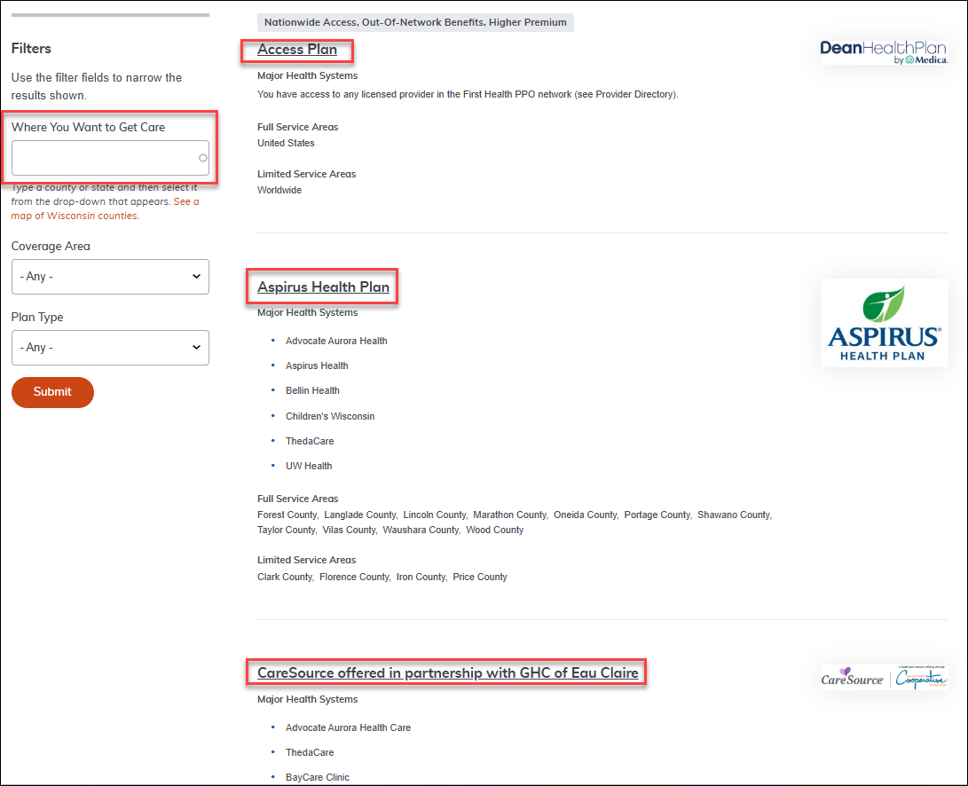
Decision 3 – select your health plan
Go to the Health Plan Search to determine what providers are available in your area
Type the county where services will be received
Available health plans and their major health systems will appear on page
Click on the Health Plan name to access Provider Directory
Notes:
Talking point – you don’t have to pick a plan where you live or work – pick a plan in a county where you receive services

Slide 38
Decision 4 – do you need Uniform dental?
 | Uniform Dental Benefit
Network | Delta Dental PPO and Delta Dental Premier
Annual Deductible | $0
Individual Annual Maximum | $1,000/person
Diagnostic & Preventive Services (exams, cleanings, fluoride, x-rays, spacers, sealants, pulp vitality tests) + Periodontal Maintenance | 100%
Basic & Major Services Fillings Anesthesia (general & IV sedation) Emergency pain relief | 100% 80% 80%
Major & Restorative Services Implants, crowns, bridges, dentures, partials Surgical extraction, root canal (endodontics), periodontics (except maintenance), oral surgery Non-surgical extractions (above gumline) | No coverage No coverage 90%
Orthodontic Services Coverage Lifetime Maximum | 50% (under age 19) $1,500
For a small additional health insurance premium ($4/month for single and $10/month for family), can include preventive dental coverage in your health insurance

Slide 39

Prescription Coverage
All health plans include prescription coverage
Prescription benefits are administered by Navitus
If enrolled in a High-Deductible Health Plan or Access (not required to work out of state), must meet annual deductible before benefits are paid
For full details, see the Pharmacy Breakdown of Your Costs page
  Saving on Your Prescriptions video
Mail order pharmacy available – Costco Pharmacy
The ETF's Navitus website has tools to help you determine the cost of your prescriptions.

Slide 40

Prescription coverage – vaccines at in-network pharmacies
No cost for covered vaccines:
  Influenza
  Pneumonia
  Tetanus
  Hepatitis
  Shingles
  Measles
  Mumps
  Human Papillomavirus (HPV)
  Pertussis
  Varicella
  Meningitis
Things to Know Before You Go
Must be received at an in-network pharmacy
Recommended to contact pharmacy in advance
Must present Navitus card
Travel vaccines still require a copay and will likely need to be done in the doctor’s office

Slide 41
Prescription Coverage Summary
 | IYC Plan | HDHP Plan (benefits below are AFTER deductible is met)
Deductible | $0 | Combined medical/Rx deductible $1,700 individual $3,400 family
Level 1 Copay | $5 or less | $5 or less
Level 2 Coinsurance | 20% ($50 max) | 20% ($50 max)
Level 3 Coinsurance * | 40% ($150 max) | 40% ($150 max)
Level 4 Specialty Copay | $50 (Must fill at specialty pharmacy) | $50 (Must fill at specialty pharmacy)
Levels 1 & 2 Out-of-Pocket Limit (OOPL) | $600 individual $1,200 family | Combined medical & pharmacy $2,500 / $5,000 (Included in Medical OOPL)
Level 3 & 4 Out-of-Pocket Limit* | $10,600 individual $21,200 family | Combined medical & pharmacy $2,500 / $5,000 (Included in Medical OOPL)
* Level 3 “Dispense as Written” or “DAW-1” drugs may cost more
Notes:
Talking point: For Level 3 – if the Level 3 is because you want it, you’ll pay the difference. If medically necessary, doctor must complete MedWatch form

Slide 42
2026 Employee Health Premiums
Low Deductible (NON-HDHP) Health Plans
Plan | Single (monthly) | Single (biweekly) | Family (monthly) | Family (biweekly)
IYC Plan with Dental | $132.00 | $66.00 | $329.00 | $164.50
IYC Plan without Dental | $128.00 | $64.00 | $318.00 | $159.00
Access with Dental | $335.00 | $167.50 | $833.00 | $416.50
Access without Dental | $331.00 | $165.50 | $822.00 | $411.00
Access with Dental (required to work out of state) | $202.00 | $101.00 | $508.00 | $254.00
Access without Dental (required to work out of state) | $198.00 | $99.00 | $497.00 | $248.50
2026 Total and Less Than Half Time Premiums

Slide 43
2026 Employee Health Premiums
High-Deductible Health Plans
Plan | Single (monthly) | Single (biweekly) | Family (monthly) | Family (biweekly)
HDHP Plan with Dental | $49.00 | $24.50 | $122.00 | $61.00
HDHP Plan without Dental | $45.00 | $22.50 | $111.00 | $55.50
HDHP Access with Dental | $252.00 | $126.00 | $626.00 | $313.00
HDHP Access without Dental | $248.00 | $124.00 | $615.00 | $307.50
HDHP Access with Dental (required to work out of state) | $119.00 | $59.50 | $301.00 | $150.50
HDHP Access without Dental (required to work out of state) | $115.00 | $57.50 | $290.00 | $145.00

Slide 44

Health Savings Account (HSA) Contributions
A Health Savings Account is used to set aside money on a pre-tax basis to pay for eligible medical expenses for employees in an HDHP only
If eligible for the employer contribution towards health insurance, receive employer contribution towards HSA
If enrolled in a High-Deductible Health Plan, must enroll in a Health Savings Account (HSA) - only employees enrolled in a HDHP may enroll in an HSA. Must re-enroll in HSA every year!!
 | HSA Employer Contribution* | HSA Total Annual Contribution Limit (Employee + Employer)
Single Health Coverage | $852/year if covered all year ($35.50 bi-weekly/$71.00 monthly) | $4,400
Family Health Coverage | $1,704/year if covered all year ($71.00 bi-weekly/$142.00 monthly) | $8,750
 | If required to pay half of total health insurance premium, receive half of total HSA employer contribution | Age 55 or older = $1,000 catch-up contribution limit

Slide 45

2026 HeaLth insurance resources
2026 Health Insurance Website
2026 It’s Your Choice Decision Guide
Health Plan Search
Guide to Office Visit Copayments
eLearnings
Certificate of Coverage

Slide 46

Health Insurance Opt-Out Stipend
If not enrolling in health insurance, you may be eligible for up to a $2,000 opt-out stipend (prorated based on eligibility/hire date)
Eligibility requirements
  Must not be covered by state health insurance in 2026 as an employee, spouse or child; and
  If employed by the state in 2015 and was eligible for the employer contribution towards health insurance, did NOT waive coverage in 2015
  Must be eligible for employer contribution towards health insurance
Stipend is considered taxable earnings, but the earnings do not count towards the Wisconsin Retirement System.
How to Apply
  Waive health insurance in eBenefits and complete a paper health insurance application (sections 1, 12, and 13) within the first 30 days of employment and submit to agency benefits office.
  Must re-apply for the stipend every year during Open Enrollment in eBenefits.
Notes:
Talking point for new hires: stipend prorated based on when first eligible for the employer contribution towards health insurance; stops at termination

Slide 47

Wellness Incentive
WebMD ONE administers wellness incentive and other wellness benefits
If covered by State Group Health insurance, both you and your spouse can each earn a $150 Wellness Incentive by completing the following through the WebMD ONE website
  An online health assessment; and
  A health check; and
  A well-being activity
2026 Incentive Deadline = October 16,2026
Incentive paid via a $150 Well Wisconsin prepaid card
Incentive is a taxable benefit – taxes will be deducted from paycheck
Provides health coaching, fitness tracking, webinars, and other health resources such as a diabetes management program
To enjoy Well Wisconsin sponsored events, visit etf.wi.gov/well-Wisconsin-events to register
WebMD 1-800-821-6591
Notes:
Talking point: health check activities include, annual physical, biometric screening, WebMD coaching session (one call or a series of online messaging interactions via Coach Connect)

Slide 48
State Group Life Insurance
Administered by securian

Slide 49
State Group Life Insurance
Coverage Level and Premiums
Group term life insurance available to state employees
Employee coverage
  Coverage level based on annual salary
  Can select coverage of 1-5x salary
    Basic = 1x salary
    Basic + Supplemental = 2x salary
    1 – 3 units of Additional Coverage (3 – 5x salary when Basic + Supplemental are also selected)
  Premiums based on age, annual salary and coverage level
  Coverage level reviewed and updated annually based on highest year WRS-covered earnings
Spouse & Dependent Coverage
  Select 1 or 2 units of coverage
    1 unit = $10,000 spouse coverage/$5,000 child coverage ($2.10/month)
    2 units = $20,000 spouse coverage/$10,000 child coverage ($4.20/month)
  Covers spouse and all eligible dependents under age 26
Notes:
Talking point: Employer contributes towards basic and supplemental premium; premium and coverage level updates effective for April coverage

Slide 50
State group life insurance additional benefits
The following benefits are included in coverage:
  Accidental Death & Dismemberment benefits
    If death is accidental, employee death benefit payable doubles
    Benefits payable due to loss of or loss of use of hand, foot or eye
  Living Benefits
    Can receive benefits if life expectancy is 12 months or less
  Premium waiver if disabled
  Convert partial value of life insurance to pay for health or long-term care insurance premiums in retirement

Slide 51
State Group Life Insurance
Other Enrollment Opportunities
If you do not enroll when initially eligible, you can enroll:
  Within 30 days of gaining a dependent (ex. marriage, birth…)
    Can enroll in Basic coverage if not enrolled, or add 1 level of coverage if enrolled
    Can enroll in Spouse & Dependent coverage if not enrolled, or add 1 level of coverage if enrolled
  Anytime through Medical Evidence of Insurability
    Requires a medical background review which is completed by the plan’s underwriter, Securian Financial Group.
    Enrollment is not guaranteed
Employee coverage continues at retirement
  At age 65 (and retired), reduced BASIC coverage continues at no cost
Resources
  Beneficiary Designation
  Brochure
  Premiums (updated in April of every year)

Slide 52
Lifestyle benefits provided by securian
All employees and their family members, not just those enrolled in State Group Life Insurance, are eligible for the following Lifestyle Benefits from Securian (no enrollment required)
  Legal, financial and grief resources
  Travel assistance
  Legacy planning resources
  Beneficiary financial counseling
See the Lifestyle Benefits brochure for details and log in information

Slide 53

Income continuation insurance (ICI)
Short and long-term disability insurance

Slide 54
ICI Summary
Income Continuation Insurance (ICI) may replace up to 75% of your income if unable to work due to short or long-term disability
Administered by the Department of Employee Trust Funds and underwritten by The Hartford
Covers annual earnings up to $120,000
ICI premiums are determined by your WRS-covered annual salary and your accumulated sick leave balance (the higher your sick leave balance, the lower the premium)
  Premiums are adjusted annually for April coverage
If you file an ICI claim, benefit payments will begin the later of 30 calendar days or the use of all your sick leave, up to 1040 hours.
Maximum monthly ICI benefit is up to $7,500.

Slide 55
Income Continuation Insurance
Other Enrollment Opportunities
If you do not enroll in ICI at hire, you can enroll through Deferred Enrollment if you become eligible for a lower premium category based on your sick leave.
You are eligible for deferred enrollment:
The 1st time you qualify for Premium Category 3 by earning and retaining 80 or more hours of sick leave in the previous calendar year (prorated if part-time);
The 1st time you accumulate 520 or 728 hours of sick leave by the end of the previous calendar year;
In any year that you accumulate 1,040 hours of sick leave.
May apply for coverage anytime through Evidence of Insurability
Subject to underwriter approval – enrollment not guaranteed
For more information, see the ICI Plan Brochure

Slide 56

Dental insurance
Uniform Dental benefits/Delta dental ppo – preventive plan
Delta Dental PPO – Select Plan
Delta Dental PPO – Select Plus Plan

Slide 57
Delta Dental Summary of Benefits
All dental plans are administered by Delta Dental
The following plans are available:
  Uniform Dental Benefits (available if enrolled in State Group Health Insurance)
    eBenefits Tip: Enroll in Health Insurance with Dental to enroll in Uniform Dental
  Delta Dental PPO – Preventive Plan (same benefits as Uniform Dental but only available if you will not be covered by State Group Health Insurance)
    Do NOT enroll in this plan if you are enrolling in State Group Health Insurance (or are covered as a dependent under State Group Health Insurance)
  Delta Dental PPO – Supplemental Plans (offers coverage beyond Uniform Dental/Preventive Plan)
    2 options available – can only enroll in one - Select Plan and Select Plus Plan
Once enrolled, must be enrolled for entire year. Changes can only be made during open enrollment or if there is a qualifying life event

Slide 58
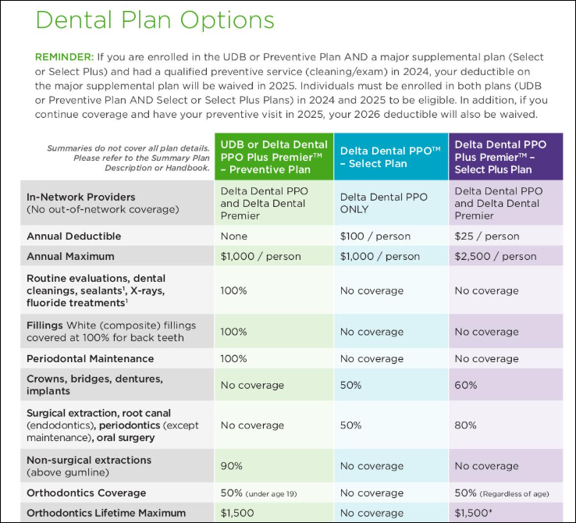
Delta
Dental
Plan Comparison

Slide 59
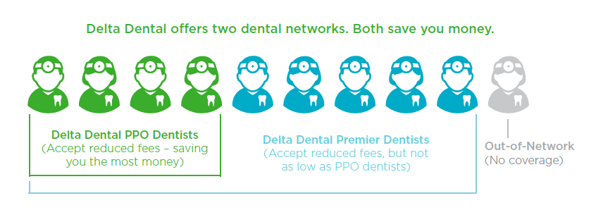
Delta dental network differences
Delta Dental PPO
  Offers significant fee reduction (lower out-of-pocket costs)
  Only network available in the Select Plan
  One of the networks available in Uniform Dental & Delta Dental PPO Select Plus Plan
Delta Dental Premier
  90% of dentists in this network but the cost savings is not as significant
  One of the networks available in Uniform Dental & Delta Dental PPO Select Plus Plan
Provider Search Page

Slide 60
Delta dental resources
Delta Dental website
2026 Delta Dental information
How Uniform/Preventive and Supplemental Dental Work Together
Benefits of Dental Insurance Video
Provider search
Additional Benefits
Evidence Based Integrative Care Plan (EBICP) – coverage for extra dental care for those who have specific medical conditions
Deductible Waiver – if enrolled in Uniform Dental or Preventive Dental AND one of the Dental Supplemental Plans AND have a qualified preventive service (cleaning/exam) in the current year, your deductible under the Supplemental Plan will be waived in the following year

Slide 61
2026 Delta Dental Monthly Premiums
Coverage level | Select (monthly) | Select (biweekly) | Select Plus (monthly) | Select Plus (biweekly) | Preventive* (monthly) | Preventive* (biweekly)
Employee | $9.08 | $4.54 | $22.24 | $11.12 | $37.18 | $18.59
Employee + Spouse | $18.16 | $9.08 | $44.52 | $22.26 | N/A | N/A
Employee + Child(ren) | $12.24 | $6.12 | $41.32 | $20.66 | N/A | N/A
Family | $21.76 | $10.88 | $68.18 | $34.09 | $92.98 | $46.49
* Preventive Plan offers the same benefits as Uniform Dental under State Group Health Insurance. Uniform Dental premium is only $4/month single or $10/month family. Do not enroll in Preventive Dental if covered by State Group Health Insurance.

Slide 62

METLIFE vision

Slide 63
METLIFE vision insurance
With your Superior Vision Preferred Provider Organization (PPO) Plan you can go to any licensed Superior vision provider and receive coverage.
Offers savings on services such as prescription sunglasses, retinal screenings and laser vision correction
Includes additional coverage for children
In-network benefits are available from Superior Vision Preferred network providers - choose from a large network of ophthalmologists, optometrists and opticians, from private practices to retailers like Costco® Optical, Walmart®, Sam’s Club®, Visionworks® , LensCrafters®, and Target Optical®. The network includes both independent and chain providers, as well as online providers. Out-of-network benefits are also available.
Resources
  Guide to Supplemental Vision Benefits
  MetLifeVision Website
  Provider Directory (scroll down and click on “Go to Site” under Find a Vision Provider)
Note: You do not need an ID card to receive services or benefits through your vision plan. Just let your provider know that your MetLife Vision Insurance is with the Superior Vision network and provide your full name and date of birth.

Slide 64
MetLIFE Vision Insurance – coverage summary

Slide 65
2026 METLIFE Vision monthly premiums
Coverage Level | Monthly | Bi-weekly
Employee | $4.72 | $2.36
Employee + Spouse | $9.40 | $4.70
Employee + Child(ren) | $10.60 | $5.30
Family | $16.94 | $8.47

Slide 66

Securian accident plan

Slide 67
Securian accident plan
Plan provides a lump sum cash payment directly to you for covered injuries, emergency and hospital care, surgery and follow-up care
  Multiple benefits available for any one accident
Includes AD&D coverage and Identity Theft Services
AD&D benefits reduced starting at age 65
Premiums taken post-tax so no taxes due on paid benefits
Can only cancel coverage due to a qualifying event
Continuation available at termination or retirement until age 70
  Premiums NOT taken from annuity – continuation directly with Securian

Slide 68
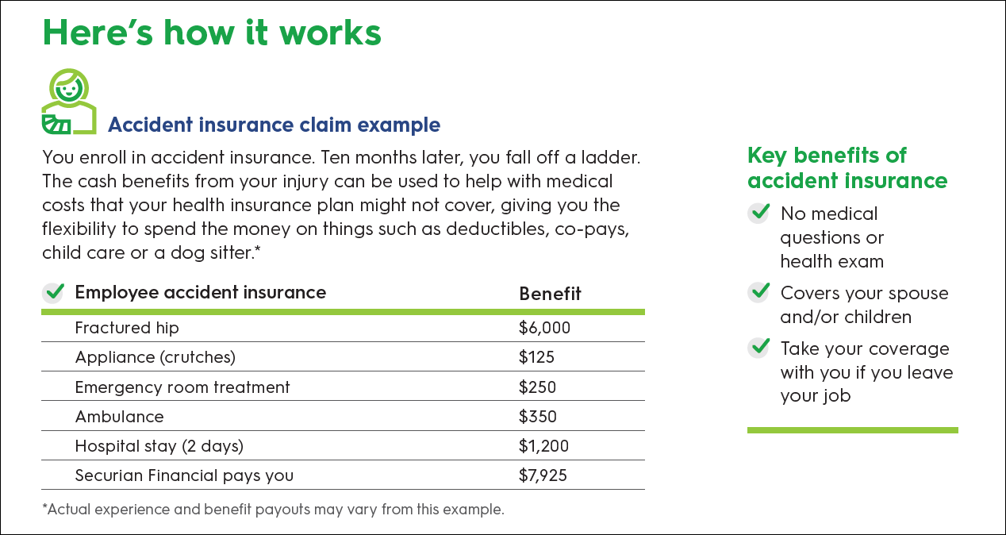
Coverage Benefit Payout Example

Slide 69
Accident Plan Resources
Plan website
Informational video
Text WIaccident to 70774 to get an electronic copy of brochure
AD&D benefits will be payable based on WRS beneficiary designation
Accident benefit summary
Plan Certificate
Identity Theft Services – General Global Assistance

Slide 70
2026 Accident Plan Premiums
Coverage Type | Monthly | Biweekly
Employee | $3.92 | $1.96
Employee + Spouse | $5.58 | $2.79
Employee + Child(ren) | $7.52 | $3.76
Family | $10.98 | $5.49

Slide 71

Beneficiary Designations

Slide 72
Beneficiary Designations
The following plans offer benefits payable upon death. To ensure that benefits are payable to the person or entity of your choosing, you should complete a beneficiary designation form.
  Wisconsin Retirement System (WRS) and State Group Life Insurance (SGL)
    The above form also applies to benefits payable under the Securian Accident Plan
  Wisconsin Deferred Compensation (WDC): The WDC allows you to designate or change your beneficiary online. Click here to log in to your WDC account and be taken directly to your My Beneficiaries page.​​
If no beneficiary designation is on file, benefits are payable per Standard Sequence
Additional information about beneficiaries can be found on ETF’s website
Remember to review/update your beneficiary forms when a life event occurs
Beneficiary information is NOT stored in the STAR Human Resources System – the information is stored with the vendor

Slide 73

Pre-tax savings plans
Healthcare flexible spending account (FSA)
Limited purpose Flexible Spending Account (LPFSA)
Dependent Day Care FSA
Pre-tax parking and Transit Accounts
Health savings Accounts (HSA)

Slide 74
Pre-tax savings plans
A variety of plans are available to allow you to set aside money on a pre-tax basis to pay for out-of-pocket medical, vision, dental and commuter expenses
Contributions made to these accounts reduce your taxable income
Referred to as Pre-Tax Savings Accounts
  Healthcare and Limited Purpose Flexible Spending Accounts (FSA)
  Dependent Day Care FSA
  Parking and Transit Accounts
  Health Savings Accounts (HSA) for High-Deductible Health Plan enrollees
All plans are administered by TASC.

Slide 75

Tasc Payment Card
You will receive a debit card to pay for eligible expenses incurred under the Pre-Tax Savings Plans
  Not available for Dependent Day Care or Transit expenses
  Includes dedicated phone number and link to employee website on back of card - 888-276-3147
  If enrolled in more than 1 plan, you use the same card for all plans
  Will receive 1 card – must request additional cards (no fee)
  Payment Card FAQ’s

Slide 76
Flexible spending accounts summary
FSA Type | Eligible Expenses | Eligible Dependents | Annual Contribution Limit for 2026 | Enrollment Restrictions
Healthcare FSA | Medical, dental, vision & prescription | You, your spouse, qualifying child or relative | Max: $3,300 | May not enroll if enrolled in an HDHP
Dependent Day Care FSA | After school care, adult or child daycare | Your spouse, qualifying child or relative | Max: $7,500 —dependent on tax filing status | No restrictions
Limited Purpose FSA | Dental, vision & post-deductible expenses | You, your spouse, qualifying child or relative | Max: $3,300 | May enroll only if also enrolled in an HDHP

Slide 77

Health care & limited purpose fsa
Used to pay for out-of-pocket health care expenses incurred by you, your spouse and qualified dependents
Minimum $50.00 required to enroll in the plan
Contribution limits are established by the IRS each year
  2026 Annual Contribution limit is $3,300
Incur health expenses between 01/01/XX – 12/31/XX
Up to $660 remaining in your Healthcare FSA/LPFSA can carry over to the following plan year. Any unspent amount over $660 will be forfeited
If enrolled in High-Deductible Health Plan, can ONLY enroll in Limited Purpose FSA
You have access to your full annual Healthcare FSA and Limited Purpose FSA election as of your plan effective date.
Once annual election is made for the year, can only make changes if there is a qualifying life event.
See the Pre-Tax Savings Accounts page for full plan details
Note: LTEs are NOT eligible to participate.

Slide 78
Sample of eligible healthcare FSA expenses
A medicine or drug (including OTC) for which you have a prescription
Insulin
Co-payments, Deductibles, and Co-insurance
Acupuncture
Bandages
Crutches
Chiropractic care
Dental Treatments
Infertility Treatments
Flu shots
Eyeglasses/exams
Menstrual Care Products
Psychotherapy, psychiatric, psychological services
See the TASC ERA brochure for a full list

Slide 79
Ineligible Healthcare FSA Medical Expenses
Items that cannot be reimbursed through Healthcare FSA
Insurance premiums
Rx drugs imported from another country
Controlled Substances that aren’t legal under federal law (e.g., marijuana)
Cosmetic Surgery
Weight-Loss programs
Maternity Clothes
Teeth Whitening services
Veterinary Fees
Personal Use Items (e.g., toothbrush, toothpaste)
Nutritional Supplements for ordinary good health
Treatment unrelated to specific health problems (e.g., massage for general well-being; chiropractic maintenance visits)

Slide 80
Eligible LPFSA Expenses (HDHP Enrollees only)
Used to pay for eligible dental, vision and post-deductible medical expenses.
Dental Expenses
Braces and orthodontia
Cleanings
Crowns
Fillings
Dentures
Copayments and deductibles
Vision Expenses
Eye exams
Prescription eyeglasses
Prescription contact lenses
Contact lens solution
Laser eye surgery / LASIK
Copayments and deductibles

Slide 81

Dependent Day care fsa
Used to pay for eligible day care expenses for your qualified dependents so you or your spouse can work, look for work, or attend school full-time
Can contribute up to $7,500 annually (Contribution limits are established by the IRS each year)
All expenses must be incurred between 01/01/XX – 12/31/XX
No carryover - unspent amounts are forfeited
You have access to your Dependent Day Care money as soon as the money is deposited into your account
Once annual election is made for the year, can only make changes if there is a qualifying event
See the Dependent Day Care page for full plan details and the Dependent Daycare Account Brochure for a breakdown on eligible costs.
Note: LTEs are NOT eligible to participate
Notes:
Talking point – this is for dependent care expenses, NOT health care expenses for your dependent

Slide 82
Eligible dependent day care expenses
If care provided enables you to work, look for work, or attend school:
Fees for licensed child daycare or adult care facilities
Before and after school care programs for dependents under age 13
Amounts paid for services (including babysitters or nursery school) provided in or outside of your home while you are at work/school
Nanny expenses attributed to dependent care
Summer Day Camp (primary purpose must be custodial not educational)
Nursery school (preschool) fees
Late pick-up fees

Slide 83
Ineligible dependent day care expenses
These items cannot be reimbursed through your Dependent Day Care account:
Expenses for non-disabled children 13 and older
Educational expenses including kindergarten or private school tuition fees
Amounts paid for food, clothing, sports lessons, field trips, and entertainment
Overnight camp expenses
Registration fees
Transportation expenses
Late payment fees
Payment for services not yet provided (payment in advance)
Medical care

Slide 84


Parking and transit accounts
Parking and Transit accounts allow you to set aside money on a pre-tax basis to pay for eligible parking and transit expenses
Minimum $50.00 required to enroll in the plan
Funds are available as soon as payroll deductions are taken
Eligible for unlimited carryover (no use it or lose it provision)
  Must have a minimum balance of $50 at the end of the plan year; balances greater than $50 will automatically rollover with no enrollment for the following plan year
Enroll or make changes at any time during the year
If you already have pre-tax payroll deductions to directly pay for a state parking lot/garage, these expenses are NOT eligible for the Parking or Transit ERA program.
See the Parking and Transit pages for full plan details
Note: LTEs are eligible to participate
Note: Employees can utilize the Commute with Enterprise option which works like a van pool. You can find more information at this link: https://www.commutewithenterprise.com/en/partners/wisconsin.html

Slide 85
Parking and transit Accounts
Parking Account
Annual Contribution Limit = $3,900 ($325/month; $162.50/biweekly)
Minimum $50.00 required to enroll
Eligible Parking Expenses include:
Parking Lots
Parking Ramps
Park and Ride Lots
Eligible parking expenses must take place at or near your place of employment, or at a location from which you commute to work
Transit Account
Annual Contribution Limit = $3,900 ($325/month; $162.50/biweekly)
Minimum $50.00 required to enroll
Eligible Transit Expenses include:
Bus
Train
Ferry
Subway
Eligible commuter expenses must be work-related

Slide 86
Health savings Accounts (HSA)
Used to set aside money on a pre-tax basis to pay for all eligible medical expenses, as well as dental and vision expenses
Must be enrolled in the state High-Deductible Health Plan (HDHP) as the subscriber to enroll
If enrolled as the subscriber of the state HDHP, you are REQUIRED to enroll in an HSA, even if you do not contribute anything yourself. Must re-enroll every year.
An HSA is a bank account that you own – funds carryover from year to year without any risk of forfeiture and go with you when you terminate employment
May contribute pre-tax payroll deductions and via online transfer from your personal bank account
You have access to your HSA money after deposits are made into your account (paycheck to paycheck)
Can change your contribution at any time

Slide 87
HSA Qualified expenses
HSA Qualified expenses include but are not limited to:
A medicine or drug which requires a prescription
Insulin
Co-payments, Deductible and Co-insurance
Acupuncture
Bandages
Crutches
Chiropractic visits
Dental Treatments
Infertility Treatments
Flu shots
Eyeglasses/exams
Menstrual Care Products
Psychotherapy, psychiatric, psychological services
See the HSA page for more details

Slide 88

Non-Qualified Expenses & HSA
If you receive an HSA distribution for reasons other than qualified medical expenses:
The amount is subject to income tax; and
May be subject to an additional 20% penalty
Learn more: www.irs.gov > Search: IRS Publication 502 and 969

Slide 89
2026 HSA Limits
 | Total Annual Employer Contribution (if covered all year) | Bi-Weekly Employer Contribution (on 1st two checks payable each month) | Total Annual Contribution Limit (Employee + Employer)
Single | $852 | $35.50/check | $4,400
Family | $1,704 | $71.00/check | $8,750
Catch-Up (age 55 or older) |  |  | $1,000
Receive half the employer contribution if you pay the less than half time rates for health insurance
Receive no employer contribution if you are not eligible for the employer contribution towards health insurance

Slide 90

Growth of hsa account
Interest
  Funds earn interest over time
  Once balance reaches $1,000, you may invest funds above that level in a variety of HSA investment options
See the HSA page on the TASC Financial website for more information about available investment options

Slide 91

Other benefits
Wisconsin Deferred compensation – 457(b) Plan
Long Term Care Insurance
Employee assistance program (EAP)
Edvest

Slide 92

Wisconsin Deferred Compensation (WDC) – IRS 457(b) Plan
Voluntary supplemental retirement savings program (no employer contribution)
Contributions can be taken on a pre-tax or post-tax (Roth) basis
Contribute flat dollar amount or % of earnings
Can enroll in, change contribution or stop deductions at any time
Can rollover eligible funds into WDC account
Variety of investment options available
Annual contribution limits (2026)
  If under age 50: $24,500
  If age 50 or older anytime during the year: $32,500
  If age 60-63, super catch-up limit: $11,250 (Total Annual Limit max = $35,750)
  If within 3 years of retirement and you apply for catch-up with WDC: $49,000

Slide 93

WISCONSIN DEFERRED COMPENSATION (Wdc)
Enroll and make changes directly with Wisconsin Deferred Compensation or call 1-877-457-9327 (will need enrollment code from agency prior to initial enrollment)
Administered by Empower Retirement
Resources
  WDC Fact Sheet
  Program Highlights
  Investment Information
  Program Resources
  Wellness and Financial Resource Center

Slide 94
Wisconsin Deferred Compensation (WDC)
Monthly fee based on total account balance
Used to cover cost of WDC recordkeeping and related plan services.
Participant Account Balance | 2026 Monthly Fee | Annual Fee
$0.00 to $5,000.00 | $0.00 | $0.00
$5,001 and over | $3.90 | $46.80

Slide 95
Long Term Care Insurance
Enrollment info:
HealthChoice offers enrollment throughout the year
Available to employees, retirees, their spouses and parents of employees, retirees, and spouses who reside in WI.
Coverage acceptance is not guaranteed. Applicants are subject to medical underwriting.
No employer contribution
Long-term care can include a variety of medical and supportive services. It can be provided in a variety of settings including nursing homes, at home, adult day care or group living arrangement.
Additional information is available on ETF’s website: https://etf.wi.gov/long-term-care-insurance
View the Consumer’s Guide to Long-Term Care by the Office of the Commissioner of Insurance
Mutual of Omaha offers a long-term care insurance plan through HealthChoice.
Employees should discuss rates and benefit questions directly with HealthChoice.
Health Choice website: https://healthchoice.com/
Phone: 800-833-5823

Slide 96
Employee Assistance Program (EAP) Partnership with Acentra Health
Can access a vast amount of information regarding Acentra Health and their services on their website at https://sowi.mylifeexpert.com
  All users will be required to create an account at first log in
  To receive the company code please contact doaeapprogram@wisconsin.gov.
May contact Acentra Health 24/7 by phone at 833-539-7285 or 877-334-0489 (TTY)
Confidential, voluntary program to assist you and your family who may be experiencing personal and work-related issues, including:
  Work-life stress
  Anxiety, depression or other mood disorders
  Relationship or other family problems, including divorce and abuse
  Substance abuse
  Parenting/caregiver support
  Legal & financial guidance
  Convenience services

Slide 97

Wisconsin’s official 529 College Savings Program
Edvest funds may be used nationwide at universities, colleges, technical colleges, professional schools and graduate programs
Funds used for tuition, fees, housing, computers and more
Earnings have potential to grow tax-free
Wisconsin residents may be eligible for a state tax deduction (limitations apply)
Can contribute via direct deposit payroll deduction
$15/pay period minimum contribution
Get started today!
Download enrollment form
Once account established, set up your payroll direct deposit through STAR (instructions)
See an introductory video for more information
Verify form received by Edvest (contact Edvest at 1-888-338-3789)

Slide 98

Canceling your benefits
Once enrolled, when and how can you cancel coverage

Slide 99
Cancelation rules (if no qualifying event)
Can Cancel Coverage at Any Time | Cancel During Open Enrollment (cancelation effective January 1st) | Must Re-Enroll Every Year (coverage ends if no election made during Open Enrollment)
Health Insurance (if premiums taken post-tax) | Health Insurance (if premiums taken pre-tax) | Health Savings Account
State Group Life | MetLife Vision | Healthcare FSA & Limited Purpose FSA
Income Continuation Insurance | Delta Dental Preventive & Supplemental Plans | Dependent Day Care FSA
Parking/Transit Accounts | Securian Accident Plan | Parking/Transit Accounts
Wisconsin Deferred Compensation |  | Health Insurance Opt-Out Stipend
Once enrolled in a plan, there are limited opportunities during the year to cancel coverage if you do not have a qualifying event. To the right is a chart of when you can cancel coverage OUTSIDE of a qualifying event.

Slide 100

Employee self service
STAR Peoplesoft system

Slide 101
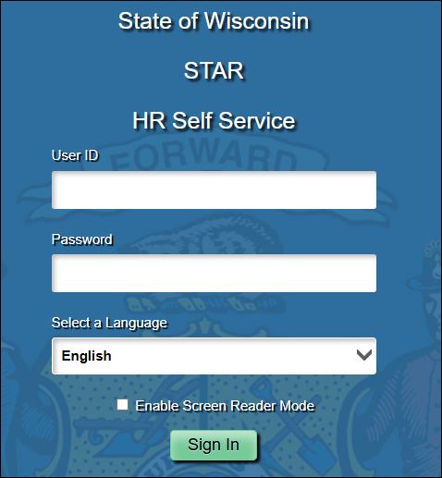
Employee self service
Employees enter payroll, timesheet, absence, and benefit information online through the State of Wisconsin STAR Human Resources System (https://ess.wi.gov)
Available on all internet-enabled devices

Slide 102
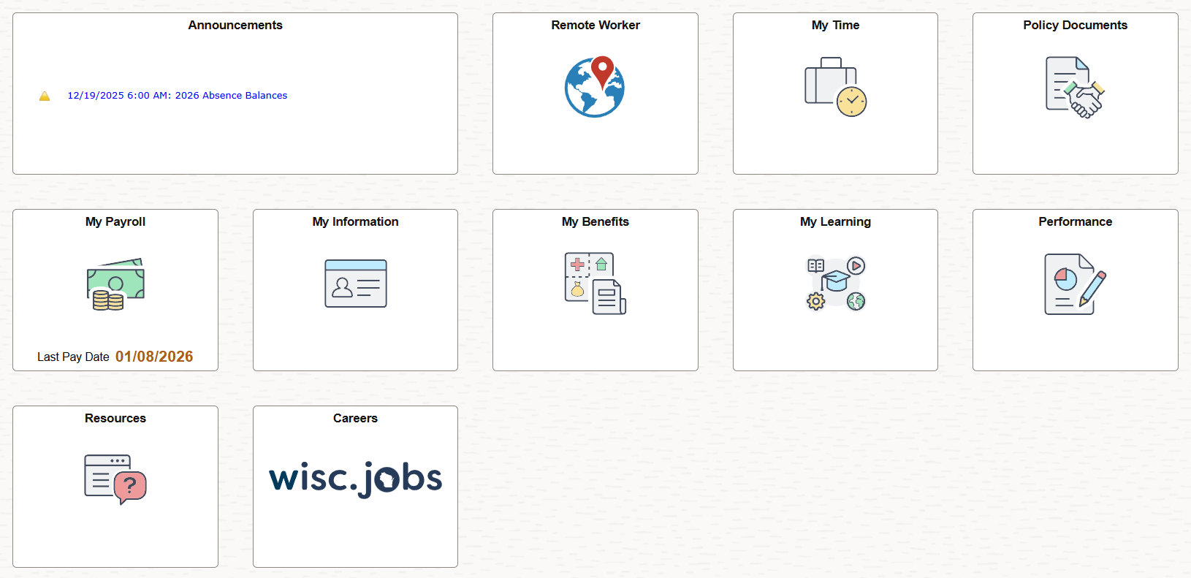
Employee self-service
Employee self-service available at: https://ess.wi.gov

Slide 103
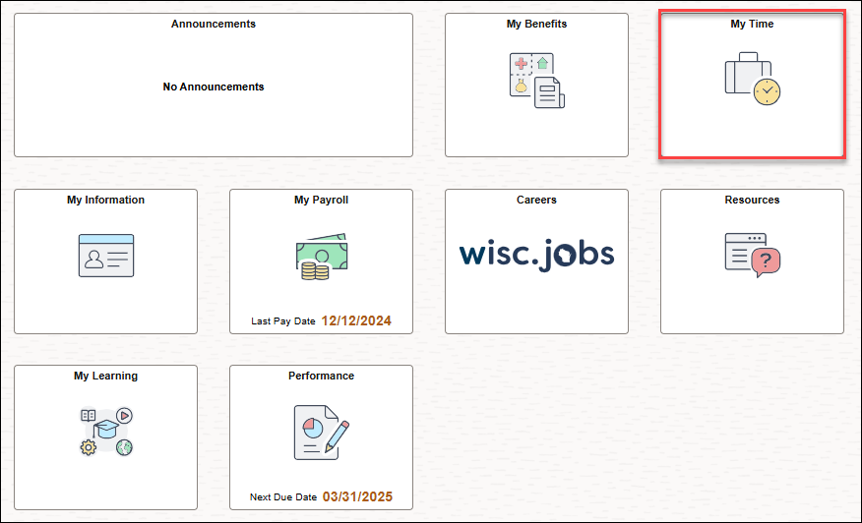
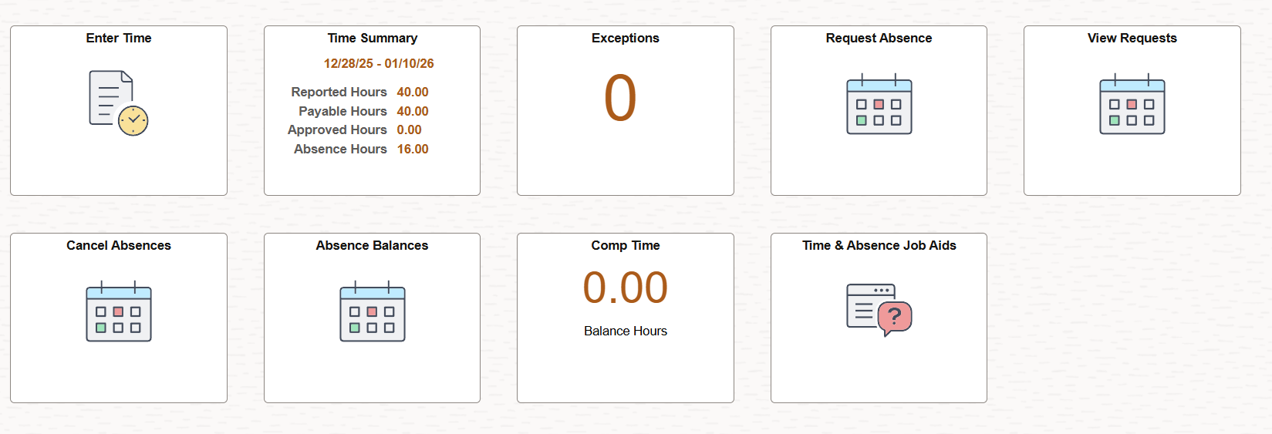
Access self service pages through tiles
Click on a Tile to see what is available within the Tile’s Navigation Collection.
Can manage all self-service functions through Employee Self Service Homepage.

Slide 104
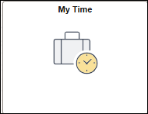
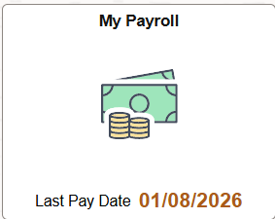
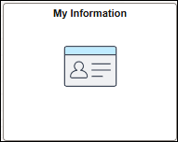
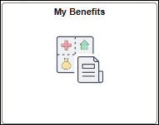
Employee self service Tile summary
My Time
Enter timesheet
Enter and review absence info
My Payroll
View paycheck and W-2s
Update direct deposit and tax withholding
My Information
Update address, phone numbers, emergency contacts and demographic info
Set Emergency Notification System (RAVE) preferences
Enter COVID vaccine and test information
My Benefits
Enroll in Benefits
Review benefit and dependent info
View 1095-C tax form
View open enrollment confirmation statement

Slide 105



Employee self service Tile summary, continued
Resources
Direct links to job aids, benefit forms, payroll information, Wellness Resources and more…
My Learning
Leader – Learning Management System
Employee development and education
Careers
Job openings available throughout the State of Wisconsin

Slide 106
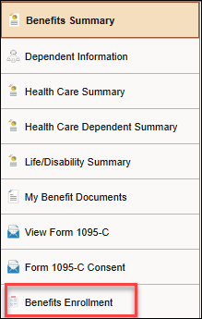

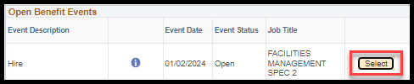
ebenefits
You should make your new hire benefit elections through eBenefits
Click on the My Benefits Tile on Employee Self Service Homepage
Then click on the Benefits Enrollment page in the My Benefits Navigation Collection
eBenefits will open to you - click on the Select button to start the enrollment process

Slide 107
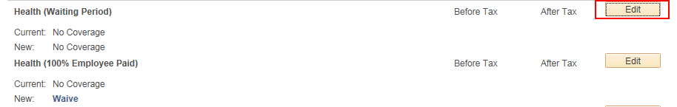
ebenefits
Click the Edit button next to the plan in which you want to enroll
  Note – must either enroll in or waive State Group Health Insurance, State Group Life Insurance (all levels) and Income Continuation Insurance
See the eBenefits Quick guide for step-by-step instructions

Slide 108
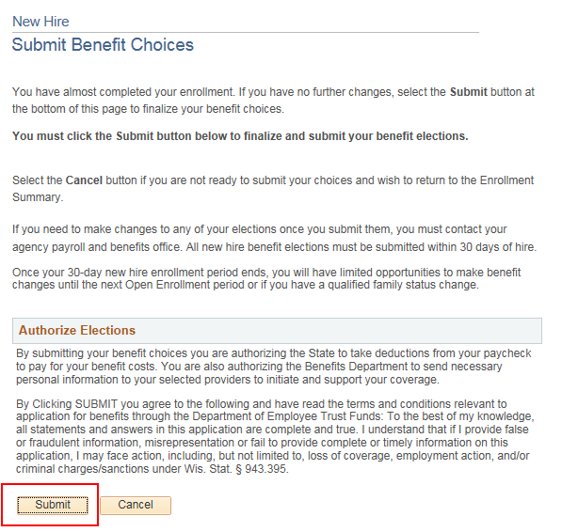
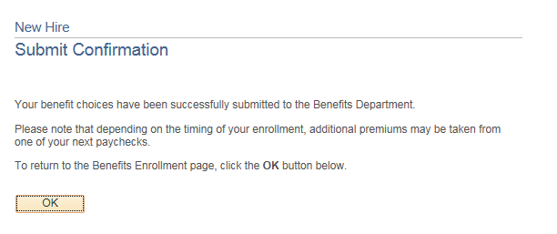
ebenefits
Always remember to submit your elections when complete
You know your elections are submitted when you see this screen

Slide 109

Ebenefits tips
Review all relevant benefit information and know the elections you are going to make before you begin
Make sure you have the legal name, date of birth and Social Security Numbers of all family members who will be covered
Do NOT add yourself as a dependent
If you make a mistake entering information about a dependent
  Do not add the same dependent more than once to try to fix the information. Contact your payroll and benefits office to make the correction.
You can save your elections and come back later BUT you must click the final Submit button to finalize your elections within 30 days of your hire

Slide 110
Employee self-service checklist
Click on the links below to see job aids about the process
Review and update your address
  Go to My Information Tile > Addresses
Set up Direct Deposit
  Go to My Payroll Tile > Direct Deposit
  First paycheck(s) is a paper check for new State Employees
Set up tax withholding
  Go to My Payroll Tile > Tax Withholding
  Taxes withheld at single and zero if you do nothing
Enter Emergency Contact information
  Go to My Information Tile > Emergency Contacts
Record time on your timesheet
  Go to My Time Tile > Enter Time
  If an exception reporter, do not record time (applies to very small number of employees)
Submit elections through eBenefits
  Go to My Benefits > Benefits Enrollment
View your earning statement
  Go to My Payroll > Paychecks
Sign up for Emergency Notifications
  Go to My Information > Emergency Notification System (RAVE)
Notes:
Talking point: Reminder – ESS can be accessed from any computer, tablet, phone or internet-enabled device

Slide 111

Contact/resource information
For any questions, please contact your agency Payroll & Benefits office
For additional State of WI employee resource information, please go to Employee Trust Funds website
For additional employee resource information, please go to the Employees Tab on the Division of Personnel Management website
See the Forms & Brochures page for applications, brochures, beneficiary designations and more

