Slide 1
Open Enrollment Training
September 20th, 2022

Slide 2
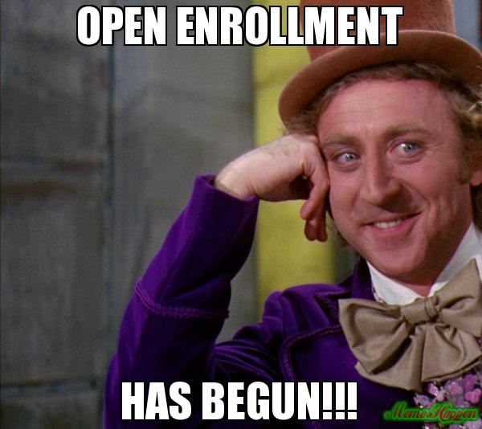
Agenda
Getting Ready for OE
Name/Data Errors and Change Process
Open Enrollment Timeline
2023 Benefit Information
Week Leading Up to OE
Technical/System Updates for 2023
Event Processing During OE
eBenefits
Confirmation Statement
OE Communications
Agency Resources
Employee Resources
OE Challenges
Next Steps

Slide 3
Getting Ready for OE
Pre-OE agency Checklist

Slide 4
Pre-OE Agency Checklist
Send Pre-OE Announcement Emails to employees by 09-21-2022
On 09/20/2022 (evening), IYC BAS Group ID added to all active employees who are NOT in the DEF benefit program (only added to DEF if employee currently enrolled in Pre-Tax-Savings plan) after 5pm
As of 09/20/2022, agencies must no longer change primary job flag- create a ticket and Central Benefits will move the flag and IYC code (in effect through the end of the year)
Run WRS Lookback on Mondays following payroll confirmation
Run WI_BN_OPEN_EVENTS with a schedule ID of EM2017 to manage events daily
Benefit Administration will also run at noon on 09/21-09/23 to help events move more quickly through the system
Create a ticket if you have an employee in the DEF benefit program who wants to enroll in Pre-Tax Savings Accounts during OE
.

Slide 5
Pre-OE Agency Checklist
Complete the following by 09/21/22
Enter all life event applications as received
Finalize all open termination events (TER, RET, TRA, TWB)
Finalize all events that need no entry
Encourage new hires to complete elections ASAP ( OE event won't open until HIR and SHR (if applicable) entry is done
Complete entry on all open SHR events
For LTEs enrolling in health or OOS at 6 months –Manually create/enter SHR events through 12/31/2022
Process all AGE events with an event date of 12/31/2022 or earlier

Slide 6
Open Enrollment Timeline

Slide 7
Open Enrollment Timeline (subject to change)
Sept 19th:
Run PP19 WRS Lookback Report + do all associated processing
Finalize as many open events as possible (TER, RET, TRA, LOA, RFL....)
Sept 20th:
OE Training for agencies, 10:30am–12:30pm
Agencies can start sending pre-OE email to employees
11/5-11/12 SHR events open for entry (enter as soon as HIR elections finalized)
(After 5pm) IYC BAS Group ID added to all active employees who are NOT in the DEF benefit program (only added to DEF if employee currently enrolled in ERA plan)
Once IYC code is on job, agencies must no longer change primary job flag – create a ticket and Central Benefits will move the flag and IYC code (in effect through the end of the year)

Slide 8
Open Enrollment Timeline (subject to change)
Sept 21st:
Deadline to process all AGE events with an event date of 12-31-22 or earlier (Run WI_BN_OVERAGE_DEPEND_RPT with an as of date of 12-31-22)
Deadline to process all SHR events by the agencies
Ben Admin Runs at Noon and 5pm
All 2023 benefit configuration in Production (tentative)
Sept 22nd:
Employee message will be sent to current WEA Trust, HealthPartners, GHC-Eau Claire and Dean Prevea360 enrollees (late in Day)
Central Benefits will finish outstanding AGE and SHR event entry – before noon
Ben Admin runs at Noon and 5pm

Slide 9
Open Enrollment Timeline (subject to change)
Sept 23rd (Friday):
Ben Admin runs at Noon and 5pm
All users, except core central staff, will be locked out of HCM starting at 5pm until notified (likely mid-day on September 24th if no issues encountered)
IYC code added to any newly active employees (since process last run)
Run process to create ~ approx. 32,000 OE events
Run all baseline audits and queries
Sept 24th:
Central Benefits and HCM benefits review to ensure OE events prepared correctly
System back open to users sometime mid-day

Slide 10
Open Enrollment Timeline (subject to change)
Sept 25th: Main OE email sent via Employee Messaging (Morning)
Sept 26th (Monday):
Start of OE period
eBenefits open to employees at midnight
Oct 3rd: run PP20 WRS Lookback Report + do all associated processing
Oct 6th:
11/13-11/26 SHR events open for entry
Do not use OE event in place of SHR event for January coverage
Oct 14th: 11/27-12/10 SHR events open for entry
Oct 17th: run PP21 WRS Lookback Report + do all associated processing
Oct 19th: 12/11-12/23 SHR events open for entry

Slide 11
Open Enrollment Timeline (subject to change)
Oct 21st: Last day of OE..... thousands of employees likely making their elections
Last day to cancel/waive benefits for 2023
eBN closes at 11:59pm
Oct 24th – Oct 25th: OE event still open to agencies to enter paper apps received on or before 10/21(final date subject to change)
Oct 31st: Run PP22 WRS lookback Report + do all associated processing
Nov 2nd: 1st OE health elections file sent to ETF
Nov 4th: 12/24-1/1/23 SHR events open for entry
Nov 9th: 2nd OE health elections file sent to ETF (updates since 11/2 file)
Nov 11th: 3rd OE health elections file sent to ETF (updates since 11/9 file)
Last day to submit OE health elections to ETF (5pm)
Nov 18th: 1st OE enrollment file sent to OPTUM Financial
Nov 28th: List of OOS enrollees sent to ETF for validation

Slide 12
Open Enrollment Timeline (subject to change)
Dec 2nd:
OE file sent to DeltaVision
2nd OE enrollment file sent to OPTUM Financial
Dec 4th: 1st day of 2022 Pay Period 26 (C pay period)
Dec 7th: OE file sent to DeltaDental (includes Supplemental Dental and Preventive Dental)
Dec 18th: 1st day of 2023 Pay Period 1
Dec 21st: Submit OE elections to Securian for Accident plan
Jan 12th: first check payable in 2023 and 1st premiums for 2023 taken
Early January:
Central Benefits will begin health compare with ETF’s system
Re-send OOS list to ETF for Validation (in case of changes)

Slide 13
Daily Processes during Open Enrollment
Once open enrollment begins, OE elections will be finalized every night (7 days/week). This process will begin at 8pm.
Confirmation statements and emails will also be generated at this time. If OE election submitted after 8pm, there will be a one-day delay for the confirmation statement.
During the last few days of OE, we’ll finalize the events several times during the day, but confirmation statements will only be generated once.
On the last day of OE, we’ll finalize the events every few hours and then more frequently as midnight approaches.

Slide 14
2023 Benefit Information

Slide 15
Action that can be taken during Open Enrollment
 | Enroll | Add or Remove Dependents | Change Plans | Cancel Coverage
Health* | X | X | X | X
Delta Dental PPO – Supplemental Plan | X | X | X | X
Delta Dental PPO – Preventive Plan | X | X | N/A | X
Deltavision | X | X | N/A | X
Accidental Plan | X | X - change coverage level | N/A | X
Healthcare FSA or LPFSA | Must re-enroll every year Coverage will automatically end if no 2023 enrollment
Dependent Day Care FSA
Pre-Tax Parking & Transit Accounts
Health Savings Account | Must re-enroll every year Enrollment will end if employee doesn't elect High Deductible Health Plan (HDHP) but employee's HSA account remains active
Health Insurance Opt-Out Stipend | Must re-enroll every year Must certify that eligibility requirement are met on an annual basis
* Can also enroll in or cancel Uniform Dental Benefits

Slide 16
2023 Plan Changes
See ETF’s Important Changes for 2023 Page
WEA Trust leaving State of Wisconsin Health Program effective 1/1/2023.
Was plan administrator for all WEA plans, Access Plan, State Maintenance Plan (SMP).
WEA Trust East, WEA Trust West - Mayo and WEA Trust West - Chippewa Valley members must select a new health plan for 2023
Dean Health is new administrator for Access Plan and State Maintenance Plan (SMP)
Employees enrolled in the Access Plan or SMP do not need to take action during OE unless they’re changing health plans
Health Plan Service Area Changes/Expansions
Dean – Prevea360 is now Dean – Prevea360 East and West
GHC – EC has changed to Greater WI & River Region; partnered with Common Ground
HealthPartners is now HealthPartners West and Southeast
Security Health has returned to the State of Wisconsin Health Program for 2023
ERA Changes
Must contribute a minimum of $50 for Health Care FSA, LPFSA, Parking and Transit Accounts
After 2023, $50 minimum carryover account balance (if an employee does not re-enroll for next plan year)

Slide 17
2023 Plan Changes
Medical Benefit Changes
Health plan may waive prior authorization for remote patient monitoring when appropriate
Patient's immediate family can meet separately for behavioral therapy
Mental health
Substance use disorder treatment plan
Pharmacy Benefit Changes
New specialty drug program (clear bagging) added through UW Specialty Pharmacy
Only for non-Medicare members receiving care within UW Health System
Limited to certain non-oncology specialty drugs (level 4)
Provider dispenses drug and transports to location administered
Can lower costs and does not impact how members receive specialty drugs
May result in two bills
Members should contact their drug administrator for more information
Securian Accident Plan
Cash payment amounts for most claims will increase.
New benefits for 2023 include surgical anesthesia, joint replacement, and modifications to home or vehicle

Slide 18
2023 Health Insurance Premiums

Slide 19
2023 Health Insurance Premiums (Non-HDHP)
Plan | Single (monthly) | Single (biweekly) | Family (monthly) | Family (biweekly)
IYC Plan with Dental | $104.00 | $52.00 | $257.00 | $128.50
IYC Plan without Dental | $100.00 | $50.00 | $248.00 | $124.00
Access with Dental | $245.00 | $122.50 | $608.00 | $304.00
Access without Dental | $241.00 | $120.50 | $599.00 | $299.50
Access with Dental (required to work out of state) | $158.00 | $79.00 | $396.00 | $198.00
Access without Dental (required to work out of state | $154.00 | $77.00 | $387.00 | $193.50

Slide 20
2023 Health Insurance Premiums (HDHP)
Plan | Single (monthly) | Single (biweekly) | Family (monthly) | Family (biweekly)
HDHP with Dental | $39.00 | $19.50 | $96.00 | $48.00
HDHP without Dental | $35.00 | $17.50 | $87.00 | $43.50
HDHP Access with Dental | $180.00 | $90.00 | $447.00 | $223.50
HDHP Access without Dental | $176.00 | $88.00 | $438.00 | $219.00
HDHP Access with Dental (required to work out of state) | $93.00 | $46.50 | $235.00 | $117.50
HDHP Access without Dental (required to work out of state | $89.00 | $44.50 | $226.00 | $113.00

Slide 21
Supplemental Plans
Vision, Dental, Accident Plan

Slide 22
DeltaVision No change from 2022
2023 DeltaVision Premiums
Coverage Level | DeltaVision (monthly) | DeltaVision (biweekly)
Employee | $5.72 | $2.86
Employee + Spouse | $11.42 | $5.71
Employee + Child(ren) | $12.88 | $6.44
Family | $20.58 | $10.29

Slide 23
Delta Dental Premiums No change from 2022
2023 Monthly Dental Premiums
Coverage Level | Select Plan | Select Plus Plan | Preventive
Employee | $9.76 | $20.98 | $34.72
Employee + Spouse | $19.52 | $41.96 | N/A
Employee + Child(ren) | $13.16 | $38.96 | N/A
Family | $23.40 | $64.28 | $86.80

Slide 24
Securian Accident Plan No change from 2022
2023 Accident Plan Premiums
Coverage Level | Accident Plan (monthly) | Accident Plan (biweekly)
Employee | $4.38 | $2.19
Employee + Spouse | $6.26 | $3.13
Employee + Child(ren) | $8.44 | $4.22
Family | $12.32 | $6.16

Slide 25
HSA/FSA Limits

Slide 26
HSA Limits
Increase in total HSA annual contributions maximum
No Change to HSA annual employer contributions
Single =$750
Family = $1,500
Prorated if required to pay < ½ time rates or coverage effective after January 1st
 | 2022 | 2023 | Change
Single | $3,650 | $3,850 | + $200
Family | $7,300 | $7,750 | + $450
Catch-Up (age 55 or older) | $1,000 | $1,000 | No Change

Slide 27
Pre-Tax Savings Account Limits
 | 2022 | 2023 | Change
Healthcare and Limited Purpose FSA *Up to $570 may be rolled over from 2022 to 2023 | $2,750 | Min: $50 Max: $2,850 | + $100
Dependent Day Care FSA *No funds may be rolled over from 2022 to 2023 | $5,000 | $5,000 | No change
Parking & Transit Account *All unused funds roll over from 2022 to 2023 | $270 | $280 | + $10
2023 FSA limits have not been released by IRS
If there is a significant change to limits for 2023, ETF will determine if the limits will be changed under state plan
New for 2023:
Minimum $50 contribution for FSA plans for 2023; excludes Dep Care and HSA plans

Slide 28
Well Wisconsin (powered by Web MD)
What's New for 2023

Slide 29
Important Dates – Well Wisconsin
Timeline:
10-14-2022
Mid-November
January 2023
Beginning of February
Incentive deadline for 2022
Employers start submitting requests for 2023 onsite health screenings
Home Mailers highlighting 2023 program
Onsite health screening events begin
2023 Incentive Deadline = October 13, 2023

Slide 30
2023 Well Wisconsin Incentive Overview
Earn $150 incentive by completing 3 activities:
Health assessment
Health check
One well-being activity
Incentive Deadline: October 13,2023
Well Wisconsin
webmdhealth.com/wellwisconsin
WebMD 1-800-821-6591

Slide 31
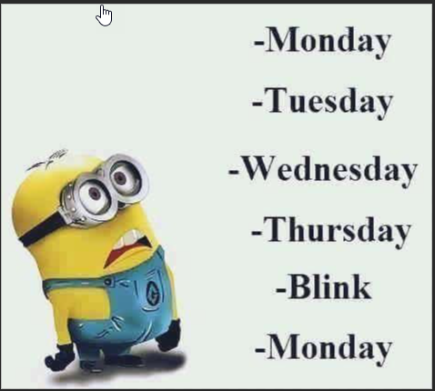
The Week leading Up to OE
Keep Calm one more week

Slide 32
BAS Group ID
Tuesday (09-20-22), a process will run to tag an employee's job record with a BAS group ID of "IYC"
The BAS group ID is on the Benefit Administration page in Job Data
Any employee who has this tag, will have an OE event created
All active employees who are NOT in the DEF program will get an IYC code
Exception: If in DEF and enrolled in Pre-Tax Savings Plan for current year, will get IYC code
Multiple jobs – will only be added to benefit primary (this is why you can't change the benefit primary flag)
Note: You may see DUP or NON listed in the BAS Group ID Field. These People either have multiple benefit records or several active employee instances. These codes are added to make sure that only 1 OE event prepares for the person.
Multiple benefit records will be added to the lowest numbered eligible job row

Slide 33
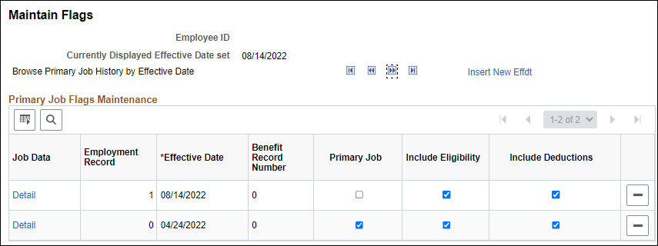
BAS Group ID – Multiple Jobs – Benefit Primary Flag
Employees who have multiple jobs have a benefit primary flag
Once the IYC code is put on Job on 09-20-22, agencies must not change the benefit flag
If there is no IYC code on the benefits primary job, the OE event will disconnect in the system and the employee won't be able to make their OE elections
From 09-20-22 until early 2023 (date TBD), agency must submit a ticket if the benefit flag needs to be moved

Slide 34
BAS Group ID
If there are new hires during the Open Enrollment Period, there will be a process ran each night to put the BAS Group ID on the job and create the OE event
Anyone who moved from DEF to a non-DEF benefit program during this time will also get an IYC
Never Delete the value in the BAS Group ID field
Never enter a value in the BAS Group ID field
Remember to tell your HR staff this
If the BAS Group ID is NOT on the top of stack job row on the employee's benefit primary job, the OE event will disconnect from the job record and shut down to the employee
This process will be run throughout the OE period
Last day the process will be run -TBD

Slide 35
70Y Events
Central Benefits will generate and process all 70Y events through the end of the year
Reason – the OE event will term coverage under life and ICI on the wrong date if someone turns 70 between now and the end of the year
Consequence – you may see 70Y events on the BAS Activity Table for the rest of the year – ignore them. Central Benefits will monitor and manage

Slide 36
Technical/System Updates for 2023
Impact of December C Pay Period
Updates to Preventive Dental Certificate
Annual Updates to OOS Certificate

Slide 37
Impact of December C Pay Period
Typically, all the benefit event rules in the system set the Deduction Begin Date of an enrollment on the pay period prior to the coverage effective date. If this happens to be a C pay period (when no benefits deductions are taken), deductions begin on the next A pay period.
The 2022 December C pay period requires the adjustment of some of the deduction begin dates associated with Open Enrollment.

Slide 38
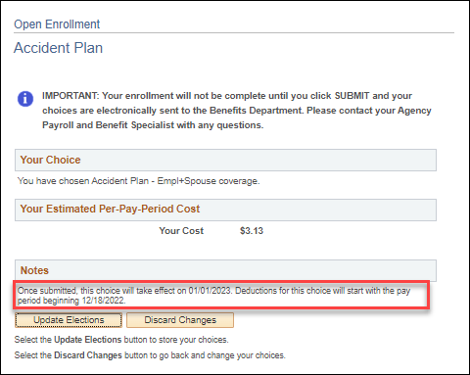
Impact of December C Pay Period – Health, Dental, Vision, Accident Plan, OOS Deduction Begin Date
The deduction begin date of the enrollment (or waive) will be 12-18-22 (12-1-22 for LEG). No deductions will be taken in the 2022 PP26-deductions will begin in 2023 PP1.
Note for LEG: the image applies to non-LEG agencies only. LEG agencies will have a deduction begin date of 12-1-22 for these plans.

Slide 39
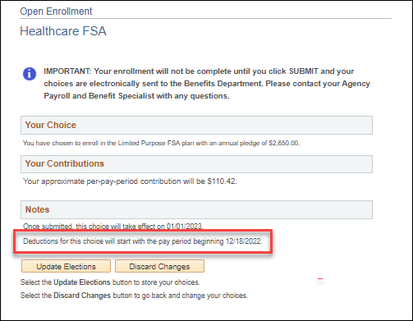
Impact of December C Pay Period – Pre-Tax Saving Account
The deduction begin date of the enrollment (or waive/term will be 12-18-22 (first day of the 2023 PP1).
This date had to be updated because the 2022 PP26 is in the 2022 Plan Year and the deduction begin date must coincide with the pay period start date of the 1st pay period payable in 2023.
Note for LEG: Initially the deduction begin date for these plans will be set to 1-1-23. After Open Enrollment, Central Benefits will manage the process to update the deduction begin dates to 12-1-22.

Slide 40
Preventive Dental Certificate
The Delta Dental PPO- Preventive Plan is only available to employees who are not covered by State Group Health Insurance as either an employee or dependent, regardless of whether they are enrolled in Uniform Dental. This plan has the same benefits as Uniform Dental, but the employee must pay the full cost (no employer contribution).
Anyone who is enrolling needs to answer a question to confirm they will not have State Group health Coverage – had to add a question for those who want to waive coverage during Open Enrollment.

Slide 41
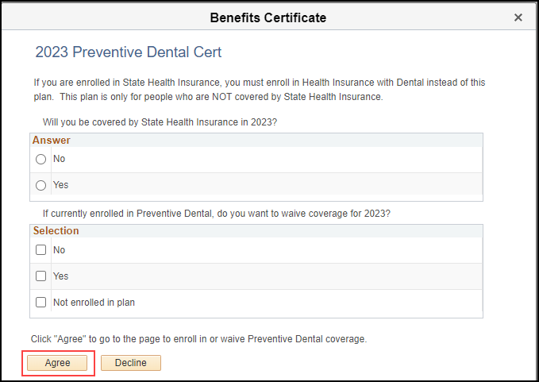
Preventive Dental Certificate
Must enter "No" to the first question or "Yes" to the second question to access the enrollment page

Slide 42
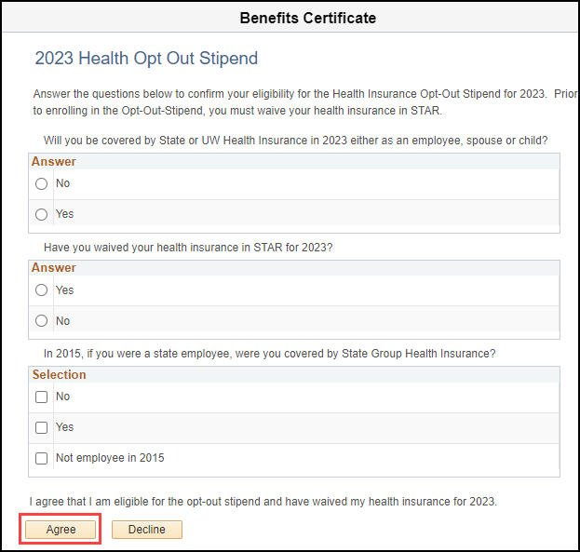
Annual Update to OOS Certificate
As a reminder, employees must complete an OOS certificate every year during open enrollment

Slide 43
OOS Reminders
Continuing the tradition, during OE employees will apply for OOS through eBN
Reminder – new hires must apply for stipend via paper health application and agency should enter on either SHR or OOS event
Never enter OOS directly in Additional Pay
Employees will be enrolled in the Opt-Out Stipend Simple Benefit Plan
Enrollment in the OOS simple benefit plan creates the Additional Pay OOS entry
When an employee terminates, the OOS plan Enrollment and the OOS Additional Pay election will end when the TER/RET/TRA/TEB event is finalized
For detailed information about how the OOS Flow through the system, see the Open Enrollment Administrator Job Aid
Notes:
Confirm job aid is up to date/check link

Slide 44
OOS Eligibility Validations
The following OOS eligibility validation will be done by Central Benefits:
Confirm employee is not enrolled in both health insurance and OOS
Look for employees who were enrolled in 2022 but not in 2023 (and didn't enroll in health for 2023)
Will monitor OOS elections effective in the last quarter of 2022 to ensure they are notified of requirement to re-apply for 2023
The list of open enrollment enrollees will be sent to ETF twice (in November and January). ETF will validate that the employee is not a covered dependent under the state health plan and confirm the employee is not on the list of people who are ineligible because they didn't carry health insurance in 2015 as an active state employee.
A monthly file is also sent year-round to ETF to validate new enrollments

Slide 45
eBenefits

Slide 46
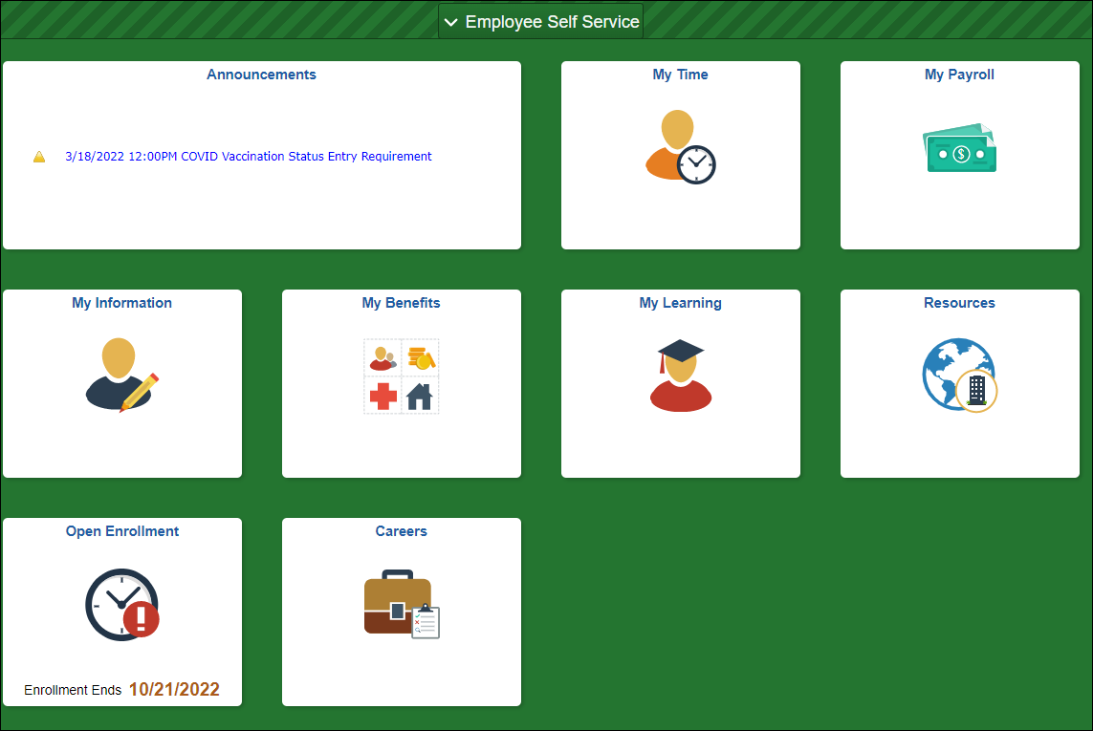
eBenefits
Employees will click on Open Enrollment Tile to access eBenefits

Slide 47
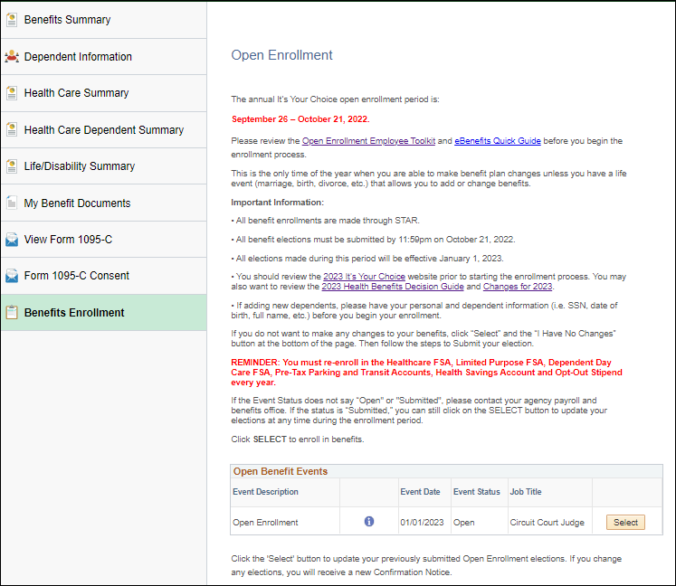
eBenefits
Open Enrollment Tile contains direct access to eBenefits.

Slide 48
eBenefits
If an employee is enrolled in the following health plans, they will see “ no coverage” listed under the “new” health plan. These employees are required to choose a new health plan for 2023.
WEA Trust East, WEA Trust West – Chippewa Valley, WEA Trust West – Mayo
Dean Prevea360
HealthPartners
GHC-Eau Claire

Slide 49
eBenefits Demo

Slide 50
OE Confirmation Statement
Online Benefit File

Slide 51
Confirmation Statement & Employee Email
Once the employee submits OE Elections

Slide 52
Confirmation Statement & Employee Email
Once employee submits OE election.....
Employee submits OE elections
OE event is finalized around 8pm
Employee receives email that confirmation statement available
Confirmation statement loads to B-File
If employee submits a new OE election, employee will receive an updated confirmation statement, but historical confirmation statement will be saved
If employee submits OE election after 8pm, there will be a one-day delay in receiving the confirmation statement.

Slide 53
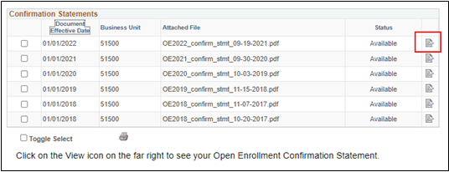
Confirmation Statement Views
All confirmation statements for OE2018-OE2023 will be available online. The most recent confirmation statement will be at the top of the page

Slide 54
Confirmation Statement Notification Email

Slide 55
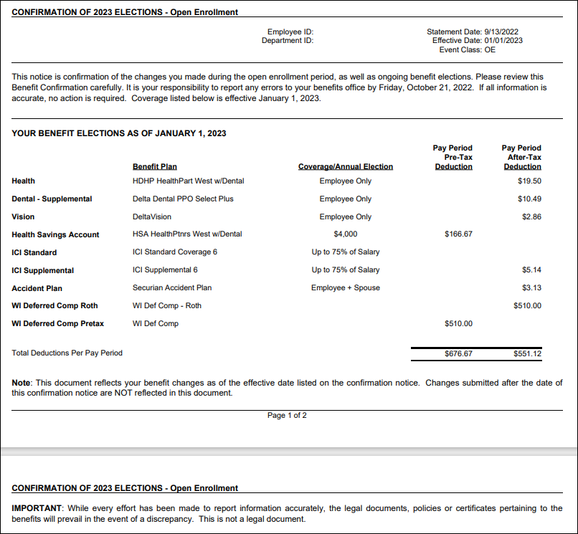
Confirmation Statement Example

Slide 56
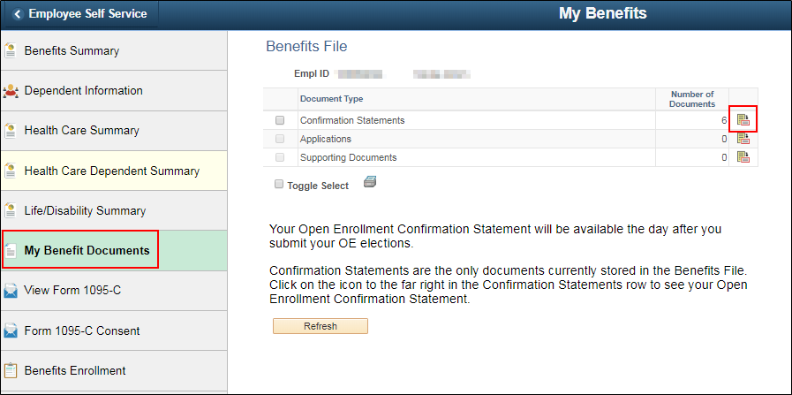
How Employees Access Confirmation Statement
Confirmation statement in online benefits file
ESS Landing Page – My Benefits Tile – My Benefit Documents

Slide 57
How Employees Access Confirmation Statement
Will be brought to Confirmation Statements
OE2018-OE2023 Confirmation Statements will be visible on this page

Slide 58
Agency Access to Confirmation Statements
Agencies can access an individual confirmation statement
Go to Benefit Administration Dashboard- Benefit Enrollment Tile – Review Employee Benefit Folder – Employee Benefit Documents
Agencies can also access all confirmation statements for their agency
Go to the Navigator and go to – State of Wisconsin (STAR) - Benefits Administration - Process – Print Confirmation Statements
For full details, see the OE Administrator Job Aid
Notes:
Update hyperlink

Slide 59
Event Processing during OE

Slide 60
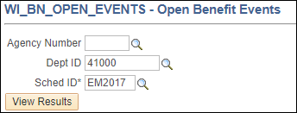
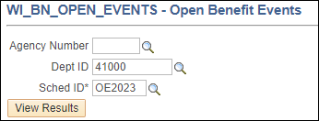
Identifying OE Events
All OE events not in Finalized – Enrolled status will be on the Open Event Query
WI_BN_OPEN_EVENTS
Enter Schedule ID "OE2023" to see OE events
Enter Schedule ID "EM2017" to see non-OE event

Slide 61
Importance of Event Order
Why are we trying to get all the 2022 benefit events finalized before we create the OE event?
Every benefit event that is created pulls in all benefit information from the prior event
Benefit events must be processed in event date order to ensure benefits flow correctly through the system
Since the OE event has an event date of 1-1-23, we're trying to get all events with a 2022 event date through the system before we create the 1-1-23 OE event
Once the OE event is prepared, if a 2022 event is processed, Central Benefits will need to reprocess the OE event to pick the 2022 elections and/or eligibility change.
CB monitors for this daily during and after OE – agency not required to submit a ticket, but it's recommended if you are entering a life event during the OE period.

Slide 62
2022 Event Processing
Enter 2022 election as soon as you receive them
Any 2022 event in which a dependent is ADDED or REMOVED, will affect the OE event
Reminder – never delete a dependent – just remove dependent from plan
Life event entry must be done and then OE event must be reprocessed to pull in dependent changes
BENEFIT PROGRAM (FTB, DEF, LTE...) and Elig Config Field changes that occur After the OE event is created – OE event must be reprocessed
OE event will be attached to the old benefit program/eligibility and benefit options available under that benefit program

Slide 63
2022 Event Processing – MAR Example
Employee married on 10-8-22
Adds spouse to health, vision and dental
OE event created on 09-23-22 so it was created when all elections had single coverage
Action Needed by Agency
Add 10-8-22 event to BAS Activity Table
Enter elections on MAR event
Submit ticket to have Central Benefits reprocess OE event to pick up elections made on MAR event
Since the MAR event (10-8-22) is EARLIER than the OE event date (1-1-23), the OE event will temporarily close, and the MAR event will open. The OE event will stay closed until the MAR event is finalized

Slide 64
2022 Event Processing – MAR Example
The OE event will automatically re-open once the MAR event is finalized – even if the event has not been reprocessed to pick up the new enrollments
During OE, agency should submit a ticket on the day the life event is added to the BAS Activity Table (preferably early in the day).
Central Benefits will open the event, agency can do entry on life event and then Central Benefits will finalize life event and immediately reprocess OE event – all in the same day (all benefits must be entered on the event)
Reduces risk of employee doing entry on event that doesn't have most current elections
Ticket Name = OE2023 –Reprocess OE due to Life Event – Empl Name & ID
After OE, Central Benefits will monitor for this and reprocess OE events as needed (no ticket necessary)

Slide 65
2022 Event Processing
What happens if employee submitted OE elections BEFORE life event entry is done?
Central Benefits will capture enrollment made on the OE event, reprocess the OE event (this will delete all elections made on the OE event) and will re-enter the elections that were made on the OE event (taking into account new dependents).
A new confirmation statement will be generated, and the employee will receive a confirmation statement notification email
Agency should direct employee to validate elections and print new confirmation statement

Slide 66
Event Reminders
Only one event can be open at a time – if an event with an event date prior to 1-1-23 is open, it will close the OE event until the event with the 2022 event date is finalized
OE events will be created on 09-23-22
Only benefit enrollment information finalized as of 09-23-22 will be pulled in the OE event
The benefit program on record on 09-23-22 determines what options are available on OE event
If benefit enrollments or the benefit program changes after 09-23-22, the OE event must be reprocessed by Central Benefits to pick up changes
Any benefit or job entry done AFTER 09-23-22 (regardless of effective date) will not be reflected on the OE event until Central Benefits reprocesses the OE event

Slide 67
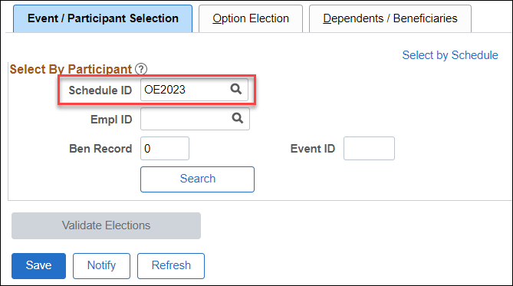
Paper Application Entry
Go to Perform Election Entry to do paper application entry
Schedule ID = OE2023
If OE event is not available for entry, submit an SSO ticket – Central Benefits will open the event for you

Slide 68
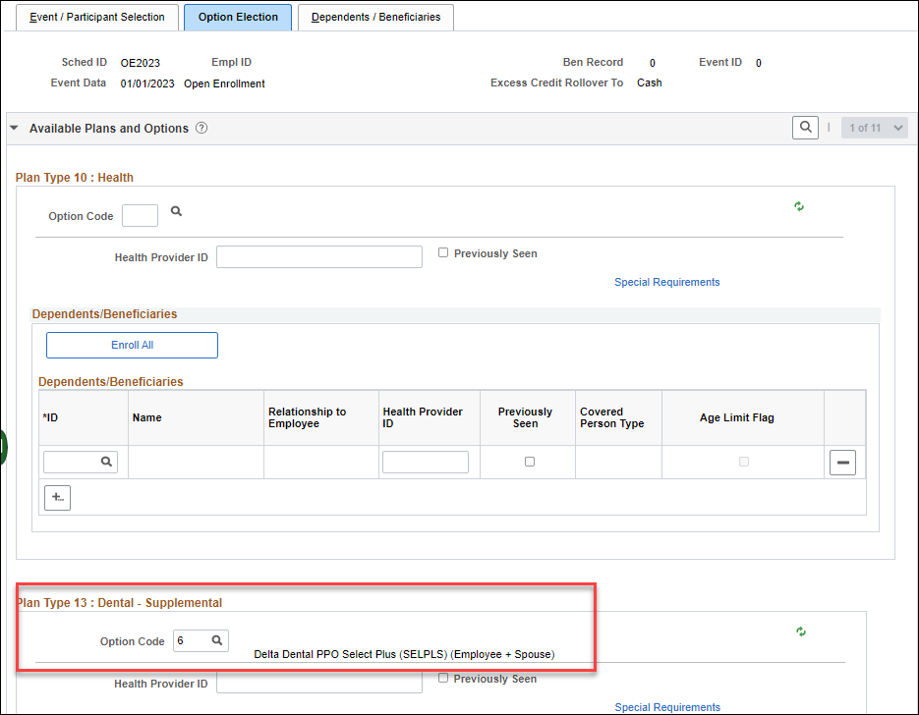
Paper Application Entry
Only plans with open enrollment are available for entry
Current elections will be prepopulated for:
Health, Dental, Vision & Accident Plan
All other plan elections will be blank (FSA, HSA, OOS)

Slide 69
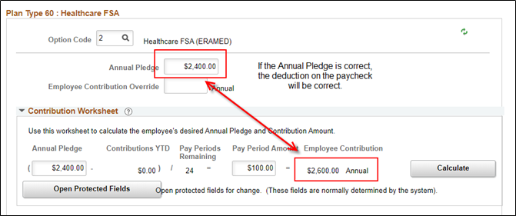
Paper Application Entry
Never enter an override on HSA, Healthcare FSA, Dependent Care FSA, Parking or Transit
Enter a POTT if you need to override the amount for any reason
There is an issue with the Contribution Worksheet for the HSA/FSA plans in Perform Election Entry. The number of pay periods is correctly displaying this year but the total annual contribution does not calculate correctly. If the annual elections is correct, the paycheck amount will be correct.
The correct number of pay periods display in eBN

Slide 70
Paper Application Entry
Once you finish entry, confirm Process Status = Entered
Once you do entry, employee can still make/change elections through eBenefits
If you need to do additional entry after the event is submitted, you will need to send in an SSO ticket to have the OE event re-opened
Ticket subject line – OE2023 – re-open OE event, Name and Empl ID

Slide 71
Dependent Reminders
Reminder: Never delete a dependent from the system – EVER!
If a dependent is listed twice, submit a ticket to merge dependent records
If the employee adds themselves as a dependent, submit a ticket
These issues often make the OE event go to Election Error status

Slide 72
Supplemental Plan Cancelation Deadline
Supplemental Plan Cancelation Deadline
All supplemental plan cancelations for 2023 should be submitted through eBenefits
Applications received after the end of OE enrollment should only be accepted if there are extenuating circumstances

Slide 73
FSA/HSA/ERA Changes/Late Enrollments
If employee enrolled in Dep Care or Health FSA (or LPFSA) during OE but wants to change election amount, can enter changes until we send the first OE file to OPTUM Financial on 11-18-22 (date subject to change)
If employee made no elections during OE or change comes in after file sent to OPTUM Financial, employee must file an appeal
HSA, Parking, Transit changes after OE
Enter changes on OE event until file sent to OPTUM Financial on 11-18
Will need to submit ticket for Central Benefits to do once OE event is closed to agency entry
If changes received after 11-18, put elections on 1-1-23 HSA or COM event
Event date must be 1-1-23 in this situation

Slide 74
Agency Resources

Slide 75
Agency Resources
OE Administrator Resources and OE Communications webpages
Communications pages has information about all employee messages and other communications
ETF Virtual Employer Forums
Health Plan and Vendor Contact Informational Page
Template PPT for employee OE training
Administrator job aid
Ability to review/print confirmation statements
Queries to Monitor status of OE event

Slide 76
Central Benefits Monitoring
Central Benefits will be doing the following monitoring/auditing during and after OE:
OE events that are out of sequence due to life events or eligibility changes
Central Benefits will review, and reprocess events as needed
Central Benefits will monitor, and an email will be sent via Employee Messaging for the following:
OE Notified Status
HSA Follow-up (enrolled in HDHP but have not elected HSA for 2023)
OOS Follow-up (currently enrolled in OOS but have not made an election yet or currently enrolled in OOS but didn't elect OOS or health for 2023)
WEA Trust Follow-up (currently enrolled in WEA Trust but have not made an election to a new plan or waived coverage for 2023)
Dean Prevea360 Follow-up (currently enrolled in Dean Prevea360 but have not made an election to a new plan or waived coverage for 2023)
HealthPartners Follow-up (currently enrolled in HealthPartners but have not made an election to a new plan or waived coverage for 2023)
GHC-Eau Claire Follow-up (currently enrolled in GHC-Eau Claire but have not made an election to a new plan or waived coverage for 2023)

Slide 77
Central Benefits Monitoring Central Benefits will monitor and reach out to the agencies on the following:
Enrolled in HDHP but has other coverage (including Medicare) or is 65 years or will be turning 65 next year
Enrolled OOS + health insurance
Enrolled in health + preventive dental
Missing marital status and dependent information
Enrolled in Access Out of State for 2023
Very low FSA elections (under $50)
Enrolled in LPFSA + non-HDHP
Enrolled in HDHP + regular healthcare FSA
Removing dependents under 19 or a spouse but kept family coverage
Late year FSA elections

Slide 78
Employee Resources

Slide 79
Employee Resources
eBenefits
ETF Virtual Q & A Sessions
ETF Website
2023 Health Decision Guide
Agency benefit fairs
Open enrollment Toolkit
EBenefits Quick Start Guide
Open Enrollment Summary Brochure
Open Enrollment PPT
Confirmation statement
Benefits Mentor – Your Interactive Benefits Counselor

Slide 80
OE Challenges
All stuff that happens after the OE event is created.....

Slide 81
September/ October Hires
For employees who start PP20 –PP22 (09/11 - 10/22), encourage them to make their new hire elections ASAP
Once the HIR event is finalized, the SHR event will open (if applicable). Watch for SHR events daily.
Once entry is done on the SHR event, the OE event will open. This group will be handled like all other employees provided the OE event can be opened to the employee prior to the end of the OE period.
Note: If an employee is still within their initial 30-day enrollment period at the end of the OE period and the employee didn’t submit their OE elections, you can still collect paper OE applications and have them manually entered on the OE event.

Slide 82
Hires Prior to 12-1-22 (no access to OE event or within first 30 days)
The following will apply to late pay period hires in PP20 (9/11 – 09/24), all hires in PP21 (9/25-10/8), PP22 (10/9-10/22), PP23 (10/23-11/5), PP24 (11/6-11/19), and some hires in PP25 (11/20-12/3).
Healthcare FSA, Dependent Care FSA
Remind employees that coverage they enter in HIR event is effective in 2022
If they want coverage for 2023, must complete a paper application within 30 days of hire (if no elections made on OE)
Create a ticket, attach application and Central Benefits will do entry on either OE or ADM (depends on timing of receipt of application)
Parking/Transit
Remind employees that coverage they enter on HIR event is effective in 2022
If they want coverage for 2023, collect a paper application and create a 1-1-23 COM event and enter elections

Slide 83
Hires Prior to 12-1-22 (no access to OE event or within first 30 days)
HSA:
If coverage is effective in 2022, remind employee that coverage they enter on HIR is effective 2022
They must complete a paper application for 2023 (if not entered on OE event)
If they have an OE event, enter on OE event
If no OE event, collect a paper application and create a 1-1-23 HSA event and enter elections
If coverage is effective in 2023, no additional action needed - HSA election will be entered on SHR event (or OE event if created for October hires)
WEA Trust
If the employee wants WEA Trust (hired prior to 12/1 with prior WRS State service), the employee should enroll in WEA Trust on the HIR event.
They must complete a paper application for 2023 (if not entered on OE event)
If they have an OE event, enter on OE event
If no OE event, collect a paper application, create a 01/01/23 ADM, process applications, and submit a SSO ticket with applications to Central Benefits explaining the reason for the ADM event.
Opt-Out Stipend – if eligible for the employer contributon in 2022, make sure that the employee completes 2 health insurance applications opting out for both years – one for 2022 and one for 2023
Use the SHR event (or OOS event if employee has prior service) to enter 2022 election and a 1-1-23 OOS event for the 2023 elections

Slide 84
December 2 – 31 Hires
For employees hired 12/2 - 12/31, the 2022 HSA limits connect to their enrollments event though coverage is effective 1-1-23
Solution:
HSA - can change at any time so if the employee wants to maximize, can create an HSA event to increase annual elections (event date = 1-1-23 or later)
The new plans available in 2023 will be available for enrollment

Slide 85
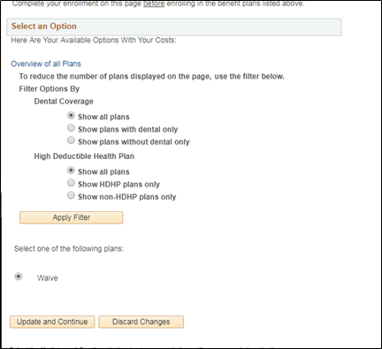
WRS-Covered LTEs in First 6 Months
IF WRS-covered LTE in first 6 months as of 1-1-23, the OE event opens Plan Types 1U and 1V and the employee will not be given an opportunity to make an election in health

Slide 86
Do I Need a Ticket for That?
When to create a ticket

Slide 87
When to Create an OE Ticket
All OE tickets should have a subject line that starts "OE2023, Employee Name, Empl ID"
You should create a ticket in the following situations:
The employee adds/removes a dependent due to a life event during the Open Enrollment Period
Central Benefits will reprocess the OE event to pick up the dependent changes
The employee has a dependent listed more than once – create a SSO ticket so Central Benefits can delete the dependent – do not delete the dependent yourself
You need to make a paper OE election and the event is not open to you (attach application to the SSO ticket but redact SSN)
You need to have the OE event created for someone in the DEF benefit program
You need the benefit flag moved

Slide 88
Next Steps
Take a deep breath.....

Slide 89
Next Steps
CB will send OE updates through payroll and benefits email distribution list
Working to finalize all employee and agency resources by end of week
Agencies should keep working to finalize as many events as possible
Reminder: All users will be locked out of HCM at 5pm on Friday
In process of updating DPM benefits pages with 2023 benefit information, forms and brochures

Slide 90
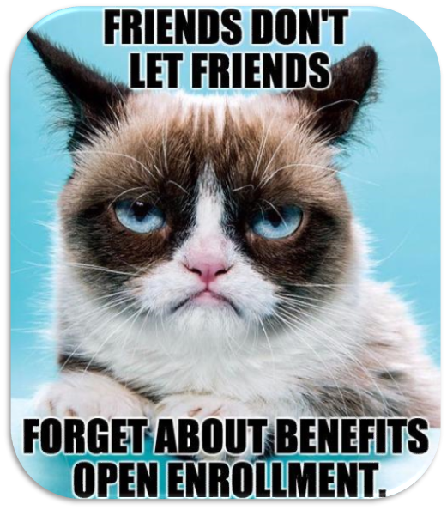
Questions?

