Slide 1


Open Enrollment Training
October 1, 2025

Slide 2
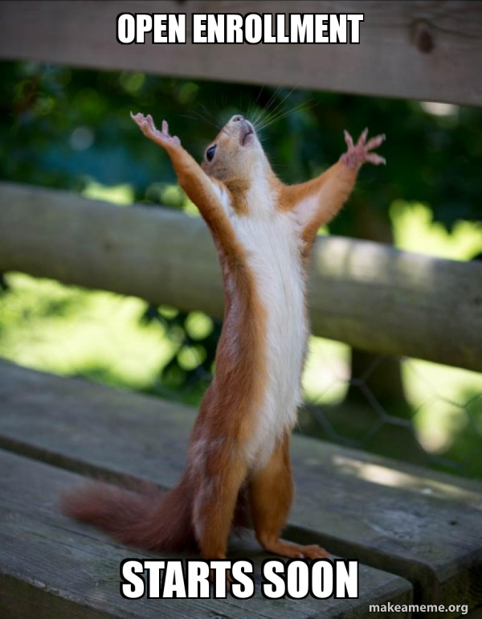
Agenda
Getting Ready for OE
Name/Data Errors and Change Process
Open Enrollment Timeline
2026 Benefit Information
Week Leading Up to OE
Technical/System Updates for 2026
Event Processing During OE
eBenefits
Confirmation Statement
OE Communications
Agency Resources
Employee Resources
OE Challenges
Next Steps

Slide 3

Getting Ready for OE
Pre-OE agency Checklist

Slide 4

Pre-OE Agency Checklist
Send Pre-OE Announcement Emails to employees by 10/02
On 09/29/2025 (evening), IYC BAS Group ID added to all active employees who are NOT in the DEF benefit program (only added to DEF if employee currently enrolled in Pre-Tax-Savings plan) after 5pm
  As of 09/29/2025, agencies must no longer change primary job flag- create a ticket and Central Benefits will move the flag and IYC code (in effect through the end of the year)
Run WRS Lookback on Mondays following payroll confirmation
Run WI_BN_OPEN_EVENTS with a schedule ID of EM2017 to manage events daily
  Benefit Administration will also run at noon on 10/01-10/03/25 to help events move more quickly through the system
Create a ticket if you have an employee in the DEF benefit program who wants to enroll in Pre-Tax Savings Accounts during OE
.

Slide 5
Pre-OE
Agency Checklist
Complete the following by 10/02/25
  Enter all life event applications as received
  Finalize all open termination events (BIR, MAR, DIV, ELG, TER, RET, TRA, LOA, RFL....)
  Finalize all events that need no entry
  Encourage new hires to complete elections ASAP. OE event won't open until HIR and SHR (if applicable) entry is done
  Complete entry on all open SHR events
    For LTEs enrolling in health or OOS at 6 months –Manually create/enter SHR events through 12/31/2025
  Process all AGE events with an event date of 12/31/2025 or earlier

Slide 6

Open Enrollment Timeline

Slide 7
Open Enrollment Timeline (subject to change)
Week of Sept 15th:
Run PP19 WRS Lookback Report + do all associated processing
Finalize and process as many open events as possible (BIR, MAR, DIV, ELG, TER, RET, TRA, LOA, RFL....)
10/19- 11/4 SHR events open for entry (enter as soon as HIR elections finalized)
Complete all open AGE events thru the end of the year
Sept 29th:
Once IYC code is on job, agencies must no longer change primary job flag – create a ticket and Central Benefits will move the flag and IYC code (in effect through the end of the year)
After 5pm, IYC BAS Group ID added to all active employees who are NOT in the DEF benefit program (only added to DEF if employee currently enrolled in ERA plan)
Run PP20 WRS Lookback Report + do all associated processing

Slide 8
Open Enrollment Timeline (subject to change)
Oct 1st- 2nd:
Deadline to process all AGE and SHR events by the agencies (10/02)
Oct 3rd (Friday):
Ben Admin runs at Noon and 5pm.
Central Benefits will finish outstanding AGE and SHR event entry – before noon
Finalize and process as many open events as possible (BIR, MAR, DIV, ELG, TER, RET, TRA, LOA, RFL....)
All users, except core central staff, will be locked out of HCM starting at 5pm until notified (likely mid-day on October 4th if no issues encountered)
Ben Admin runs at Noon and 5pm.
OE Training for agencies, 1:00pm – 3:00pm (10/01)
Finalize and process as many open events as possible (BIR, MAR, DIV, ELG, TER, RET, TRA, LOA, RFL....)
Agencies should send out OE is Coming email (10/01-10/02)

Slide 9
Open Enrollment Timeline (subject to change)
Oct 3rd (Friday), con’t:
Run process to create ~ approx. 33,000 OE events
Run all baseline audits and queries
Oct 4th (Saturday):
Central Benefits and HCM benefits review to ensure OE events prepared correctly
System back open to users sometime mid-day
Oct 6th: (Monday)
Start of OE period
IYC code added to any newly active employees (since process last run)
Main OE email sent via Employee Messaging (early morning)
eBenefits opens to employees at midnight

Slide 10

Open Enrollment Timeline (subject to change)
Additional October dates
Oct 7th: 11/13 – 11/26 SHR events open for entry
Do not use OE event in place of SHR event for January coverage
Oct 31st: Last day of OE….thousands of employees likely making their elections
Last day to cancel/waive benefits for 2026
eBN closes at 11:59pm
Oct 13th: run PP21 WRS Lookback Report + do all associated processing
Oct 14th: 11/27 – 12/23 SHR events open for entry
Oct 27th: run PP22 WRS Lookback Report + do all associated processing

Slide 11
Open Enrollment Timeline (subject to change)
November Dates
Nov 19th: Last day to submit OE health elections to ETF (5pm) (updates since 11/12 file)
Nov 24th: List of OOS enrollees sent to ETF for validation
Nov 3- Nov 5: OE event still open to agencies to enter paper apps received on or before 10/31 (final date subject to change)
Nov 4th: 12/24 – 1/1/26 SHR event open for entry
Nov 10th: Run PP23 WRS Lookback Report + do all associated processing
Nov 12th: 1st OE health elections file sent to ETF
Nov 17th:1st OE enrollment file sent to TASC
Nov 24th: Run PP24 WRS Lookback Report + do all associated processing

Slide 12
Open Enrollment Timeline (subject to change)
December Dates
Dec 12th: OE file sent to DeltaDental (includes Supplemental Dental and Preventive Dental)
January Dates
Jan 8th: first check payable in 2026
Early January:
Dec 14th: 1st day of 2026 Pay Period 1
Dec 17th: Send OE elections to Securian for Accident Plan
Central Benefits will begin health compare with ETF’s system
Re-send OOS list to ETF for Validation (in case of changes)
After OE file sent in December, new hires won’t be sent until after 1/1/26
Dec 29th: Final File sent to Delta Vision for 2025 enrollments
Dec 8th: Run PP25 WRS Lookback Report + do all associated processing
2nd OE file sent to TASC
Dec 15th: OE file sent to MetLife Vision (new vendor)

Slide 13
Daily Processes during Open Enrollment
Once open enrollment begins, OE elections will be finalized every night (7 days/week). This process will begin at 9:30pm.
Confirmation statements and emails will also be generated at this time. If OE election submitted after 9:30pm, there will be a one-day delay for the confirmation statement.
During the last few days of OE, we’ll finalize the events several times during the day, but confirmation statements will only be generated once.
On the last day of OE, we’ll finalize the events every few hours and then more frequently as midnight approaches.

Slide 14
2026 Benefit Information

Slide 15
Action that can be taken during Open Enrollment
 | Enroll | Add or Remove Dependents | Change Plans | Cancel Coverage
Health* | X | X | X | X
Delta Dental PPO – Supplemental Plans | X | X | X | X
Delta Dental PPO – Preventive Plan | X | X | N/A | X
MetLife Vision | X | X | N/A | X
Accident Plan | X | X - change coverage level | N/A | X
Healthcare FSA or LPFSA | Must re-enroll every year Coverage will automatically end if no 2026 enrollment
Dependent Day Care FSA
Pre-Tax Parking & Transit Accounts
Health Savings Account | Must re-enroll every year Enrollment will end if employee doesn't elect High Deductible Health Plan (HDHP), but employee's HSA account remains active
Health Insurance Opt-Out Stipend | Must re-enroll every year Must certify that eligibility requirement are met on an annual basis
* Can also enroll in or cancel Uniform Dental Benefits

Slide 16
2026 Plan Changes
See ETF’s Insurance Changes for 2026 Page
Benefit Changes
The annual medical deductible for the High Deductible Health Plan (HDHP) and Access HDHP has increased to:
    Individual: $1,700
    Family: $3,400
The annual Health Savings Account employer contribution for employees covered by an HDHP has increased to $852 for an individual and $1,704 for family coverage.
The Group Insurance Board approved the following benefit changes effective 1/1/26:
  Coverage of Continuous Glucose Monitors (CGMs) will only be under the pharmacy benefit through Navitus

Slide 17
2026 Plan Changes
Health Plan Name Change
Common Ground will be known as CareSource
Dean Prevea360 East will be known as Prevea360 East
Dean Health Plan - Medica West and Mayo Clinic Health System will be known as Medica West and Mayo Clinic Health System
  If currently enrolled in these plans, you do not need to do anything to remain in them.
State Maintenance Plan
SMP will continue to be offered in Florence County
Pre-Tax Savings Accounts: Reminder
Employees must have a minimum of a $50 carryover account balance from 2025 to roll over unused funds into 2026 (if an employee does not re-enroll for next plan year)

Slide 18

eBenefits Demo

Slide 19
2026 Health Insurance Premiums

Slide 20
2026 Health Insurance Premiums (Non-HDHP)
Plan | Single (monthly) | Single (biweekly) | Family (monthly) | Family (biweekly)
IYC Plan with Dental | $132.00 | $66.00 | $329.00 | $164.50
IYC Plan without Dental | $128.00 | $64.00 | $318.00 | $159.00
Access with Dental | $335.00 | $167.50 | $833.00 | $416.50
Access without Dental | $331.00 | $165.50 | $822.00 | $411.00
Access with Dental (required to work out of state) | $202.00 | $101.00 | $508.00 | $254.00
Access without Dental (required to work out of state | $198.00 | $99.00 | $497.00 | $248.50

Slide 21
2026 Health Insurance Premiums (HDHP)
Plan | Single (monthly) | Single (biweekly) | Family (monthly) | Family (biweekly)
HDHP with Dental | $49.00 | $24.50 | $122.00 | $61.00
HDHP without Dental | $45.00 | $22.50 | $111.00 | $55.50
HDHP Access with Dental | $252.00 | $126.00 | $626.00 | $313.00
HDHP Access without Dental | $248.00 | $124.00 | $615.00 | $307.50
HDHP Access with Dental (required to work out of state) | $119.00 | $59.50 | $301.00 | $150.50
HDHP Access without Dental (required to work out of state | $115.00 | $57.50 | $290.00 | $145.00

Slide 22
Supplemental Plans
Vision, Dental, Accident Plan

Slide 23
MetLife Vision
New Vendor
2026 DeltaVision Premiums
Coverage Level | MetLife Vision (monthly) | MetLife Vision (biweekly)
Employee | $4.72 | $2.36
Employee + Spouse | $9.40 | $4.70
Employee + Child(ren) | $10.60 | $5.30
Family | $16.94 | $8.47

Slide 24
Delta Dental Premiums
2026 Dental Premiums
Coverage level | Select (monthly) | Select (biweekly) | Select Plus (monthly) | Select Plus (biweekly) | Preventive (monthly) | Preventive (biweekly)
Employee | $9.08 | $4.54 | $22.24 | $11.12 | $37.18 | $18.59
Employee + Spouse | $18.16 | $9.08 | $44.52 | $22.26 | N/A | N/A
Employee + Child(ren) | $12.24 | $6.12 | $41.32 | $20.66 | N/A | N/A
Family | $21.76 | $10.88 | $68.18 | $34.09 | $92.98 | $46.49

Slide 25
Securian Accident Plan
2026 Accident Plan Premiums
Coverage Level | Accident Plan (monthly) | Accident Plan (biweekly)
Employee | $3.92 | $1.96
Employee + Spouse | $5.58 | $2.79
Employee + Child(ren) | $7.52 | $3.76
Family | $10.98 | $5.49

Slide 26
HSA/FSA Limits

Slide 27
HSA Limits
 | 2025 | 2026 | Change
Single | $4,300 | $4,400 | + $100
Family | $8,550 | $8,750 | + $200
Catch-Up (age 55 or older) | $1,000 | $1,000 | No Change
Increase in total HSA annual contributions maximum
Increase to HSA annual employer contributions
  Single =$852 increase of $24
  Family = $1,704 increase of $54
  Prorated if required to pay < ½ time rates or coverage effective after January 1st

Slide 28
Pre-Tax Savings Account Limits
 | 2025 | 2026 | Change
Healthcare and Limited Purpose FSA *Up to $660 may be rolled over from 2025 to 2026 | Min: $50 Max: $3,200 | Min: $50 Max: $3,300 | + $100
Dependent Day Care FSA *No funds may be rolled over from 2025 to 2026 | $5,000 | $7,500 | + $2,500
Parking & Transit Account *must have $50 in account to roll over from 2025 to 2026 | $315/mo | $325/ mo | + $10
Medical FSA, Parking & Transit Accounts
  Employees must have a minimum of a $50 carryover account balance from 2025 to roll over unused funds into 2026 (if an employee does not re-enroll for next plan year)

Slide 29
TASC forms Updates/changes for 2026
TASC has said the HSA Transfer form will be available from TASC in late November, early December 2025.​ Central Benefits will update the DPM website once the form is available.
Important for 2026: ​Members will not have the option to pay the remaining FSA annual election amount via payroll deduction for COBRA coverage. Members can still COBRA their FSA by mailing in the FSA COBRA form and the remaining payment (via check) to ETF. ETF will notify TASC to extend the FSA COBRA coverage based on the payment received.

Slide 30

Well Wisconsin (powered by Web MD)
What's New for 2026

Slide 31
2026 Wellness Updates
Starting January 1, 2026, participants have access to the following evidence-based programs:
  Health Coaching for chronic conditions, mental health, physical activity, nutrition, stress, & more
  Diabetes Prevention Program for those at risk of developing diabetes and It’s Your health: Diabetes (in collaboration with Navitus)
  Positively Me, a year-long program helping to support participants with losing weight
  Mental health support with meQuilibrium and Togetherall
  Kaia Health, pain management

Slide 32
Important Dates – Well Wisconsin
Incentive Deadline for 2025: 10/17/2025
Mid-November: Employers start submitting requests for 2026 onsite health screenings
January 2026: Home mailers highlighting 2026 program
Beginning of February, onsite health screening events begin

Slide 33

2026 well Wisconsin incentive overview
Earn $150 incentive by completing 3 activities:
    Health assessment
    Health check
    One well-being activity
  Incentive Deadline: October 16, 2026
Well Wisconsin
webmdhealth.com/wellwisconsin
WebMD 1-800-821-6591

Slide 34

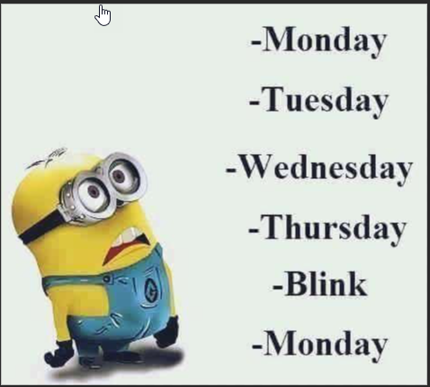
The Week leading Up to OE
Keep Calm, we’re almost there!

Slide 35
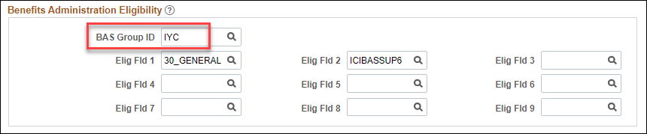
BAS Group ID
Monday (09-29-25), a process was run to tag an employee's job record with a BAS group ID of "IYC"
The BAS group ID is on the Benefit Administration page in Job Data
Any employee who has this tag, will have an OE event created
All active employees who are NOT in the DEF program will get an IYC code
  Exception: If in DEF and enrolled in Pre-Tax Savings Plan for current year, will get IYC code
  Multiple jobs – will only be added to benefit primary (this is why you can't change the benefit primary flag)
    Note: You may see DUP or NON listed in the BAS Group ID Field. These People either have multiple benefit records or several active employee instances. These codes are added to make sure that only 1 OE event prepares for the person.
  Multiple benefit records will be added to the lowest numbered eligible job row

Slide 36
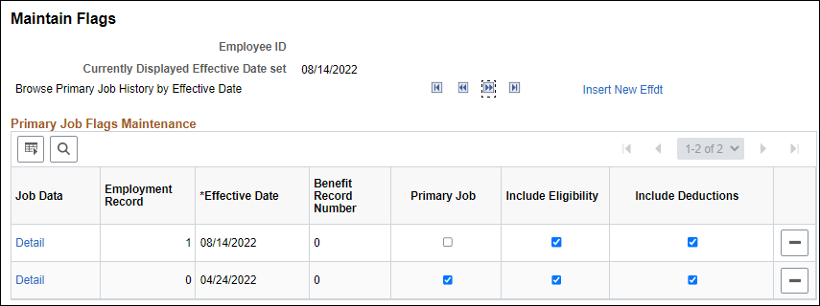
BAS Group ID – Multiple Jobs – Benefit Primary Flag
Employees who have multiple jobs have a benefit primary flag
Once the IYC code is put on Job on 09-29-25, agencies must not change the benefit flag
  If there is no IYC code on the benefits primary job, the OE event will disconnect in the system and the employee won't be able to make their OE elections
From 09-29-25 until early 2026 (date TBD), agency must submit a ticket if the benefit flag needs to be moved

Slide 37
BAS Group ID
If there are new hires during the Open Enrollment Period, there will be a process run each night to put the BAS Group ID on the job and create the OE event
  Anyone who moved from DEF to a non-DEF benefit program during this time will also get an IYC
Never Delete the value in the BAS Group ID field
Never enter a value in the BAS Group ID field
Remember to tell your HR staff this
If the BAS Group ID is NOT on the top of stack job row on the employee's benefit primary job, the OE event will disconnect from the job record and shut down to the employee
This process will be run throughout the OE period
  Last day the process will be run -TBD

Slide 38
70Y Events
Central Benefits will generate and process all 70Y events through the end of the year
  Reason – the OE event will term coverage under Life on the wrong date if someone turns 70 between now and the end of the year
  Consequence – you may see 70Y events on the BAS Activity Table for the rest of the year – ignore them. Central Benefits will monitor and manage

Slide 39
Technical/System Updates for 2026
Updates to Preventive Dental Certificate
Annual Updates to OOS Certificate

Slide 40
Preventive Dental Certificate
The Delta Dental PPO- Preventive Plan is only available to employees who are not covered by State Group Health Insurance as either an employee or dependent, regardless of whether they are enrolled in Uniform Dental. This plan has the same benefits as Uniform Dental, but the employee must pay the full cost (no employer contribution).
Anyone who is enrolling needs to answer a question to confirm they will not have State Group Health Coverage – had to add a question for those who want to waive coverage during Open Enrollment.

Slide 41
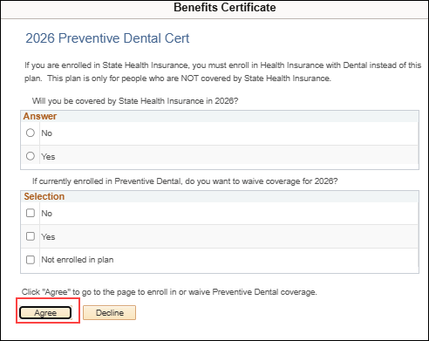
Preventive Dental Certificate
Must enter "No" to the first question and "Yes" to the second question to access the enrollment page

Slide 42
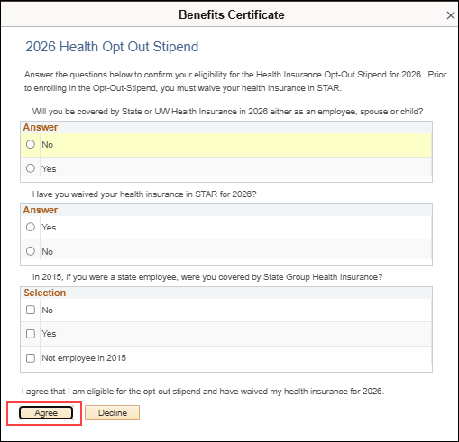
Annual Update to OOS Certificate
Must enter "No" to the first question, "Yes" to the second question, and either “Yes” or “Not employee in 2015” to third questions to access the enrollment page

Slide 43
OOS Reminders
Continuing the tradition, during OE employees will apply for OOS through eBN
  Reminder – new hires must apply for stipend via paper Health application and agency should enter on either SHR or OOS event
Never enter OOS directly in Additional Pay
Employees will be enrolled in the Opt-Out Stipend Simple Benefit Plan
Enrollment in the OOS Simple Benefit Plan creates the Additional Pay OOS entry
When an employee terminates, the OOS plan enrollment and the OOS Additional Pay election will end when the TER/RET/TRA/TEB event is finalized
For detailed information about how the OOS flows through the system, see the Open Enrollment Administrator Job Aid

Slide 44
OOS Eligibility Validations
The following OOS eligibility validation will be done by Central Benefits:
  Confirm employee is not enrolled in both health insurance and OOS
  Look for employees who were enrolled in 2025 but not in 2026 (and didn't enroll in health for 2026)
  Will monitor OOS elections effective in the last quarter of 2025 to ensure they are notified of requirement to re-apply for 2026
  The list of open enrollment enrollees will be sent to ETF twice (in November and January). ETF will validate that the employee is not a covered dependent under the state health plan and confirm the employee is not on the list of people who are ineligible because they didn't carry health insurance in 2015 as an active state employee.
  A monthly file is also sent year-round to ETF to validate new enrollments

Slide 45
eBenefits

Slide 46
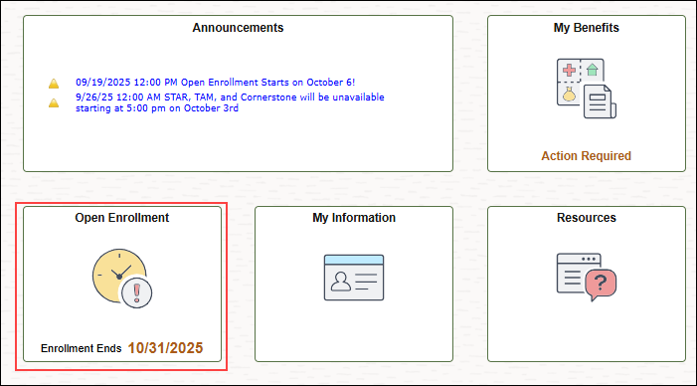
eBenefits
Employees will click on Open Enrollment Tile to access eBenefits

Slide 47
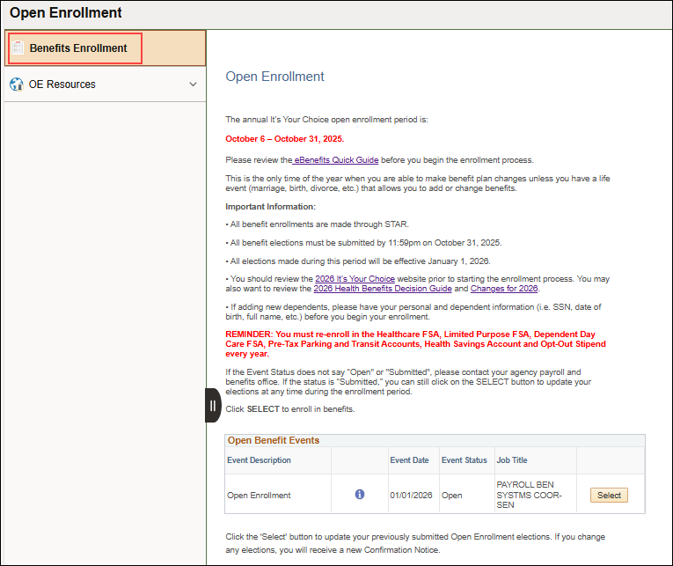
eBenefits
Open Enrollment Tile contains direct access to eBenefits.

Slide 48
OE Confirmation Statement
Online Benefit File

Slide 49
Confirmation Statement & Employee Email
Once employee submits OE election.....
Employee submits OE elections
OE event is finalized around 9:30pm
Employee receives email that confirmation statement available
Confirmation statement loads to B-File
If employee submits a new OE election, employee will receive an updated confirmation statement, but historical confirmation statement will be saved
If employee submits OE election after 9:30pm, there will be a one-day delay in receiving the confirmation statement.

Slide 50
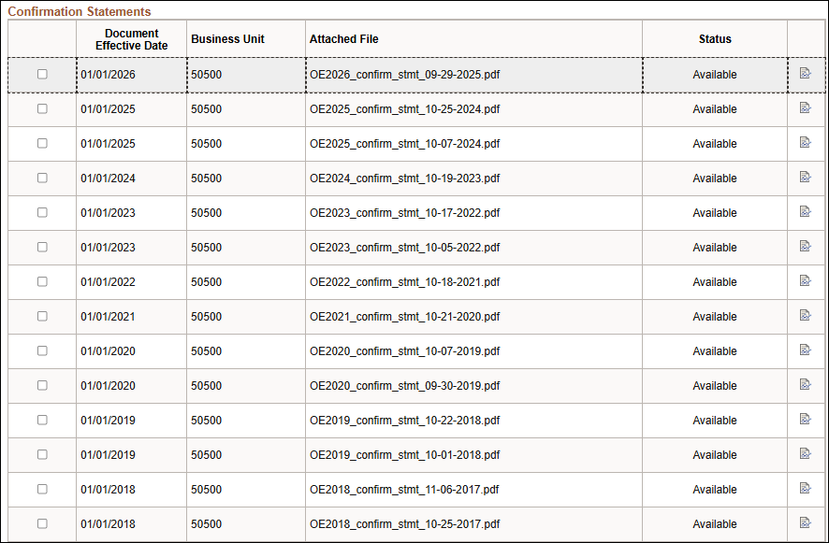
Confirmation Statement Views
All confirmation statements for OE2018-OE2026 will be available online. The most recent confirmation statement will be at the top of the page

Slide 51
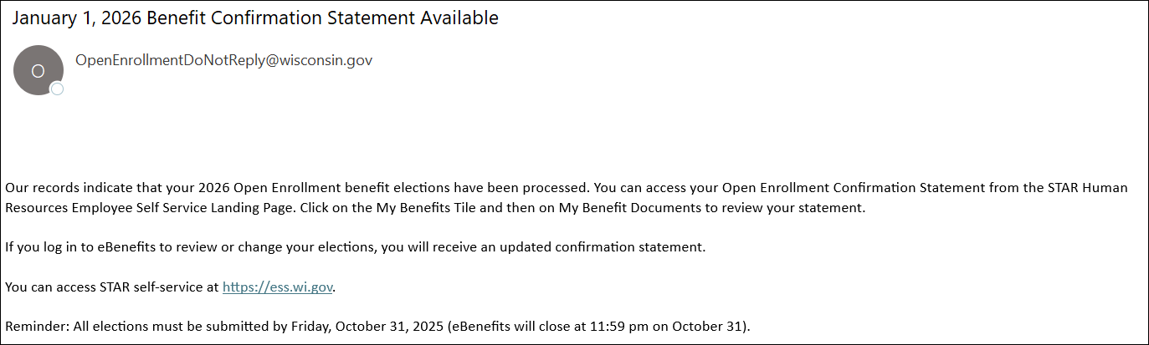
Confirmation Statement Notification Email

Slide 52
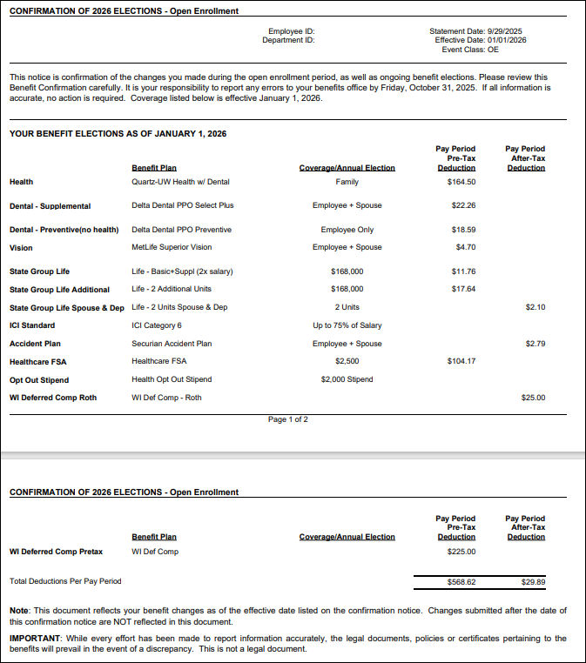
Confirmation Statement Example

Slide 53
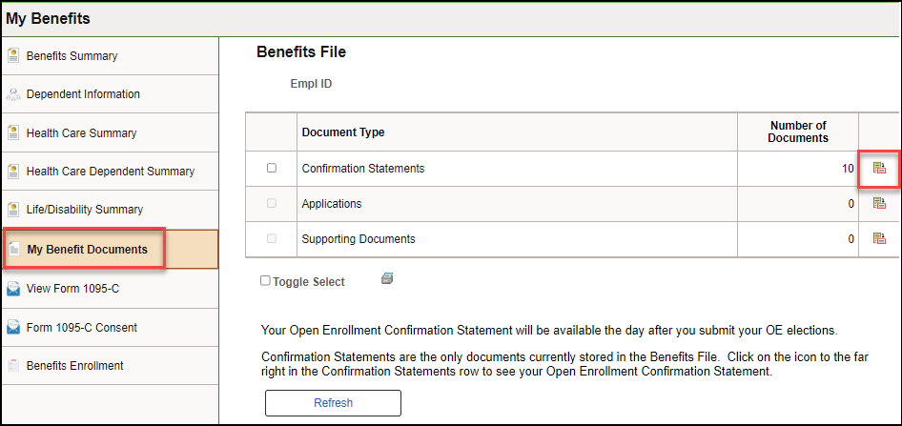
How Employees Access Confirmation Statement
Confirmation statement in online benefits file
ESS Landing Page – My Benefits Tile – My Benefit Documents
Click on the icon to open the Confirmation Statement page

Slide 54
How Employees Access Confirmation Statement
Will be brought to Confirmation Statements
  OE2018-OE2026 Confirmation Statements will be visible on this page

Slide 55
Agency Access to Confirmation Statements
Agencies can access an individual confirmation statement
Go to Benefit Administration Dashboard- Benefit Enrollment Tile – Review Employee Benefit Folder – Employee Benefit Documents
Agencies can also access all confirmation statements for their agency
Go to the Navigator and go to – State of Wisconsin (STAR) - Benefits Administration - Process – Print Confirmation Statements
For full details
OE Administrator Job Aid

Slide 56
Event Processing during OE

Slide 57
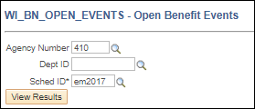
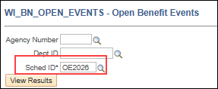
Identifying OE Events
All OE events not in Finalized – Enrolled status will be on the Open Events Query
  WI_BN_OPEN_EVENTS
  Enter Schedule ID "OE2026" to see OE events
  Enter Schedule ID "EM2017" to see non-OE events

Slide 58
Importance of Event Order
Why are we trying to get all the 2025 benefit events finalized before we create the OE event?
  Every benefit event that is created pulls in all benefit information from the prior event
  Benefit events must be processed in event date order to ensure benefits flow correctly through the system
  Since the OE event has an event date of 1-1-26, we're trying to get all events with a 2025 event date through the system before we create the 1-1-26 OE event
  Once the OE event is prepared, if a 2025 event is processed, Central Benefits will need to reprocess the OE event to pick up the 2025 elections and/or eligibility change.
    CB monitors for this daily during and after OE – agencies are not required to submit a ticket, but it's recommended if you are entering a life event during the OE period.

Slide 59
2025 Event Processing
Enter 2025 election as soon as you receive them
Any 2025 event in which a dependent is ADDED or REMOVED, will affect the OE event
Reminder – never delete a dependent – just remove dependent from plan
Life event entry must be done and then OE event must be reprocessed to pull in dependent changes
BENEFIT PROGRAM (FTB, DEF, LTE...) and Elig Config Field changes that occur After the OE event is created – OE event must be reprocessed
OE event will be attached to the old benefit program/eligibility and benefit options available under that benefit program

Slide 60
2025 Event Processing – MAR Example
Employee married on 10-12-25
Adds spouse to health, vision and dental
OE event created on 10-03-25 so it was created when all elections had single coverage
Action Needed by Agency
Add 10-12-25 MAR event to BAS Activity Table
Enter elections on MAR event
Since the MAR event (10-12-25) is EARLIER than the OE event date (1-1-26), the OE event will temporarily close, and the MAR event will open. The OE event will stay closed until the MAR event is finalized

Slide 61
2025 Event Processing – MAR Example
During OE Central Benefits will monitor for events out of sequence and reprocess OE events as needed.
**No tickets are necessary during OE**
The OE event will automatically re-open once the life event is finalized – even if the event has not been reprocessed to pick up the new enrollments
After OE, agency should submit a ticket on the day the life event is added to the BAS Activity Table (preferably early in the day).
  Central Benefits will open the event, agency can do entry on life event and then Central Benefits will finalize life event and immediately reprocess OE event – all in the same day (all benefits must be entered on the event)
  Reduces risk of employee doing entry on event that doesn't have most current elections
  Ticket Name = OE2026 –Reprocess OE due to Life Event – EE full name & Empl ID

Slide 62
2025 Event Processing
What happens if employee submitted OE elections BEFORE life event entry is done?
  Central Benefits will capture enrollment made on the OE event, reprocess the OE event (this will delete all elections made on the OE event) and will re-enter the elections that were made on the OE event (taking into account new dependents).
  A new confirmation statement will be generated, and the employee will receive a confirmation statement notification email
  Agency should direct employee to validate elections and print new confirmation statement

Slide 63
Event Reminders
Only one event can be open at a time – if an event with an event date prior to 1-1-26 is open, it will close the OE event until the event with the 2025 event date is finalized
OE events will be created on 10-3-25 (after 5pm)
Only benefit enrollment information finalized as of 10-03-25 will be pulled in the OE event
The benefit program on record on 10-03-25 determines what options are available on OE event
If benefit enrollments or the benefit program changes after 10-03-25, the OE event must be reprocessed by Central Benefits to pick up changes
Any benefit or job entry done AFTER 10-03-25 (regardless of effective date) will not be reflected on the OE event until Central Benefits reprocesses the OE event

Slide 64
OPEN eNROLLMENT and Retirees –
If you have an employee who knows they will be retiring on or before 1/1/26, they should complete paper applications to make benefit changes.
The employee should not make changes within ESS because these changes will never go over to ETF.
ETF is requesting retirees complete paper applications, and the agency send them to ETF for processing.
  If faxing, be sure to include the EE name, ETF member ID and reason for fax (i.e., EE is retiring prior to 1/1/26).
  ETF FAX number is 608-267-4549
Per ETF: The instructions changed this year and are now documented in the State Agency Health Insurance Standards, Guidelines and Administration Employer Manual (ET-1118), Chapter 6, Section 601 F. Please review that section for information about how to complete the Continuation – Conversion Notice (ET-2311) for terminations after OE but before January 1.

Slide 65
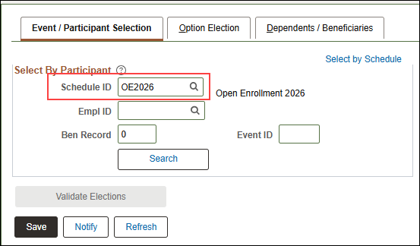
Paper Application Entry
Go to Perform Election Entry to do paper application entry
Schedule ID = OE2026
If OE event is not available for entry, submit an SSO ticket – Central Benefits will open the event for you

Slide 66
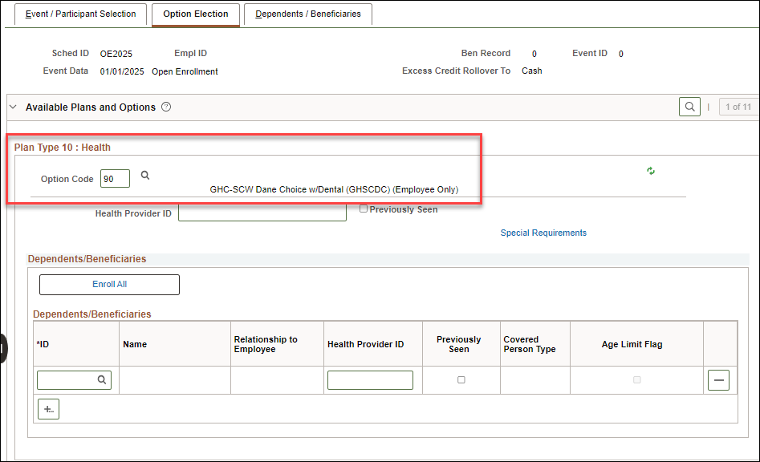
Paper Application Entry
Only plans with open enrollment are available for entry
Current elections will be prepopulated for:
  Health, Dental, Vision & Accident Plan
HSA and OOS plan elections will be blank

Slide 67
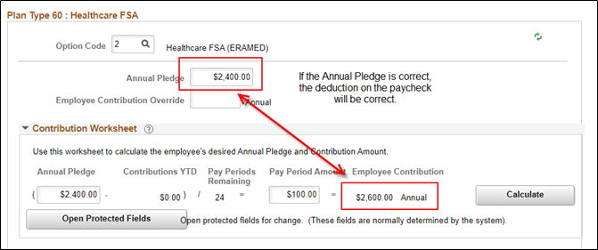
Paper Application Entry
Never enter an override on HSA, Healthcare FSA, Dependent Care FSA, Parking or Transit
  Enter a POTT if you need to override the amount for any reason
There is an issue with the Contribution Worksheet for the HSA/FSA plans in Perform Election Entry. The number of pay periods is correctly displaying this year but the total annual contribution does not calculate correctly. If the annual election is correct, the paycheck amount will be correct.
  The correct number of pay periods displays in eBN

Slide 68
Paper Application Entry
Once you finish entry, confirm Process Status = Entered
Once you do entry, employee can still make/change elections through eBenefits
If you need to do additional entry after the event is submitted, you will need to send in an SSO ticket to have the OE event re-opened
Ticket subject line – OE2026 – re-open OE event, EE full name and Empl ID

Slide 69
Dependent Reminders
Reminder: Never delete a dependent from the system – EVER!
  If a dependent is listed twice, submit a ticket to merge dependent records
  If the employee adds themselves as a dependent, submit a ticket
  These issues often make the OE event go to Election Error status
  Employees are not allowed to remove a dependent under age 19 from health insurance without documentation.
  Employees are not allowed to remove a spouse for their family coverage (while maintaining family coverage) during OE unless a qualifying event has occurred.

Slide 70
Supplemental Plan Cancelation Deadline
Supplemental Plan Cancelation Deadline
  All supplemental plan cancelations for 2026 should be submitted through eBenefits
  Applications received after the end of Open Enrollment thru 12/31 require a ticket for CB to process.
  Applications received after 12/31 would have to go thru the appeals process.

Slide 71
FSA/HSA/ERA Changes and Late Enrollments
If employee enrolled in Dep Care or Health FSA (or LPFSA) during OE but wants to change election amount, CB can enter changes until 12/31/2025. A ticket is required.
If employee made no elections during OE, they have until the first file is sent to TASC (11/17/25) to submit a paper application for 2026. After 11/17/25, employee must file an appeal.
HSA, Parking, and Transit changes after OE: will need to submit ticket for Central Benefits to do once OE event is closed to agency (11/5/25)
After 12/29/25, agencies should use a 1/1/26 HSA or COM event

Slide 72
OE Appeals
All TASC appeals must be submitted on or before 1/31.
  Agencies should refer to the Post-OE Agency Job Aid for instructions
Health, Dental, Vision and Accident Plans
  Employee submits a written request (letter or email) for ETF review to the employer no later than April 15 following the open enrollment period.
  Please reference the Appeals process outlined in the Health Admin Manual, Chapter 6 (Section 604) or the Post-OE Agency Job Aid (link will be updated once we receive the TASC forms)
Late IYC Health appeals:
  Approved requests prior to January 31st will be retroactively effective to January 1.
  Requests approved after January 31st will be effective prospectively to the first of the month following receipt of the application.
Dental, Vision and Accident Plans
  Approved requests will be retroactively effective to January 1 and EE is responsible for all back premiums.
Notes:
Update links

Slide 73

Agency Resources

Slide 74
Agency Resources
OE Administrator Resources and OE Communications webpages
  Communications pages has information about all employee messages and other communications
ETF Virtual Employer Forums
Health Plan and Vendor Contact Information Page
Template PPT for employee OE training
Administrator job aid
Ability to review/print confirmation statements
Queries to Monitor status of OE event
Notes:
Update links

Slide 75
Central Benefits Monitoring
Central Benefits will be doing the following monitoring/auditing during and after OE:
  OE events that are out of sequence due to life events or eligibility changes
    Central Benefits will review, and reprocess events as needed
  Central Benefits will monitor, and an email will be sent via Employee Messaging for the following:
    OE Notified Status
    HSA Follow-up (enrolled in HDHP but have not elected HSA for 2026)
    OOS Follow-up (currently enrolled in OOS but have not made an election yet or currently enrolled in OOS but didn't elect OOS or health for 2026)

Slide 76
Central Benefits Monitoring
Central Benefits will monitor and reach out to the agencies on the following:
Enrolled in HDHP but has other coverage (including Medicare) or is 65 years or will be turning 65 next year
Enrolled OOS + health insurance
Enrolled in health + preventive dental
Missing marital status and dependent information
Enrolled in Access Out of State for 2026
Enrolled in LPFSA + non-HDHP
Enrolled in HDHP + regular healthcare FSA
Removing dependents under 19 or a spouse but kept family coverage
Late year FSA elections

Slide 77
Employee Resources

Slide 78
Employee Resources
eBenefits
ETF Online Forums and Videos
ETF Website
2026 Health Decision Guide
Agency benefit fairs
Open enrollment Toolkit
EBenefits Quick Start Guide
Open Enrollment Summary Brochure
Open Enrollment PPT
Confirmation statement

Slide 79
OE Challenges
All stuff that happens after the OE event is created.....

Slide 80
September/ October Hires
For employees who start PP20 –PP23 (09/07 – 11/01/25), encourage them to make their new hire elections ASAP
  Once the HIR event is finalized, the SHR event will open (if applicable). Watch for SHR events daily.
  Once entry is done on the SHR event, the OE event will open. This group will be handled like all other employees provided the OE event can be opened to the employee prior to the end of the OE period.
  Note: If an employee is still within their initial 30-day enrollment period at the end of the OE period and the employee didn’t submit their OE elections, you can still collect paper OE applications and have them manually entered on the OE event.

Slide 81
Hires Prior to 12-1-25 (no access to OE event or within first 30 days)
The following will apply to late pay period hires in PP20 (9/07 – 09/20), all hires in PP21 (9/21-10/4), PP22 (10/5-10/18), PP23 (10/19-11/1), PP24 (11/2-11/15), PP25 (11/16-11/29) and some hires in PP26 (11/30-12/13).
Healthcare FSA, Dependent Care FSA
Remind employees that coverage they enter in HIR event is effective in 2025
If they want coverage for 2026, must complete a paper application within 30 days of hire (if no elections made on OE)
Create a ticket, attach application and Central Benefits will do entry on either OE or ADM (depends on timing of receipt of application)
Parking/Transit
Remind employees that coverage they enter on HIR event is effective in 2025
If they want coverage for 2026, collect a paper application and create a 1-1-26 COM event and enter elections

Slide 82
Hires Prior to 12-1-25 (no access to OE event or within first 30 days)
HSA:
If coverage is effective in 2025, remind employee that coverage they enter on HIR is effective 2025
They must complete a paper application for 2026 (if not entered on OE event)
If they have an OE event, enter on OE event
If no OE event, collect a paper application and create a 1-1-26 HSA event and enter elections
If coverage is effective in 2026, no additional action needed - HSA election will be entered on SHR event (or OE event if created for October hires)
Opt-Out Stipend – if eligible for the employer contribution in 2025, make sure that the employee completes 2 health insurance applications opting out for both years – one for 2025 and one for 2026
Use the SHR event (or OOS event if employee has prior service) to enter 2025 election and a 1-1-26 OOS event for the 2026 elections

Slide 83
December 2 – 31 Hires
For employees hired 12/2 - 12/31, the 2025 HSA limits connect to their HIR event though coverage is effective 1/1/26
Solution:
HSA - can change at any time so if the employee wants to maximize, can create an HSA event to increase annual elections (event date = 1-1-26 or later)
The new plans available in 2026 will be available for enrollment

Slide 84
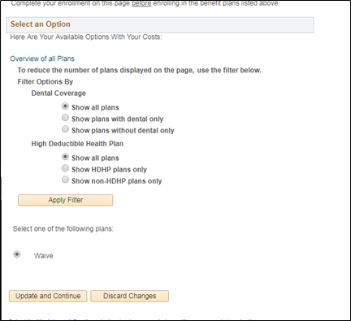
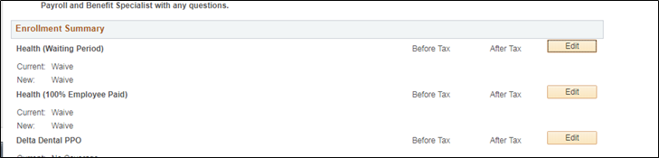
WRS-Covered LTEs in First 6 Months
IF WRS-covered LTE in first 6 months as of 1-1-26, the OE event opens Plan Types 1U and 1V and the employee will not be given an opportunity to make an election in health

Slide 85

Do I Need a Ticket for That?
When to create a ticket

Slide 86
When to Create an OE Ticket
All OE tickets should have a subject line that starts "OE2026, Employee Full Name, Empl ID"
You should create a ticket in the following situations:
The employee adds/removes a dependent due to a life event after the Open Enrollment Period
Central Benefits will reprocess the OE event to pick up the dependent changes
The employee has a dependent listed more than once – create a SSO ticket so Central Benefits can delete the dependent – do not delete the dependent yourself
You need to make a paper OE election, and the event is not open to you (attach application to the SSO ticket but redact SSN)
You need to have the OE event created for someone in the DEF benefit program
You need the benefit flag moved

Slide 87


Next Steps
Take a deep breath.....

Slide 88
Next Steps
CB will send OE updates through payroll and benefits email distribution list
Working to finalize all employee and agency resources by end of week
Agencies should keep working to finalize as many events as possible
Reminder: All users will be locked out of HCM at 5pm on Friday
In process of updating DPM benefits pages with 2026 benefit information, forms and brochures

Slide 89
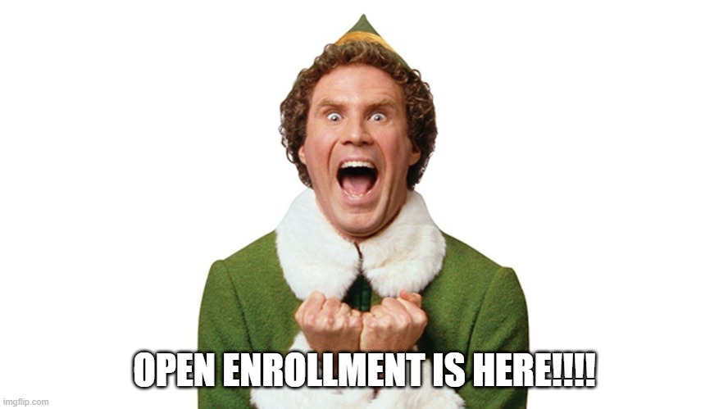
Questions?

