Slide 1


Open Enrollment: Tips, Tricks, and Reminders
October 1, 2026

Slide 2

Agenda
Getting Ready for OE
Open Enrollment Communications
2027 Benefit Information
My Insurance Benefits (MIB)/MIB Demo
OE Benefits Summary
Agency Resources
Employee Resources
OE Reminders
Next Steps

Slide 3

Getting Ready for OE
Pre-OE agency Reminders

Slide 4

Pre-OE Agency reminders
Remind employees to get their MyWisconsin ID account set up as soon as possible.
  If an EE receives an error message about completing their verification, please have them follow-up as soon as possible to complete the process. The error page will direct them to one of two email addresses:
    ETFSMBITSCMemberReview@etf.wi.gov
    ETFSMBIDHelp@etf.wi.gov
Send Pre-OE Announcement Emails to employees by 10/02
Remember to keep reviewing and doing your regular daily processes, such as:
  Review your Task List in MIB
  Run WRS Lookback on Mondays following payroll confirmation
  Making sure benefit flags are on the correct job – agencies can move their own flags this year. No JIRA ticket is needed.
  Benefit records being added, where needed
Encourage new hires to complete elections ASAP in MIB. OE won't open to them until new hire election entry is done.
Enter your employee terminations timely

Slide 5

Open Enrollment communications

Slide 6
Open Enrollment Communications
Communications:
Agencies should send out OE is Coming email (10/01-10/02)
OE Agency Training, 9:00am – 10:30am on 10/01
Main OE email sent via Employee Messaging (early morning of 10/5/26)
Agencies should run Benefit Detail Reports (BDR) in MIB
Central Benefits will provide the first Accident Plan report. Agencies should continue to run this report daily throughout OE
Can run ad-hoc a Benefits Compare BDR during OE for your EEs
Notes:
Delete

Slide 7
Oe vendor files
Vendor | First File Sent Date – Dates subject to change anytime, multiple files could be sent
Health Plans | Sent on daily maintenance file
Delta Dental – Supplemental plans, Preventive, and Uniform | 12/07/2026
Vision – MetLife | 12/29/2026
Securian Accident Plan | Sent on first file in 2027
TASC | 11/16/2026

Slide 8
2027 Benefit Information

Slide 9
Action that can be taken during Open Enrollment
 | Enroll | Add or Remove Dependents | Change Plans | Cancel Coverage
Health* | X | X | X | X
Delta Dental PPO – Supplemental Plans | X | X | X | X
Delta Dental PPO – Preventive Plan | X | X | N/A | X
MetLife Vision | X | X | N/A | X
Accident Plan | X | X - change coverage level | N/A | X
Healthcare FSA or LPFSA | Must re-enroll every year Coverage will automatically end if no 2027 enrollment
Dependent Day Care FSA
Pre-Tax Parking & Transit Accounts
Health Savings Account | Must re-enroll every year Enrollment will end if employee doesn't elect High-Deductible Health Plan (HDHP), but employee's HSA account remains active
Health Insurance Opt-Out Incentive | Must re-enroll every year Must certify that eligibility requirement are met on an annual basis
* Can also enroll in or cancel Uniform Dental Benefits
**For 2027 coverage, employees must re-enroll their dependents in the Accident Plan.

Slide 10
2027 Plan Changes
See ETF’s Insurance Changes Page
Benefit Changes
The annual medical deductible for the Non-High-Deductible Health Plan and Access plan has increased to:
    Individual: $400
    Family: $800
The annual medical deductible for the High-Deductible Health Plan (HDHP) and Access HDHP has increased to:
    Individual: $2,000
    Family: $4,000
The annual Health Savings Account employer contribution for employees covered by an HDHP has increased to $876 for an individual and $1,752 for family coverage.
The Group Insurance Board approved the following benefit changes effective 1/1/2027:
  An initial 50 total visits will continue to be allowed each year for physical, occupational, and speech therapy combined. New for 2027, if medically necessary, 50 additional visits for all therapies combined will be covered.
  Up to three daytime garments for each affected body part every six months and two nighttime garments every two years covered for lymphedema compression garments.
  Laser hair removal to treat hidradenitis suppurativa is now covered.
  Specialized contact lenses covered to treat degenerative eye diseases for members ages 18 and younger.

Slide 11
2027 Plan Changes
Health Plan Changes
Robin with HealthPartners will be known as HealthPartners Northeast
IYC Health Plan will be shown as Choice Health Plan​
Review the 2027 Health Plan Map to see which Health Plans are available in each county: https://etf.wi.gov/insmedia/2027/state-health-plan-map
State Maintenance Plan
No counties will have the SMP plan under the State Health Plan
Pre-Tax Savings Accounts: Reminder
Employees must have a minimum of a $50 carryover account balance from 2026 to roll over unused funds into 2027 (if an employee does not re-enroll for next plan year)

Slide 12
2027 Health Insurance Premiums

Slide 13
2027 Health Insurance Premiums (Non-HDHP)
Plan | Single (monthly) | Single (biweekly) | Family (monthly) | Family (biweekly)
Choice Health Plan with Dental | $140.00 | $70.00 | $346.00 | $173.00
Choice Health Plan without Dental | $135.00 | $67.50 | $335.00 | $167.50
Access with Dental | $373.00 | $186.50 | $925.00 | $462.50
Access without Dental | $368.00 | $184.00 | $914.00 | $457.00
Access with Dental (required to work out of state) | $214.00 | $107.00 | $536.00 | $268.00
Access without Dental (required to work out of state | $209.00 | $104.50 | $525.00 | $262.50

Slide 14
2027 Health Insurance Premiums (HDHP)
Plan | Single (monthly) | Single (biweekly) | Family (monthly) | Family (biweekly)
HDHP with Dental | $52.00 | $26.00 | $128.00 | $64.00
HDHP without Dental | $47.00 | $23.50 | $117.00 | $58.50
HDHP Access with Dental | $285.00 | $142.50 | $707.00 | $353.50
HDHP Access without Dental | $280.00 | $140.00 | $696.00 | $348.00
HDHP Access with Dental (required to work out of state) | $126.00 | $63.00 | $318.00 | $159.00
HDHP Access without Dental (required to work out of state | $121.00 | $60.50 | $307.00 | $153.50

Slide 15
Supplemental Plans
Vision, Dental, Accident Plan

Slide 16
MetLife Vision
No plan or premium changes for 2027
2027 MetLife Vision Premiums
Coverage Level | MetLife Vision (monthly) | MetLife Vision (biweekly)
Employee | $4.72 | $2.36
Employee + Spouse | $9.40 | $4.70
Employee + Child(ren) | $10.60 | $5.30
Family | $16.94 | $8.47
M​embers will not receive an ID card for MetLife coverage. Members will only need to tell their vision providers that they have MetLife Superior Network.​

Slide 17
Supplemental Delta Dental Premiums
2027 Dental Premiums
Coverage level | Select (monthly) | Select (biweekly) | Select Plus (monthly) | Select Plus (biweekly) | Preventive (monthly) | Preventive (biweekly)
Employee | $9.08 | $4.54 | $23.08 | $11.54 | $38.48 | $19.24
Employee + Spouse | $18.16 | $9.08 | $46.16 | $23.08 | N/A | N/A
Employee + Child(ren) | $12.24 | $6.12 | $42.90 | $21.45 | N/A | N/A
Family | $21.76 | $10.88 | $70.78 | $35.39 | $96.24 | $48.12

Slide 18
Securian Accident Plan
No premium changes for 2027
2027 Accident Plan Premiums
Coverage Level | Accident Plan (monthly) | Accident Plan (biweekly)
Employee | $3.92 | $1.96
Employee + Spouse | $5.58 | $2.79
Employee + Child(ren) | $7.52 | $3.76
Family | $10.98 | $5.49
Action Needed: Members who currently have a Securian Accident Plan that covers any dependents (spouse and/or children), must reenroll their dependents in the Accident Plan during open enrollment to have coverage that continues past January 1, 2027.
If members do not reenroll their dependents during open enrollment, the dependents will no longer have Accident Plan coverage, and the member's plan will change to individual coverage. ​​

Slide 19
HSA/FSA Limits

Slide 20
HSA Limits
 | 2026 | 2027 | Change
Single | $4,400 | $4,500 | + $100
Family | $8,750 | $9,000 | + $250
Catch-Up (age 55 or older) | $1,000 | $1,000 | No Change
Increase in total HSA annual contributions maximum
Increase to HSA annual employer contributions
  Single =$876 increase of $24
  Family = $1,752 increase of $48
  Prorated if required to pay < ½ time rates or coverage effective after January 1st

Slide 21
Pre-Tax Savings Account Limits
 | 2026 | 2027 | Change
Healthcare and Limited Purpose FSA *Up to $680 may be rolled over from 2026 to 2027 | Min: $50 Max: $3,300 | Min: $50 Max: $3,400 | + $100
Dependent Day Care FSA *No funds may be rolled over from 2026 to 2027 | $7,500 | $7,500 | No change
Parking & Transit Account *must have $50 in account to roll over from 2026 to 2027 | $325/mo | $340/ mo | + $15
Medical FSA and Parking & Transit Accounts
  Employees must have a minimum of a $50 carryover account balance from 2026 to roll over unused funds into 2027 (if an employee does not re-enroll for next plan year)

Slide 22
TASC reminder for 2027
Important reminder for 2027: ​Members will not have the option to pay the remaining FSA annual election amount via payroll deduction for COBRA coverage. Members can still COBRA their FSA by mailing in the FSA COBRA form and the remaining payment (via check) to ETF. ETF will notify TASC to extend the FSA COBRA coverage based on the payment received.

Slide 23

Well Wisconsin (powered by Web MD)
What's New for 2027

Slide 24
2027 Wellness Updates
Starting January 1, 2027, participants have access to the following evidence-based programs:
  Health Coaching for chronic conditions, mental health, physical activity, nutrition, stress, & more
  Diabetes Prevention Program
  Weight management solutions
  Mental health support with meQuilibrium and Togetherall
  Musculoskeletal support

Slide 25
Important Dates – Well Wisconsin
Incentive Deadline for 2026: 10/16/2026
Mid-November: Employers start submitting requests for 2027 onsite health screenings
January 2027: Home mailers highlighting 2027 program
Beginning of February, onsite health screening events begin

Slide 26

2027 well Wisconsin incentive overview
Earn $150 incentive by completing 3 activities:
    Health assessment
    Health check
    Well-being activity
  Incentive Deadline: October 15, 2027
Well Wisconsin
webmdhealth.com/wellwisconsin
WebMD 1-800-821-6591

Slide 27
OOS Reminders
Starting a new tradition, during OE employees will apply for OOS through MIB
Employees will be enrolled in the Opt-Out Incentive Simple Benefit Plan in PS
Enrollment in the OOS Simple Benefit Plan creates the Additional Pay OOS entry
When an employee terminates, the OOS plan enrollment and the OOS Additional Pay election will end

Slide 28
My Insurance Benefits (MIB)

Slide 29
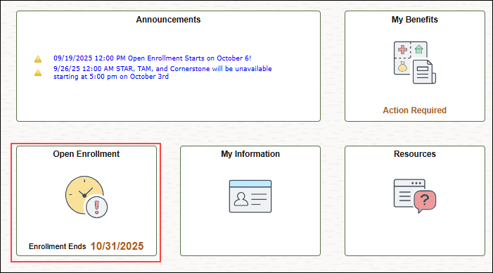
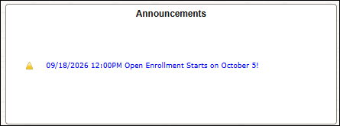
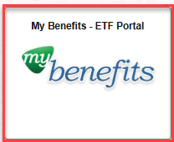
How to access MIB
Employees can log into ess.wi.gov and click on the My Benefits – ETF Portal tile to access MIB.
The EE will log-in using their MyWisconsin ID and password

Slide 30
My Insurance Benefits demo
How to run Benefit Detail Reports (BDRs)

Slide 31
OE Benefit Summary
MIB

Slide 32
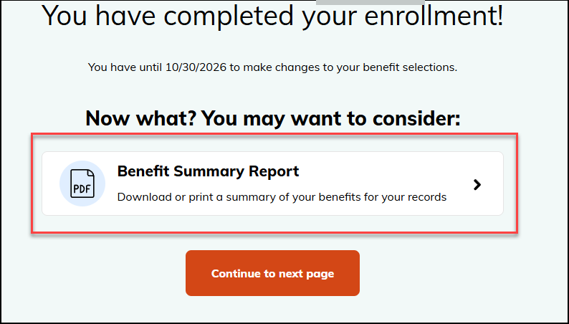
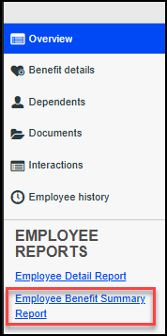
OE Benefit Summary
Once employee submits OE election.....
Employees can view their Benefits Summary document immediately in MIB
What EE will see:
HR Admin Role:

Slide 33
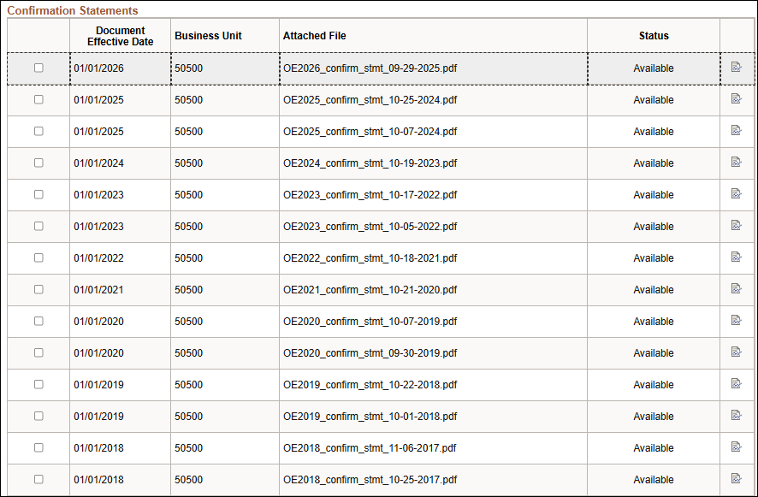
Historical OE Confirmation Statement Views
All confirmation statements for OE2018-OE2026 will be available in PS.
Employee navigation: ESS Landing Page – My Benefits Tile – My Benefit Documents
Agency Navigation for individual EE: Go to Benefit Administration Dashboard- Benefit Enrollment Tile – Review Employee Benefit Folder – Employee Benefit Documents

Slide 34
OPEN eNROLLMENT and Retirees
If you have an employee who knows they will be retiring on or before 1/1/27, they should complete paper applications to make benefit changes.
The employee should not make changes within MIB due to not having access to all applicable plans for retirees, such as Medicare Advantage Plans.
ETF is requesting retirees complete paper applications, and the agency send them to ETF for processing.
  The agency can submit OE applications via Box, email, fax, or mail.
  If faxing, be sure to include the EE name, ETF member ID and reason for fax (i.e., EE is retiring prior to 1/1/27).
  ETF FAX number is 608-267-4549
Per ETF: The instructions are documented in the State Agency Health Insurance Standards, Guidelines and Administration Employer Manual (ET-1118), Chapter 6, Section 601 F.

Slide 35
Dependent Reminders
If the EE is adding a new dependent in MIB, they are required to provide dependent verification documentation within 90-days of the enrollment date.
  If the EE does not verify their dependent, they will not be included on the 2027 contract
Employees are not allowed to remove a dependent under age 19 from health insurance without documentation.
Employees are not allowed to remove a spouse from their family coverage (while maintaining family coverage) during OE unless a qualifying event has occurred.

Slide 36
Supplemental Plan Cancelation Deadline
Supplemental Plan Cancelation Deadline
  All supplemental plan cancelations for 2027 should be submitted through MIB
  If the OE event is no longer available, there will be October, November and December Late Enrollment Change QLEs to use. You can refer to the ET-1111, section 9.1 for more details.
  Any late OE requests after 12/31 must go thru ETF for review.
Notes:
Come back once process is verified

Slide 37
FSA/HSA Changes, Rescinds, and Late Enrollments
Election Changes (during OE):
Rescinding Election (after OE ends and prior to January 1)
Late Enrollment Form (after OE ends and no later than January 31)
The member will initiate an appeal using the QLE that will auto-populate in MIB
Members may change their elections for the 2027 plan year at any time during Open Enrollment by logging into My Insurance Benefits (MIB) system or contacting their Payroll & Benefits Office
The member will initiate an appeal using the QLE that will auto-populate in MIB
See the ET-1111, Section 9.1
Election Rescind Request Form (optional: to be submitted to the employer)
See the ET-1111, Section 9.1
Late Enrollment Form (optional: to be submitted to the employer)

Slide 38
OE Changes - 10/31 – 12/31
New for 2027, employees may submit a Late OE Change between 10/31 and 12/31 via My Insurance Benefits.
10/31
Member submits “October Late Enrollment Change”
11/1-11/30
Member submits “November Late Enrollment Change”
12/1-12/31
Member submits “December Late Enrollment Change”
See ETF State Kick-Off
Slides for more details

Slide 39
Late OE Changes – After 12/31
ETF will process late OE requests after 12/31/2026
Employee
Writes a “member statement”
Employer
Submits the member statement to ETF
ETF
Approve or Deny
Submits to Employer
If approved, the “January Late Open Enrollment Change” change reason will be made available for the employee to submit their OE request
See ETF State Kick-Off
Slides for more details

Slide 40

Agency Resources

Slide 41
Agency Resources
OE Administrator Resources and OE Communications webpages
  Communications pages has information about all employee messages and other communications
2027 ETF Open Enrollment website
ETF Virtual Employer Forums
ETF State Kick-Off PPT Slides
Health Plan and Vendor Contact Information
Template PPT for employee OE training
Employer Checklist for Open Enrollment
Notes:
Update links

Slide 42
Agency
Monitoring
Central Benefits can assist agencies with running a Benefit Detail Report (BDR)
  Accident Plan
  OOS
HDHP no HSA – will be available in the ET-1111, Ch. 9.2
Notes:
Come back with info

Slide 43
Employee Resources

Slide 44
Employee Resources
My Insurance Benefits (MIB)
ETF Online Forums and Videos
2027 ETF Open Enrollment Website
2027 Insurance Benefits Decision Guide
Agency benefit fairs
Open enrollment Toolkit
Open Enrollment Summary Brochure
Open Enrollment PPT
Benefits Summary document in MIB
Employee Checklist for Open Enrollment
Notes:
Need to update links

Slide 45
OE reminders
All stuff that happens after OE.....

Slide 46
Hires during and after oe, prior to 12-2-26
Opt-Out Incentive (OOS)
Healthcare FSA, Dependent Care FSA, HSA
Remind newly hired employees that coverage they enter in MIB is effective for plan year 2026 only.
If they want coverage for 2027, the EE must make the election on their OE event, if it’s open.
If the OE event is no longer available, there will be November and December late OE Appeal QLEs to use. You can refer to the ET-1111, section 9.1 for more details.
Parking/Transit
Remind newly hired employees that coverage they enter in MIB is effective for plan year 2026 only.
If they want coverage for 2027, the EE must make the election on their OE event, if it’s open.
If the OE event is no longer available, there will be November and December late OE Appeal QLEs to use. You can refer to the ET-1111, section 9.1 for more details.
MIB show the election as a monthly benefit, but it comes thru as an annual election in PS. Be sure to review these values closely so they are not over the monthly IRS limit of $325.00.
Employees must enroll in the OOS during their 30-day enrollment window.
If they want coverage for 2027, the EE must make the election on their OE event, if it’s open.
If the OE event is no longer available, there will be November and December late OE Appeal QLEs to use. You can refer to the ET-1111, section 9.1 for more details.

Slide 47
Hr administrator responsibilities post-oe
November 2-6
Employers can make corrections to member enrollment without using late Open Enrollment change reason
My Insurance Benefits will begin to map forward benefits
November 9-13
Employers can make corrections to member enrollment without using late Open Enrollment change reason
Employers should add dependents to Accident Plans for employees who did not act during OE, if applicable
You must have documentation from the EE before making changes in MIB

Slide 48
Do I Need an Ivanti Ticket for That?
When to create a ticket

Slide 49
When to Create an OE Ivanti Ticket
All OE related issues within MIB should have an Ivanti ticket submitted. Be sure to include the EE name, ETF MID and OE2027 in the subject line.
You should create a ticket in the following situations:
If you have an EE who will be retiring.
You need to have the OE event created for someone in the DEF benefit program

Slide 50
When to create a jira ticket
A ticket should be created if the EE or agency verifies incorrect employee demographic data within MIB.
During or after OE, if a life event QLE that is processed in MIB does not come thru correctly on base benefits in PS.
  Agencies should be reviewing dates and documentation closely prior to approving the QLE

Slide 51


Next Steps
Take a deep breath.....

Slide 52
Next Steps
CB will send OE updates through payroll and benefits email distribution list
Working to finalize all employee and agency resources by end of week
In process of updating DPM benefits pages with 2027 benefit information, forms and brochures

Slide 53
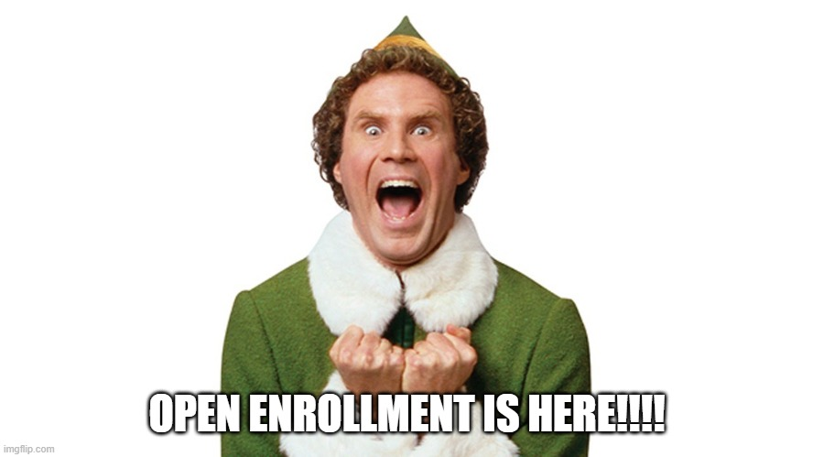
Questions?

