Slide 1
Register/cert training 102 plus a few follow-ups
April 13, 2021

Slide 2
agenda
Wisc.Jobs Website vs Careers Tile in Employee Self Service
Training Follow-Up
LTE Recruitments and “Rating”
Registers and Certifications
Expanded Certification
Multiple Screening Levels
Multiple Certifications
Other Stuff

Slide 3
Wisc.jobs vs Careers tile in employee self service
Internal vs external applicants

Slide 4
Wisc.jobs = external applicants
The focus of Wisc.Jobs is now primarily for External Applicants
It can be used by employees to search for jobs, but they must apply for jobs via the Careers Tile in Employee Self Service
When the applicant clicks to see the Job Posting…

Slide 5
Wisc.jobs = external applicants
They are taken to the external applicant page

Slide 6
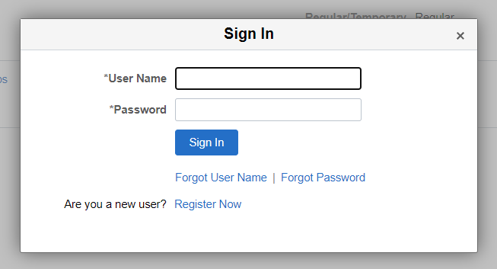
Wisc.jobs = external applicants
When they click on Apply for Job, the login for external applicants pops up
There is no way for the system to know if someone is an employee or an external applicant at this point

Slide 7
Wisc.jobs = external applicants
A pop-up message has been added to the external login page to help drive employees in the right direction
We are looking to see if there is a way to identify employees at this point in the process

Slide 8
Message for internal applicants who try to create external applicant account
When someone is creating an external user account, there is logic to look at the person’s last name, birth month/day, and last 4 of SSN to see if it matches an active employee with an unlocked IAM
The following message appears:

Slide 9
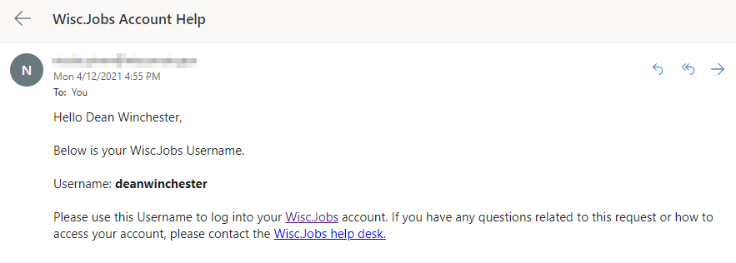
Message for external applicants who try to create a duplicate account

Slide 10
Training follow-up

Slide 11
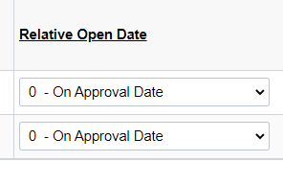
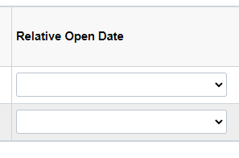
Job postings – post and remove date
When we turned on Approval Workflow, it impacted how the sections within the Job Posting Destinations section reacted.
Until we can make the changes, please do the following:
Change the Relative Open Date to blank

Slide 12
Job postings – Remove date - CORRECTION
Enter the Remove Date – logic correction
The Remove Date = Day After the Application Deadline. If your application deadline is 4/20/21, the Remove Date should be 4/21/21. The job will remain posted until the day turns to the Remove Date.

Slide 13
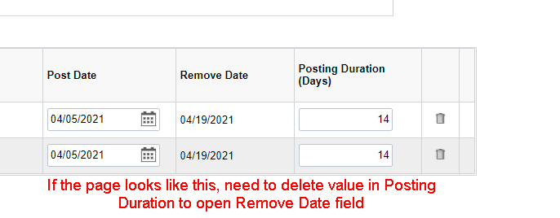
Job postings – remove date
If you need to make changes to your Remove Date, you need to either:
Change the days in the Posting Duration field; or
Delete the days in the Posting Duration field – this will open the Remove Date field for entry, and you can enter a new Remove Date

Slide 14
Lte Recruitments and “rating”
Forwarding applicants vs routing resumes

Slide 15
LTE applicant collection methods
There are 2 primary ways to collect and send information for LTE recruitments to the Hiring Manager
Forward the applicants (resume attached to email)
Route the applicants (can include resume, letter of qualifications and any other attachments)

Slide 16
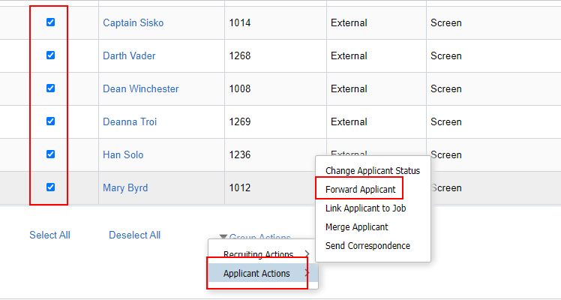
Forwarding applicants
If the supervisor/hiring manager just wants to see the resumes of the applicants, the applicants can be forwarded.
Select all the applicants you want to forward
Notes:
Job ID 1254 used as example

Slide 17
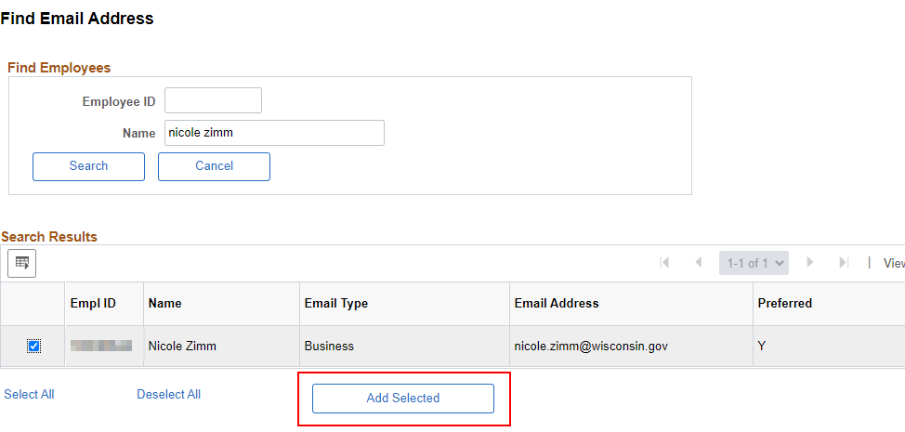
Forward applicants
On the Forward Applicant Page, enter the email of the hiring manager or click Find to access their information

Slide 18
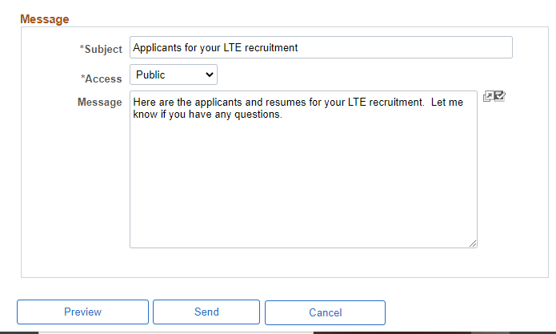
Forward applicants
Enter a Subject and Message
Click Preview to review message
Click Send to send message

Slide 19
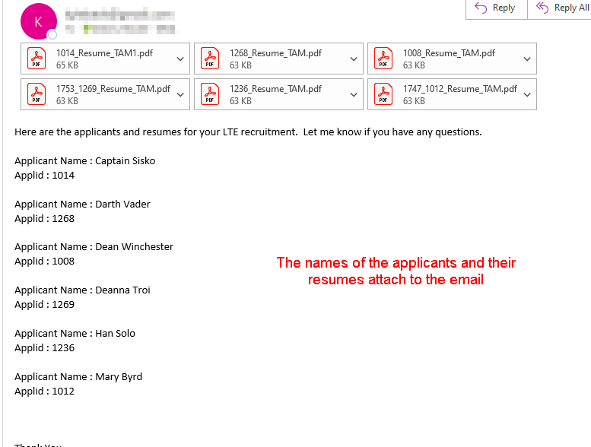
Forward applicants
Let’s forward applicants for Job ID 1254

Slide 20
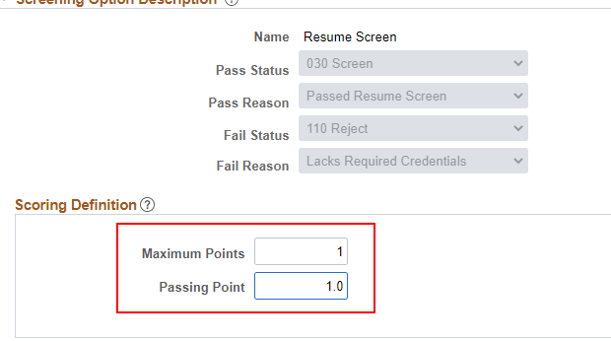
Route the applicants
Create a Pass/Fail Resume Screen for routing purposes
Pass = they will be interviewed
Fail = they will not be interviewed

Slide 21
Route the applicants
The resume screen set up is providing a way for the hiring manager to indicate who they want to move forward (they will rate the applicant either 0 or 1)
You don’t have to go through all the Resume Screen processing if you don’t want to.
You can route the applicants from the Applicants Tab

Slide 22
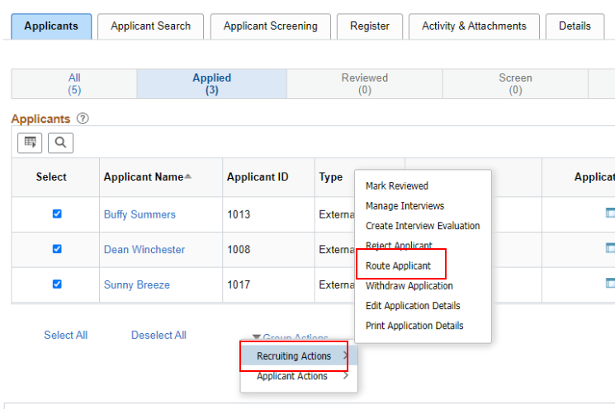
Route the applicants
Select the applicants you want to route

Slide 23
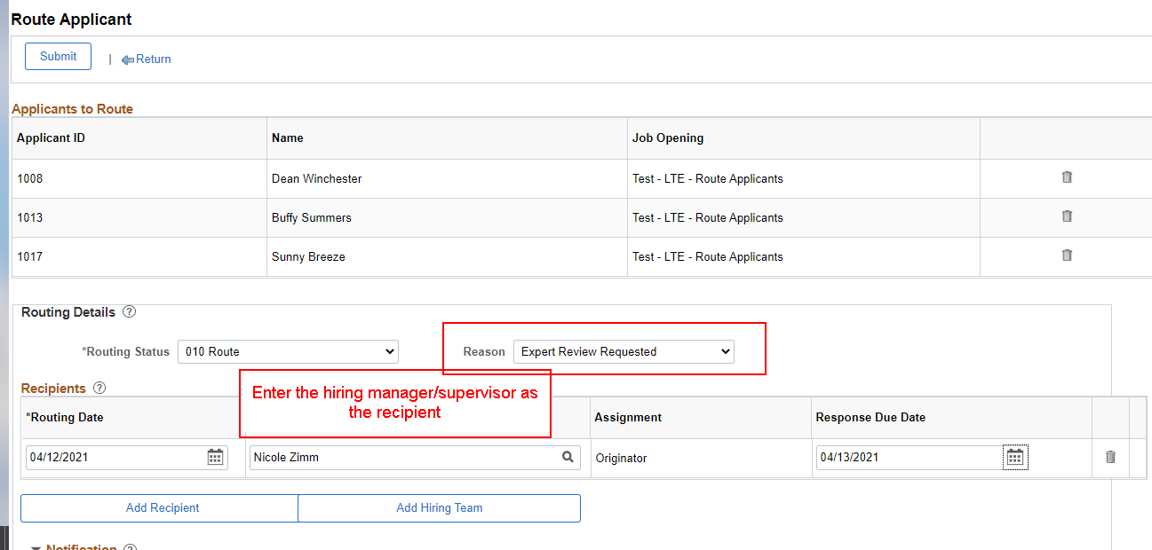
Route the applicants
You will be brought to the same page where you route the resumes for a regular resume screening

Slide 24
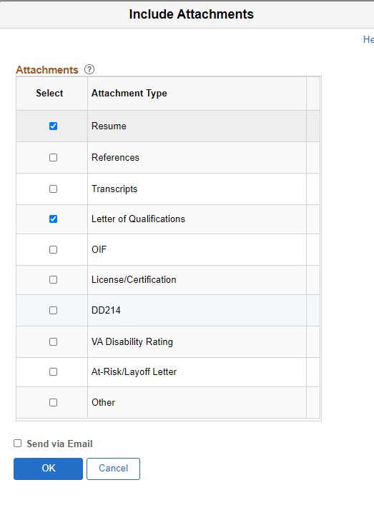
Route the applicants
Enter what you want the hiring manager to have access to as part of the review
Note: The default is now set to NOT send the attachments via email. You will need to check the box if you want to include the attachments in the email to the hiring manager.

Slide 25
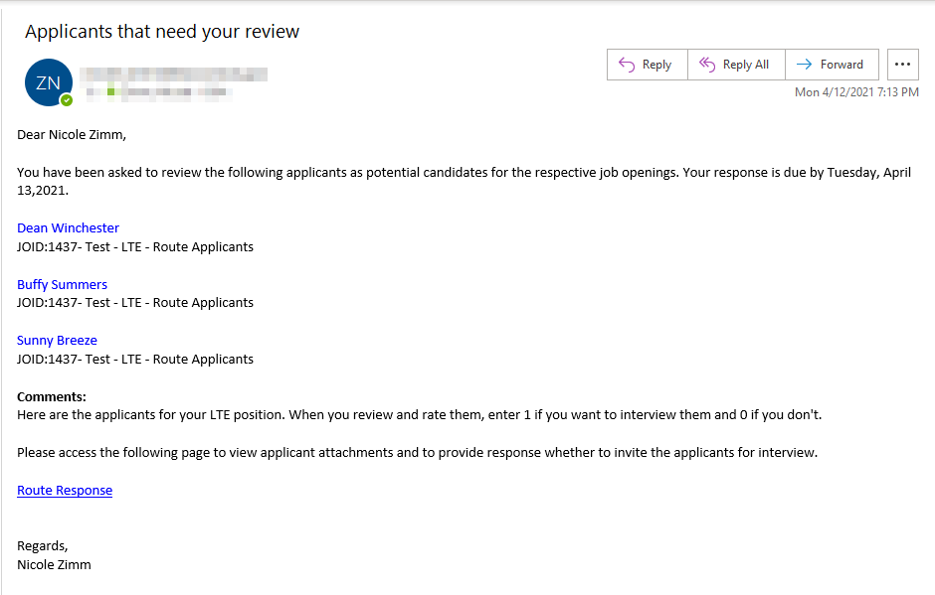
Route the applicants
The hiring manager will receive an email with the applicants and a link to their information

Slide 26
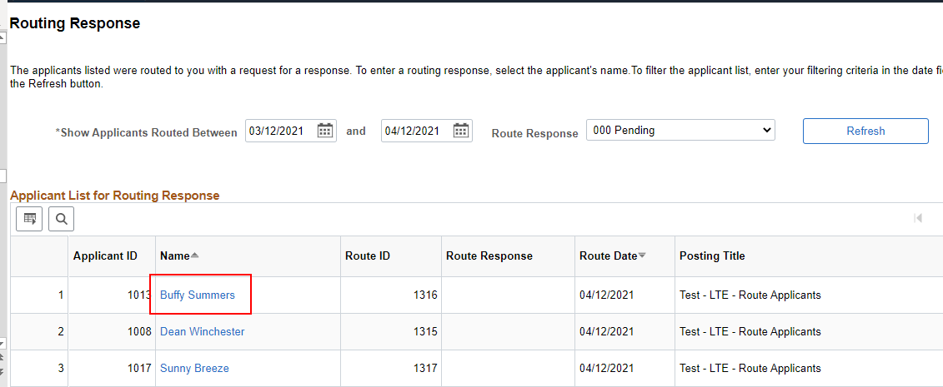
Route the applicants
The hiring manager will see all the applicants on the Routing Response page and can review their materials

Slide 27
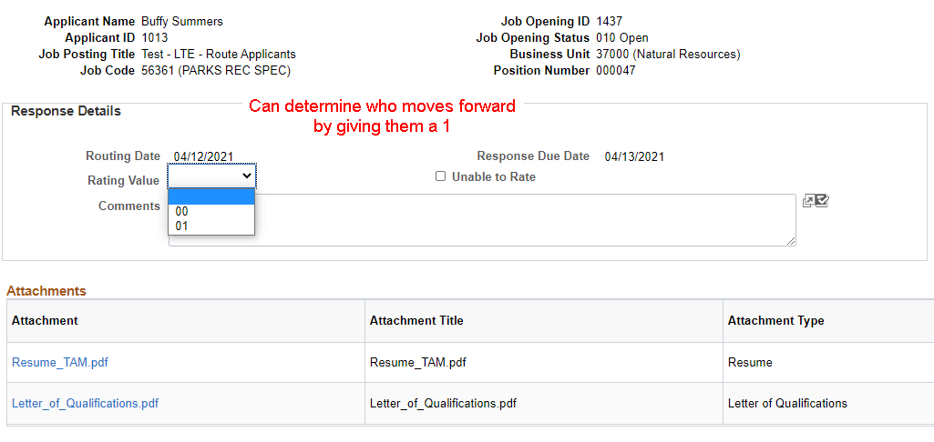
Route the applicants

Slide 28
Run resume screening to see who is moving forward
Can run the resume screening to quickly see who is moving forward

Slide 29
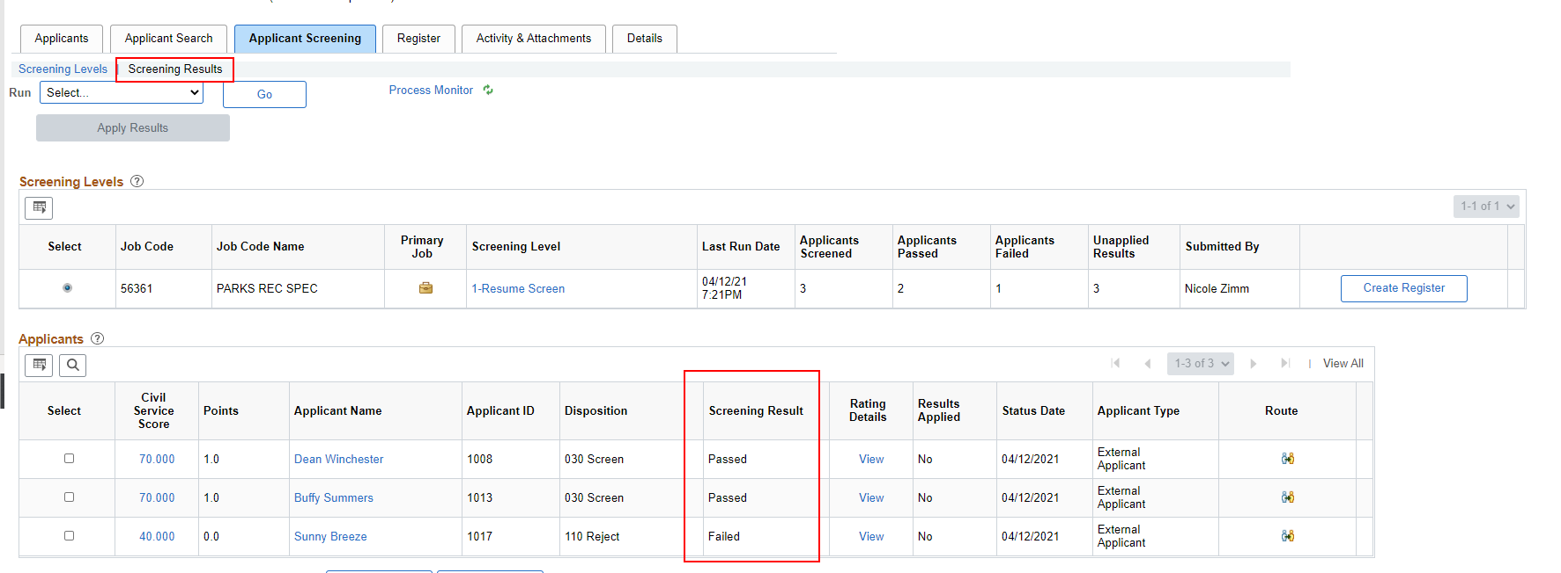
Review screening results

Slide 30
Can route and run screening level at any time
You do not have to wait for the Job Posting to come down before routing applicants for an LTE recruitment
You can route applicants and run the screening level as often as you like to bring in more applicants
Let’s look at some new applicants on Job ID 1437 and run the process

Slide 31
Registers and certifications

Slide 32
Pass/Fail Recruitments
A pass/fail recruitment has an assessment where the passing point is equal to the maximum points available in the screening
Will typically be either an online screening or a pass/fail resume screening
The Civil Service Score generated will be 70 for pass and 40 for fail
Notes:
Online screening Job 1438

Slide 33
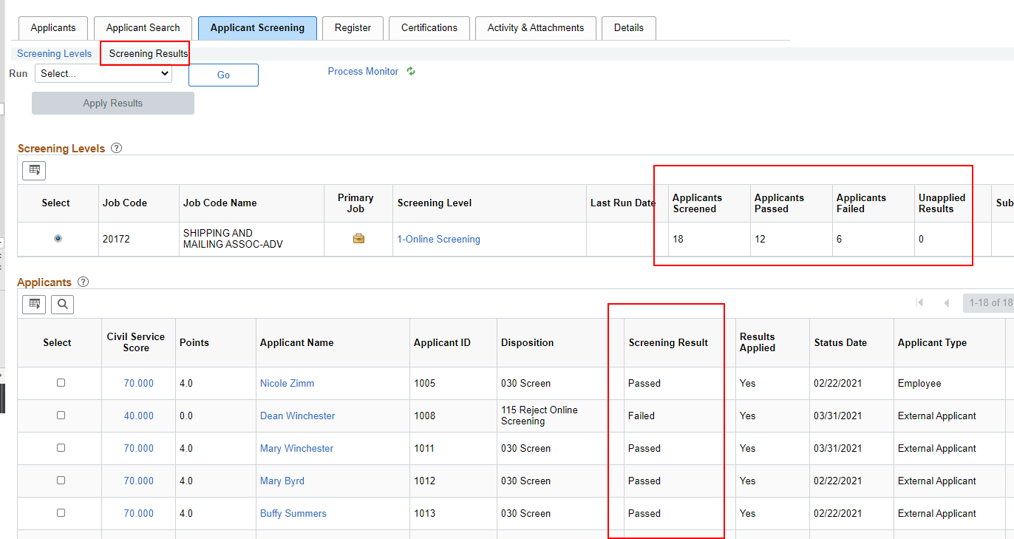
Pass/Fail online screening results example

Slide 34
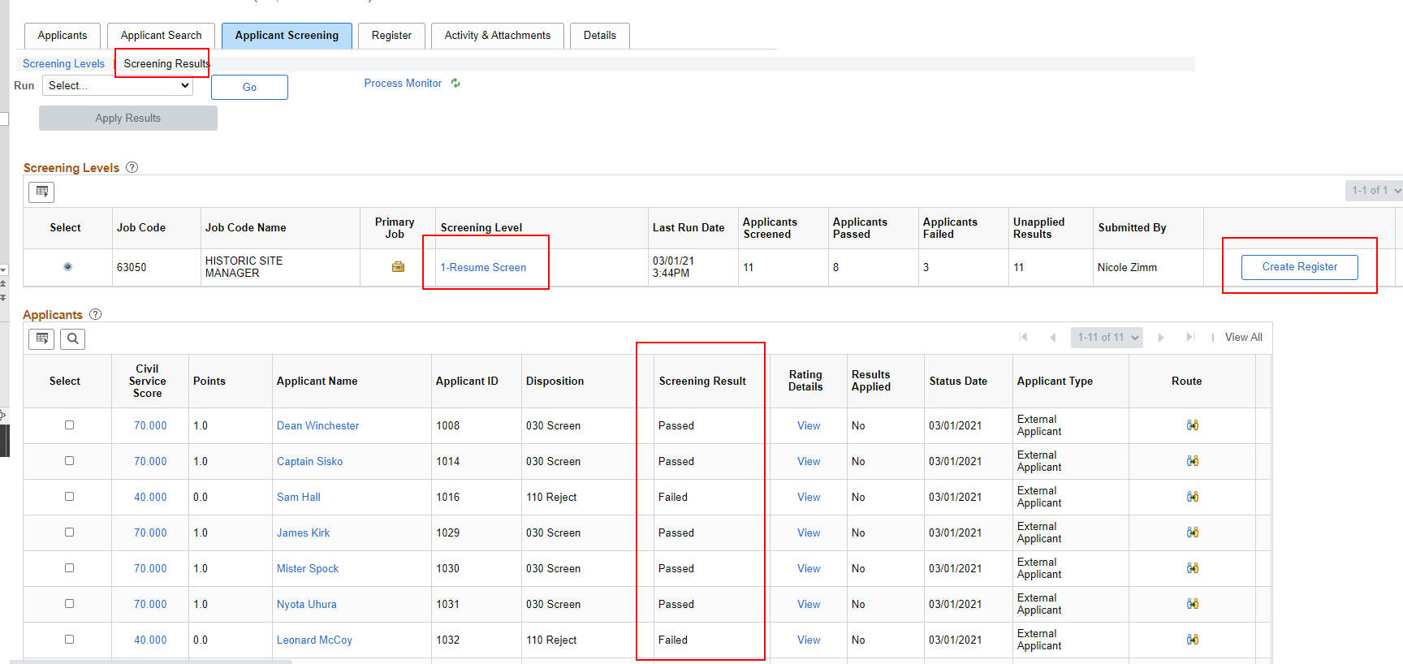
Pass/fail Resume screening results example

Slide 35
Pass/fail register
Click Create Register
The following message will pop up – click Yes (we are not applying results)

Slide 36
Pass/fail register
The Register will populate on the Register Tab
The Register Expiration Date will default to 6 months from the date the register is created (update as needed)
Click on the download button to export the information on the page
Score Export Analysis Report is forthcoming

Slide 37
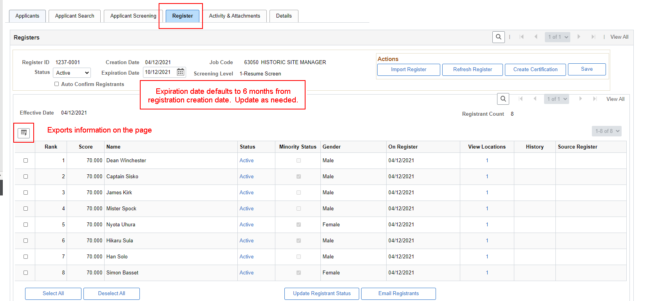
Pass/fail register

Slide 38
Create certification
Once you are confident in your Register, click the Create Certification button on the Register page

Slide 39
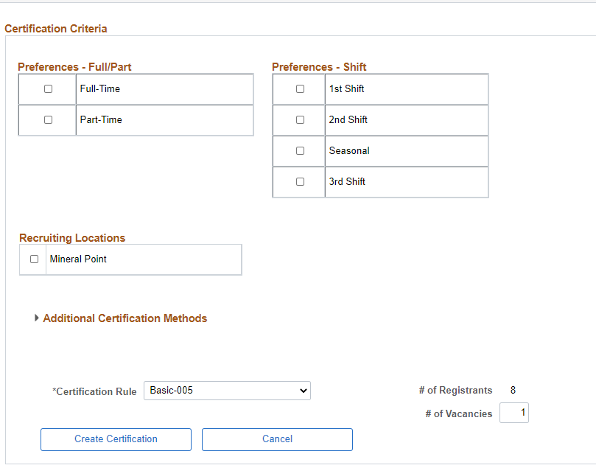
Create certification
A certification criteria page will pop up
Currently the 2 employment questions and the locations associated with the Job Opening appear on the page.
We are in the process of making updates to this page, so the employment questions only appear as criteria if used in the Job Opening

Slide 40
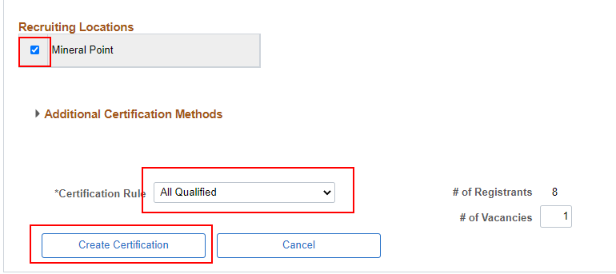
Create certification – pass/fail
If you must select at least 1 criteria and the Certification Rule
Enter the number of vacancies
For a pass/fail recruitment, select a Cert Rule of All Qualified
Click Create Certification

Slide 41
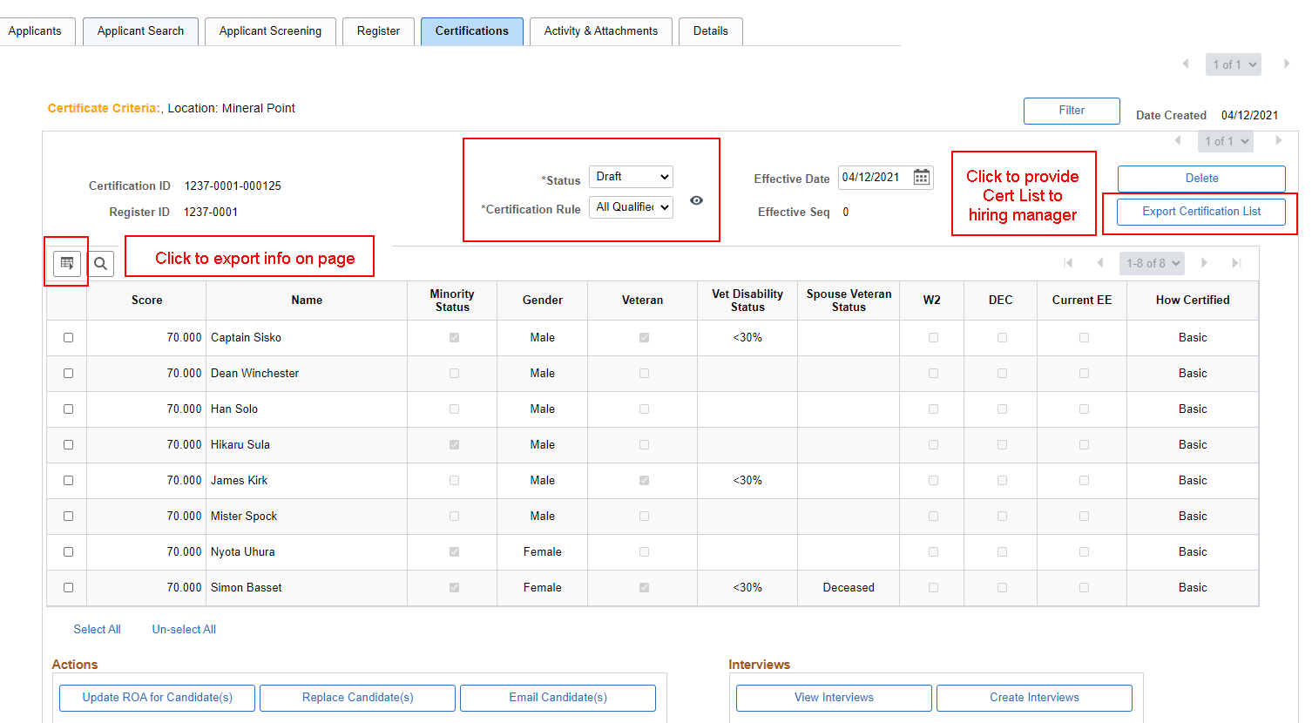
Certification will initially be in draft status

Slide 42
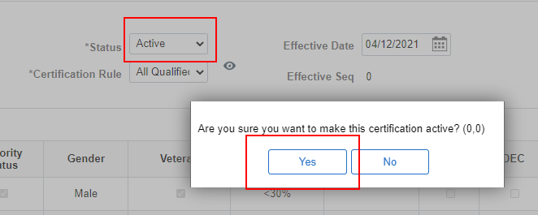
Finalizing certification
Update the Status to Active to activate the Certification

Slide 43
Pass/cert register & Certification demo
Let’s look at Job ID 1237
Pass/Fail Resume Screen
Let’s run the process and download the cert list

Slide 44
Expanded certification
Notes:
Job ID 1243

Slide 45
Expanded certification
All expanded certification logic is configured in the system
The expanded certification category associated with an applicant displays on the certification
The certification logic is also accessible from the certification page

Slide 46
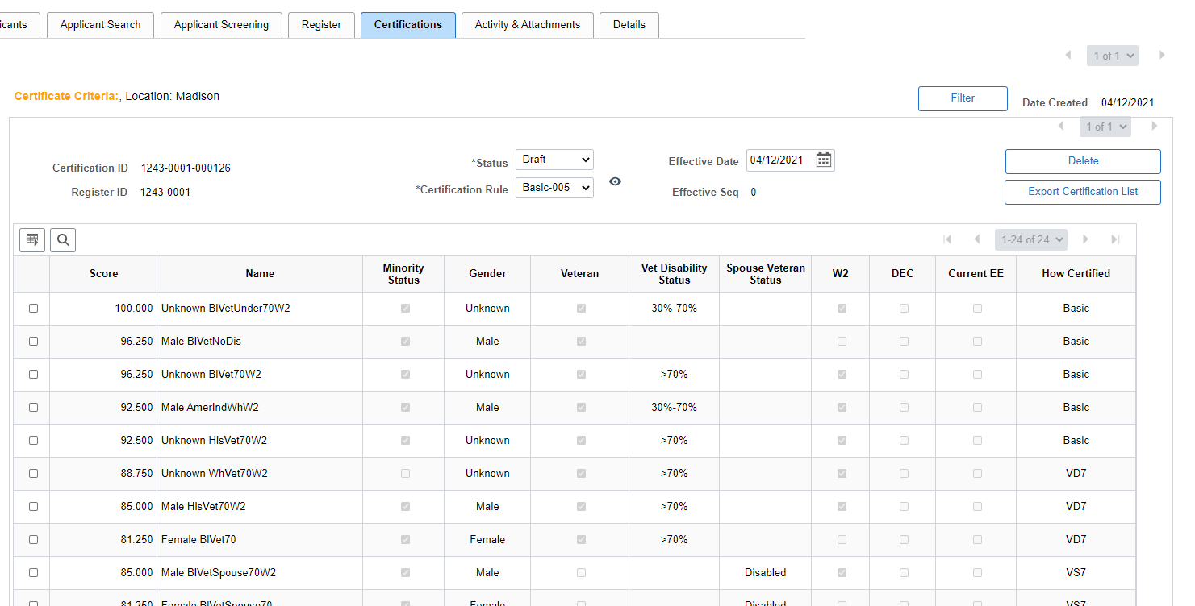
Certification example (those are all test names – applicant names will appear under name)

Slide 47
Expanded certification definitions – how certified
Basic = based on basic cert rule selected
VD7= veteran with at least 70% disability
VS7 = spouse of at least 70% disabled veteran
VTR = veteran of any status
VTD = veteran of any disabled status
VKA = unremarried spouse of veteran killed in action
VDS = unremarried spouse of veteran who died of service-related disability
DEC = disabled expanded certification
MEC = underutilized minority
WEC = underutilized women
DEL = disabled eligible

Slide 48
Accessing expanded certification applicant information
W2, DEC, DEL Eligibility
State of Wisconsin (STAR) – Recruiting – W2, DEC, DEL Eligibility
Under-utilization (MEC, WEC)
State of Wisconsin (STAR) – Recruiting – Under-Utilization (MEC, WEC)
Query: WI_HRS_UNDERUTIL_WEC_MEC
Leaving the Checkmark boxes for Women and Minorities blank will return everything. Checking those boxes will only bring back "Yes" values.

Slide 49
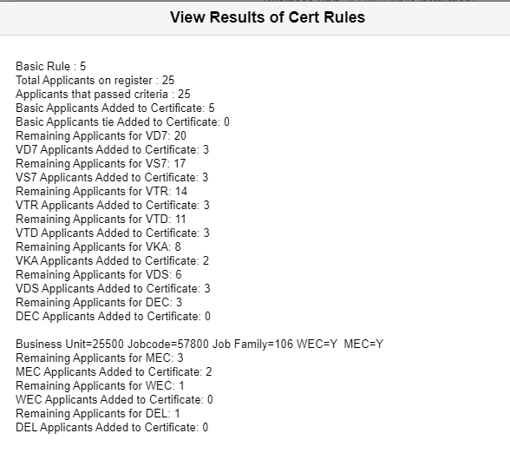
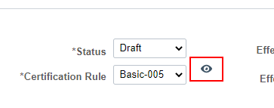
Reviewing cert rule logic
Click on the “eye” next to the Cert Rule to see the details behind the certification
Let’s look at Job ID 1243

Slide 50
Multiple screening levels
Plus changing the passing point
Notes:
Job ID 1296

Slide 51
CSS calculated on final screening level
If there are multiple screening levels, the CSS is calculated on the final screening level
Example – Online + Resume Screening
Use an online screening for mandatory qualification
Use resume screen for CSS generation, register/cert

Slide 52
Update passing point
Once you run the screening results, if you need to adjust the passing point, adjust the passing point on the screening level and re-run the screening level
This will recalculate the CSS
Let’s review Job ID 1296 to update the passing point and review multiple screening levels

Slide 53
Creating multiple certifications
Notes:
Job ID 1160

Slide 54
Multiple criteria
You can create certifications on several different types of criteria
Let’s look at Job ID 1160 for options

Slide 55
Additional Register/cert training
In about 3-4 weeks, we’ll do a follow-up training that focuses on more complex register/certification topics

Slide 56
Other updates
As time permits

Slide 57
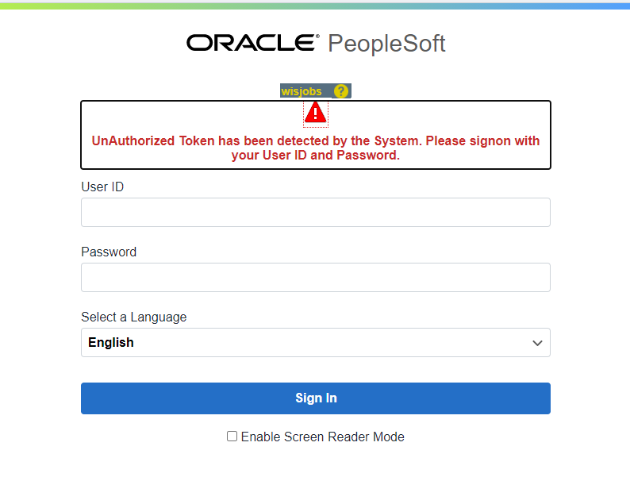
Looking at external site while logged in to STAR
You may have received this message when logged into STAR and accessing a Job Posting through Wisc.Jobs.

Slide 58
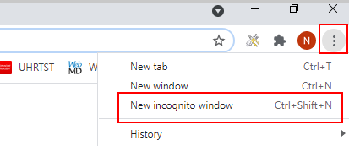
Looking at external site while logged in to STAR
These two things violate security because you are trying to access STAR from both an internal and external perspective.
You will either need to be logged out of STAR or open Wisc.Jobs in a different browser or via incognito in Chrome to access both systems without error.

Slide 59
Why do I keep getting kicked out of the system when I’m creating a job posting?
You will be knocked out of the system due to 15 minutes on inactivity. If you spend too much time creating the Job Posting (it’s not saving while you are in there), you might time out and lose your work.
Recommendation – if you are on the Job Posting page for several minutes, click OK on the bottom of the page so you get back to the main Job Posting page and click Save as Draft. Then go back into the Job Posting to finish your work.

Slide 60
Upcoming trainings & some other stuff
April 16th: Post Certification Processes Training from 9 – 10:30am
We will likely need some additional trainings and items come up and people become more familiar with the system
We’ll work to identify needs with the Primary Agency Recruiters
More job aids are coming over the next few weeks – we’ll let you know when they are available

Slide 61
Enjoy the rest of your day

