Slide 1
Understanding the applicant experience
March 31, 2021

Slide 2
agenda
Candidate Types
Creating an External Applicant Account
Searching for Jobs
Applying for Jobs
Other Functions within Candidate Gateway
Manually Adding Applicants to a Job Opening

Slide 3
Candidate types
Internal vs external candidates

Slide 4
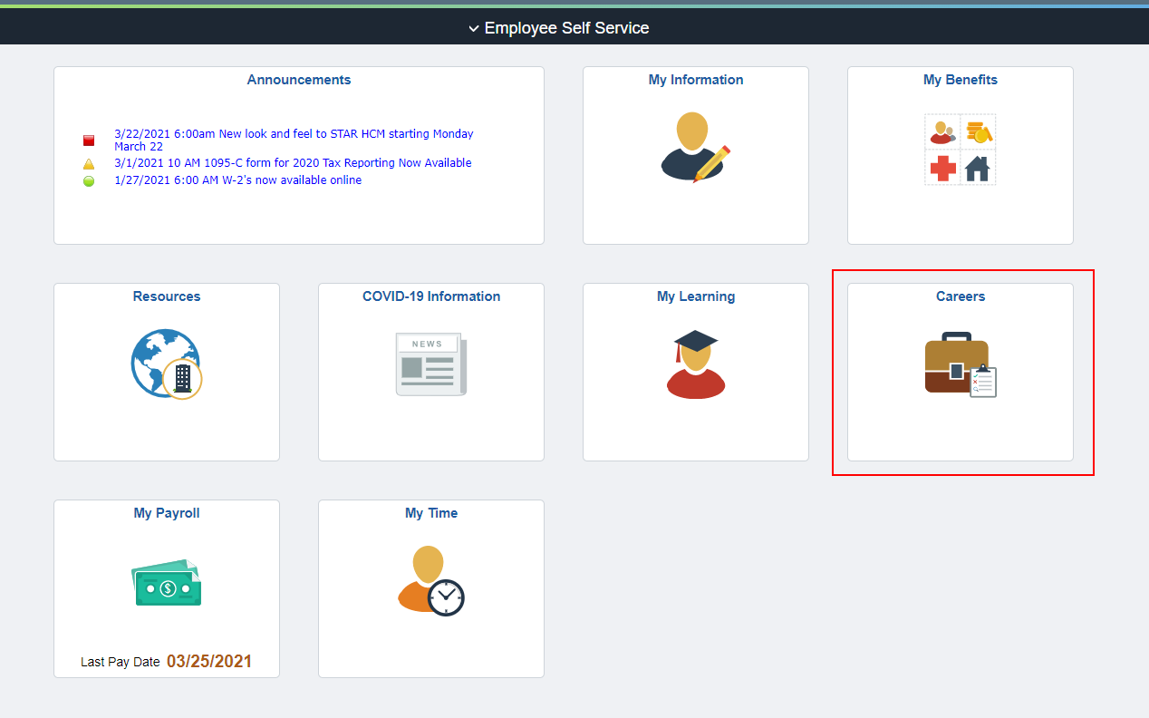
Internal candidates
Internal candidates are those who can log into STAR Human Resources with an IAM and password.
They will access Candidate Gateway through the Careers Tile on the Employee Self Service Landing Page.

Slide 5
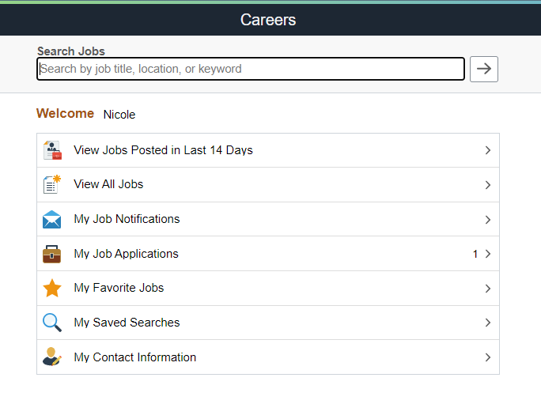
Internal candidates
Once the employee clicks on the Careers Tile, they will be brought to the Candidate Gateway landing page
The employee’s first name will appear on the page

Slide 6
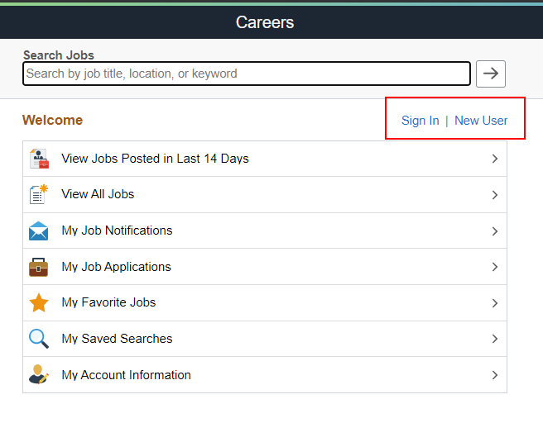
External candidates
Those that do not have access to STAR must create an external user account
No Wisc.Jobs account information will transfer to TAM so all external applicants will need to create a new account
They will initially be brought to the Candidate Gateway landing page, but the page will have New User and Sign In options.

Slide 7
Creating an external applicant account

Slide 8
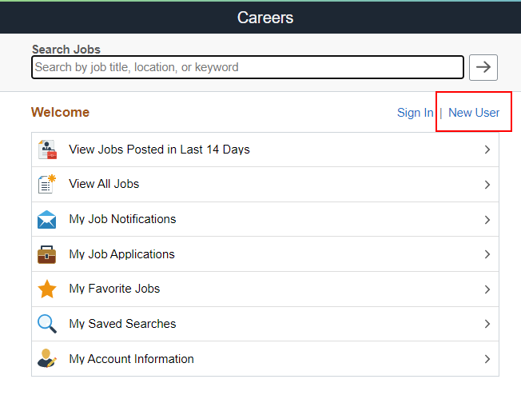
Creating an external applicant account
The applicant will initially click New User on the Candidate Gateway landing page to start the account creation process.

Slide 9
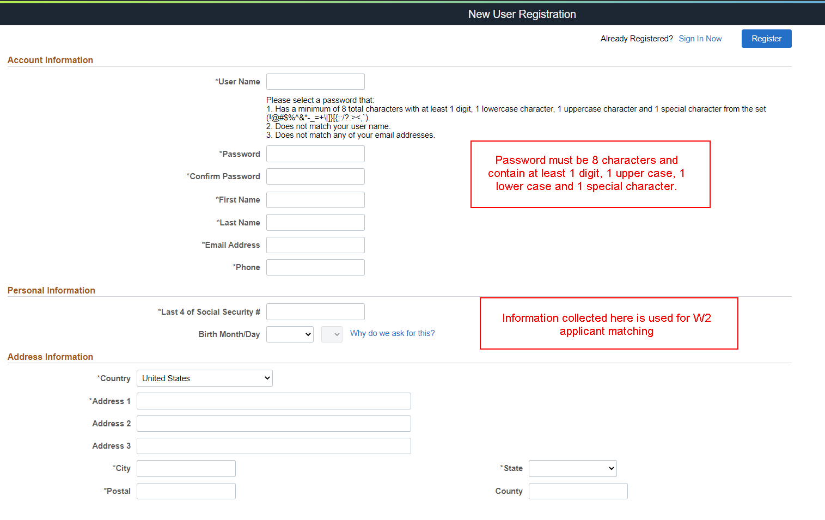
Creating an external applicant account
The new user will have to complete the identifying information at the top of the page

Slide 10
Personal information

Slide 11
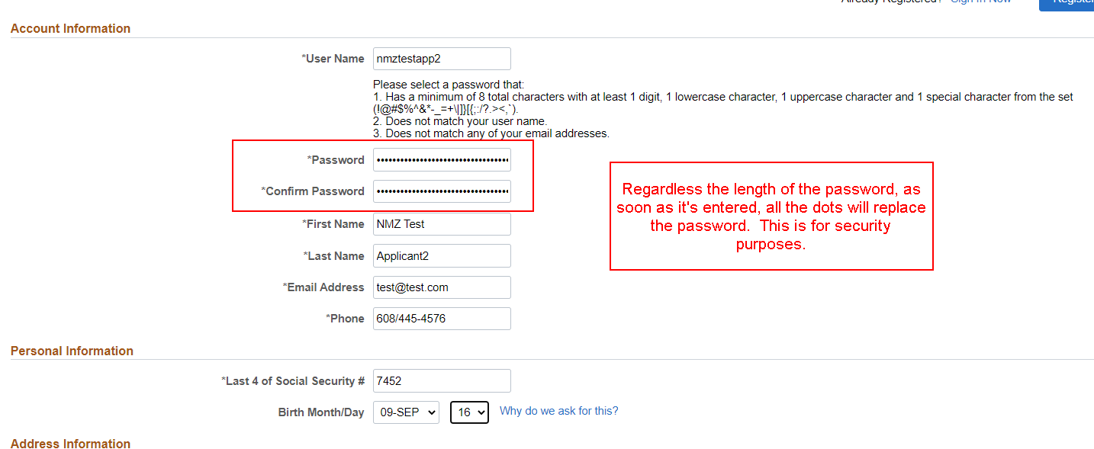
Completed upper section of page

Slide 12
Completed bottom section of the page

Slide 13
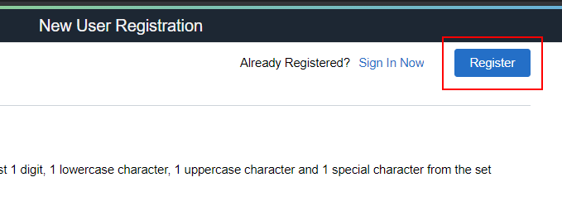
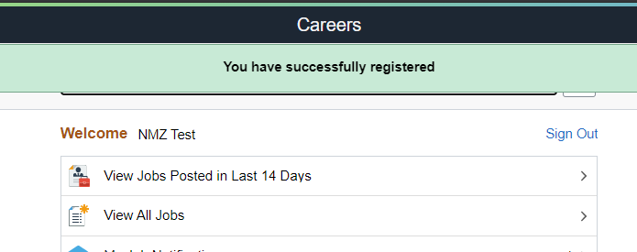
Completing the registration process
Once the page is completed, the applicant will click Register at the top of the page to complete the process
The applicant will then be brought back to the CG Landing Page

Slide 14
Can current employees create external applicant accounts?
When an external account is created, there is logic comparing several pieces of data to determine if the person creating the applicant account is an employee
The applicant will receive a warning and directions (still finalizing language) if there is a match

Slide 15
Merging internal and external accounts
If someone’s applicant status changes (internal to external or external to internal), the accounts can be merged
Additional information will be forthcoming

Slide 16
Let’s create an external applicant account

Slide 17
Searching for jobs
Candidate gateway

Slide 18
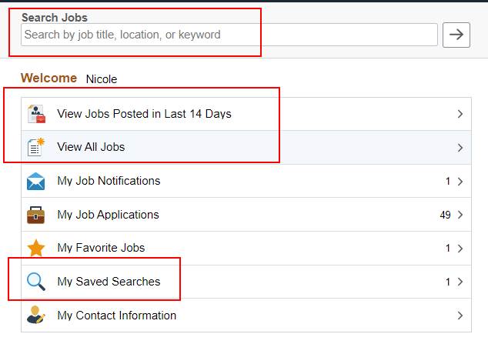
Searching for jobs in candidate gateway
Internal and external candidates search for jobs the same way within Candidate Gateway
Initial search parameters on landing page
View Jobs Posted in the Last 14 Days
View All Jobs
My Saved Searches
Search Bar

Slide 19
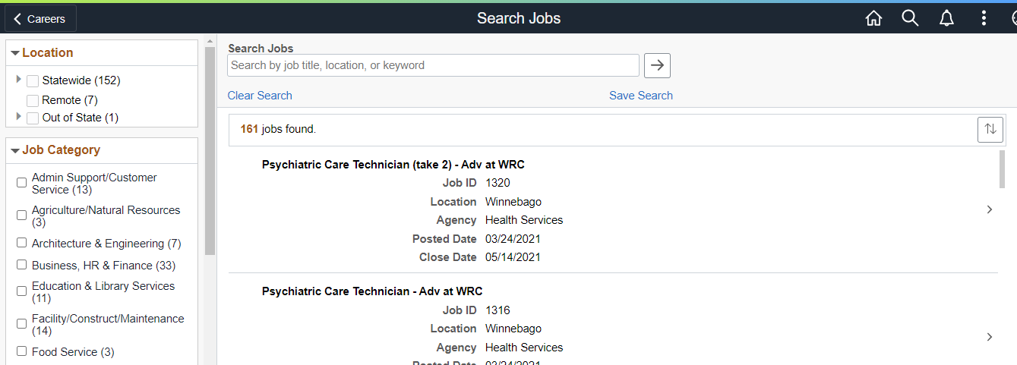
Searching for jobs in candidate gateway
Once any search criteria is entered on the landing page, job seekers will be brought to the main Search Jobs Page

Slide 20
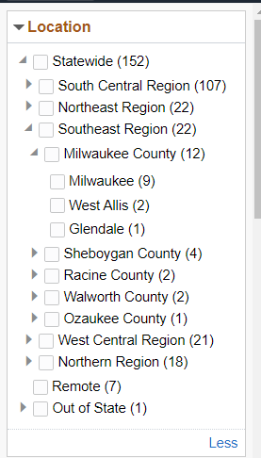
Location search
Locations are nested under Statewide
Statewide
Regions
Counties
Cities
Remote and Out of State are separate
Due to nesting of locations, it’s recommended that the recruiting location(s) attached to the job opening are at the city level if possible

Slide 21
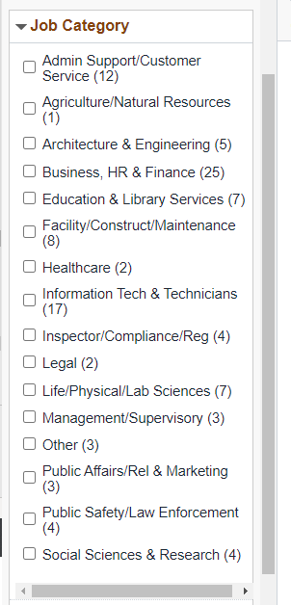
Job category search
Each job code is assigned a Default Job category – this is what drives the Job Category search

Slide 22
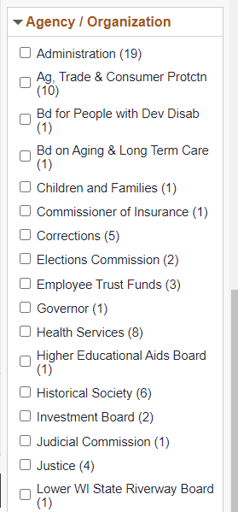
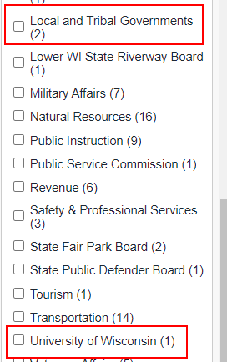
Agency search
Can search by agency
Non-STAR entities (ex. Local Government, UW…) will continue to post their jobs – they are included in agency listing

Slide 23
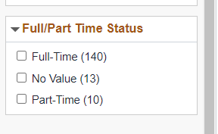
Full and part time status
Can search on full- and part-time status
Beware: only one status can be attached to a Job Opening

Slide 24
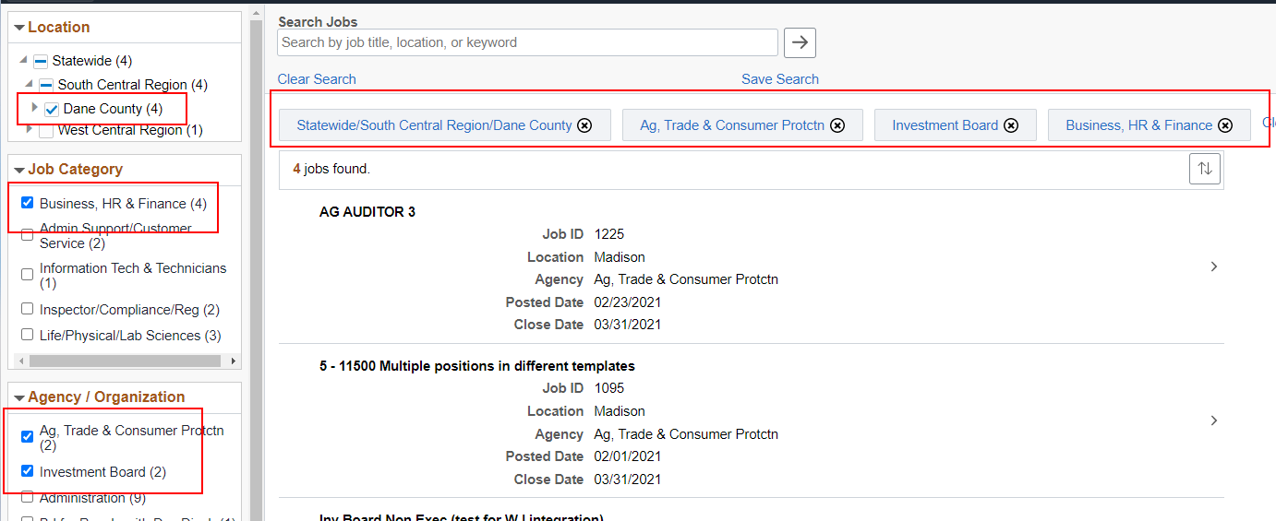
Multiple search parameters available

Slide 25
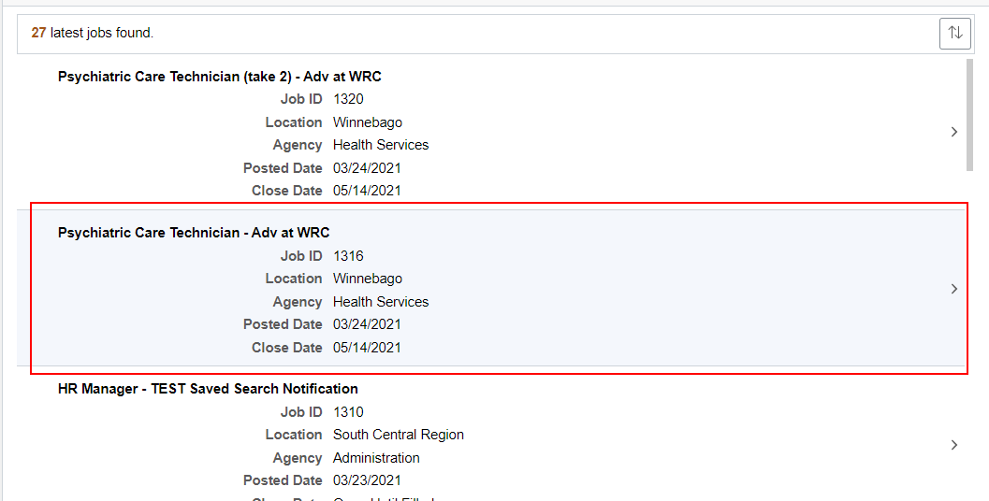
Viewing a job posting
Click anywhere on the Job to view the full Job Posting

Slide 26
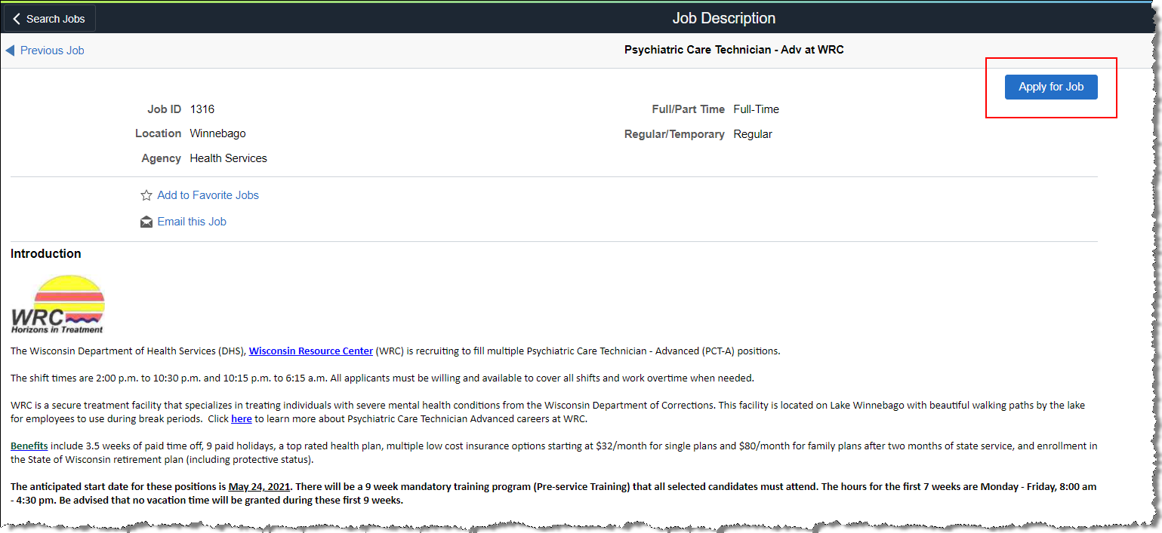
Job posting example

Slide 27
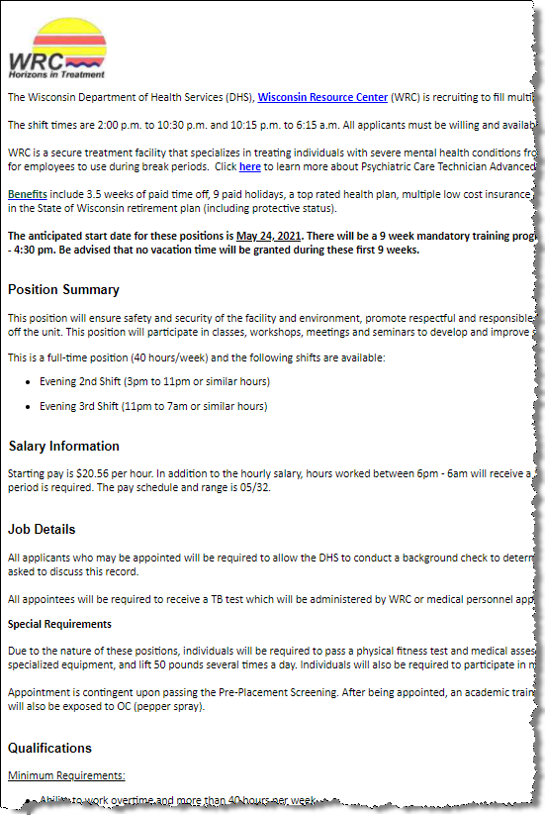
Job posting sections
The following sections are in the Job Posting:
Introduction
Position Summary
Salary Information
Job Details
Qualifications
How to Apply
Deadline to Apply

Slide 28
Let’s search for jobs in candidate gateway

Slide 29
How does the New wisc.jobs website play into this?
The new Wisc.Jobs site….
Includes the Wisc.Jobs branding
Provides applicant resources
Is “more attractive to the eye”
Allows for different types of searching
Links to Candidate Gateway

Slide 30
Applying for jobs

Slide 31
Applying for a job
From the Job Posting, the job seeker will click on the Apply for Job button at the top of the page to start the process

Slide 32
Applying for a job (non-star entities)
The Apply for Job button will not appear on the page for a non-STAR entity Job Posting or for the Courts and Legislature at this time
The Courts and Legislature will be fully onboarded to TAM at a later date

Slide 33
Not every job opening looks the same
There are several items in the Job Opening that drive the applicant experience
The template attached to the job opening will determine the applicant experience when it comes to the requirements around submitting a resume, letter of qualifications and work experience
If it is a Statewide or multi-location recruitment, the applicant will be asked to select where they want to work
The applicant will need to answer specific assessment questions if part of the job opening

Slide 34
Warning – template id information coming to you again…
The following template information was shared in the Job Opening 103 training but it’s worth a quick overview

Slide 35
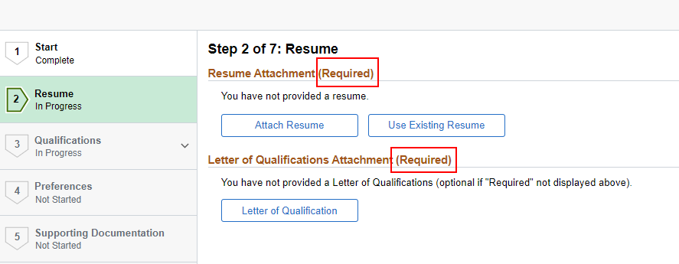
Template ID 3001 – Resume and LOC required, Work Exp Hidden
Resume and Letter of Qualifications Required
Work History is not displayed

Slide 36
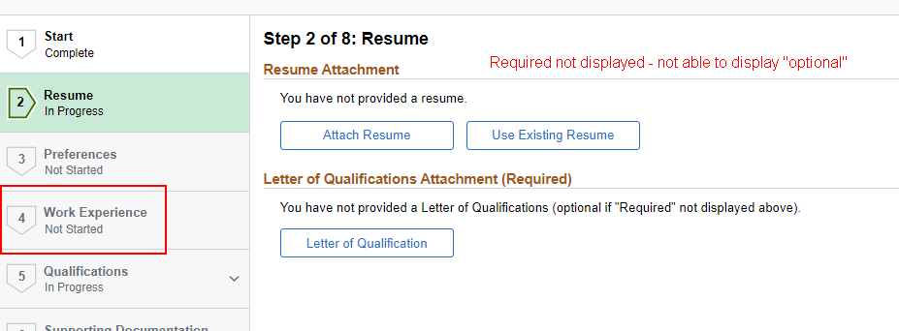
Template ID 3002 – resume/Work Exp Optional, LOC required

Slide 37
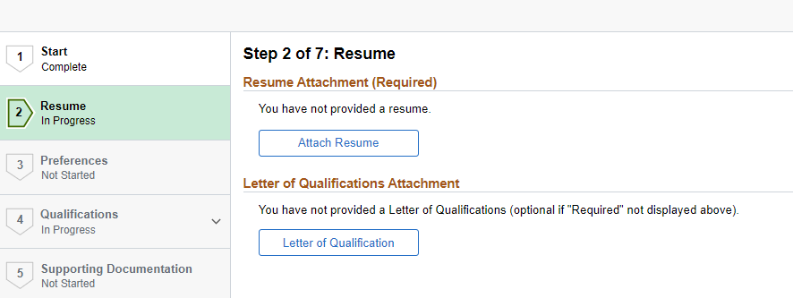
Template ID 3003 – Resume required, LOC optional, Work Exp Hidden

Slide 38
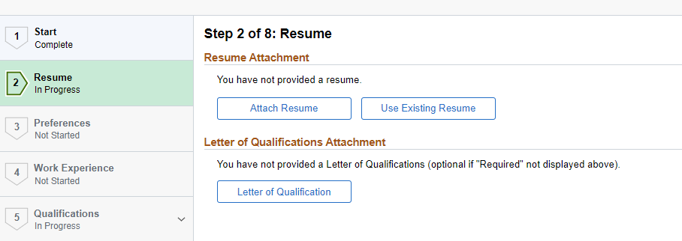
Template ID 3004 – Resume/Work Exp & LOC Optional

Slide 39
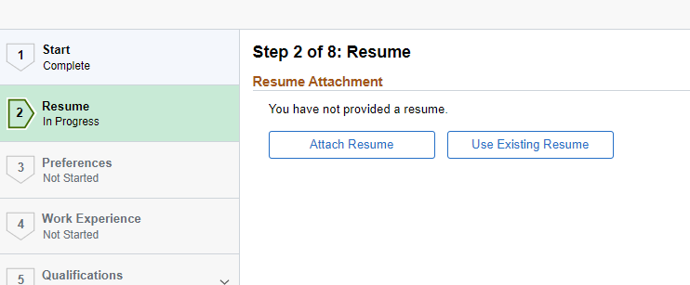
Template ID 3005 – Resume/work Exp Optional, LOC Hidden

Slide 40
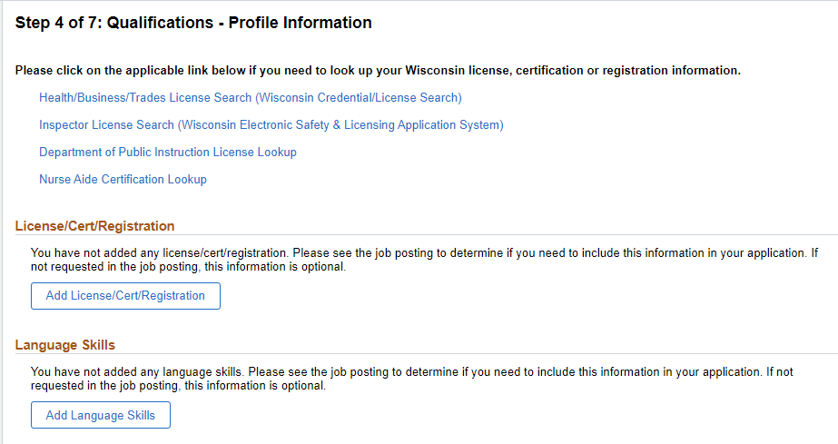
Profiles items across all templates - optional

Slide 41
Supporting documentation across all templates - optional

Slide 42
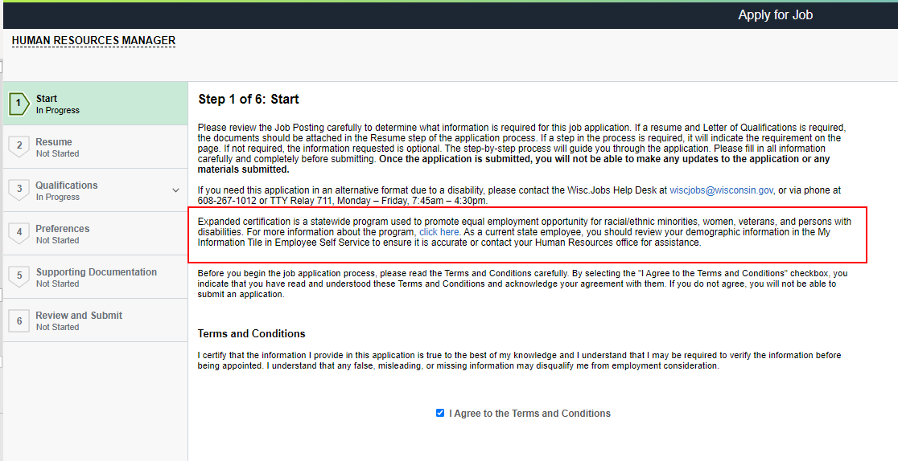
Step 1 of application process – internal candidates

Slide 43
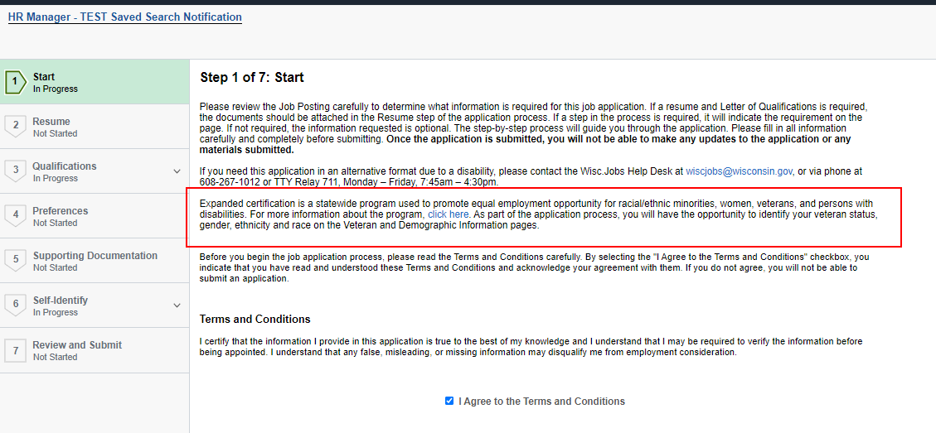
Step 1 of application process – external candidates

Slide 44
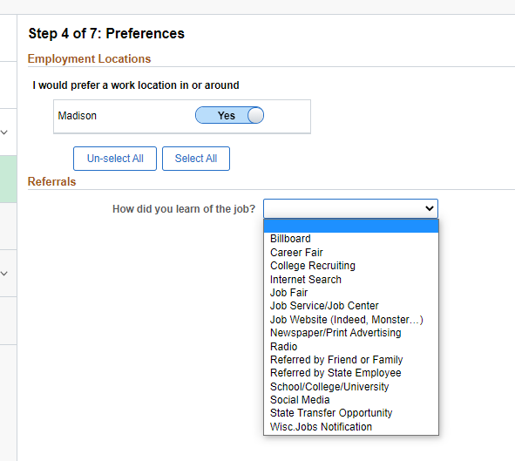
Preferences page
This page will be different based on two factors:
How many recruiting locations are on the Job Opening
If employment questions were used
Referral information is also on this page
This example is only 1 location

Slide 45
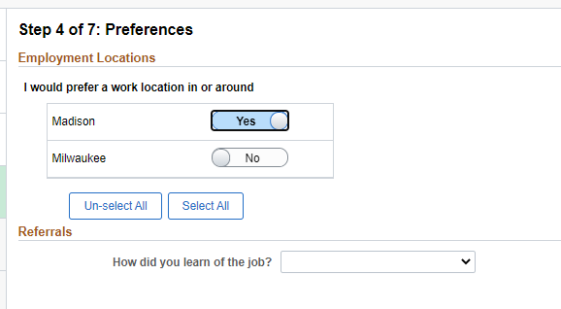
Preferences page
2 location example

Slide 46
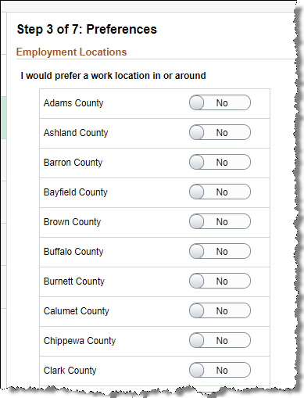
Preferences page
If Recruiting Location = Statewide, all counties in Wisconsin are available for selection

Slide 47
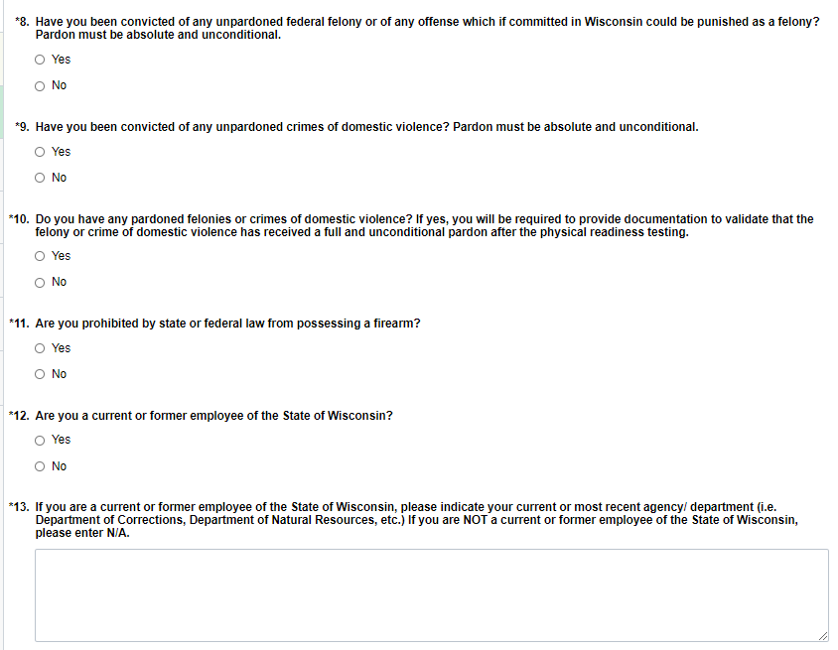
questions
If there is an online or manual screening, questions will display to applicant in the Qualifications step.
The applicant must provide a response to all questions before moving on

Slide 48
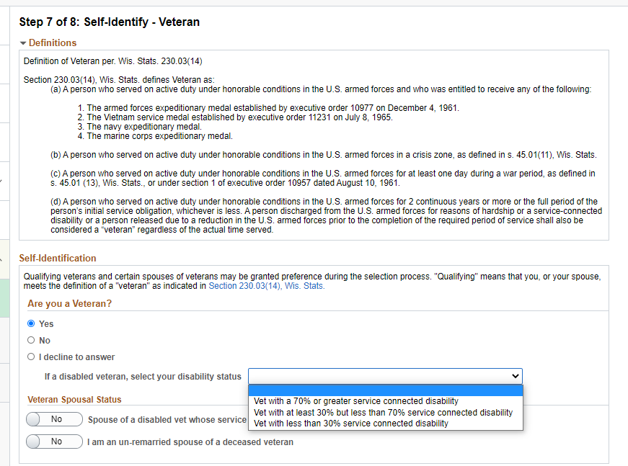
Veteran status – external applicants only

Slide 49
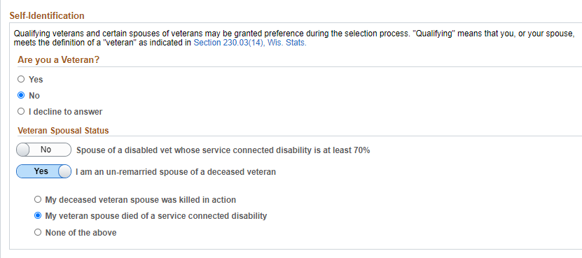
Veteran status – external applicants only

Slide 50
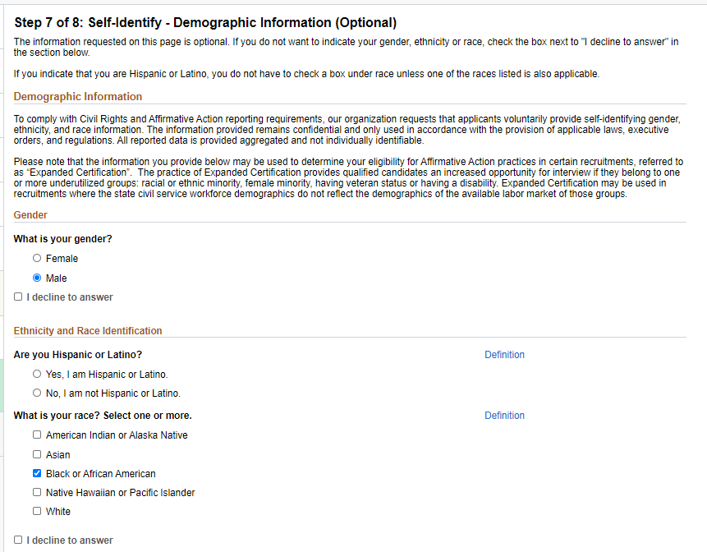
Demographic information – external applicants only

Slide 51
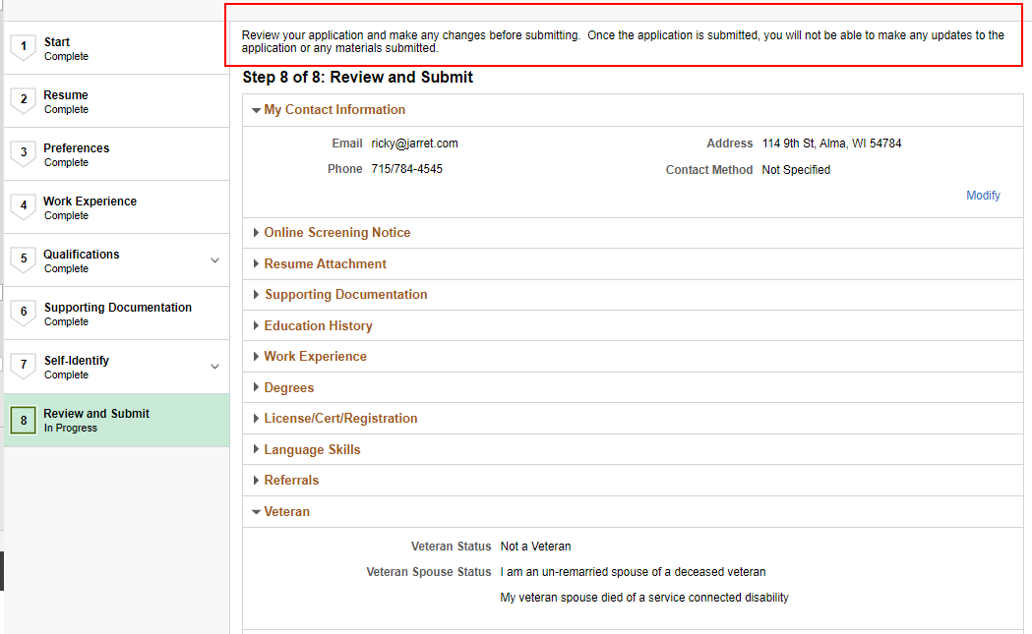
review and submit page

Slide 52
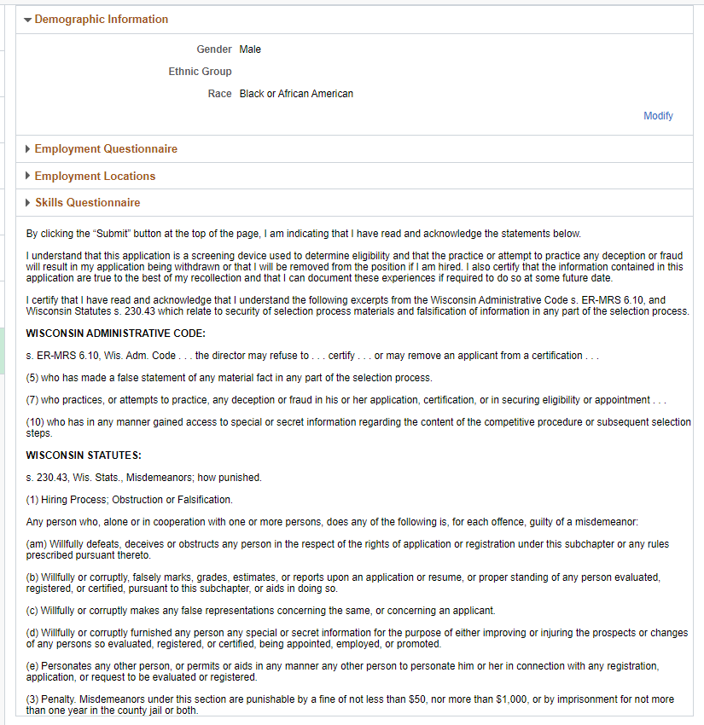
Review and submit page

Slide 53
Submitting an application
Applicant will click the Submit button on the top of the Review and Submit page

Slide 54
Let’s apply for a few jobs….

Slide 55
Other functions within candidate gateway

Slide 56
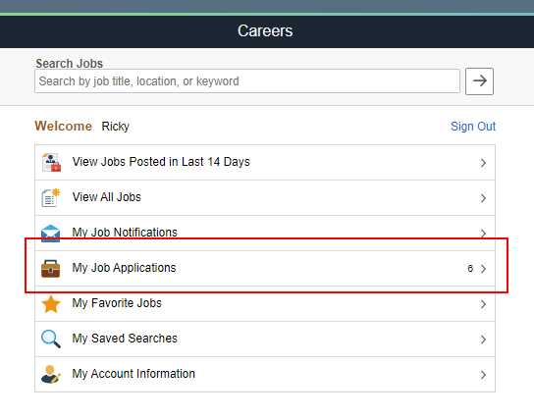
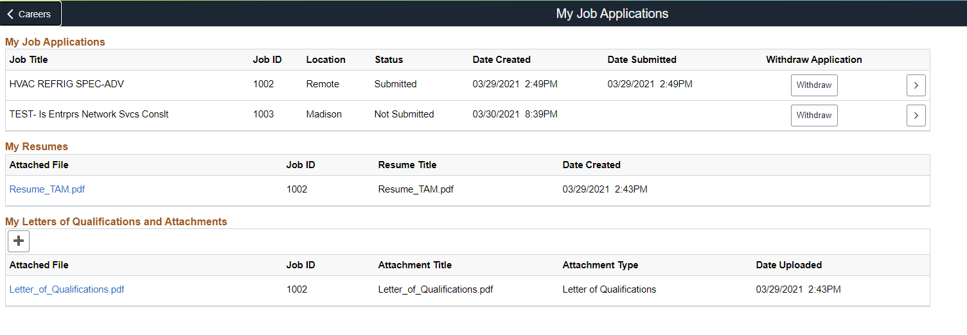
Reviewing your applications

Slide 57
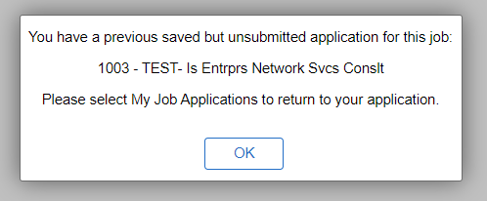
Continuing a saved application
You can save your application as a draft at any time
Go into My Job Applications to continue the process
If you try to apply for a job through the Job Posting that is already in progress, this message will display

Slide 58
Withdrawing your application

Slide 59
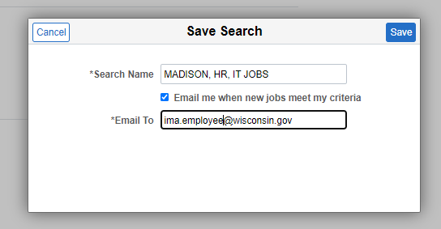
Save a search
When you enter criteria on the Search page, you can save the search
When jobs are posted that match your criteria, you will receive an email with links to the listings

Slide 60
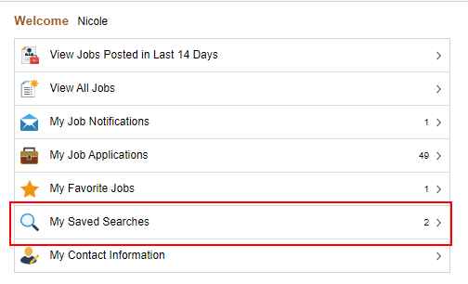
Save a search
Click on My Saved Searches to see all saved searches
Click on the Search button to see what jobs are currently active under the search criteria

Slide 61
Manually adding applicants to a job opening

Slide 62
Manually adding applicants
There are times when applicants must be manually added to a Job Opening because they are not required (or are unable) to apply through Candidate Gateway
Recruiters will be able to manually add applicants – let’s focus on career execs and non-competitive vets

Slide 63
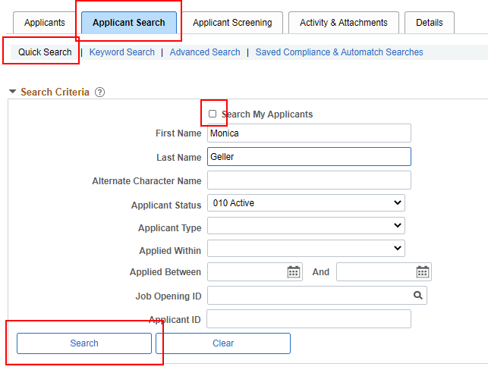
Adding applicants to the job opening
Within the Job Opening, go to the Applicant Search Tab
Click on Quick Search
Uncheck the box next to Search My Applicants
If this box is checked, only applicants who have applied to one of your jobs will appear in the Search Results
Enter the applicant’s name and click Search

Slide 64
Adding applicants to the job opening
From the Search Results page, click Actions – Link Applicant to Job

Slide 65
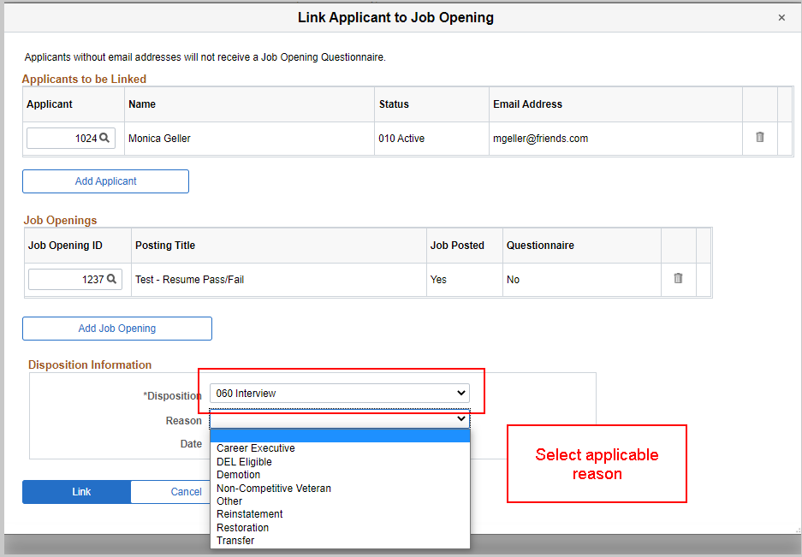
Adding applicants to the job opening
For applicants who do not go through the regular screening process with other applicants, you will move them directly to the “Interview” status.
This status was selected because it is a step past the status in which the “regular” applicants will be in during the screening process.

Slide 66
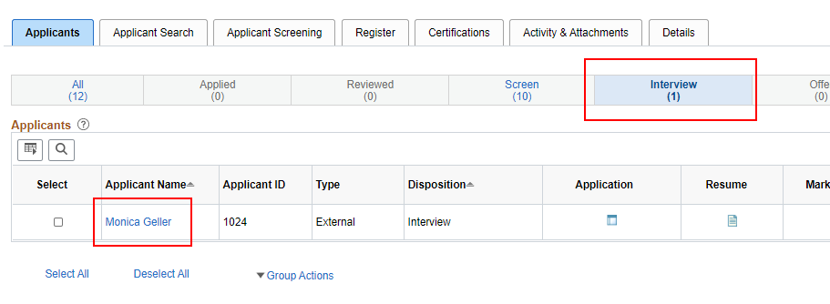
Adding applicants to the job opening
The applicant is now in Interview Status on the Job Opening

Slide 67
Adding a resume
If the applicant previously applied for a job with a resume, the most recent resume will attach to the Job Opening
If there is no resume on file for the applicant, go to Other Actions – Recruiting Actions – Edit Application Details

Slide 68
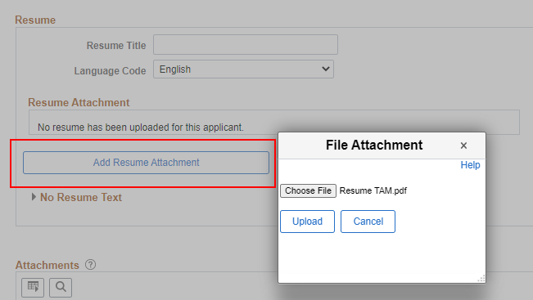
Adding a resume
Click Add Resume Attachment and upload the Resume

Slide 69
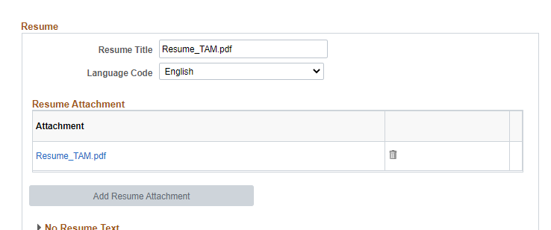
Resume added

Slide 70
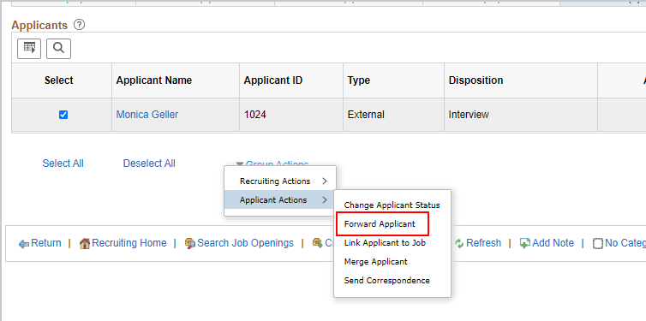
forwarding applicant to hiring manager for review
If you want to send applicant materials to the hiring manager outside of the regular routing process used for a resume screen, you can “forward the applicant”
From the same applicant page, click on Group Actions (it’s also under Other Actions) – Applicant Actions – Forward Applicant

Slide 71
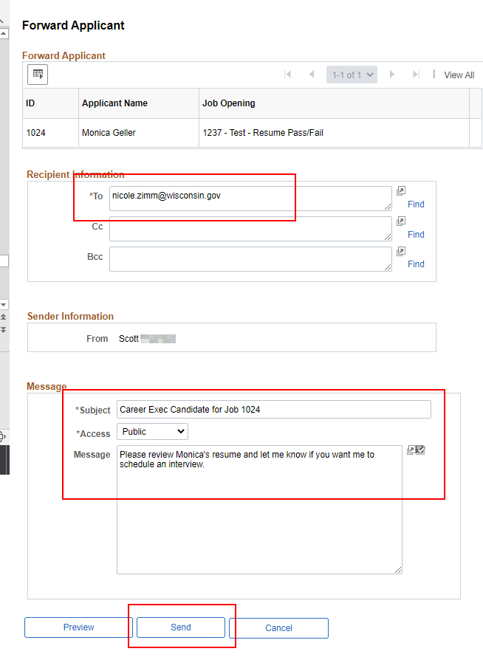
Forwarding applicant
Complete the applicable fields on the Forward Applicant Page
The resume on file will automatically be attached to the email

Slide 72
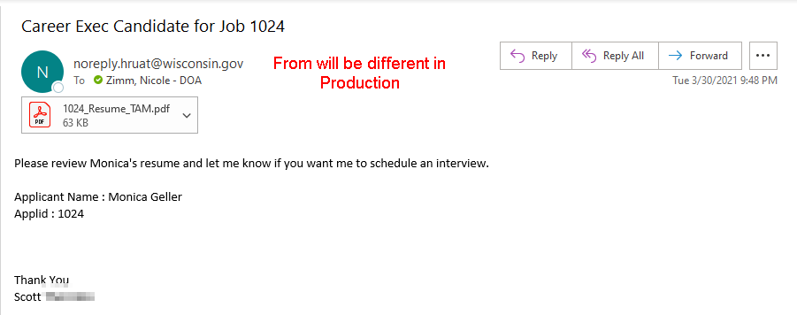
Email generated

Slide 73
Training and implementation timeline

Slide 74
Training and implementation timeline
April 5th: First day agency recruiters will have access to TAM to create Job Openings
April 5th – 8th: Daily drop-in virtual support labs
Meeting invites will be sent to primary agency recruiting contact – this person is responsible for working with agency to gather questions and bring them to the labs
April 9th: Last application deadline that should be used in current Wisc.Jobs

Slide 75
Training and implementation timeline
April 9th: Register/Cert 101 Training from 9 – 10:30am
April 10th – 12th: Window where the current WJ will move to a new URL, the new WJ website will go up and applicants will be able to start applying for jobs in the new system (exact date/time TBD).
As a reminder, applicants will be able to access their job cart and other materials in the “old” Wisc.Jobs through at least July 1st and agency recruiters will be able to access the admin side of the “old” Wisc.Jobs until an as yet to be determined point in the future.
April 13th: Register/Cert 102 Training from 1 – 2:30pm
April 16th: Post Certification Processes Training from 9 – 10:30am

Slide 76
Other updates
A request was sent to the HR Directors and Primary Agency Recruiting contacts the morning of 3/30 to request a list of employees who should be granted the Recruiting and Agency Approver security roles.
Will mass provision the security roles (will not have to go through Security Request form)
Once the mass provisioning is done, if security is needed, it will have to go through the Security Request Form

Slide 77
Other updates
An email was sent to the Primary Agency Recruiting Contacts to collect any screening/assessment answers that need to be added to the system prior to next week
The email included a template to collect Questions that you want created if you don’t want to create them yourself
Job aids will be available on Monday

