Slide 1
ICI Annual update and Deferred Enrollment training
January 17, 2024

Slide 2
agenda
ICI Annual Update Process
ICI Deferred Enrollment Process
Timeline
Next Steps
Resources

Slide 3
ICI Annual update process

Slide 4
What is the ici annual update period?
Evaluates an employee’s prior year sick leave accrual/usage and WRS earnings to determine the employee’s ICI premium category and coverage level for the year.
2023 Data Elements Finalized
All WRS-covered earnings loaded to WRS ABBR
All leave for review period finalized
ICI Annual Update Process Run in STAR
Process loads all relative data elements to ICI Annual Report
Process determines correct Elg Fld 2 and ABBR value
Agency Review of ICI Annual Report
Agency reviews data output for any needed updates
Agency makes Elg Fld 2 and ABBR updates directly on report page in STAR
All Updates Complete Prior to PP3 Confirm
Central Benefits validates agency changes
New ICI ABBR row added for all ICI enrollees
Row added to job if Elg Fld 2 needs to be updated (creates ICI event)
Once ICI event finalized, ICI plan enrollment updated effective 2-1-XXXX if premium category change
Consolidation of ICI Basic and Supplemental into 1 plan
ICI Consolidation merge
• 01-14-24 job data row consolidating ICI Basic and Supplemental into 1 plan
•ICI plan enrollment updated with a 2-1-24 row if currently enrolled changing option codes

Slide 5
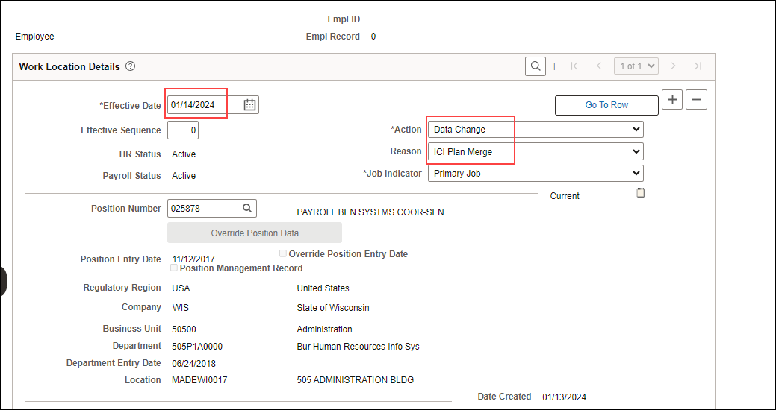
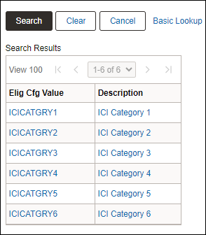
ICI Consolidation Merge- Job Data UPdate
The Elg Field 2 values were updated to remove Supplemental
All eligible employees received a 1-14-2024 job data row consolidating the ICI Basic and Supplemental into 1 plan
LEG: Job row effective date = 1-2-24

Slide 6
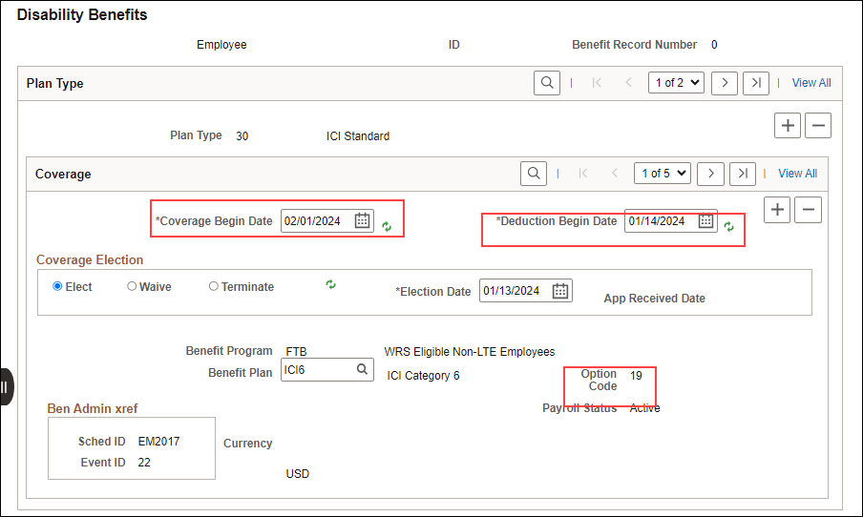
ICI Consolidation Merge- Base Benefits Update
ICI Base Benefits was also updated for any employee receiving the ICI merge job data row. This updated the ICI Option Codes with a 2-1-24 coverage begin date

Slide 7
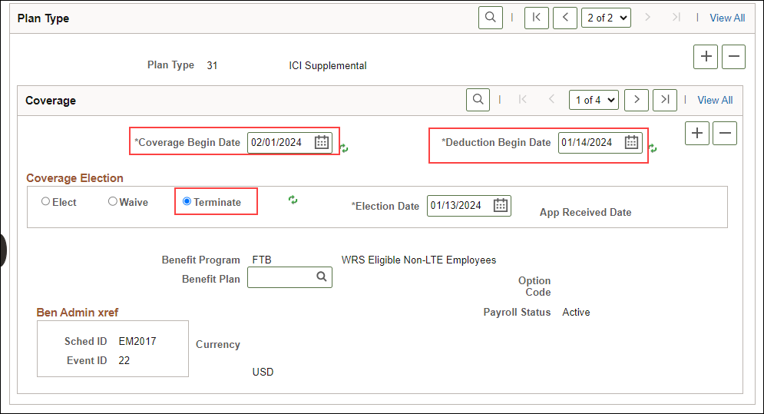
ICI Consolidation Merge- Base Benefits Update
If the employee was previously enrolled in supplemental before the merge a termination row effective 2-01-24 now shows.

Slide 8
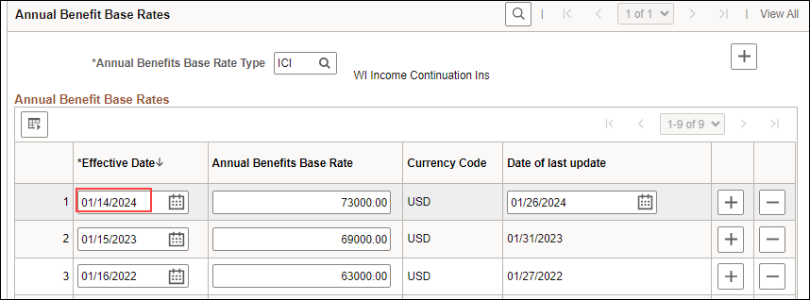
Output of ICI annual update period
All current ICI enrollees will receive a 1-14-2024 ICI ABBR
All employees with an Elg Fld 2 change receive a 1-14-24 effective dated job row that updates Elg Fld 2
LEG: Job row effective date = 1-2-24

Slide 9
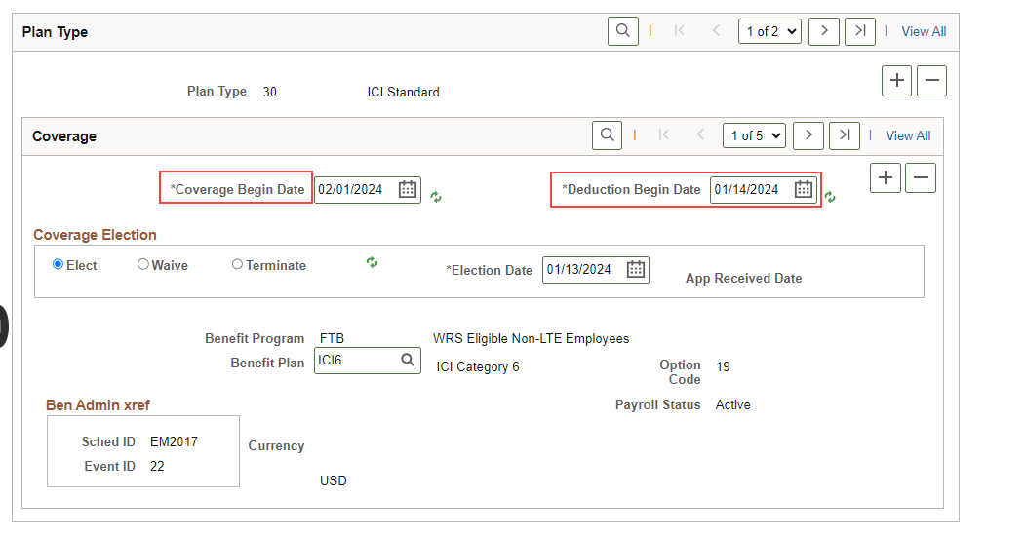
Output of ICI annual update period
All employees with a premium category change will receive a new Standard ICI enrollment row (Plan Type 30) effective 2-1-24.

Slide 10
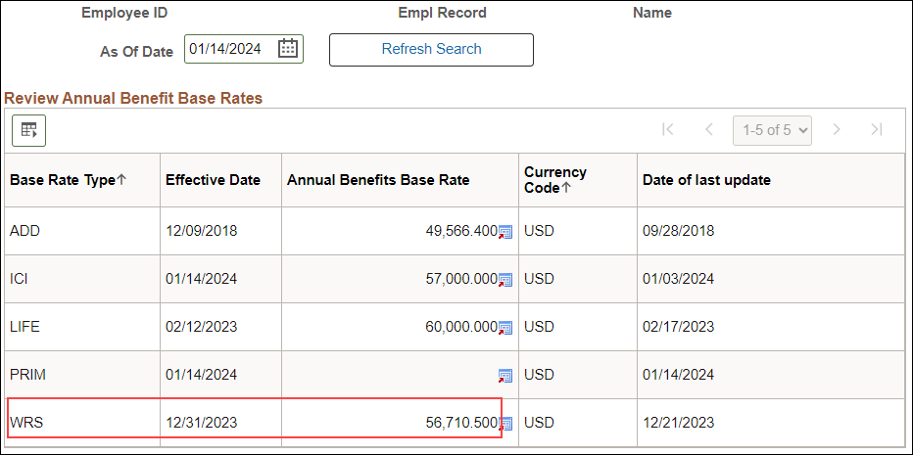
WRS Annual benefits base rate (ABBR)
WRS ABBR tracks prior year WRS earnings
Effective Date of the WRS ABBR will always be 12-31-XXXX
Static value that will only be used to populate ICI annual reports
Can be used as a historical reference as time goes on
Was populated on 1-14-24

Slide 11
ICI ABBR Update
All employees currently enrolled in ICI will receive a 1-14-2024 ICI ABBR as part of this process.
For most employees, the ICI ABBR is based on last year’s WRS reportable earnings, rounded up to the next highest $1000. The following people are an exception to this rule:
Employee was hired last year and does not have an entire year of WRS reportable earnings
Employee had a permanent FTE change and does not have an entire year of WRS reportable earnings associated with the new FTE
Employee was on an authorized unpaid leave of absence last year (ABBR and Category should remain the same)
Employee is currently enrolled in the ICI Premium Waiver Plan
For the above employees, the ABBR should remain at the current level.
If earnings > $120,000, ICI ABBR = $120,000

Slide 12
ICI ABBR report logic
Is current ICI ABBR effective date <= 1-15-23
Yes
Is the employee enrolled in the ICI Premium Waiver Plan?
No
New ABBR = Current ABBR
No
Yes
New ABBR = Current ABBR
New ABBR = Prior Year WRS (WRS ABBR) rounded up to next highest $1000
Note: If prior year WRS earnings = $0, the current ICI ABBR = new ABBR.
If WRS earnings > $120,000, ICI ABBR = $120,000.

Slide 13
How ICI Premium category is determined
ICI Category | Sick Leave Balance as of 12-30-23 (12-31-23 for LEG) | Earned during Reporting Year
1 | <184 hours (and not currently in Category 4 – 6) | N/A
2 | 184 hrs to < 520 hours (and not currently in Category 4-6) | N/A
3 | N/A – based on leave usage and not currently in Category 4-6 | 80 hrs or greater (prorated by FTE)
4 | Initial Eligibility: 520 to < 728 hrs Permanent Plateau – once enrolled in Cat 4, can never drop to lower category (regardless of sick leave balance or usage) | N/A
5 | Initial Eligibility: 728 to < 1040 hrs Permanent Plateau – once enrolled in Cat 5, can never drop to lower category (regardless of sick leave balance or usage) | N/A
6 | Initial Eligibility: 1040 hrs and up Permanent Plateau – once enrolled in Cat 6, can never drop to lower category (regardless of sick leave balance or usage) | N/A

Slide 14
Elg Fld 2 – what is it and what does it do?
An employee’s ICI eligibility is in Elg Fld 2 on the Benefits Program Participation Page in Job Data.
The process will update Elg Fld 2 to reflect the employee’s new premium category.

Slide 15
How is ICI enrollment updated as part of this process?
Once Elg Fld 2 is determined the report will assign the employee to the correct ICI plan
The value in Elg Fld 2 will determine how the ICI enrollment is updated when the process is run to finalize the ICI event
If enrolled in the ICI premium waiver plan, nothing will be updated (not Elg Fld 2, ICI enrollment or ABBR)

Slide 16
How to Run Report
Navigation: Workforce Administrator Homepage – Annual Processing Tile – ICI Annual/Deferred Folder – ICI Eligibility Verification Page
You must always enter your Company. For WIS, you should also enter your Business Unit. If reviewing for a Region, just enter the Company and all departments within your regional security will return. Click Search.

Slide 17
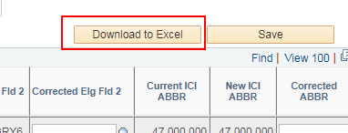
How to Run Report
The report based on your criteria will appear on the page. Click on the Download to Excel button. This will create an Excel document that you can use to do your validation.

Slide 18
How to run Report
The Excel document will show the selection criteria used and give you an output of all data elements.

Slide 19
How to Navigate online page
Summary information is displayed on the main report page. You will also be able to correct Elg Fld 2 and the ABBR directly on this page.
To see additional data elements for an employee, click on the View ICI Detail icon on the far right of the page.

Slide 20
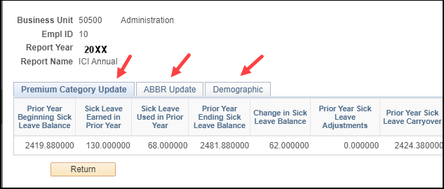
How to Navigate online page
This will bring up all data elements for the employee. Click on one of the tabs to see detailed information.

Slide 21
How to Navigate online page
If you update a field on the page, you must enter a Comment
Comments will appear on the Excel output for both the Annual Update and Deferred reports

Slide 22
How to Correct Elg fld 2 and ICI ABBR
If a correction is needed for Elg Fld 2 or the ABBR, make the correction directly on the report page
Enter the Empl ID and Company of the person who needs correction. Click Search.
Select the correct Elg Fld 2 value and/or enter the correct ABBR and click Save
IAM + date/time of entry will update on the page

Slide 23
Central Benefits validations
In advance of the agency review of the information, Central Benefits performs 20+ validations of the data. If updates are made by Central Benefits, the agency will see the update, when it was updated and applicable comments. Agencies should review all updates entered. Validations include:
Employees not currently enrolled in ICI Premium Waiver Plan but were enrolled at some point during 2023 as identified on the following query: CEN_BN_ICI_WAIVER_ENROLL. The ABBR and Category should not change for these employees.
There are several people on the report whose prior year WRS earnings is either a round number or within $1 of an earnings threshold. The ABBR for this group of people is not rounding correctly. Central Benefits has reviewed and updated the ABBR on the review page.
Review of any $0 ABBRs
Initial review of Category 3 assignments

Slide 24
Agency Data Validations
The vast majority of employees need no validation
The following are areas of potential data validation:
Validate the New ABBR
Review employees whose new ICI enrollment is Category 3
Review employees currently in Category 3 but are projected to drop to Category 1 or 2
Review employees whose current ICI enrollment is ICIPRW
Review employees with recent sick leave adjustments

Slide 25
New ABBR Validation
There is a large change in the ABBR – either positive or negative
Was the employee on an unpaid LOA last year? If yes, the ABBR should remain at its current level
Is the current ABBR > $120,000? The ABBR should be capped at $120,000 so the large change is likely bringing the ABBR down to $120,000.
Did the employee have an FTE change last year but the ABBR was not updated to reflect the change?
If yes, the ABBR should be updated to reflect projected earnings based on the new FTE
Did the employee have a significant salary change last year?
If yes, the ABBR should be based on last year’s WRS earnings if there was no FTE change or LOA.
Did the employee terminate last year but was then rehired later in the year?
The ABBR should be based on the projected earnings of the new job – agency will have to correct

Slide 26
New ABBR Validation
The ABBR effective date is in January of 2023 but just after 1-15-2023?
The ABBR will not be updated if the effective date of the ABBR is after 1-15-23
Should the employee have had a 1-15-23 ABBR effective date? Did the employee have a full year of earnings in 2023?
If yes, the new ABBR should be based on last year’s WRS earnings – agency will have to correct
The ABBR effective date is after 1-15-23 but the employee worked all year, didn’t have an FTE change, and was never on an unpaid LOA.
ABBR should be based on prior year’s WRS earnings – agency will have to correct

Slide 27
New ABBR Validation
ABBR effective date is 1-15-23 or earlier but the employee did not go under the WRS until AFTER 1-15-23
Employee should be on projected earnings as of WRS start date – agency will have to correct ABBR
Employee is currently enrolled in the ICI Premium Waiver plan
Confirm that the effective date of the ICI Premium waiver was in 2023 or before.
If premium waiver is effective in 2024, determine correct ABBR.

Slide 28
Ongoing ABBR tips
If an employee is going on an unpaid LOA, enter a new effective dated ICI ABBR row with the same ABBR amount and an effective date of the first day of the unpaid LOA.
This will allow you to easily identify employees who were on an unpaid LOA and the system will NOT update their ABBR the following year.
Never enter an ABBR for an employee who is not under the WRS
If an employee has a minimum 30-day break in employment, enter a new ABBR based on the employee’s new projected salary
Always update the ABBR if there is a permanent FTE change
The ABBR should NOT be updated if there is a salary change or if the employee moves from one STAR agency to another.
See Appendix A of the ICI Admin Manual.

Slide 29
Eligibility for category 3 + Earned > 130 Hours of sick leave
Category 3 eligibility is based on Ending SL balance – Starting SL balance
SL adjustments (ex. transfer from another payroll center) may put employee in Category 3 when not eligible
Look at the Pr Yr Beginning Sick Leave Bal column. If this is 0, typically this is a transfer from another payroll center
Look at the Pr Yr Sick Leave Adjustment column to see if the person had a large positive adjustment. This is also typically a transfer from another payroll center.
Subtract the Sick Leave Used from the Sick Leave Earned to see if the employee accumulated at least 80 hours of sick leave (prorated if part-time)
Correct Elg Fld 2 as needed

Slide 30
Drop fROm Category 3 to Categories 1 or 2
In the Current 30 Enrollment column, filter for ICIB3C
In the New ICI Basic Enrollment column, filter for ICI1 & ICI2
Did someone miss Category 3 by only a few hours (review the change in SL balance column)?
Can the employee swap leave used (if option available at your agency)?
Was there a recent leave adjustment not reflected in the report?

Slide 31
Enrolled in ICI Premium waiver plan
Filter for ICIPRW the New 30 Enrollment column
Validate the effective date of the enrollment in the ICI Premium Waiver plan and the dates the employee was on an unpaid LOA.
If the employee was on an unpaid LOA last year, the report should correctly assess these people – the employee’s ABBR and category will NOT be updated during this year’s annual update process
If the unpaid leave of absence did not begin until this year, the report is NOT assessing the person correctly (the report assumes the leave occurred last year). You will need to determine the correct ABBR and Elg Fld 2 value and enter updates on the report.

Slide 32
Demo/Review
Let’s look at the ICI Annual Report page

Slide 33
New item on Annual Report
• When reviewing the Annual Report if an employee’s Current Elg Fld 2 value has a supplemental value (meaning they are enrolled in Supplemental) and the New Elg Fld 2 value is blank DO NOT ENTER a CORRECTED ELG FLD 2 value.
•These employees are staying in their current category and the merge process consolidating the two ICI plans updated their Elg Fld 2 value and placed them into the new ICI category.

Slide 34
Questions on annual update process?
ICI Annual Update Job Aid

Slide 35
ICI Deferred Enrollment

Slide 36
What is the ICI Deferred Enrollment Period?
The Deferred enrollment is looking at employees eligible for ICI but not currently enrolled
Employees who are not currently enrolled in ICI but are eligible for ICI premium categories 3, 4 or 5 for the FIRST time
Employees may enroll in ICI in any year that he or she is eligible for premium category 6

Slide 37
Process overview – newly eligible for ICI
Process evaluates an employee’s prior sick leave accrual/usage and historical ICI deferred enrollment offers (based on value in Elg Fld 4 on the Benefits Program Participation page in Job Data) and determines if the employee should be offered a deferred enrollment.
ICI Deferred - Newly Eligible Process Run In STAR
Agency Review of Output
Row added to job to update Elg Fld 2 & 4 + ICI ABBR loaded
DEF event open in eBN and for paper entry
Elections Entered and Finalized
All open DEF events at end of period auto-closed

Slide 38
Output of ICI Deferred Enrollment period
Everyone eligible for deferred enrollment receives a 3-2-24 effective dated job row that updates Elg Fld 2 (3-1-24 for LEG)
If newly eligible, Elg Fld 4 is also updated to capture offer of coverage
Elg Fld 4 populated for newly eligible only

Slide 39
Output of ICI Deferred Enrollment period
If newly eligible for ICI, receive an ICI ABBR with an effective date of 1-14-24.

Slide 40
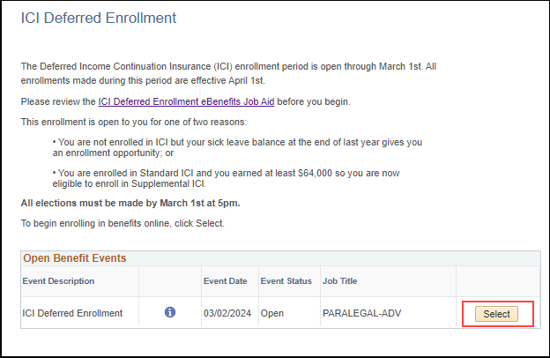
Output of ICI Deferred Enrollment period
DEF event is created by job update – this event will open in eBenefits and Perform Election Entry

Slide 41
eBenefits
Only plans available to employee will appear on enrollment page

Slide 42
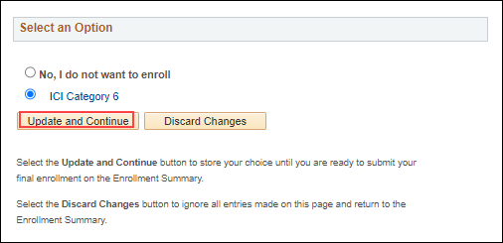
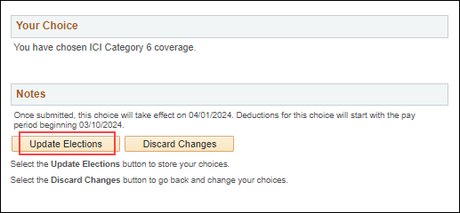
ebenefits
Employee enrolls in plan(s)

Slide 43
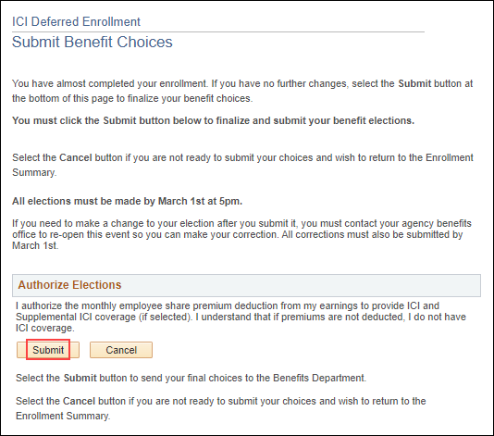
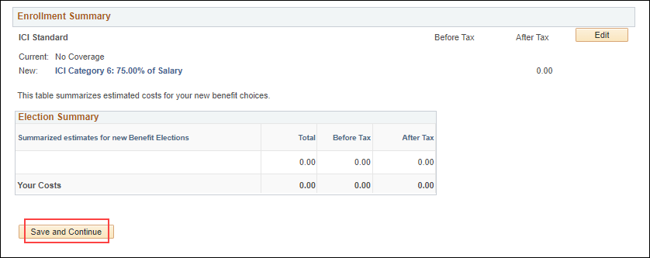
ebenefits
Enrollments appear on Summary Page
Must Submit Elections

Slide 44
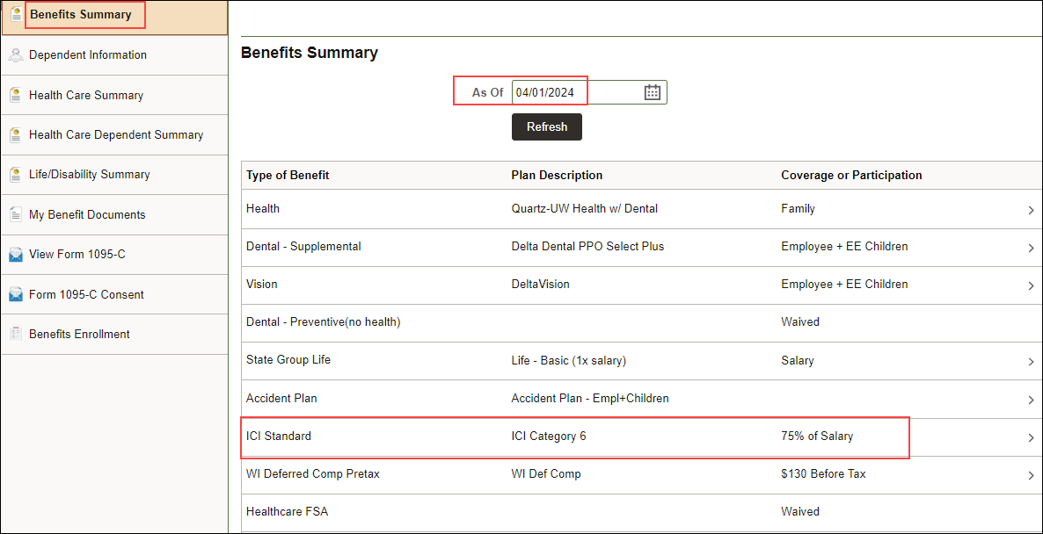
No Confirmation statement generated
Employee should enter a future “as of” date on the Benefits Summary page to review enrollment

Slide 45
Newly eligible report logic – who is on the report
On report if…
Not enrolled in ICI; and
Eligible for ICI Category 3, 4 or 5 for the first time; or
Eligible for ICI Category 6
There are 2 values on the report
Calculated Elg Fld 2
Final Elg Fld 2

Slide 46
How to derive Calculated elg fld 2
ICI Category | If Ending Sick Leave Balance is… | Calculated Elg Fld 2 should be…
3 | Change in Sick Leave Balance >= 80 hours (prorated if part-time) | ICICATGRY3
4 | 520 to < 728 hrs | ICICATGRY4
5 | 728 to < 1040 hrs | ICICATGRY5
6 | 1040 hrs and up | ICICATGRY6

Slide 47
How to derive Final Elg Fld 2
If calculated Elg Fld 2 is…. | And Elg Fld 4* is… | Final Elg Fld 2 is…
ICICATGRY3 | Blank or there is no record of ICICAT3 | ICICATGRY3
 | ICICAT3 | Blank (employee not listed on report)
ICICATGRY4 | Blank or there is no record of ICICAT4, ICICAT5 or ICICAT6 | ICICATGRY4
 | ICICAT4, ICICAT5 or ICICAT6 | Blank (employee not listed on report)
ICICATGRY5 | Blank or there is no record of ICICAT5 or ICICAT6 | ICICATGRY5
 | ICICAT5 or ICICAT6 | Blank (employee not listed on report)
ICICATGRY6 | Blank or there is no record of ICICAT6 | ICICATGRY6
 | ICICAT6 | ICICATGRY6
*Process looks at all Elg Fld 4 values when determining
Final Elg Fld 2 (not just top of stack)

Slide 48
How to access ICI Deferred reports
Navigation: Workforce Administrator Homepage – Annual Processing Tile – ICI Annual/Deferred Folder – ICI Eligibility Verification Page
Click on the Report Name down arrow and select ICI Deferred Newly Eligible. Enter your Company (required) and Business Unit (not required). If reviewing for a Region, just enter the Company and all departments within your regional security will return. Click Search.

Slide 49
Agency Data Validations
Newly Eligible
Confirm Category 3 are truly eligible based on leave accrual/usage listed in report
We’ve been tracking prior ICI offerings electronically for several years now but if you have any record of prior offerings not captured in STAR, review those people

Slide 50
Issues to watch
Process creates future-dated job row
Once process has ran, a ticket will need to be submitted if you need any job updates prior to 3-2-24 (3-1-24 for LEG)
Closing events that get ahead of DEF event
If event has earlier event date, it will temporarily close DEF event – monitor open events to ensure DEF stays open
No confirmation statement of elections – employee should enter a future “as of” date on the Benefits Summary page to review enrollment
Once election made on DEF event, the employee CANNOT go back in and make elections. Agency must submit a ticket to re-open the event.

Slide 51
Employee notification of ICI Deferred enrollment
There is 1 notification:
Newly eligible for ICI
Employees will receive notice via Employee Messaging
Agencies can reach out or follow-up as needed

Slide 52
Questions on the deferred enrollment process?
Deferred Enrollment Job Aid

Slide 53
Timeline and next steps

Slide 54
Timeline
January 14th – 12-31-23 WRS ABBR added with 2023 WRS earnings
January 14th – ICI Annual Information loaded to agency review table
(Deferred Enrollment report not available until all Annual Update processes complete)
January 17th – ICI Annual and Deferred Training
January 17th – Agency review period for ICI Annual Update report begins

Slide 55
Timeline
January 22nd at 4pm - Legislature ONLY: End of ICI Annual Report review period. All Elg Fld 2 and ABBR updates must be entered on ICI Annual report page. All job, ICI ABBR and ICI enrollment updates will be made the evening of 1-22-24.
January 24th – announcement on self-service landing page regarding ICI Annual Update Period
January 24th at 4pm – All Elg Fld 2 and ABBR updates must be entered on ICI Annual Report page without exception

Slide 56
Timeline
January 26th– based on agency updates to the ICI Annual Report, the following updates will occur:
If there is a change to Elg Config Fld 2, a row on job data will be inserted effective 1-14-24 (Action = Data Change, Reason = ICI Category Change) and Elg Fld 2 will be updated to new value.
Elg Fld 2 will be updated to reflect the employee’s ICI enrollment in Plan Type 30.
For LEG Employees Only – the effective date on job will be 1-2-24 and this process will occur on 1-22-24.
ICI ABBR will be updated effective 1-14-24 (the 1st day of the pay period in which the first half of the February ICI deduction is taken)
For LEG employees: ABBR effective date will be the same for LEG employees
If there is an ICI category change, the ICI event created by the job update will be used to move the employee to the correct ICI plan effective 2-1-24

Slide 57
Timeline
January 29th – agency review period of ICI Deferred Enrollment Period will begin (all updates associated with the ICI Annual Update must be complete before this process is run)
February 1st – last day employees can submit an application to cancel ICI coverage effective 2-1-24 (use 2-1-24 CAN event to cancel coverage)
February 1st– PP3 confirmation
ICI premiums based on new ABBR and ICI category
For LEG Employees Only – all ICI Annual Updates reflected on 2-1-24 paycheck
February 7th at 4pm – end of ICI Deferred Enrollment Agency review period - All Elg Fld 2 and ABBR updates must be entered on ICI Deferred Enrollment page without exception

Slide 58
Timeline
February 9th (evening)
Run process to add a row to Job for all newly eligible (update Elg Fld 2 and 4)
Action/Reason = Data Change/ICI Deferred Enrollment
Effective Date = 3-2-24 for all except LEG (3-1-24 for LEG)
Run process to load ICI ABBR for all newly eligible
Effective Date = 1-14-24
February 12th
DEF event open for entry
Employees will be notified of eligibility via Employee Messaging

Slide 59
Timeline
March 1st at 5pm – End of Deferred Enrollment Period
eBenefits will close at 5pm
All agency entry of paper applications received must be done by 5pm
After March 1st – agency will have to create a ticket for paper applications that need entry
Ticket Subject Line = ICI Deferred Entry, Employee Name, Empl ID
Attach ICI application- Entry must be done by Central Benefits to preserve application receipt date
March 28th– PP7 Confirmation (1st premiums taken associated with deferred enrollment)
April 1st – Coverage effective date of all ICI deferred enrollments
April 4th – PP7 Check Date

Slide 60
What’s Next?
Agencies should review ICI Annual Update and ICI Deferred Enrollment Job Aids (all ICI resources on Central Benefits page)
Agencies should begin ICI Annual Update review process
Once agency review period is over, Central Benefits will validate agency updates/report output before job/ABBR updates are done
Agencies will be notified once Deferred Enrollment information is available for validation for review

Slide 61
Additional Resources
2024 ICI Premiums
ICI Premium Calculator (coming soon)
ETF Information about 2024 ICI Annual Update/Deferred Enrollment
ICI Report Navigation: Workforce Administrator Homepage – Annual Processing Tile – ICI Annual/Deferred Folder – ICI Eligibility Verification Page

Slide 62
Questions?

