Slide 1
It’s Your Choice Open Enrollment
September 25, 2023 –
October 20, 2023

Slide 2
Open Enrollment Emails
Open Enrollment emails will be sent directly from STAR again this year through employee messaging. Emails will be sent from OpenEnrollmentDoNotReply@wisconsin.gov and reference some aspect of Open Enrollment.
Watch for these emails – they will contain important information and provide instructions. You should also expect to receive some Open Enrollment emails directly from your agency.

Slide 3
Actions that Can be Taken during Open Enrollment
 | Enroll | Add or Remove Dependents | Change Plans | Cancel Coverage
Health* | X | X | X | X
Delta Dental PPO – Supplemental Plan | X | X | X | X
Delta Dental PPO – Preventive Plan Only available if NOT covered by State Group Health Insurance | X | X | N/A | X
DeltaVision | X | X | N/A | X
Accident Plan | X | X- change coverage level | N/A | X
Healthcare FSA or LPFSA | Must re-enroll every year Coverage will automatically end if no 2024 enrollment
Dependent Day Care FSA
Pre-Tax Parking & Transit Accounts
Health Savings Account | Must re-enroll every year If you don’t elect a High Deductible Health Plan (HDHP), enrollment will end and you can no longer contribute, but you will have access to funds in your account.
Health Insurance Opt-Out Stipend | Must re-enroll every year Must certify that eligibility requirements are met on an annual basis
* Can also enroll in or cancel Uniform Dental Benefit

Slide 4
Benefits NOT Part of Open Enrollment
You can not enroll in State Group Life Insurance or Income Continuation Insurance during the Open Enrollment Period
You can apply for coverage through Evidence of Insurability at any time
You can cancel coverage at any time
You can enroll in or make changes to Wisconsin Deferred Compensation at any time
You can enroll in or make change to Edvest at any time
You can enroll in Long Term Care through HealthChoice at any time. For more information call 1-800-833-5823.

Slide 5
Introducing Benefits Mentor – Your Virtual Benefits Counselor
IBM Benefits Mentor is a benefits counselor for active state employees and non-Medicare retirees. Powered by ETF’s secure data warehouse, Benefits Mentor will use your claims information (if available) as a basis for personalized plan design recommendations. Benefits Mentor also considers your medical needs and what is most important to you when choosing a health plan.
You will need to register and verify your email address prior to using Benefits Mentor for the first time.
Click here to get started
*Note: Chrome is the preferred internet browser for Benefits Mentor. You are not enrolling through Benefits Mentor – you enter all enrollments in eBenefits in STAR Employee Self Service.

Slide 6
Open Enrollment Resources
2024 It’s Your Choice Website
2024 It’s Your Choice Decision Guide
Important Changes for 2024
Health Plan Search

Slide 7
State Group Health Insurance
Changes for 2024
Enrollment Choices
Opt-Out Stipend Requires Action

Slide 8
New Benefits
New Health Plan
GHC of South-Central Wisconsin (GHC-SCW) will split into two separate networks starting January 1, 2024: GHC-SCW Dane Choice and GHC-SCW Neighbors. Both networks will include UW and Meriter hospitals and specialists.
Medical Benefit Changes
The annual medical deductible for the High Deductible Health Plan (HDHP) and Access HDHP has increased to:
Do a 2024 Health Plan Search to see which health plans are available in each county.
*Family: $3,200
Coverage has been expanded for advance care planning.
The expectation that physical, speech, and occupational therapies result in significant improvements for patients within two months of the beginning of treatment has been removed.
The requirement of a 30-day rental of infusion pumps for insulin, pain relievers, and other drugs prior to the purchase of equipment has been removed.
The requirement that members who change health plans during an inpatient stay need to move to a new in-network facility due to the change in the plan provider has been removed
*Individual: $1,600

Slide 9
State Group Health
Changes allowed:
Enroll or cancel coverage for 2024
Add or remove eligible dependents
Only dependents 19 or older can be removed
Change health plan design or network
Enroll in or cancel Uniform Dental
Health plan providers may change annually
You should confirm that your doctors, clinics and hospitals are available in 2024. See ETF’s Health Plan Search.

Slide 10
Health Insurance Plan Designs
Before selecting a specific health plan, you need to pick a health plan design
With or Without Uniform Dental coverage
It’s Your Choice Plan (low deductible) or High Deductible Health Plan (HDHP)
Specific provider network (IYC Health Plan) or a nationwide network (Access)
Resources
Health Plan Design Cost Comparison
Health Plan Design video

Slide 11
Low vs High Deductible Health Plan For a full comparison chart of all health plan design options, go to: Breakdown of Your Costs
 | IYC Health Plan (low deductible) | IYC HDHP
Annual Medical Deductible | $250 individual $500 family | $1,600 individual $3,200 family
Office Visit Co-Pay (non-specialty) | $15 (not subject to deductible) | Full cost until deductible met; $15 thereafter
Office Visit Co-Pay (specialty & urgent care) | $25 (not subject to deductible) | Full cost until deductible met; $25 thereafter
Emergency Room (copays may be waived if admitted) | $75 | Full cost until deductible met; $75 thereafter
Mental Health/Alcohol and Drug Abuse | Outpatient Services: $15 copayment per visit up to OOPL | Outpatient Services: After deductible, $15 copayment per visit up to OOPL
Annual Medical Out-of-Pocket Limit | $1,250 individual $2,500 family | $2,500 individual $5,000 family
Routine, preventive services required by law | Plan pays 100%, not subject to deductible
Transplants | After deductible, you pay 10% up to out-of-pocket limit | After deductible, you pay 10% up to out-of-pocket limit

Slide 12
HDHP/HSA Eligibility
HDHP/HSA Eligibility
Employee (subscriber) must NOT be covered by any other health insurance, including Medicare Part A and Part B, and TRICARE
Employee (subscriber) can’t be claimed as a dependent on another person’s tax return (unless it’s your spouse)
Employee (subscriber) can’t be over 65 years of age.
If the subscriber (employee) meets the HDHP eligibility requirements, the employee can enroll in single or family coverage
Even if a covered family member is eligible for Medicare or covered by other insurance, they can still be covered as a dependent on an HDHP.

Slide 13
Prescription Coverage
All health plans include prescription coverage
Prescription benefits are administered by Navitus
If enrolled in a High Deductible Health Plan, must meet annual deductible before benefits are paid
For full details, including cost breakdowns, see the Pharmacy page
The Navi-Gate website has tools to help you determine the cost of your prescriptions.
Watch the Saving on Your Prescriptions video for cost saving tips

Slide 14
Prescription Coverage Summary
 | IYC Plan | HDHP Plan (benefits below are AFTER deductible is met)
Deductible | $0 | Combined medical/Rx deductible $1,600 individual $3,200 family
Level 1 Copay | $5 or less | $5 or less
Level 2 Coinsurance | 20% ($50 max) | 20% ($50 max)
Level 3 Coinsurance (Dispensed as Written drugs may cost more) | 40% ($150 max) | 40% ($150 max)
Level 4 Specialty Copay | $50 (Must fill at specialty pharmacy) | After deductible $50 (Must fill at specialty pharmacy)
Levels 1 & 2 Out-of-Pocket Limit | $600 individual $1,200 family | Combined medical & pharmacy $2,500 / $5,000
Level 3 & 4 Out-of-Pocket Limit | $9,450 individual $18,900 family | Combined medical & pharmacy $2,500 / $5,000

Slide 15
2024 Employee Health Premiums Non-HDHP Plans
Plan | Single (monthly) | Single (biweekly) | Family (monthly) | Family (biweekly)
IYC Plan with Dental | $115.00 | $57.50 | $286.00 | $143.00
IYC Plan without Dental | $112.00 | $56.00 | $276.00 | $138.00
Access with Dental | $270.00 | $135.00 | $673.00 | $336.50
Access without Dental | $267.00 | $133.50 | $663.00 | $331.50
Access with Dental (required to work out of state) | $173.00 | $86.50 | $438.00 | $219.00
Access without Dental (required to work out of state) | $170.00 | $85.00 | $428.00 | $214.00

Slide 16
2024 Employee Health Premiums HDHP Plans
Plan | Single (monthly) | Single (biweekly) | Family (monthly) | Family (biweekly)
HDHP Plan with Dental | $42.00 | $21.00 | $107.00 | $53.50
HDHP Plan without Dental | $39.00 | $19.50 | $97.00 | $48.50
HDHP Access with Dental | $197.00 | $98.50 | $494.00 | $247.00
HDHP Access without Dental | $194.00 | $97.00 | $484.00 | $242.00
HDHP Access with Dental (required to work out of state) | $100.00 | $50.00 | $259.00 | $129.50
HDHP Access without Dental (required to work out of state) | $97.00 | $48.50 | $249.00 | $124.50

Slide 17
Health Savings Account (HSA) Contribution If enrolled in a High Deductible Health Plan for 2024, must enroll in an HSA Must re-enroll in HSA every year!!
HSA Annual Employer Contribution* (no change from 2023)
HSA Total Annual Contribution Limit (employee + employer)
Single = $750 ($31.25 bi-weekly/$62.50 monthly)
Family = $1,500 ($62.50 bi-weekly/$125.00 monthly)
If required to pay half of total health insurance premium, receive half of total HSA employer contribution
Single = $4,150 ($300 increase from 2023)
Family = $8,300 ($550 increase from 2023)
Age 55 or older = $1,000 catch-up contribution limit
NOTE: Contributions taken over 24 paychecks per year (12 if paid monthly)
* If not eligible for employer contribution towards health insurance, no employer HSA contribution

Slide 18
Health Insurance Opt Out Stipend (OOS) If you’re not enrolling in health insurance for 2024, you may be eligible for $2,000 opt-out stipend
Eligibility requirements
Must not be covered by state or UW health insurance in 2024 as an employee, spouse or child; and
If employed by the state in 2015 and were eligible for the employer contribution towards health insurance, did NOT opt out of coverage in 2015.
$2,000 stipend is paid over 24 pay periods per year (paid on first 2 checks payable each month)
Stipend is considered taxable earnings, but the earnings do not count towards the Wisconsin Retirement System.

Slide 19
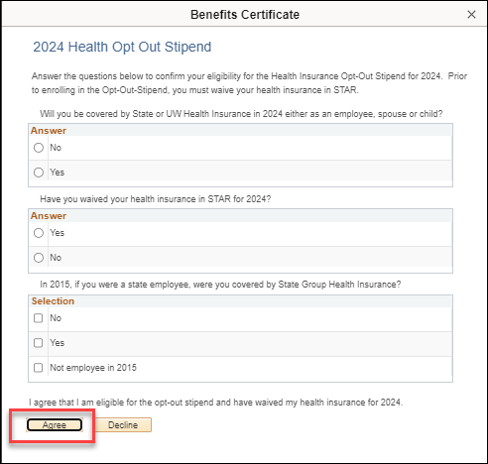
OOS in eBenefit
Prior to enrolling in the OOS, you must first waive health insurance in eBenefits
Then click the Edit next to Opt-Out Stipend in eBenefits (at bottom of plan summary page)
You will then be asked a series of questions to ensure that you are eligible for the opt out stipend
Once you answer the questions correctly, you will only be able to apply for the Opt-Out Stipend like all other benefit plans.

Slide 20
Staywell- Well Wisconsin
Powered by WebMD

Slide 21
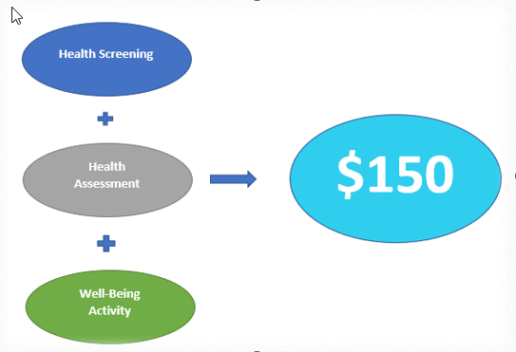
2024 Well Wisconsin Incentive Overview
Subscriber and spouse can both earn the incentive
2024 Wellness Incentive deadline is October 11, 2024
2023 Wellness Incentive deadline is October 13, 2023

Slide 22
2024 Well Wisconsin
The Well Wisconsin program, administered by WebMD, provides tools and resources to help participants set health and well-being goals, track progress and earn incentives.
WebMD
If new to Well Wisconsin, you will be required to set up a new online account thru WebMD One Wellness Portal.

Slide 23
Securian Accident Plan
What is the Accident Plan?
Example of Payout

Slide 24
Securian Accident Plan
Plan provides a lump sum cash payment directly to you for covered injuries, emergency and hospital care, surgery and follow-up care
Multiple benefits available for any one accident - See Accident Insurance Plan summary for payout amounts
Includes AD&D coverage and Identity Theft Services
Premiums taken post-tax so no taxes due on paid benefits
Can only cancel coverage due to a qualifying event or during Open Enrollment
Continuation available at termination or retirement until age 70
Premiums NOT taken from annuity – continuation directly with Securian

Slide 25
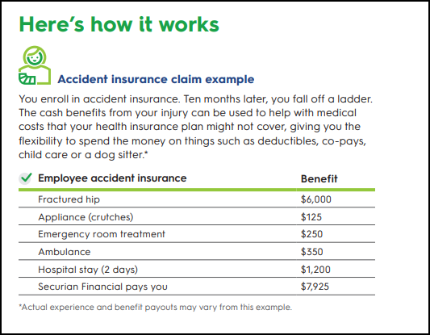
Coverage Benefit Payout Example

Slide 26
Accident Plan Resources
Plan website
Informational video
AD&D benefits will be payable based on WRS beneficiary designation
Accident Plan Brochure
Identity Theft Services – Generali Global Assistance

Slide 27
2024 Accident Plan Premiums
Premium decrease from 2023
Coverage Type | Monthly | Biweekly
Employee | $3.72 | $1.86
Employee + Spouse | $5.32 | $2.66
Employee + Child(ren) | $7.17 | $3.59
Family | $10.47 | $5.24

Slide 28
Dental Plans
Uniform Dental Benefit
Delta Dental PPO – Preventive Plan
Delta Dental PPO – Supplemental Plans (Select and Select Plus Plans)

Slide 29
Dental Plan Summary
All dental plans are administered by Delta Dental
The following plans are available:
Uniform Dental Benefits (available if enrolled in State Group Health Insurance)
Delta Dental PPO – Preventive Plan (same benefits as Uniform Dental but only available if not covered by State Group Health Insurance)
Delta Dental PPO – Supplemental Plans (offers coverage beyond Uniform Dental/Preventive Plan)
Select Plan and Select Plus Plan

Slide 30
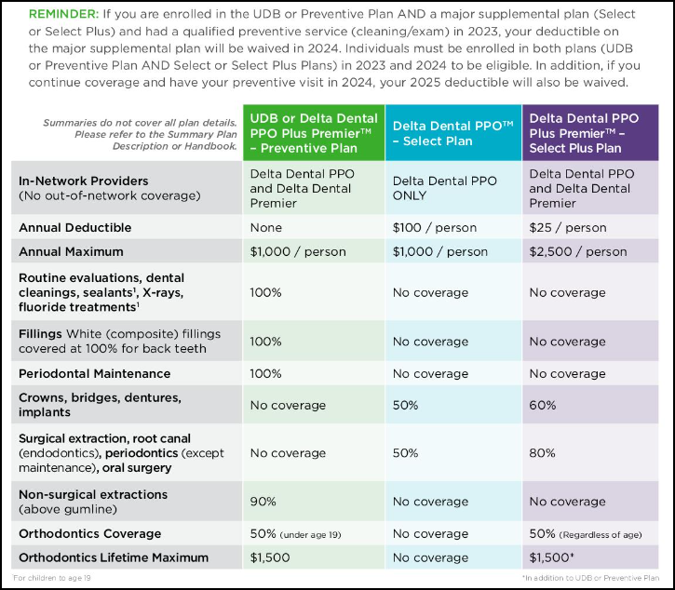
Dental Plan Comparison
How Basic and Major Coverage Work Together

Slide 31
Preventive Plan
Delta Dental PPO – Preventive Plan
Provides same coverage as Uniform Dental Benefits
Cleanings
Fluoride Treatment
Fillings
Children’s orthodontia
Can only enroll if not covered by State Group Health Insurance as an employee or dependent
If enrolled in State Group Health as an employee or dependent, must enroll in Uniform Dental when enrolling in health insurance (“Health with Dental” in eBenefits)
A certification must be completed in eBenefits in order to enroll in the Preventive Plan

Slide 32
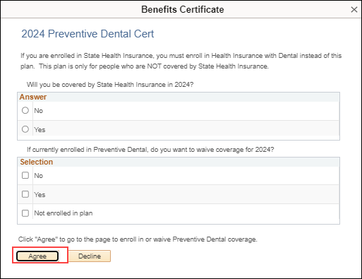
Enrolling or Waiving Preventive Dental in eBenefits
In order to access the Preventive Dental enrollment page in eBenefits, you must answer the questions in a certificate that will pop up in eBenefits
If you want to enroll, answer “No” to the 1st question and “Not Enrolled in the Plan” for the 2nd question
If you want to cancel your current coverage, answer the 1st question as applicable and answer “Yes” to the 2nd question

Slide 33
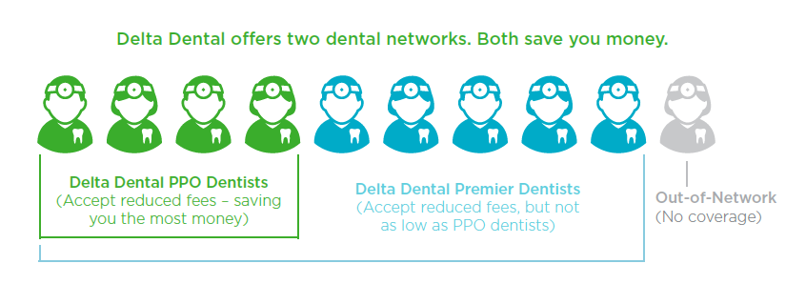
Delta Dental Network Differences
Delta Dental PPO
Offers significant fee reduction (lower out-of-pocket costs)
Only network available for the Select Plan
One of the networks available in Uniform Dental, Preventive, & Delta Dental PPO Select Plus Plan
Delta Dental Premier
90% of dentists in this network but the cost savings is not as significant
One of the networks available in Uniform Dental, Preventive,& Delta Dental PPO Select Plus Plan
Provider Search Page (not supported by Internet Explorer)
Printable PDF Directory also available

Slide 34
2024 Delta Dental Premiums
Coverage level | Select (monthly) | Select (biweekly) | Select Plus (monthly) | Select Plus (biweekly) | Preventive (monthly) | Preventive (biweekly)
Employee | $9.08 | $4.54 | $21.60 | $10.80 | $36.10 | $18.05
Employee + Spouse | $18.16 | $9.08 | $43.22 | $21.61 | N/A | N/A
Employee + Child(ren) | $12.24 | $6.12 | $40.12 | $20.06 | N/A | N/A
Family | $21.76 | $10.88 | $66.20 | $33.10 | $90.28 | $45.14

Slide 35
Vision

Slide 36
DeltaVision
Premiums will not change for 2024
DeltaVision partners with EyeMed Vision Care to provide vision benefits
New enrollees will receive an insurance card from EyeMed Vision in late December/early January
In-network benefits from Insight network providers - one of the largest vision networks in the nation. Includes both independent, chain, and online providers. Out-of-network benefits also available.
Once coverage is effective, exclusive savings, discounts, and rebates on vision care and services above and beyond your vision benefits are available through EyeMed’s online member portal.

Slide 37
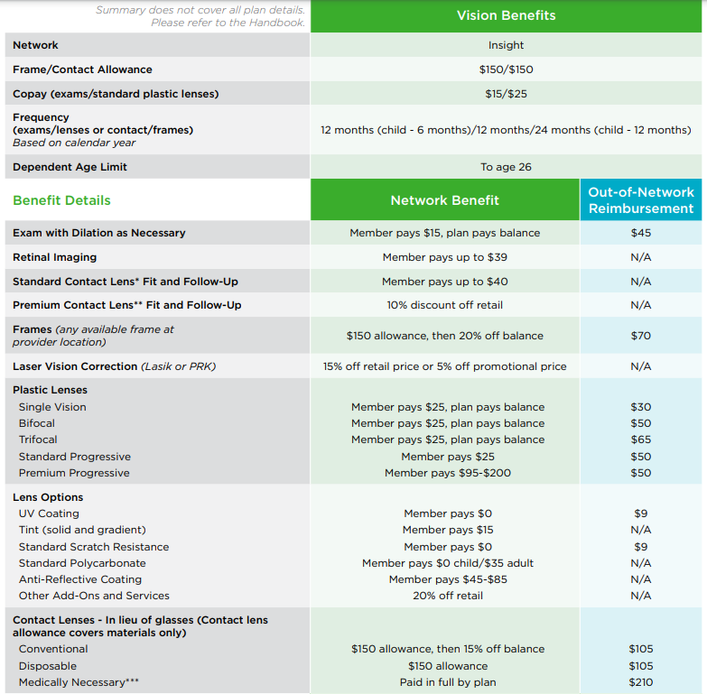
Vision Summary of Benefits
DeltaVision Resources
DeltaVision Providers (EyeMed)
DeltaVision Website
DeltaVision Overview

Slide 38
2024 DeltaVision Premiums
Coverage level | Monthly | Bi-weekly
Employee | $5.72 | $2.86
Employee + Spouse | $11.42 | $5.71
Employee + Child(ren) | $12.88 | $6.44
Family | $20.58 | $10.29

Slide 39
Pre-Tax Savings Accounts
Healthcare FSA
Limited Purpose Healthcare FSA (for those enrolled in HDHP)
Dependent Day Care FSA
Pre-Tax Parking and Transit Accounts
Health Savings Account (HSA)

Slide 40
What is a Pre-Tax Savings Account?
There are several pre-tax savings accounts available that allow you to set aside money on a pre-tax basis to pay for eligible expenses. All deductions are taken out before Federal, State, and FICA taxes are calculated so you save money on taxes
Eligible expenses may include:
Medical, prescription, dental and vision out-of-pocket costs
Child or adult daycare expenses
Parking or transit expenses
See Pre-Tax Savings Accounts for full plan details

Slide 41
Things You Should Know
Optum Financial is the administrator of all Pre-Tax Savings Plans
Optum Financial Mobile App Available
Dedicated 24/7/365 phone support: 1-833-881-8158
Employees newly enrolling will receive a debit card to pay for eligible expenses. Current enrollees will continue to use the same debit card used in 2023.
The debit card is NOT available for Dependent Day Care or Transit Expenses
Visit the Optum Store to easily purchase FSA and HSA-eligible products
Once you enroll in a Healthcare, LPFSA or Dependent Day Care account for the year, you can NOT change your annual election unless you have a qualifying life event

Slide 42
Flexible Spending Accounts Summary
FSA Type | Eligible Expenses | Eligible Dependents | Annual Contribution Limits | Enrollment Restrictions
*Healthcare FSA | Medical, dental, vision & prescription | You, your spouse, qualifying child or relative | Min: $50 Max: $3,050 | May not enroll if enrolled in an HDHP
Dependent Day Care FSA | After school care, adult or child daycare | Your spouse, qualifying child or relative | Max: $5,000 —dependent on tax filing status | No restrictions
*Limited Purpose FSA | Dental, vision & post-deductible expenses | You, your spouse, qualifying child or relative | Min: $50 Max: $3,050 | May enroll only if also enrolled in an HDHP
* $50 minimum annual contribution requirement for 2024

Slide 43
Sample of Eligible Healthcare FSA Expenses
Over-the-counter drugs and medicines not prescribed by a doctor (aspirin, cough medicine, decongestants, etc.)
Insulin
Co-payments, Deductibles, and Co-insurance
Acupuncture
Bandages
Personal Protective Equipment (PPE) for preventing the spread of COVID-19 (face masks, disposable gloves, hand sanitizer, sanitizing wipes…)
Crutches
Chiropractic care
Dental Treatments
Infertility Treatments
Flu shots
Eyeglasses/exams
Psychotherapy, psychiatric, psychological services
Menstrual care products (pads, liners, tampons, etc.)

Slide 44
Ineligible Healthcare FSA Medical Expenses These items cannot be reimbursed through your Healthcare FSA account:
Insurance premiums
Rx drugs imported from another country
Controlled Substances that aren’t legal under federal law (e.g., marijuana)
Cosmetic Surgery
Weight-Loss programs
Maternity Clothes
Teeth Whitening services
Veterinary Fees
Personal Use Items (e.g., toothbrush, toothpaste)
Nutritional Supplements for ordinary good health
Treatment unrelated to specific health problems (e.g., massage for general well-being; chiropractic maintenance visits)

Slide 45
Eligible LPFSA Expenses - HDHP Enrollees Only Medical expenses may only be reimbursed after your HDHP deductible is met
Dental Expenses
Vision Expenses
Braces and orthodontia
Cleanings
Crowns
Fillings
Dentures
Copayments and deductibles
Eye exams
Prescription eyeglasses
Prescription contact lenses
Contact lens solution
Laser eye surgery / LASIK
Copayments and deductibles

Slide 46
Healthcare and Limited Purpose FSA Note: LTEs are not eligible to participate
2024 Participants:
Up to $610 remaining in your Healthcare/LPFSA can carry over to the following plan year. Any unspent amount over $610 will be forfeited. **Balance less than $50 at the end of plan year 2023 after run out period requires a minimum annual election for 2024.**
Carryover funds in FSA, LPFSA, Parking, and Transit accounts will have a waiting period and be made available to employees on April 15, 2024.
Since these benefit accounts have a runout period ending March 31, Optum is not able to rollover the balances until the runout period has ended. The remaining funds will be used to process claims during the runout period. After the runout period is completed, remaining balances will transfer over to the new current plan year
2024 Participants:
Can contribute up to $3,050
Incur health expenses between 01/01/24 – 12/31/24
You have access to your 2024 annual Healthcare and Limited Purpose FSA election as of your plan effective date

Slide 47
Eligible Dependent Care Expenses If care provided enables you to work, look for work, or attend school:
Fees for licensed child daycare or adult care facilities
Before and after school care programs for dependents under age 13
Amounts paid for services (including babysitters or nursery school) provided in or outside of your home while you are at work/school
Nanny expenses attributed to dependent care
Summer Day Camp (primary purpose must be custodial not educational)
Nursery school (preschool) fees
Late pick-up fees

Slide 48
Ineligible Dependent Care Expenses These items cannot be reimbursed through your Dependent Care account:
Medical expenses
Baby-sitter in or out of your home for reasons other than to enable you to work, look for work, or attend school
Activity fees/educational supplies
Food, clothing, and entertainment
Transportation expenses
Child support payments
Kindergarten fees
Overnight camp
Late payment charges
Payment for services not yet provided (payment in advance)

Slide 49
Dependent Day Care FSA Note: LTEs are not eligible to participate
2024 Participants:
All expenses must be incurred between 01/01/24 – 12/31/24
No carryover - unspent amounts are forfeited
You have access to your Dependent Care money as soon as the money is deposited into your account
Will NOT be able to use Optum Financial | CYC debit card to pay for Dependent Care Expenses

Slide 50
Parking & Transit Accounts NOTE: LTEs are eligible to participate
Parking and Transit Accounts allow you to set aside money on a pre-tax basis to pay for or reimburse yourself for eligible parking and transit expenses
Funds are available as soon as payroll deductions are taken
Eligible for carryover
Enroll or make changes at any time during the year
If you already have pre-tax payroll deductions to directly pay for a state parking lot/garage or for Vanpool, these expenses are NOT eligible for the Parking or Transit program.

Slide 51
2024 Parking and Transit Accounts
Parking Accounts
Transit Accounts
*Annual Contribution Limit = $3,600 ($300/month; $150.00/biweekly)
Eligible Parking Expenses include:
Parking Lots
Parking Ramps
Park and Ride Lots
Eligible parking expenses must take place at or near your place of employment, or at a location from which you commute to work
*Annual Contribution Limit = $3,600 ($300/month; $150.00/biweekly)
Eligible Transit Expenses include:
Bus
Train
Ferry
Subway
Eligible commuter expenses must be work-related
*$50 minimum annual contribution requirement for 2024

Slide 52
Parking & Transit Accounts Carryover NOTE: LTEs are eligible to participate
Unused funds carryover into 2024 ** With a minimum balance of $50 at the end of the 2023 plan year; a balance greater than $50 will automatically rollover with no election for 2024**
Since these benefit accounts have a runout period ending March 31, rollover balances are not available until the runout period has ended. The remaining funds will be used to process claims during the runout period. After the runout period is completed, remaining balances will transfer over to the new plan year.

Slide 53
Health Savings Account (HSA)
High Deductible Health Plan (HDHP) Enrollees Only

Slide 54
HSA General Information
Used to set aside money on a pre-tax basis to pay for all eligible medical expenses, as well as dental and vision expenses
Must be enrolled in the state High Deductible Health Plan (HDHP) as the subscriber to enroll
If enrolled as the subscriber of the state HDHP, you are REQUIRED to enroll in an HSA, even if you do not contribute anything yourself
Must re-enroll in HSA every year.
An HSA is a bank account that you own – funds carryover from year to year without any risk of forfeiture
May contribute pre-tax payroll deductions and via online transfer from your personal bank account.
Can change your contribution at any time
You have access to your HSA money after deposits are made into your account (paycheck to paycheck)

Slide 55
What are Qualified Expenses? Qualified expenses include but are not limited to:
Over-the-counter drugs and medicines not prescribed by a doctor (aspirin, cough medicine, decongestants, etc.)
Insulin
Co-payments, Deductible and Co-insurance
Acupuncture
Bandages
Crutches
Chiropractic visits
Dental Treatments
Infertility Treatments
Flu shots
Eyeglasses/exams
Psychotherapy, psychiatric, psychological services
Menstrual care products (pads, liners, tampons, etc.)

Slide 56
Non-Qualified Expenses & HSA
If you receive an HSA distribution for reasons other than qualified medical expenses:
The amount is subject to income tax; and
May be subject to an additional 20% penalty
Learn more: www.irs.gov > Search: IRS Publication 502 and 969

Slide 57
2024 HSA Limits
Increase in total HSA annual contribution maximum
No change to HSA annual employer contribution
Single = $750
Family = $1,500
Prorated if required to pay < ½ time rates or coverage effective after January 1st
 | 2023 | 2024 | Change
Single | $3,850 | $4,150 | + $300
Family | $7,750 | $8,300 | + $550
Catch-Up (age 55 or older) | $1,000 | $1,000 | No Change

Slide 58
Growth of HSA Account
Interest
Funds earn interest over time
Once balance reaches $1,000, you may invest funds above that level in a variety of HSA investment options
See the How an HSA Works page for details

Slide 59
Wisconsin Retirement System (WRS)
Change for 2024 contribution rates

Slide 60
Wisconsin Retirement System (WRS)
WRS Category | 2024 WRS Employee Contribution | 2024 WRS Employer Contribution
General/Teacher | 6.90% | 6.90%
Executive/Elected | 6.90% | 6.90%
Protective w/ Social Security | 6.90% | 14.30%
Protective w/out Social Security | 6.90% | 14.30%
WRS contribution rate increased 0.20% from 2023

Slide 61
eBenefits
All elections made through STAR eBenefits
Will receive a confirmation notice of elections

Slide 62
OE and Retirees – NEW for 2024!
Employees who know they will be retiring on or before 1/1/24, should complete paper applications to make benefit changes and submit paper applications to the agency.
The employee should not make changes within ESS because these changes will never go over to ETF.
ETF is requesting retirees complete paper applications and the agency send them to ETF for processing.

Slide 63
eBenefits
See eBenefits Quick Guide and an Open Enrollment Summary Brochure and Checklist.
If you submit your open enrollment elections by 9:30pm on any day during open enrollment, you will receive a confirmation statement that evening. There will be a one-day delay if elections are received after 9:30pm.
Go to the My Benefits tile on the employee self-service landing page click on My Benefit Documents to access your Confirmation Statement.
If you need to change your Open Enrollment elections AFTER you submit them through eBenefits, you can go back into eBenefits at any time through October 20th to update your elections. You must re-submit your elections each time you log back in to eBenefits.

Slide 64
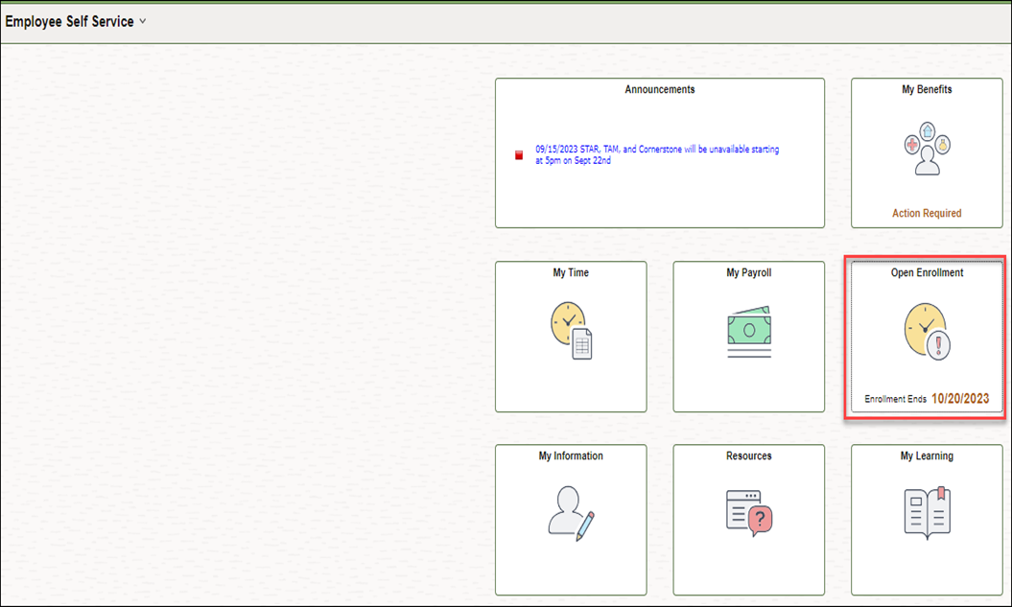
How to Access eBenefits
STAR eBenefits available at: https://ess.wi.gov
Click on the Open Enrollment Tile to access eBenefits

Slide 65
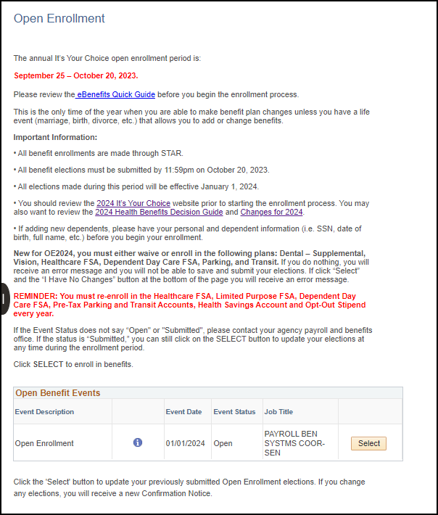
Navigating eBenefits
Click the Select Button to begin
New for OE2024, you must either waive or enroll in the following plans: Dental – Supplemental, Vision, Healthcare FSA, Dependent Day Care FSA, Parking, and Transit. If you do nothing, you will receive an error message and you will not be able to save and submit your elections.
Notes:
New screenshot

Slide 66
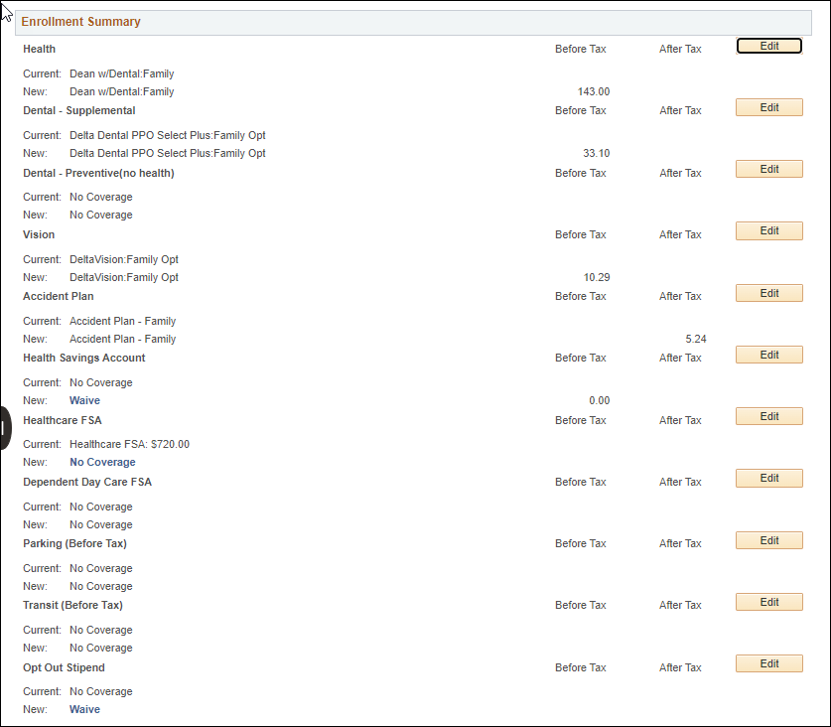
Navigating eBenefits
Once you click Select, you will be brought to the Enrollment Summary Page
Notes:
New screenshot

Slide 67
Navigating eBenefits
Please note that when you first look at your Enrollment Summary page, some plans already have a plan listed under New. These are plans where coverage automatically continues from year to year.
For other plans (all pre-tax savings accounts), you will see a current election if enrolled in 2023 but No Coverage listed under New. You are required to re-enroll in these plans every year.

Slide 68
Navigating eBenefits
To make a new election click the Edit button to the far right of the plan name
This will bring you to the plan-specific enrollment page

Slide 69
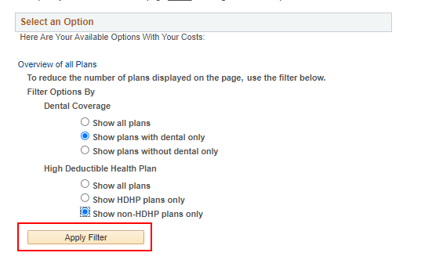
Navigating eBenefits
On each plan, you will see what you can do during Open Enrollment and links to more information.
On the health page, you can reduce the number of plans on the page by indicating the type of health plan you want
With or Without Dental
High Deductible Health Plan (HDHP) or non-HDHP

Slide 70
Navigating eBenefits
To select a plan, click on the radio button next to the plan name
You do NOT pick the coverage level; the system will determine the coverage level based on who is covered by the plan
Notes:
New screenshot

Slide 71
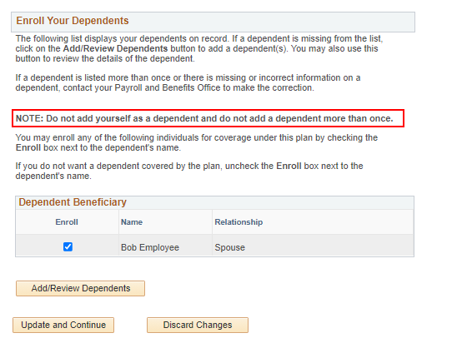
Navigating eBenefits
Scroll to the bottom of the page to review your dependents
Check the box next to any dependent who you want covered by the plan
Uncheck the box next to any dependent who you do NOT want covered by the plan
REMINDER – if you enroll in family health insurance, you are required to cover all eligible family members. For the dental and vision plans, there is no requirement to cover all family members if you elect family coverage.
Click the Add/Review Dependents button to review information about your dependent or add a new dependent. Do NOT add yourself as a dependent.

Slide 72
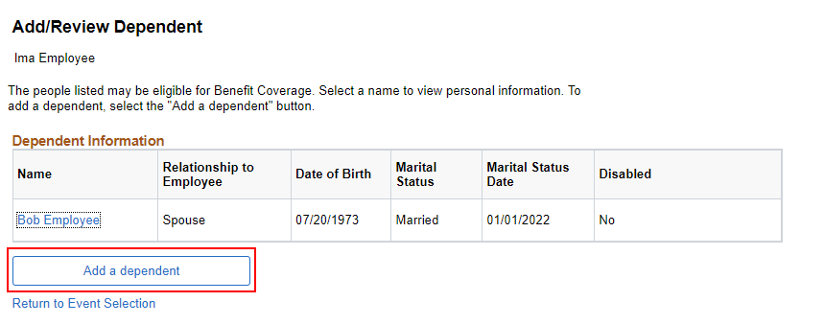
Navigating eBenefits
You can review your current dependent information, but you can NOT change it. If dependent information is wrong, contact your agency benefits office to update it. Do NOT add the dependent again.
To add a new dependent, click Add a dependent

Slide 73
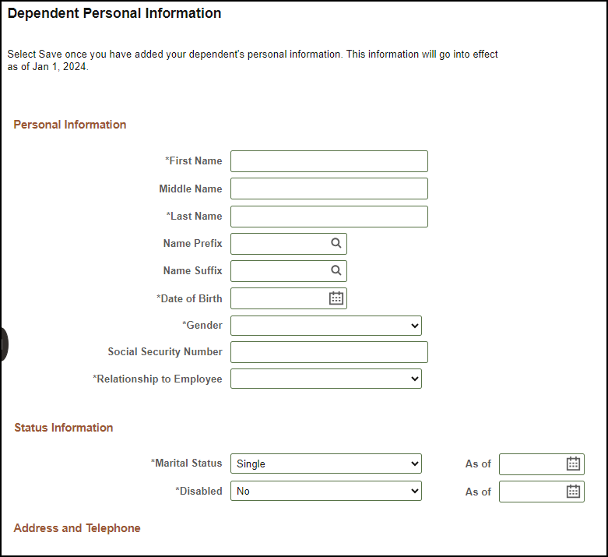
Adding a Dependent
Must enter the following:
Legal name
Date of birth
Gender
Social security number
Relationship to employee
Marital status
Marital status as of date (if not single)
Address
Phone
Save at the bottom of the page when entry complete
Notes:
New screenshot

Slide 74
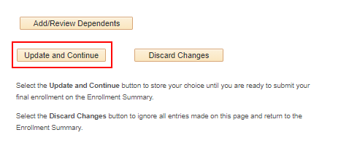
Navigating eBenefits
Once you have made your benefit plan election, click the Update and Continue button. This will store your election.
This will take you to a screen that confirms your election.

Slide 75
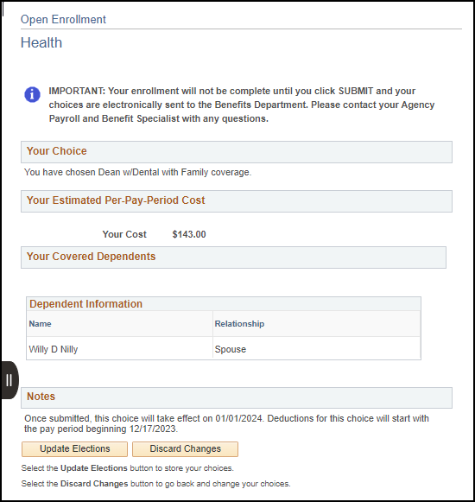
Navigating eBenefits
On this screen, confirm that your election is correct and click the Update Elections button.
You will then be brought back to the Enrollment Summary page
Notes:
New screenshot

Slide 76
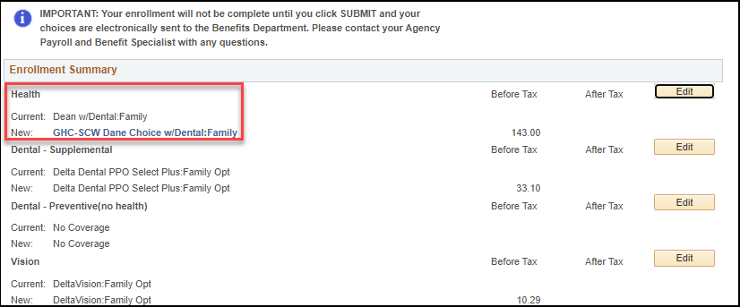
Navigating eBenefits
Your new election will now be on the Enrollment Summary page
To update a different benefit plan, click the Edit button next to that next plan
Notes:
New screenshot

Slide 77
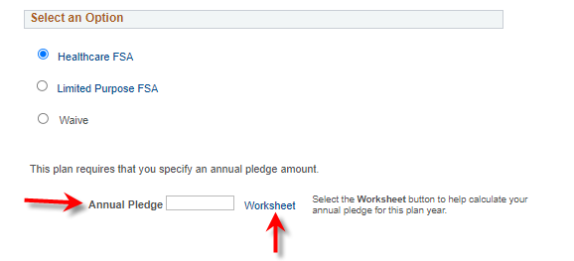
Navigating eBenefits
You must re-enroll in Pre-Tax Savings Accounts and your Health Savings Account (HSA) every year (if enrolled in a HDHP).
When you elect an FSA, you must enter an annual pledge. You can enter the annual pledge directly on the initial enrollment page or click on the Worksheet link to enter the annual pledge and see how much the deduction will be each pay period.

Slide 78
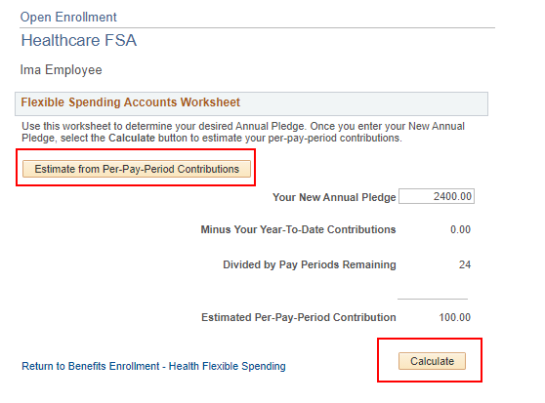
Navigating eBenefits
The worksheet allows you to enter your annual pledge and see how much the deduction will be per pay period.
Click Estimate from Per-Pay-Period Contribution to enter the pay period amount you want, and it will calculate the annual contribution.

Slide 79
Navigating eBenefits
If you would like to cancel coverage for 2024 click on the Edit button next to the plan and select the “Waive” option.
Notes:
New screenshot

Slide 80
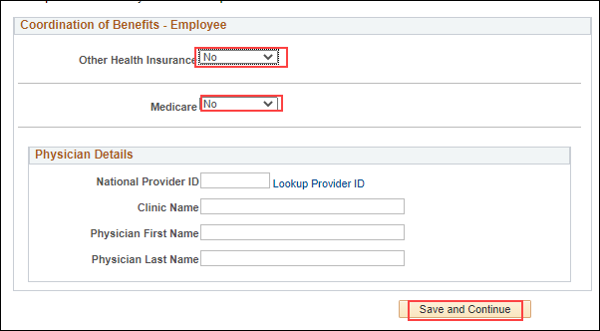
Navigating eBenefits
If you enroll in or change your health insurance for 2024, a Coordination of Benefits page will appear. You must indicate if you have Other Health Insurance or Medicare. You must select either “Yes” or “No.”
If yes, enter the information if you have it
You may also enter your clinic or physician information, but it is not required.

Slide 81
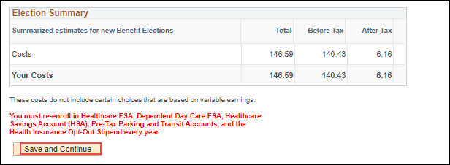
Navigating eBenefits
Once you are done making all your elections, scroll to the bottom of the Enrollment Summary Page and click the Save and Continue button. This will bring you to the next step in the process.
Notes:
New screenshot

Slide 82
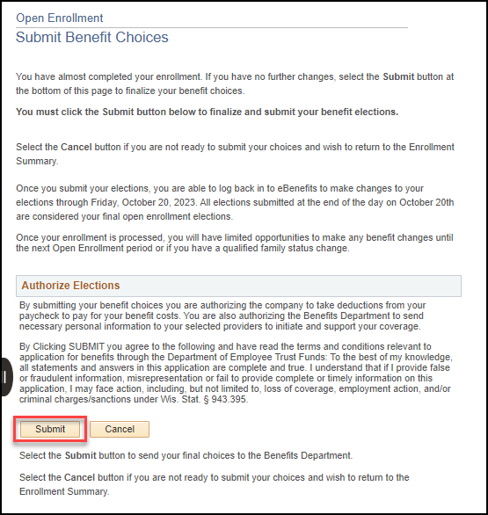
Navigating eBenefits
This is the page in which you SUBMIT your elections. You must SUBMIT your elections no later than 11:59 pm on October 20, 2023.
Notes:
New screenshot

Slide 83
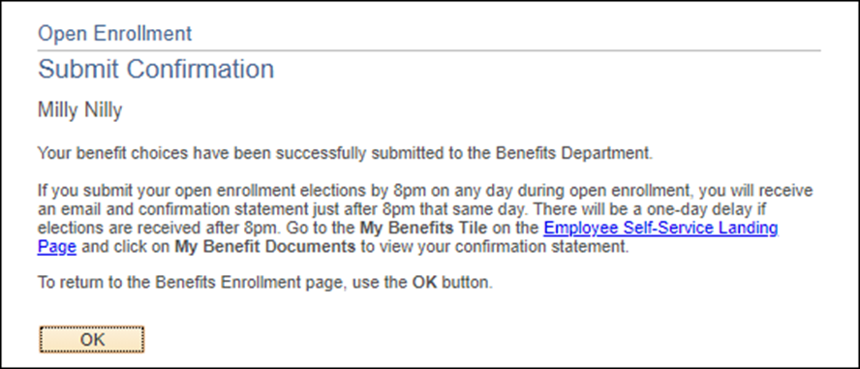
Navigating eBenefits
If you see this page, you have successfully submitted your benefit elections.

Slide 84
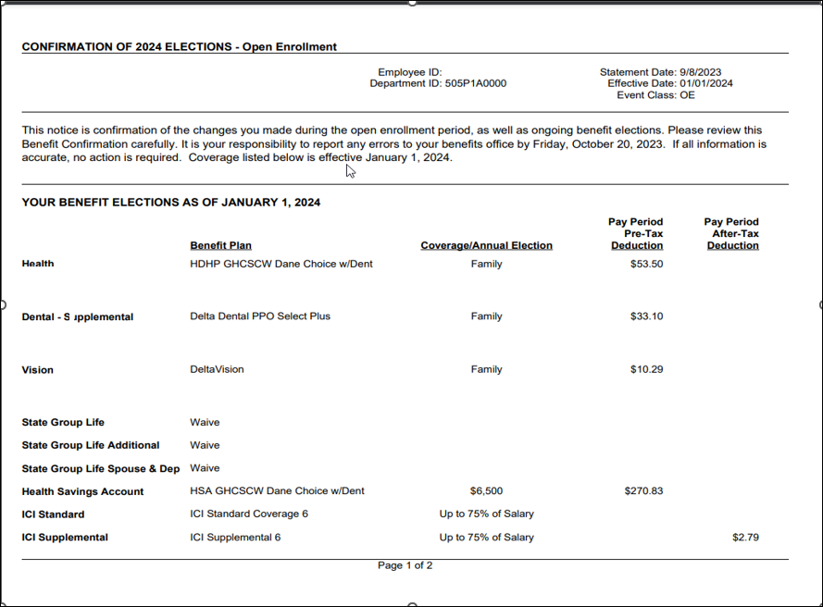
Navigating eBenefits
If you submit your elections by 9:30pm, you will receive a confirmation statement that evening. Elections submitted after 9:30pm will receive a confirmation statement the following evening.
Notes:
New Screenshot

Slide 85
eBenefit Tips
Once you submit your elections, you can go back into eBenefits at any time during the Open Enrollment period to make updates to your elections.
You must SUBMIT your elections again if you make any changes
A new confirmation statement will be generated
If you save elections but never submit them, no updates will be made to your benefits for 2024.

Slide 86
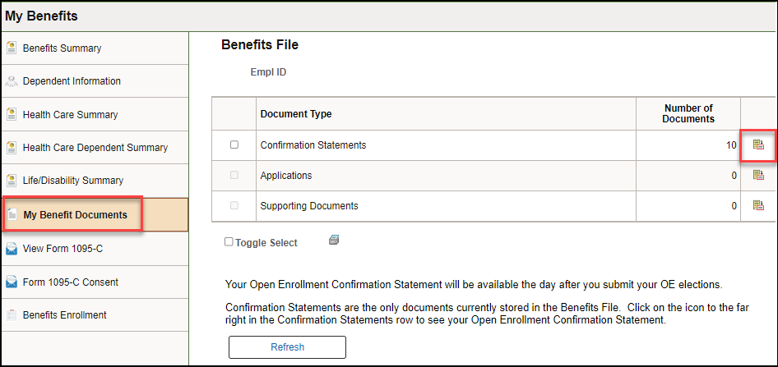
How to Access Confirmation Statement
ESS Landing Page - My Benefits Tile - My Benefit Documents

Slide 87
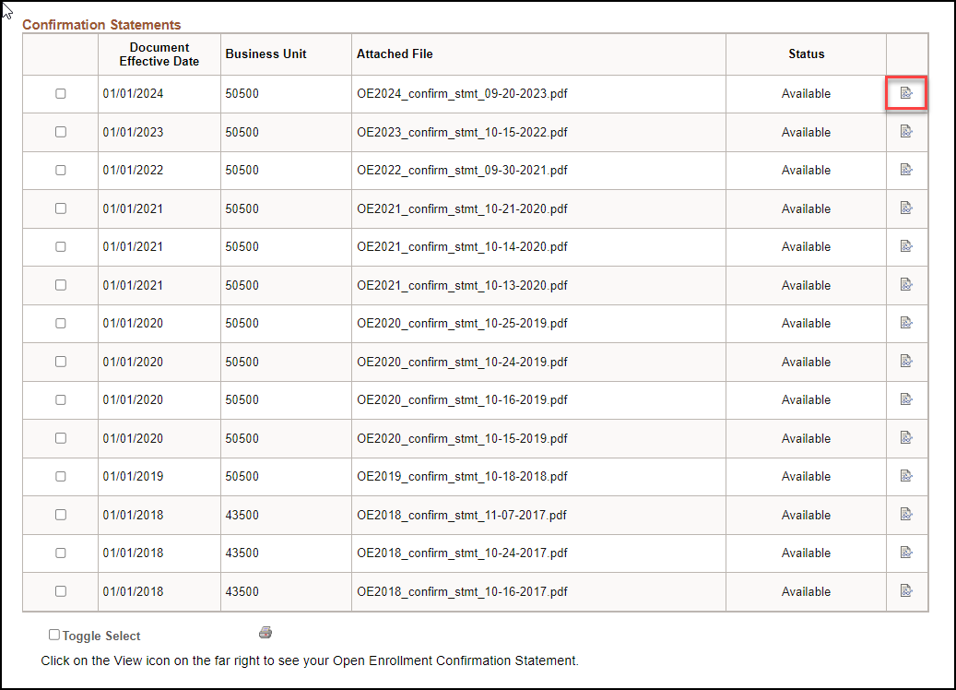
How to Access Confirmation Statement
You will be brought to your confirmation statement. Click on the icon on the right to view your statement.
If you submit your OE elections multiple times, you will see a confirmation statement for each submission. All previous year confirmation statements will also be displayed.
Only the confirmation statement with the most recent date is valid.

Slide 88
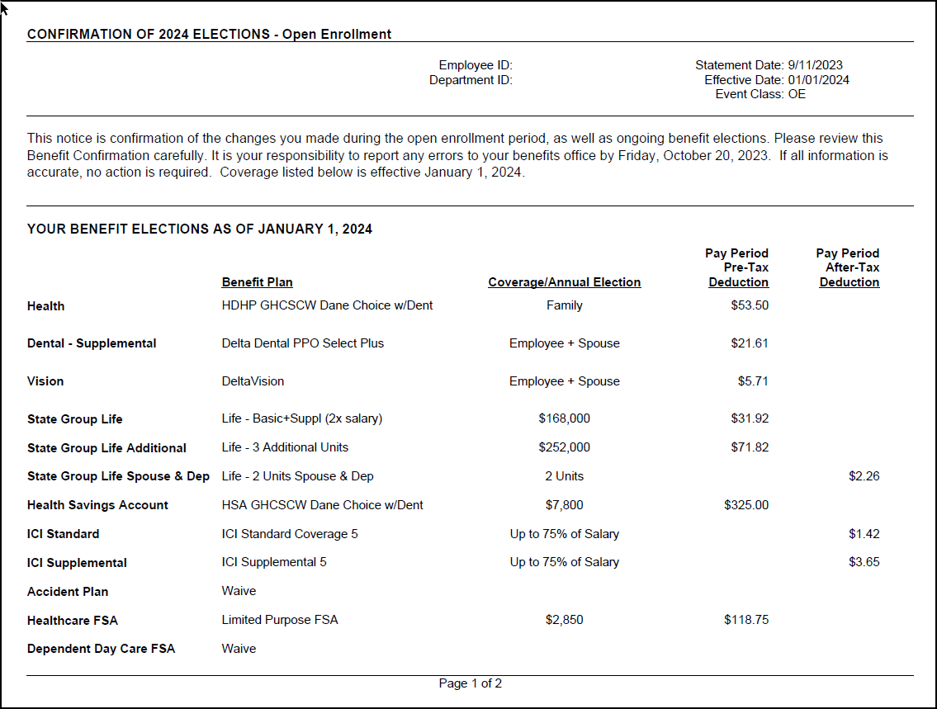
Confirmation Statement
Your confirmation statement will show ALL your benefits as of January 1, 2024. It will confirm your Open Enrollment elections and show any ongoing benefits.
If you see any errors on your Confirmation Statement either go back into eBenefits to correct or reach out to your agency’s Payroll and Benefits Specialist.
Notes:
New screenshot- same as slide 83

Slide 89
Important Reminders
Access eBenefits and your confirmation statement at https://ess.wi.gov
All Open Enrollment elections must be made by 11:59 pm on October 20th
Review your Confirmation Statement and contact your agency’s Payroll and Benefits Specialist if anything is incorrect
All elections made during Open Enrollment will be effective January 1st, 2024.

Slide 90
Questions?
Contact your agency’s payroll and benefits office.

